Slide 1
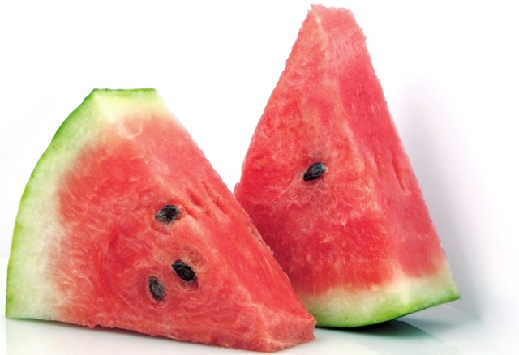
BENEFITS OF XIGUA

Slide 2
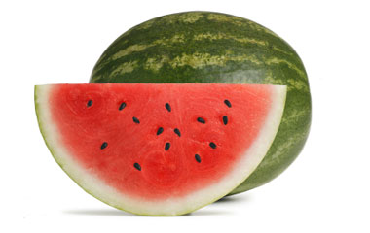
NUTRITIONAL VALUES OF XIGUA:
-Calories: 20.3.
- Carbohydrates: 4.5 grams.
-Magnesium: 11 milligrams.
-Potassium: 88.5 milligram.
- Fibre: 0.3 g.
-Folic acid: 3 micrograms.
-Beta-carotene : 18 micrograms.

Slide 3
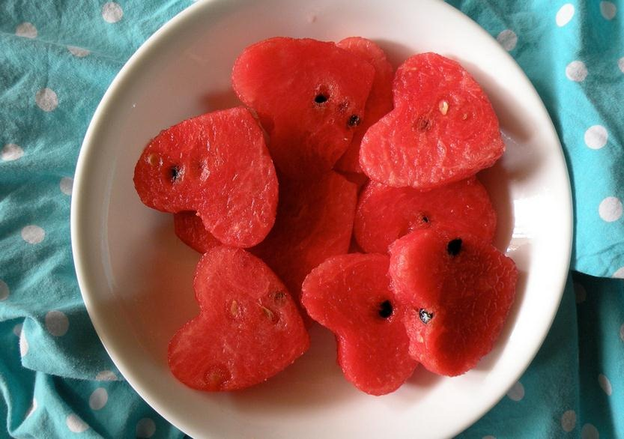
BENEFITS XIGUA:
It moisturizes and remineralizes thanks to its high water content . It has a large antioxidant power. It’s ideal for diets because only 20 calories per 100 grams . It helps to cleanse the body. It stimulates diuresis.

Slide 4
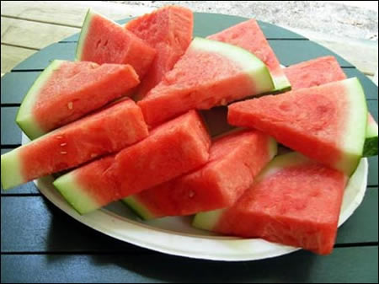
It helps athletes to soothe aching muscles and regain muscle fatigued because their amounts of:
- citrulline
- arginine and potassium
It is an anticancer fruit because it contains a lot of lycopene , hence its red color and other carotenoids such as lutein and beta-carotene .
These have proved efficient prevention against cancers such as lung, prostate and digestive tract.
It plays an important role in treating many infections in the body , including inflammation of the joints due to good amounts of vitamins A, B and C.
Reduces blood pressure by the action of L- citrulline and L -arginine . In addition, potassium and manganese help her regulate .
Therefore , it is a good fruit for our cardiovascular system and blood vessels.

