Slide 1
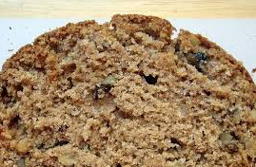
NUT BREAD

Slide 2
Walnut bread
360 grams of sourdough (fermented white mass)
360 grams of bread flour
90 grams flour whole rye,
8 grams of baker's yeast
275-300 grams of water
10 grams of salt
100 grams of green walnuts

Slide 3
ELABORATION
Dissolve the yeast in a little warm water, you can also undo rubbing with the fingertips in the flour.
Mix all dough ingredients except nuts, which will incorporate when the mass starts to be formed.
Nut bread and rye flour knead for 8 minutes if you use a kneader, if you do it by hand you may need a few more minutes. You'll get a slightly sticky dough.
Make a ball with it.

Slide 4
Flour the surface lightly and place in a large bowl covered with a cloth in a warm place without drafts, and let rise until doubled in volume ( a couple of hours).
After that, dump the dough on lightly floured work surface and divide it into portions as you want to make muffins or bread large nuts,
Place them on a baking tray and cover with cloth, let rise again until doubled in volume.
Preheat oven to 250 ° C. Bake the muffins 15-20 minutes and or bread for 30-35 minutes.

