Slide 1
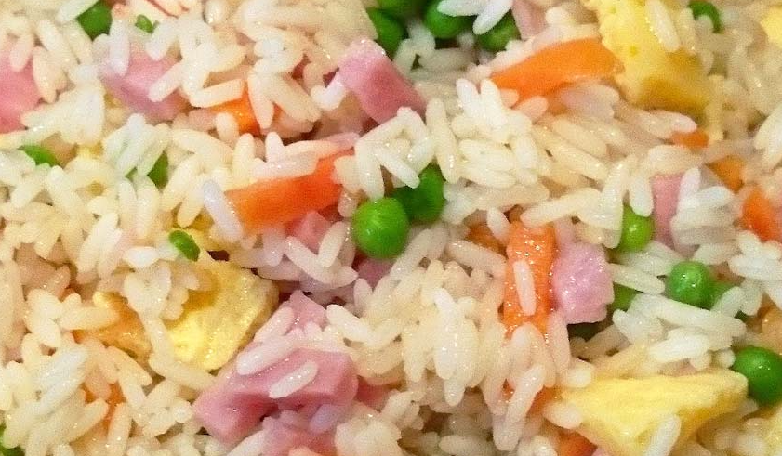
CHINESE RICE

Slide 2
CHINESE RICE
INGREDIENTS:
200 g of basmati rice
16 prawns
4 eggs
125 g of cooked ham
1 carrot
100 g of peas
100 ml of sauce of soybean
olive oil extra
pepper
parsley

Slide 3
STEPS
Peel the carrots, cut them into small bits and set them to cook in a pan with boiling water and a pinch of salt. Add the peas and cooks everything during 6-8 minutes.
Set abundant water to warm in a casserole and when it starts boiling add the rice. Cook it during approximately 12 minutes. Refresh it with cold water and drain it.
Warm some oil in the same frying pan.
Beat the eggs in a bowl and spill the mixture to the frying pan. Cut the omelette in pieces.
Peel the prawns and add them to the
Add the rice and cook it during a minute without stopping removing. Incorporates the rest of the ingredients and mix well. Add the soybean sauce and it decorates with parsley.

