Slide 1
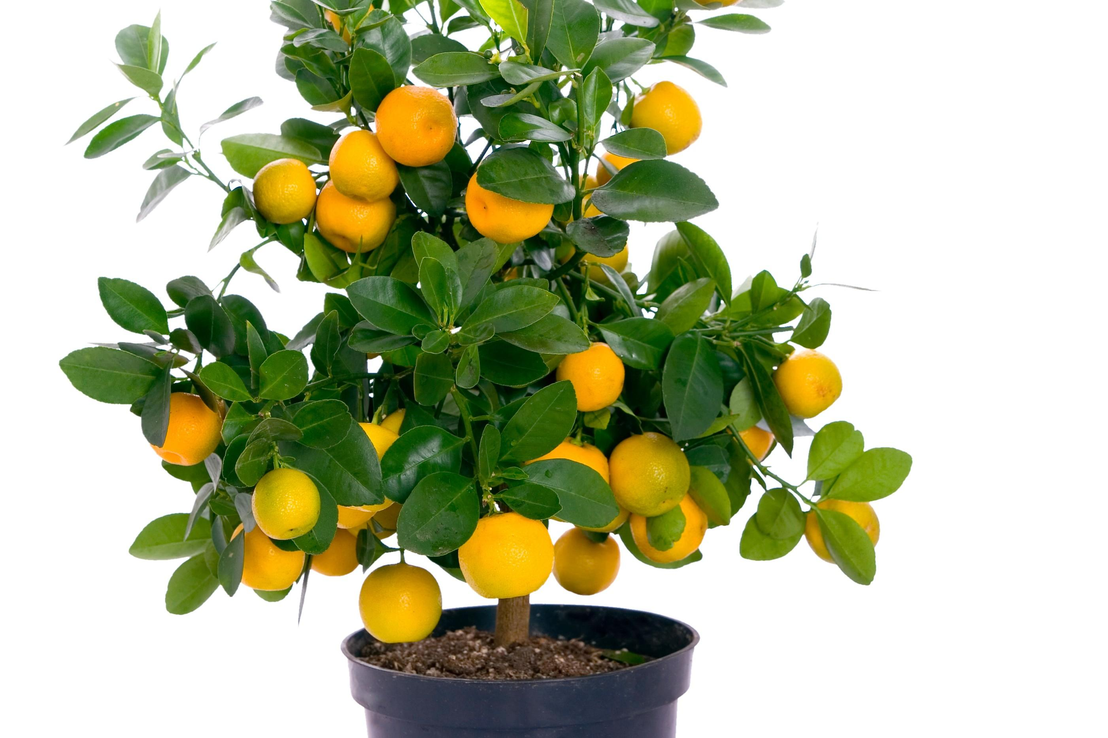
A superfood from Italy
The TANGERINE

Slide 2
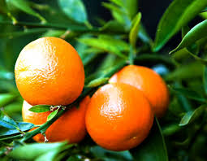
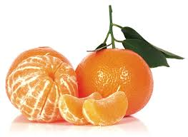
History
The mandarine orange (Citrus reticulata),
also known as the tangerine,comes from
the tropical areas of Asia.It is thought that
its name comes from the colour of the
clothes used by the Mandarins,rulers of
Ancient China.It is a fruit native from China and Indochina.Its cultivation was introduced to Europe in the nineteenth
Century.The tangerine has a particular type of fruit called hesperidium,and its pulp is formed with juice;the juice contains large amounts of vitamin C,flavonoids and essential oils.

Slide 3
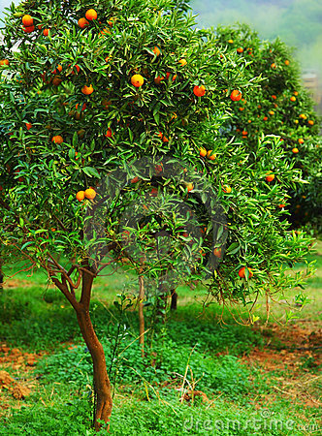
-Name
In 1828,it was called mandarine because of its origin that was supposed to be Chinese.
Everyone knew that in China the highest
Authorities were in fact the ‘’mandarins’’, so it seemed right to give the same name to these new fruits as noble and sweet but pale
in comparison with oranges.

Slide 4
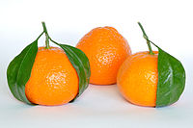
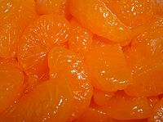
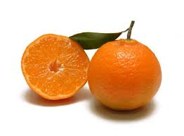
-THE FRUIT
Mandarins are smaller and less spherical than oranges. The taste is considered less sour, as well as sweeter and stronger. A ripe mandarin is firm to slightly soft, heavy for its size, and pebbly-skinned. The peel is very thin, with very little bitter white mesocarp, so they are usually easier to peel and to split into segments. Among the best varieties there is clementine a hybrid between a Mediterranean tangerine and a sweet orange named after the missionary friar Clement Rodier, that cultivated in
Algeria. Clementines tend to be easy to peel and they are seedless.
The best clementines are grown in Calabria ,our region.

Slide 5
-Health Benefits:
The tangerine has remarkable
therapeutic properties. The
fruit is used totally : his skin
is in fact full of limonane
(active antioxidant) which
has the characteristic to delay
skin aging and increasingly from
the peel is extracted an essential oil that can calm anxiety and fight insomnia and water retention.
Very rich in vitamin C, essential to keep the brain active and alert,
the tangerine is also rich in fiber and carotene and also has many vitamins B and A ,as well as a large percentage of iron, magnesium and folic acid.

Slide 6
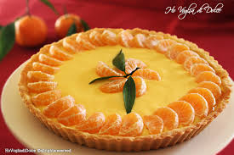
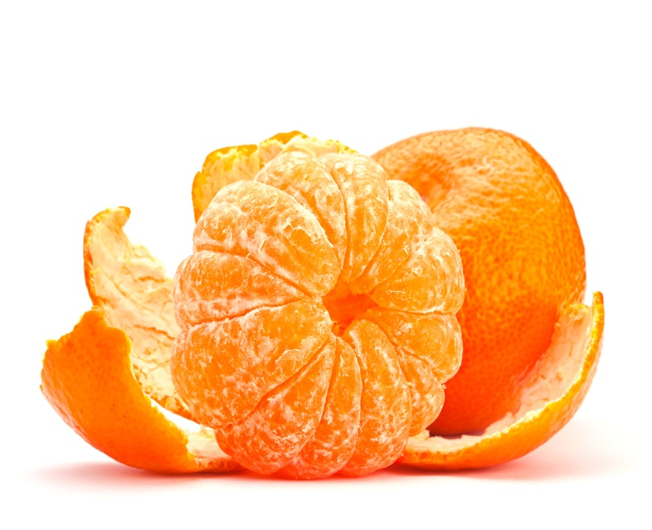
Due to the considerable quantity
of fibers, the tangerine
is indicated for the intestine and is indicated in the diets because it looks like a nutritious and easy to digest fruit. The seeds of tangerine, even if chewed, do not hurt but provide vitamins. The pulp of the mandarine (rich in vitamin C), is helpful in preventing colds and protects mucous membranes and capillaries, vitamin P promotes diuresis; it contains calcium, potassium and fibers, necessary for the bones and for the intestines and regulates blood pressure.

Slide 7
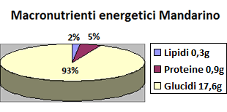
They are valuable sources of flavonoids,anti-oxidant like naringenin,naringin, hesperetin,
Vitamin A ,carotenes, xanthins and lutheins, in fact several times higher than in the oranges. They are very rich in vitamin C,(ascorbic acid) that play vital role in collagen synthesis, wound healing, anti-viral,anti cancer activity,help prevent from neurodegenerative diseases,arthritis,and cold/fever.
The vitamin C helps absorb iron in the food, they contain pectine that prevents cholesterol absorption in the gut.
Nutrients
Protein: 2 %
Lipids: 0.3 g
Carbohydrates: 4%
Dietary Fiber: 7%
Calories: 2 %
Vitamins: C 81%
A, B 4%
Thiamins 6%
Folate 6%
Minerals:Potassium5%, Magnesium 2 %
Phosphorus 2%
Copper 2%
Daily value per 100 grams

Slide 8
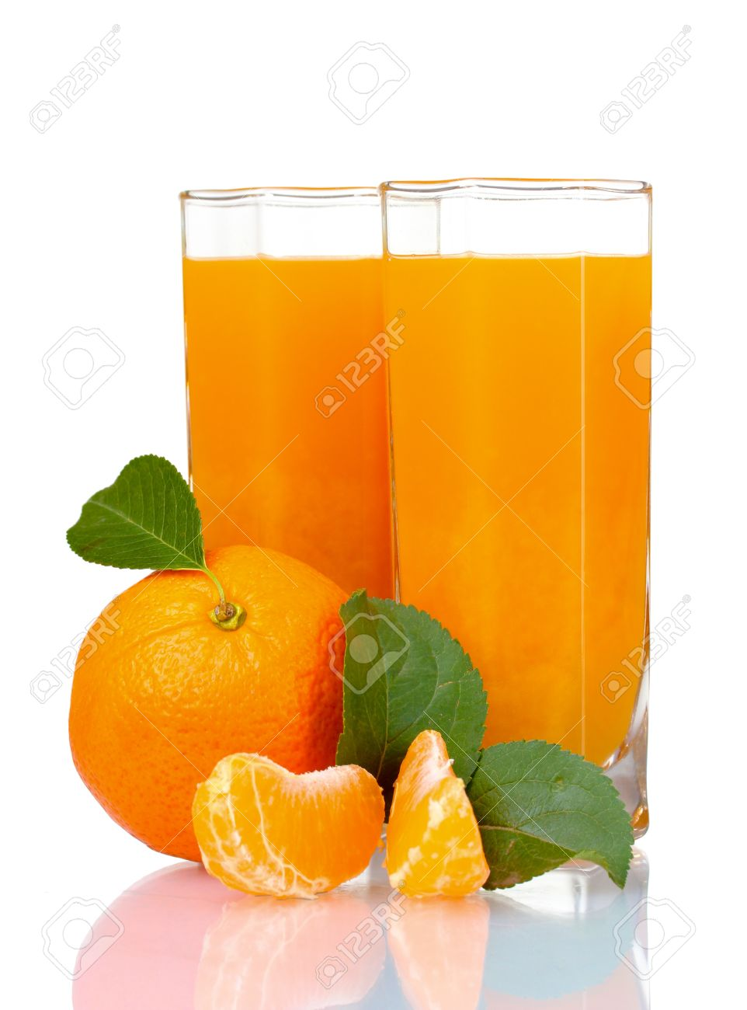
-Curiosity:
Mandarins are generally peeled and eaten fresh.
The fresh fruit is also used in salads,
desserts and main dishes.
In Chinese medicine the dried peel of the fruit is used in the regulation of ch’i , and also used to treat abdominal distension, to enhance digestion, and to reduce phlegm.
Mandarins have also been used in ayurveda (traditional medicine of India).
What Christmas dinner was if at the end of this copious meal oranges and tangerines should not stand out on the table?

Slide 9
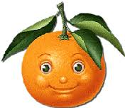
The peel is used fresh, whole
or zested , or dried as chenpi.
Ithe tangerine is used for
cooking, making cakes,marmelades, drinks, or candy.
In Italy, the most concerned regions in the culture of mandarins are Sicily,
Calabria and Campania.
In Italy are produced about 600,000 kilograms of mandarins every year,from November to February.
Top EU Country producers
Spain | 1.900.000
Italy | 853.000
Greece | 120.000

Slide 10
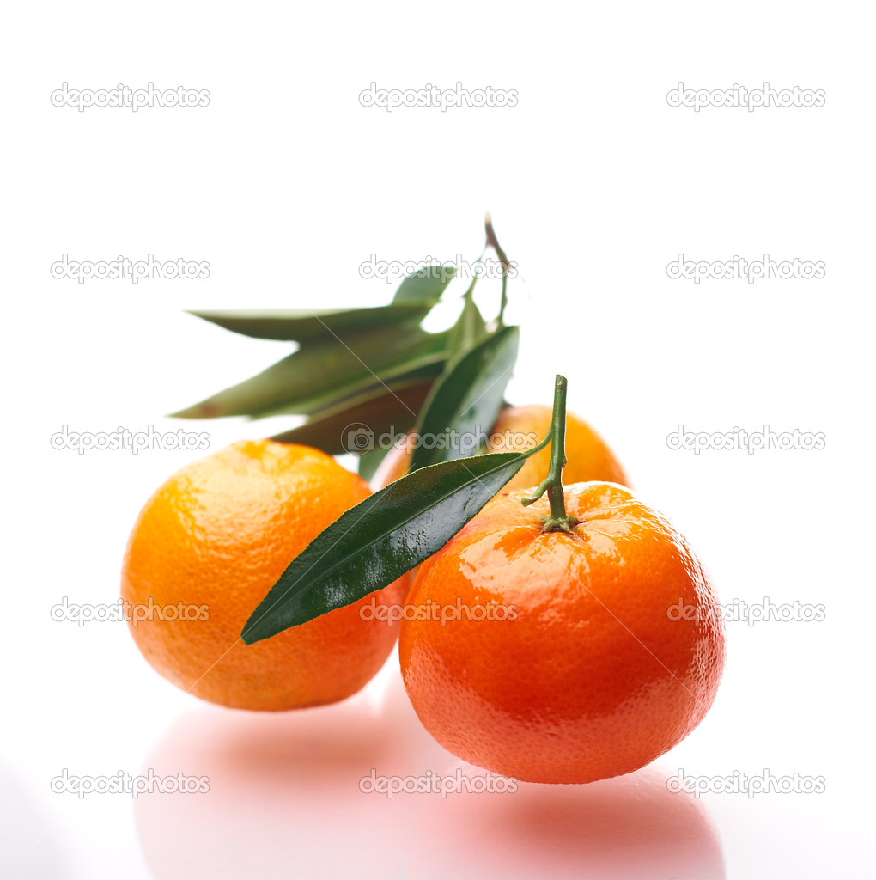
-Preservation of mandarins:
The mandarins are kept at room temperature for 2 or 3 days, but if you want to keep them longer, should be kept in a cool place or
in the fridge where they will last for up to 10 days.

Slide 11
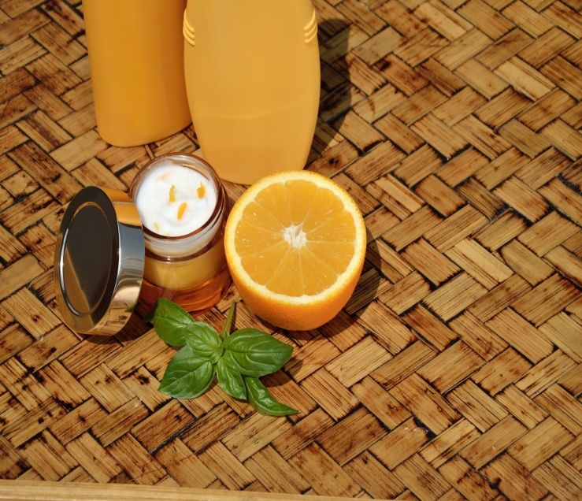
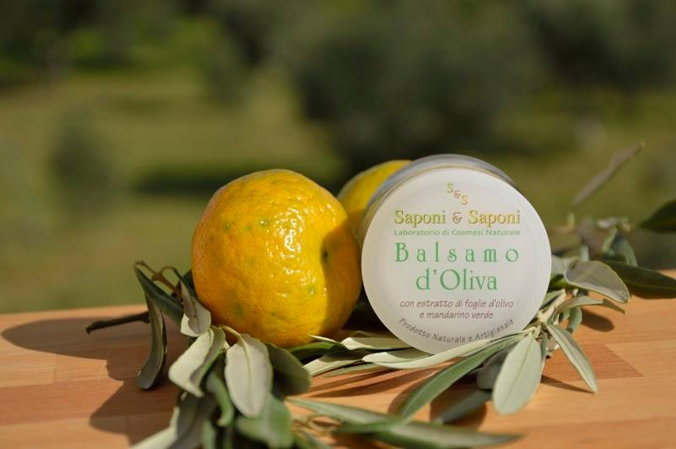
-The Mandarin in cosmetics:
Mandarin has a cleansing and draining effect on the skin. The tangerine oil is also useful for combating water retention and cellulite. In fact using tangerine peel oil you can have a healthy massage on the legs that facilitates the absorption of liquids and reduces cellulite.
The tangerine oil (100% organic) is therefore very effective for body massages; at the end of treatment
it is fully absorbed leaving the skin smooth and hydrated.

