Slide 1
Superfoods in Cartoons

Slide 2
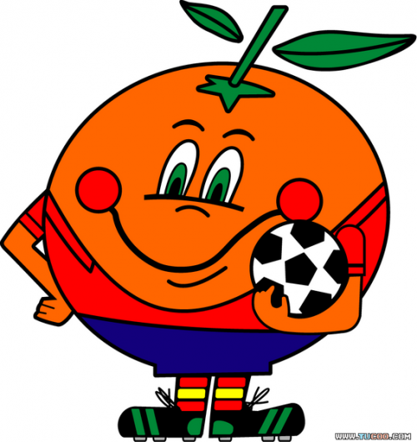
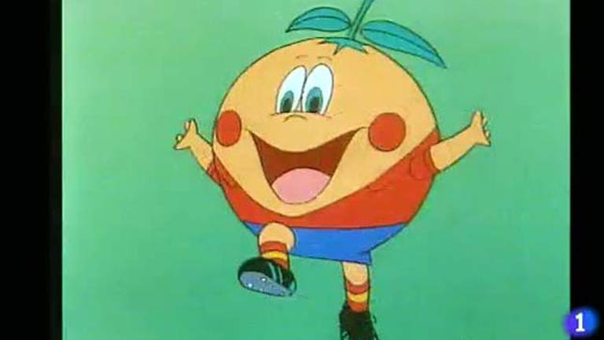
NARANJITO:
(12 years old) was the pet of the world cup organized by Spain in 1982. The figure represented an orange, a fruit that is typical of the area of Valencia and Murcia, dressed in the uniform of the national football team of Spain and a sport ball under its left arm.

Slide 3
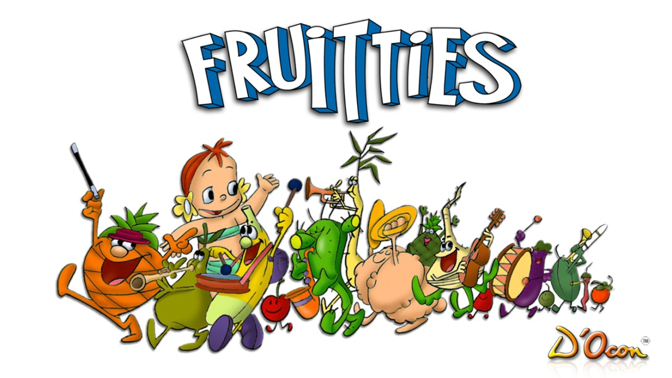
THE FRUITTIES:
It was an animated series produced and directed by Antoni D' Ocon in 1989 that achieved great popularity among children of the time, due to the personality of animated fruits.

