Slide 1
QUINCE DESSERT
CHEF : BATURALP POLAT

Slide 2
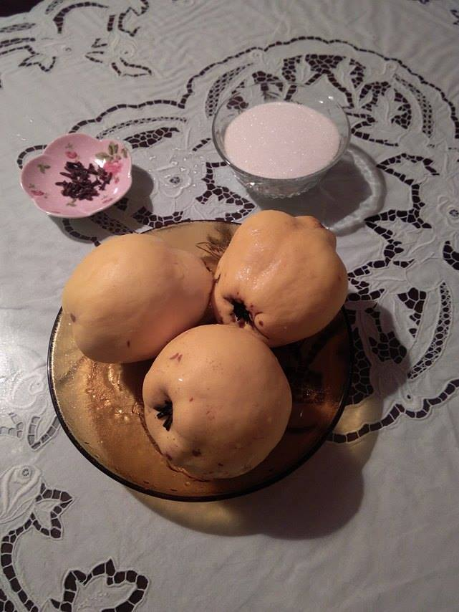
INGREDIENTS:
QUINCE
SUGAR
CLOVE
LEMON(OPTIONAL)

Slide 3
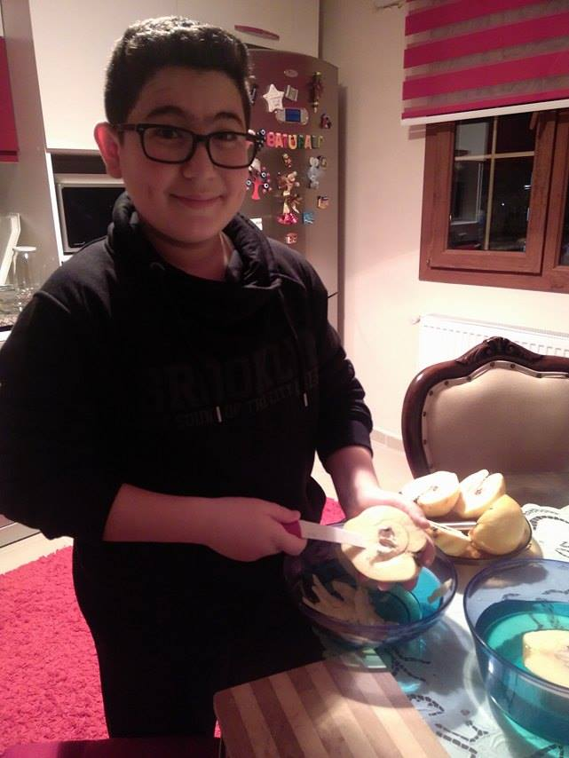
FIRST STEP:PREPARING THE QUINCE
CARVE THE QUINCES
SLICE THE QUINCES

Slide 4
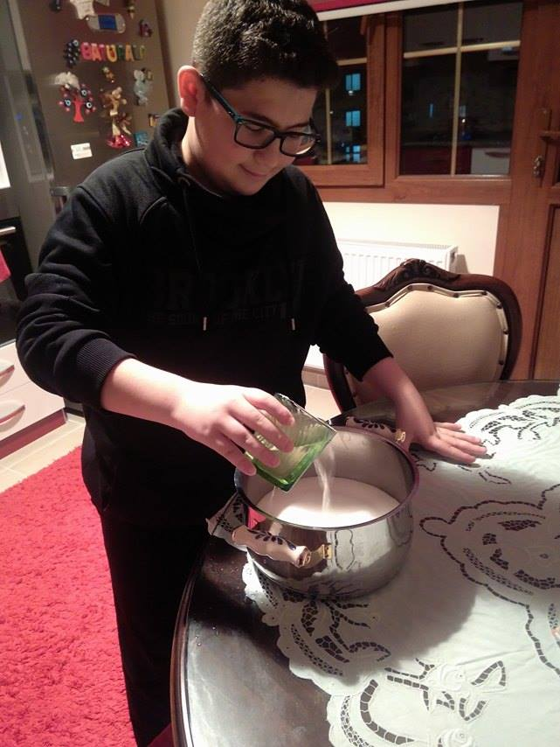
SECOND STEP:PREPARE THE SHERBET
YOU NEED TWO GLASSES OF SUGAR
AND THREE GLASSES OF WATER
FIRST YOU MIX THEM TOGETHER
THEN YOU START HEATING

Slide 5
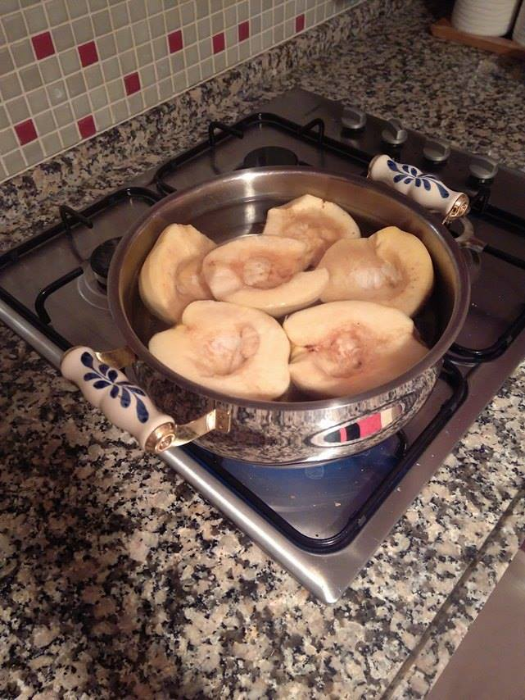
THIRD STEP:BOIL THE QUINCE
BOIL QUINCES
UNTIL THEY GET SOFT.

Slide 6
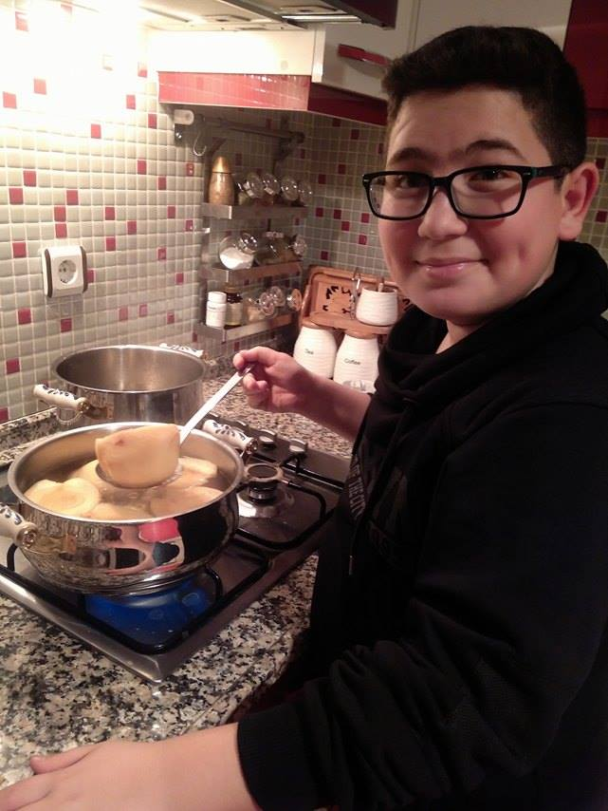
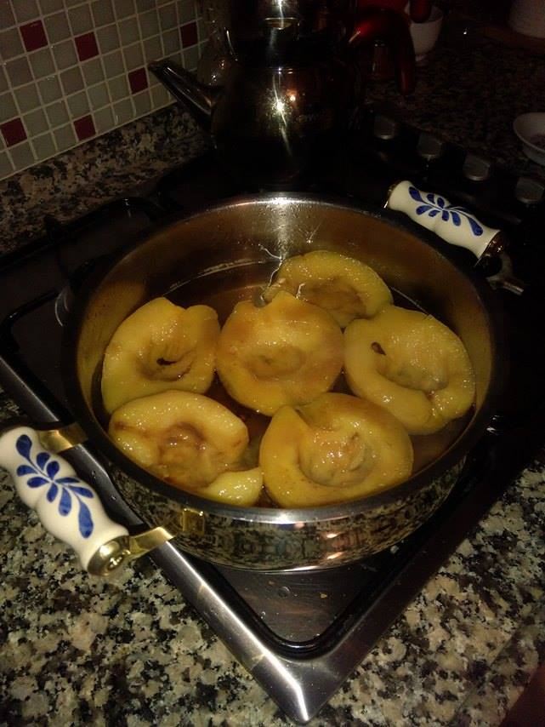
FOURTH STEP:BOIL QUINCE IN SHETBET
IF YOU WANT,
YOU CAN ADD
QUINCE’S SEED
YOU MUST BOIL
QUINCE IN SHERBET
UNTIL THEY GET RED

Slide 7
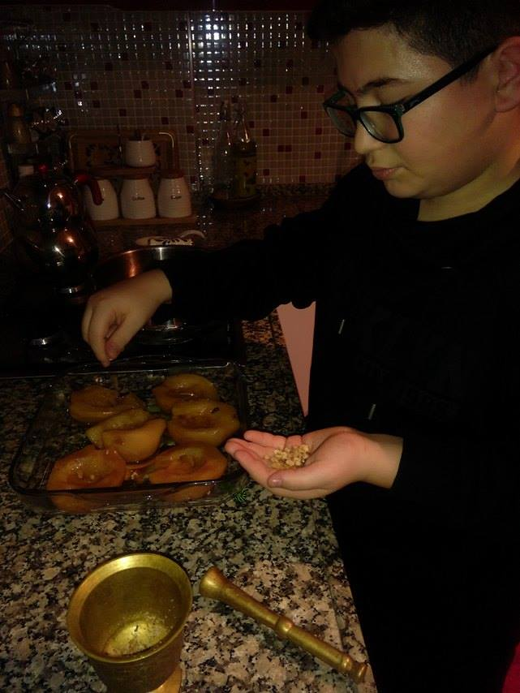
FIFTH STEP: SERVICE
YOU CAN ADD WALNUT AND
CREAM WITH SHERBET

Slide 8
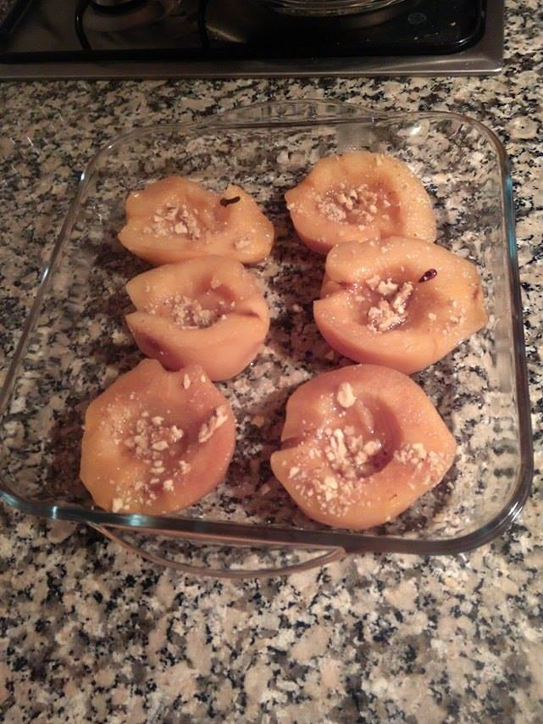
ENJOY YOUR DESSERT
AFİYET OLSUN!
BON APETIT!
DOBROU CHUT!
Metninizi Yazın

