Slide 1
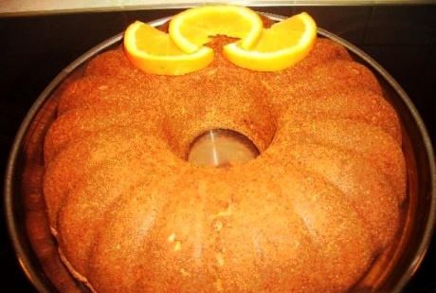
Cake with mastic
Made by Konstadina and Sofia Maria
3rd Corinth High School

Slide 2
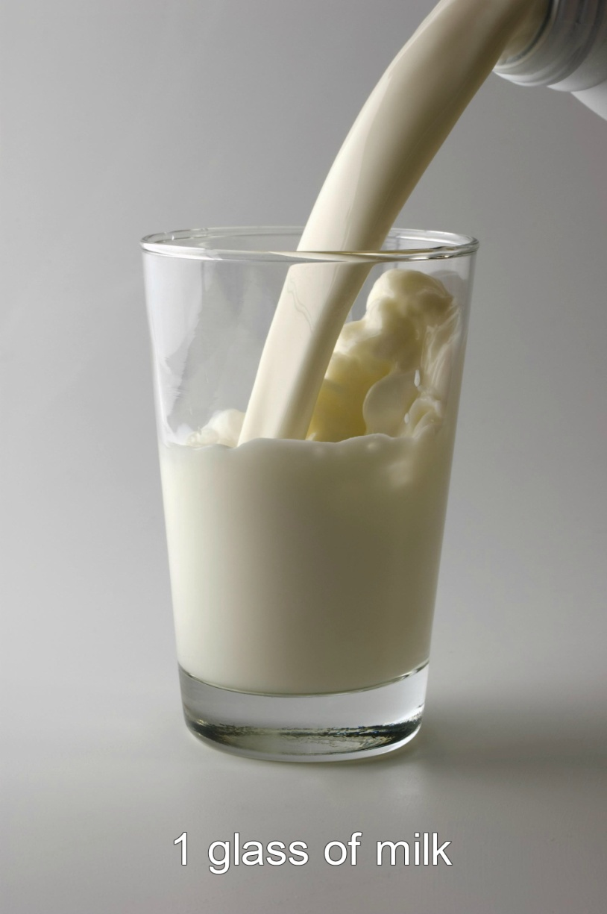
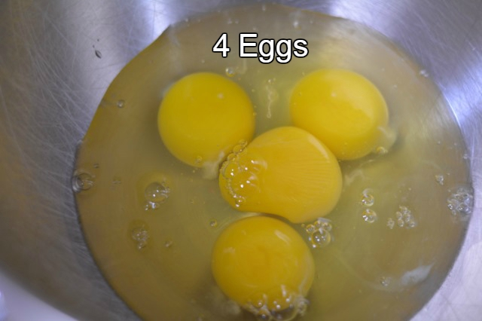
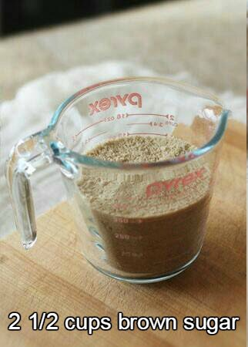
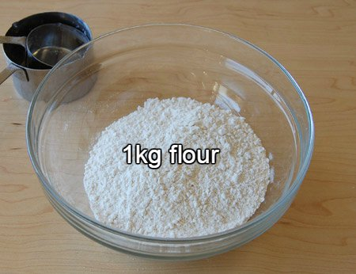
Ingredients for cake:

Slide 3
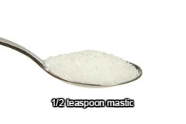
And…

Slide 4
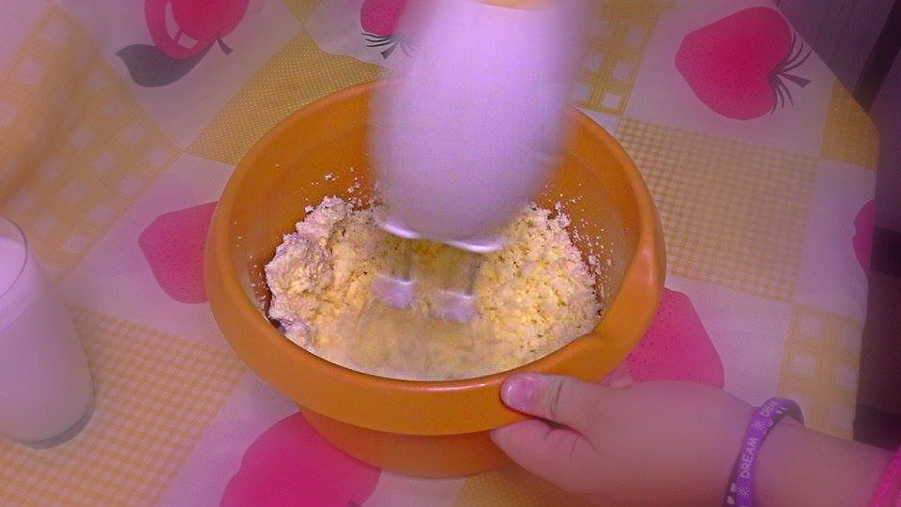
Instructions:
First, place the butter and the sugar in a bowl and mix them…

Slide 5
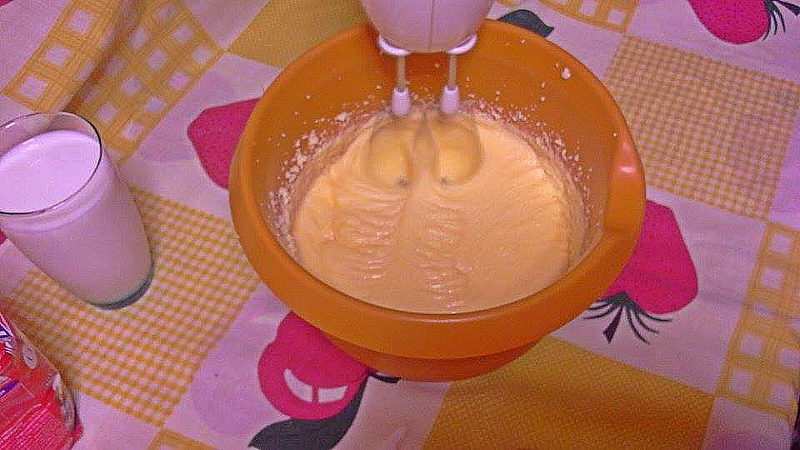
Then, add the eggs…

Slide 6
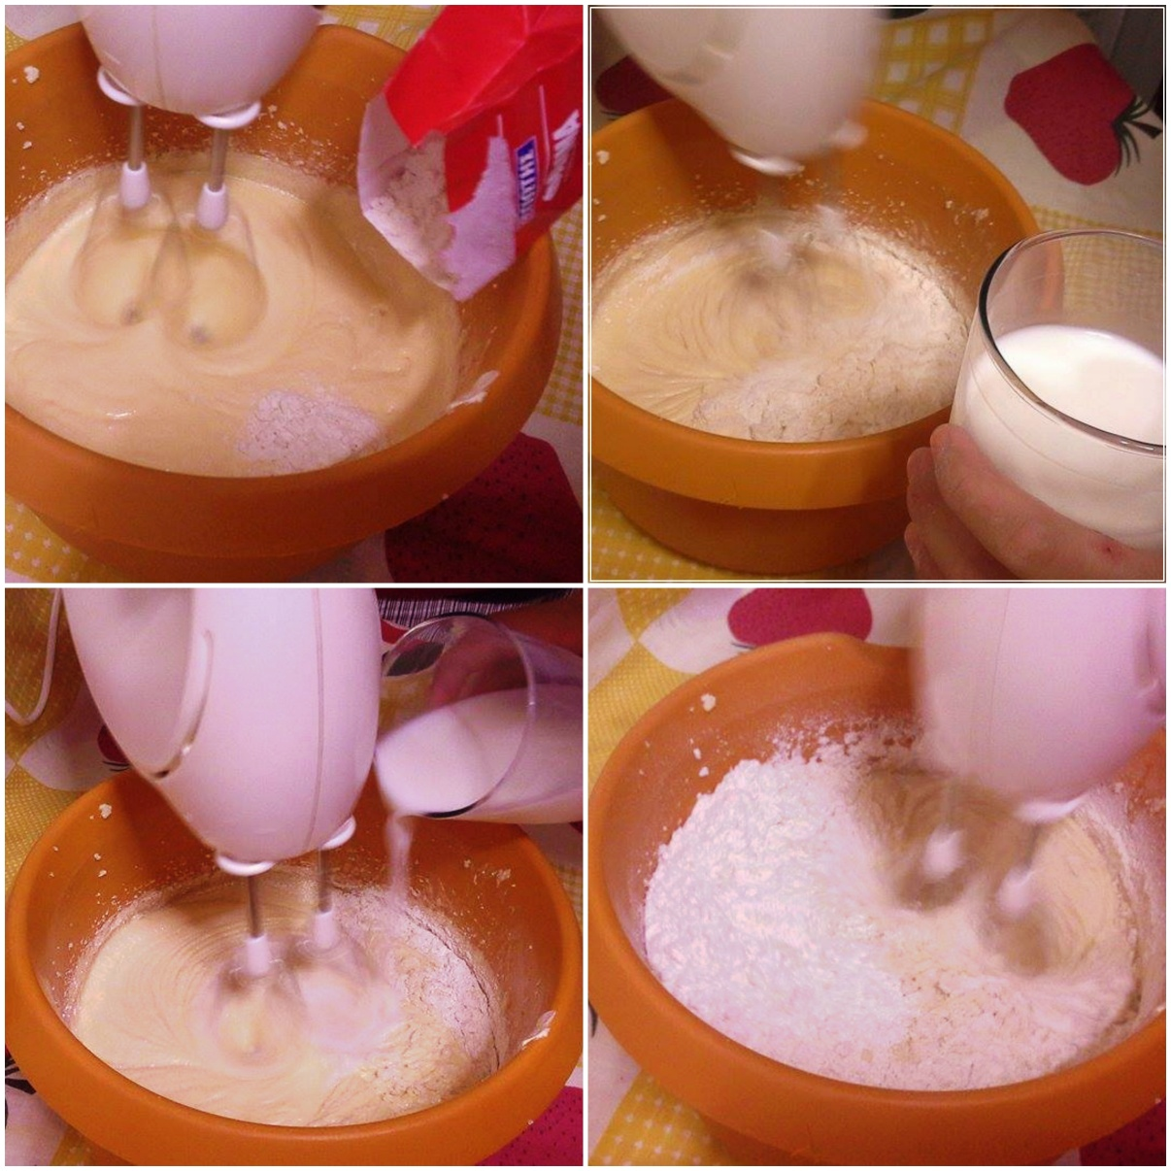
…the milk and the flour alternately and blend them.

Slide 7
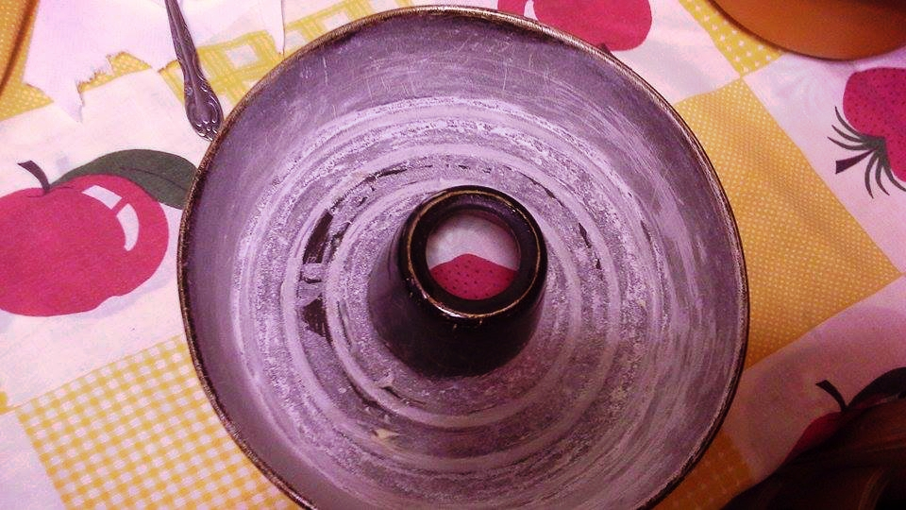
Butter the bottom and sides of a cake tin and pour the mixture in it…

Slide 8
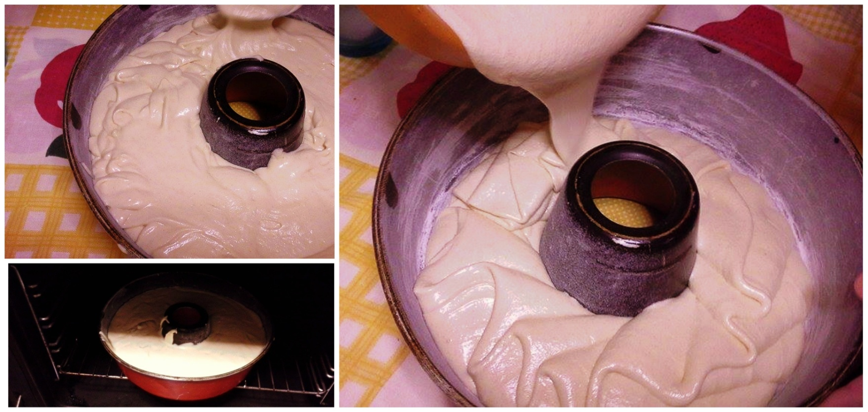
We are almost done ... All we have to do now is to bake our cake in the oven for about 45 minutes at 180 C!

Slide 9
Take the cake out of the oven and enjoy eating it all!!!!

