Slide 1
COOKIES WITH TAHINI , honey and oat
BY OLYMPIA

Slide 2
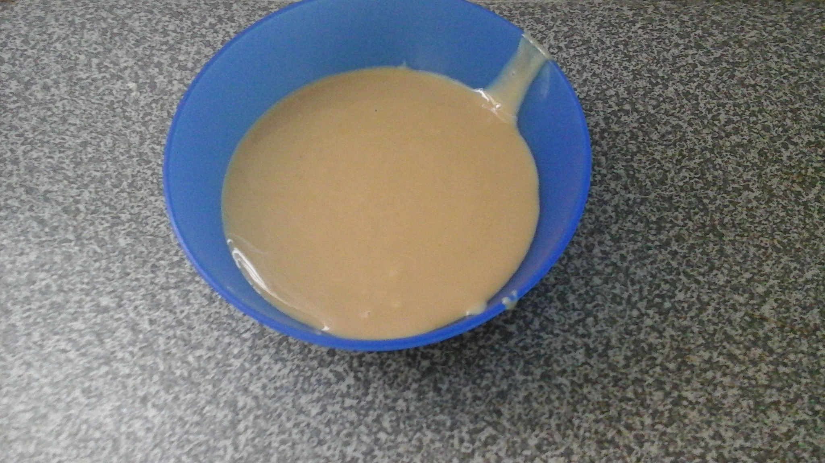
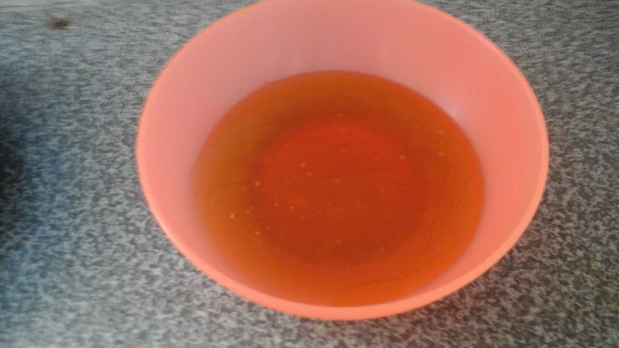
Ingredients:
100g Tahini
120g Honey

Slide 3
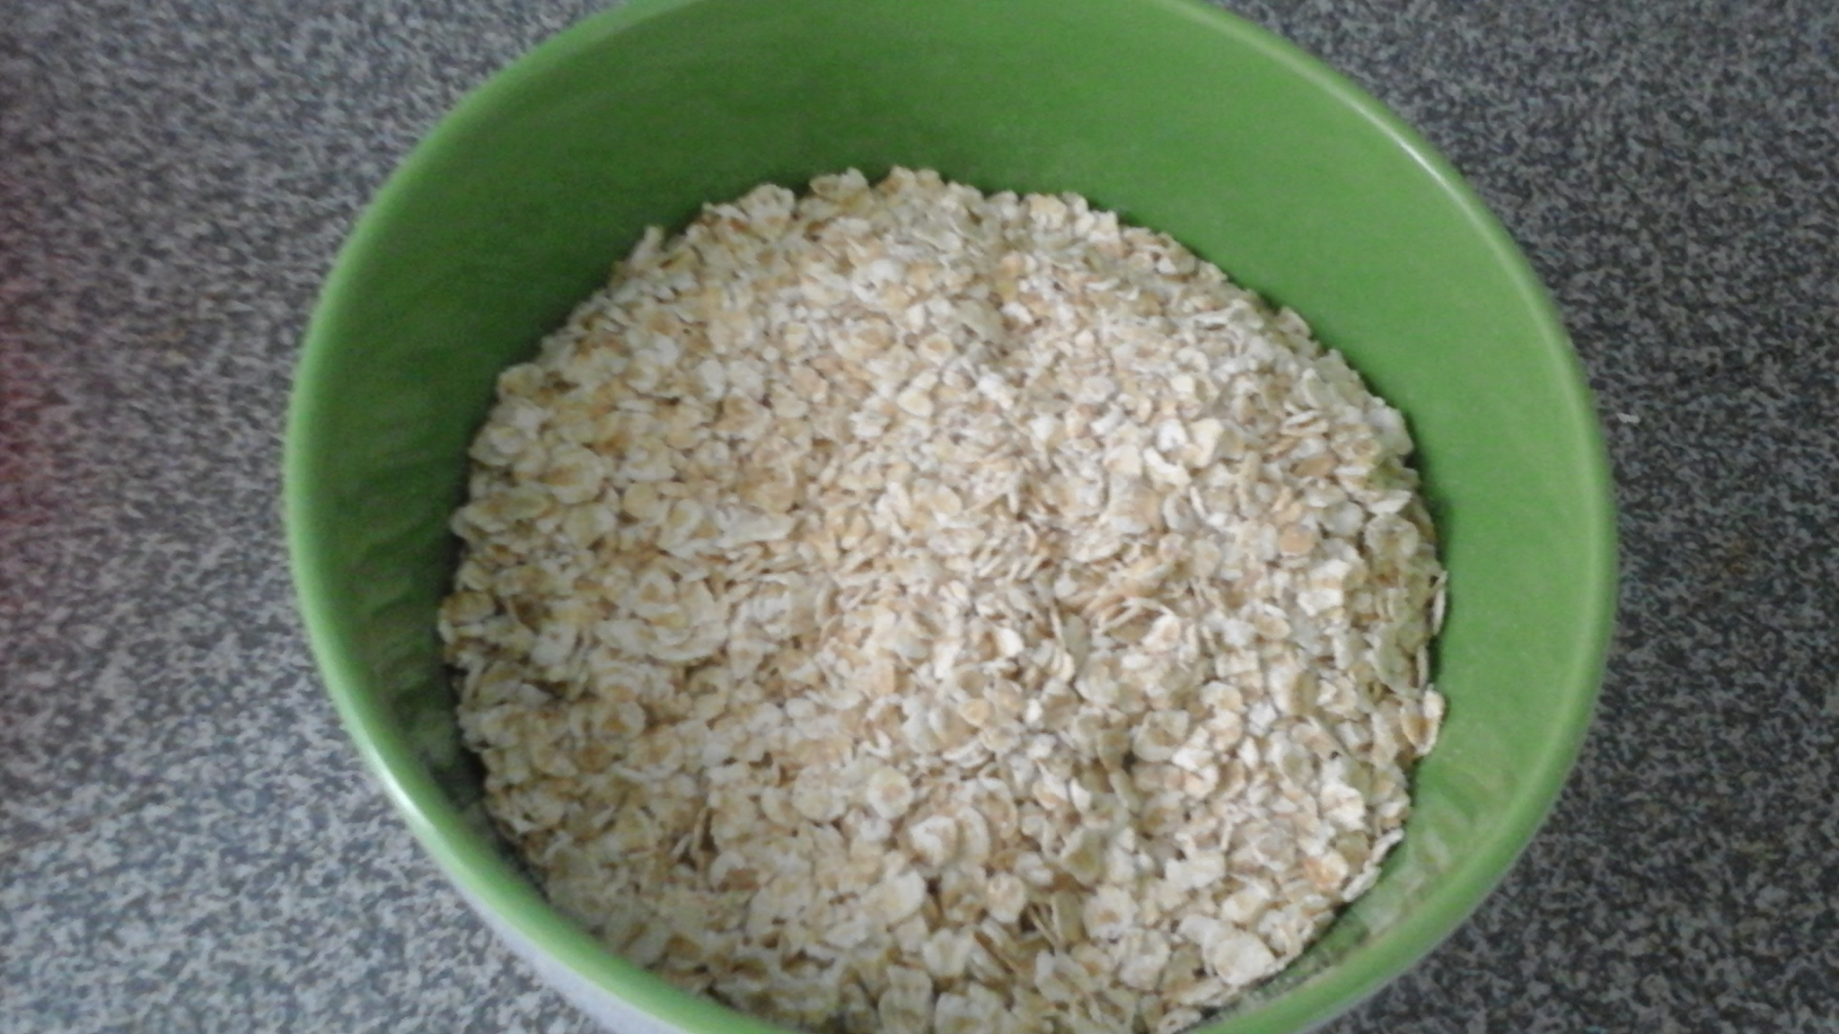
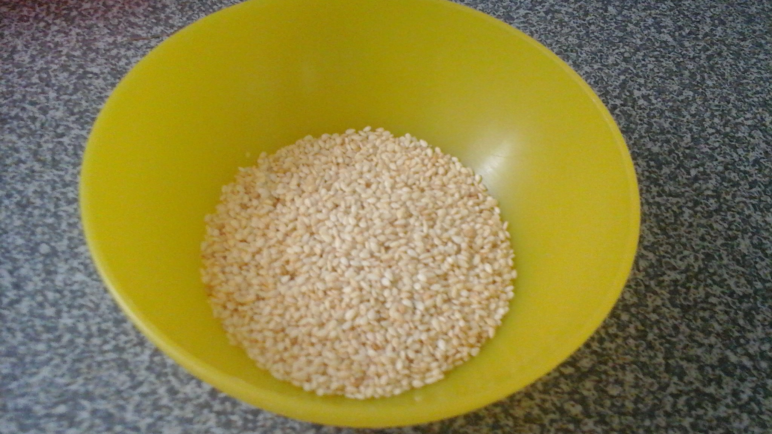
Also…
120g oat
2 tablespoons of sesame

Slide 4
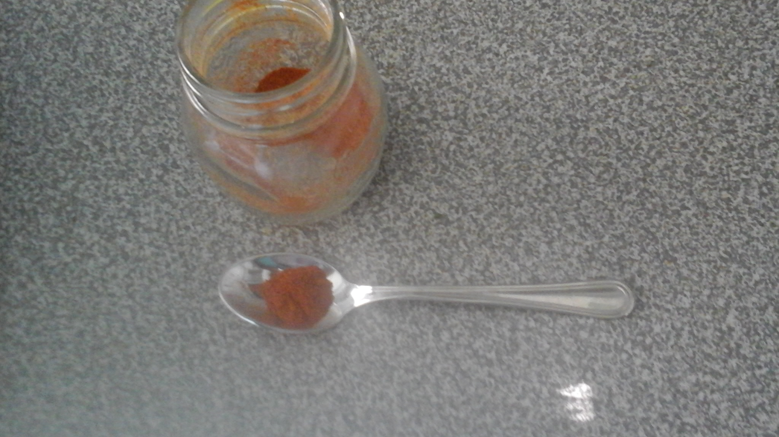
It will be a good idea if you add ½ teaspoon of cinnamon
These are all ingredients that we need.

Slide 5
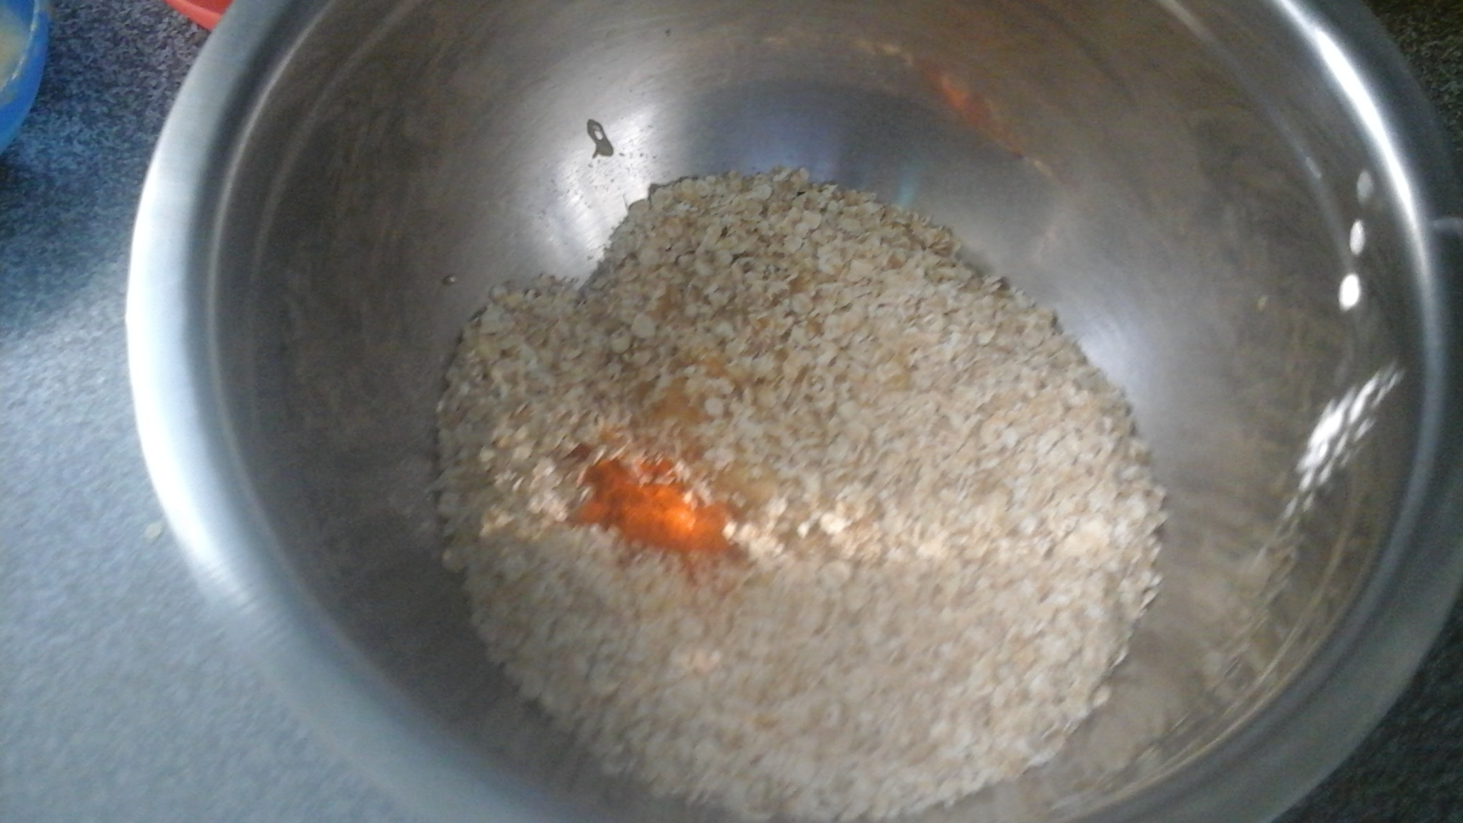
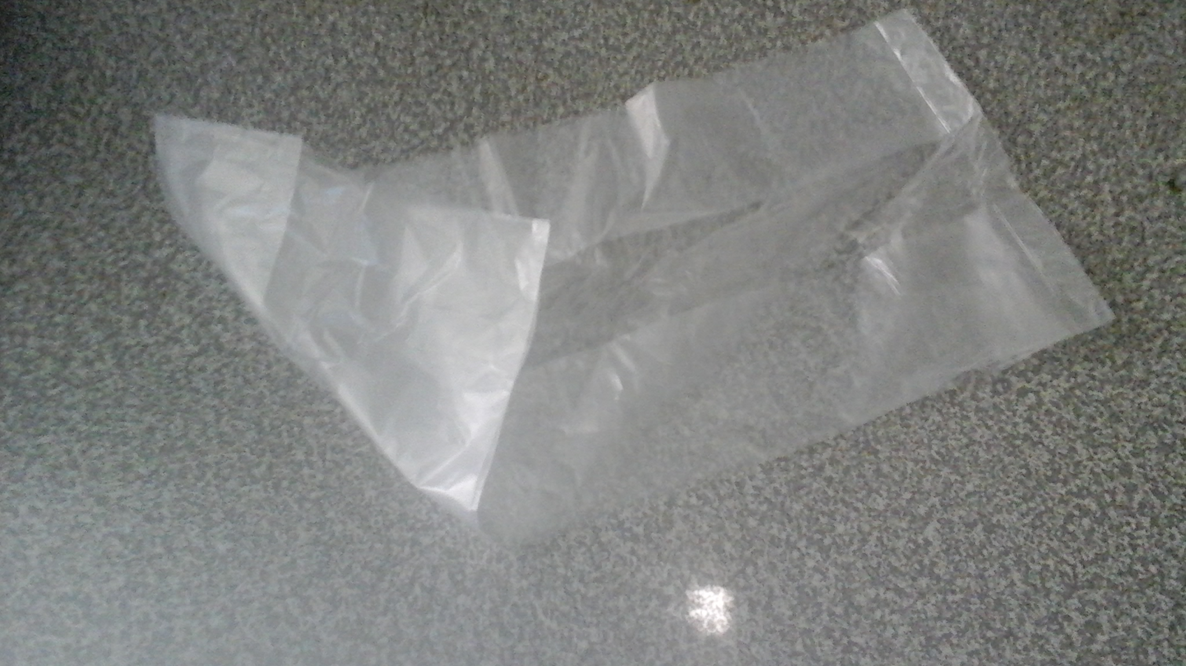
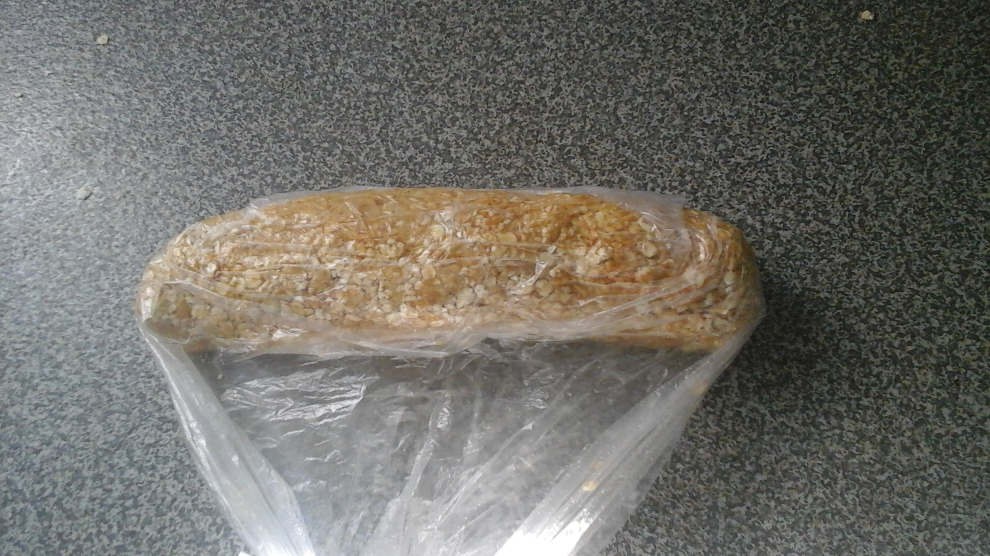
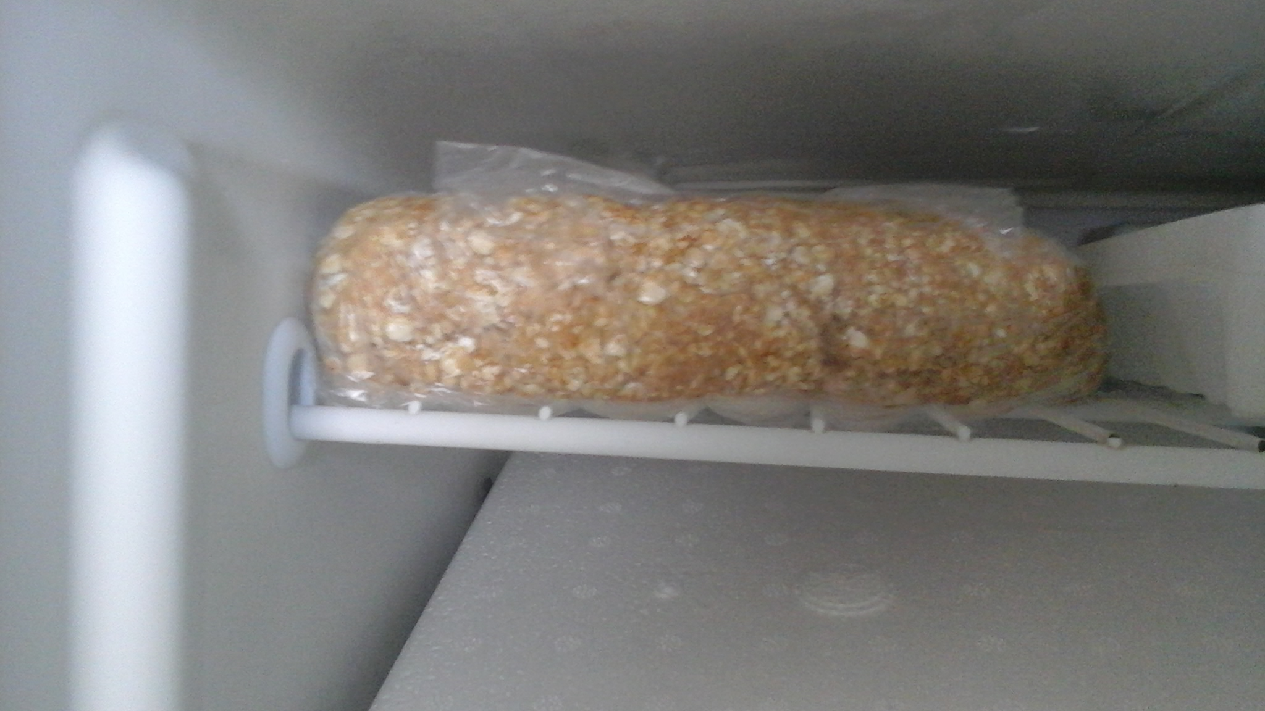
Put the tahini , the honey , the oat , the sesame and the cinnamon in a bowl.
Then, mix the ingredients with your hands.
Take a plastic food bag and put the mixture into the bag.
Put it in the fridge for 5 -10 minutes.

Slide 6
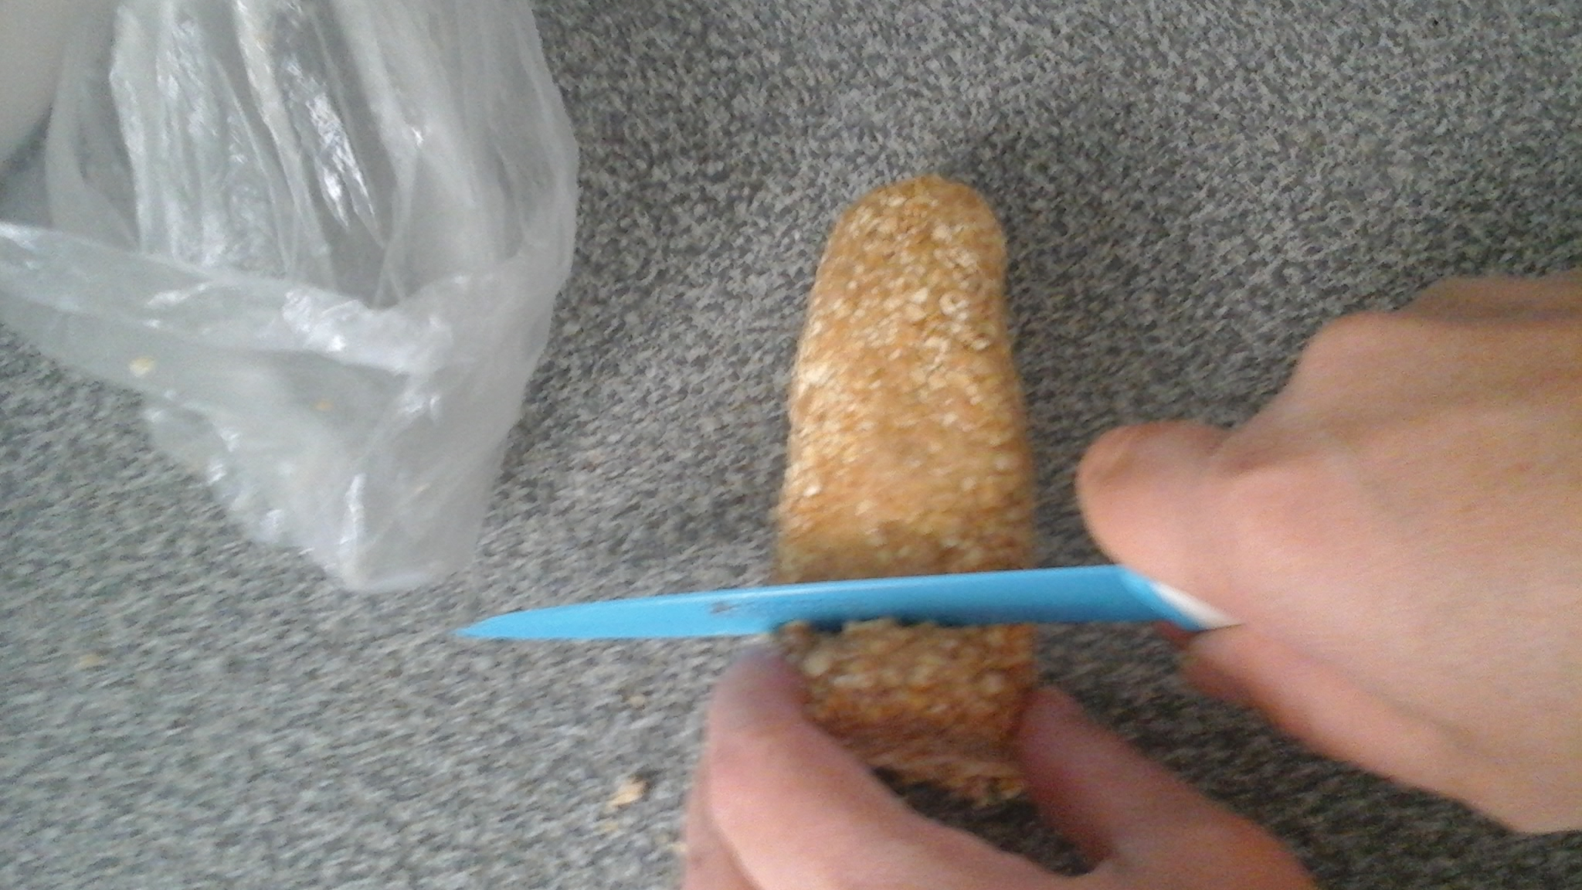
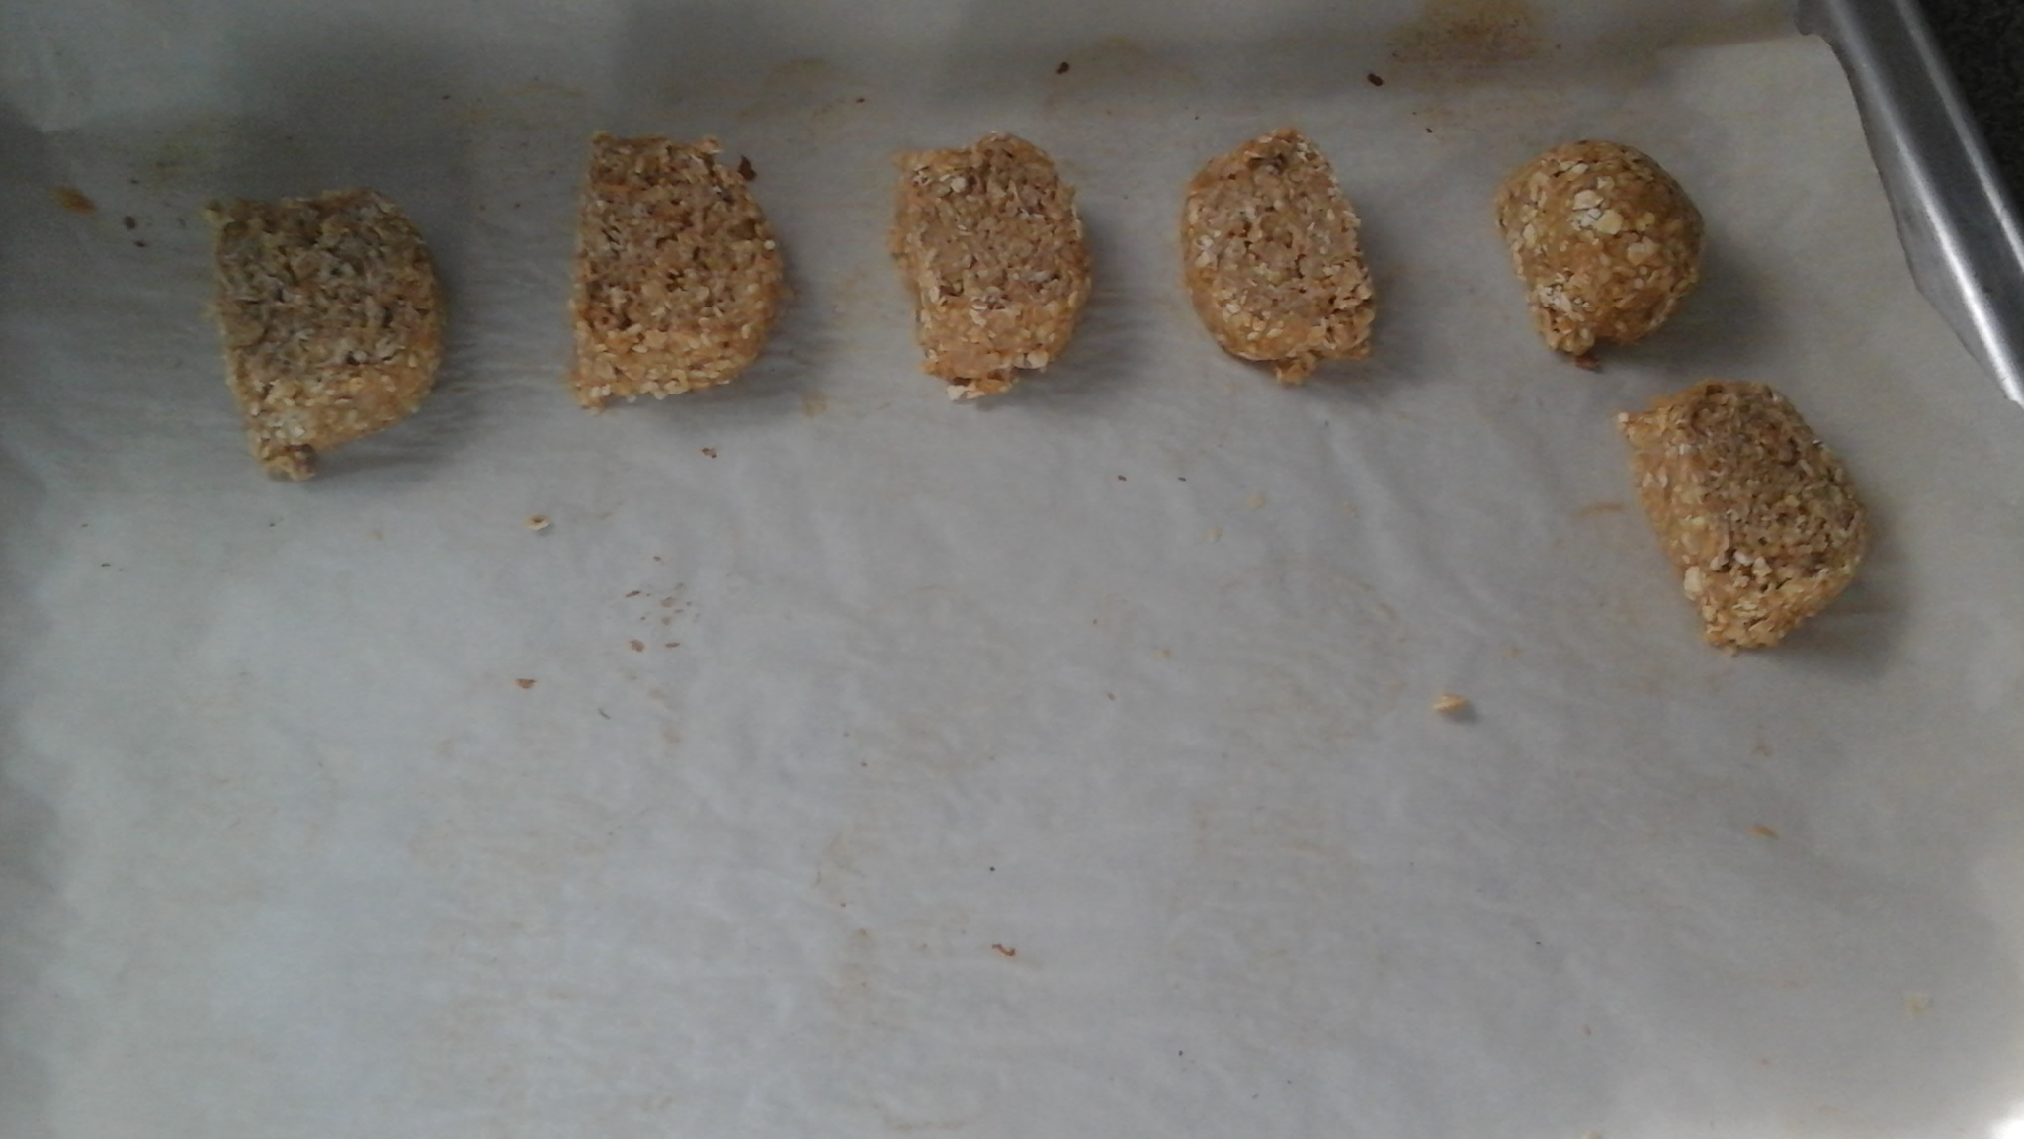
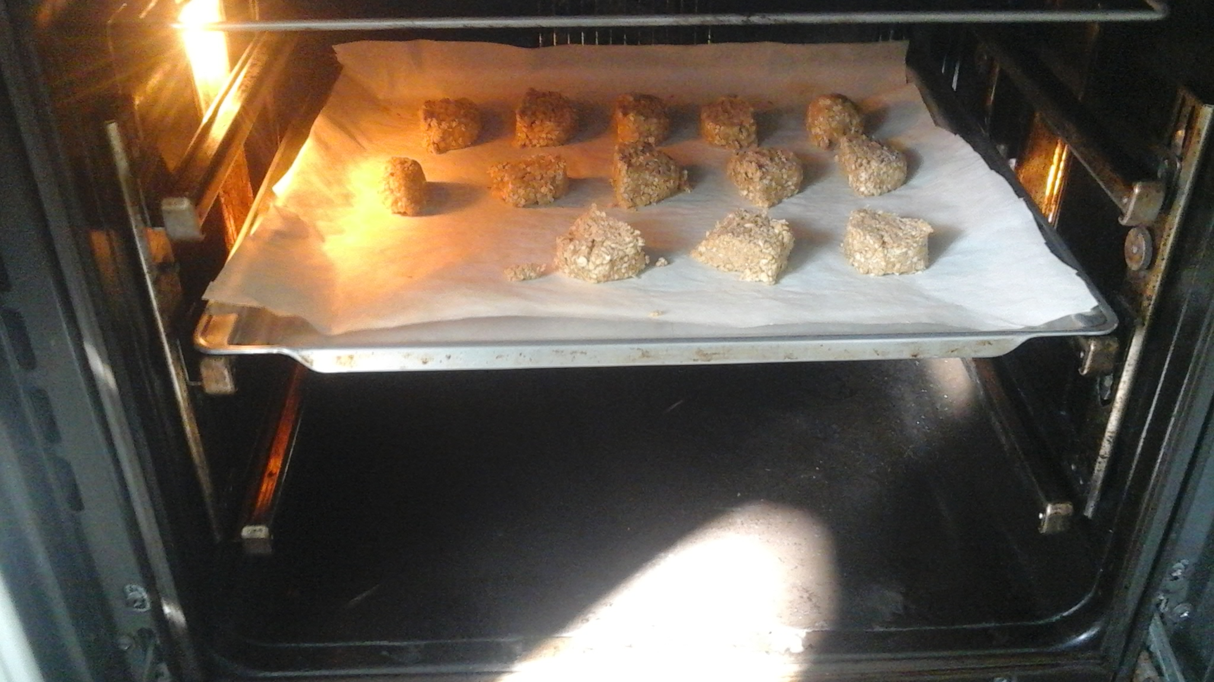
Preheat the oven at180°C .
Then, take the mixture out of the fridge and cut it in small pieces.
Put the pieces on a baking tray lined with parchment paper.
Bake the cookies for 10-15 minutes.

Slide 7
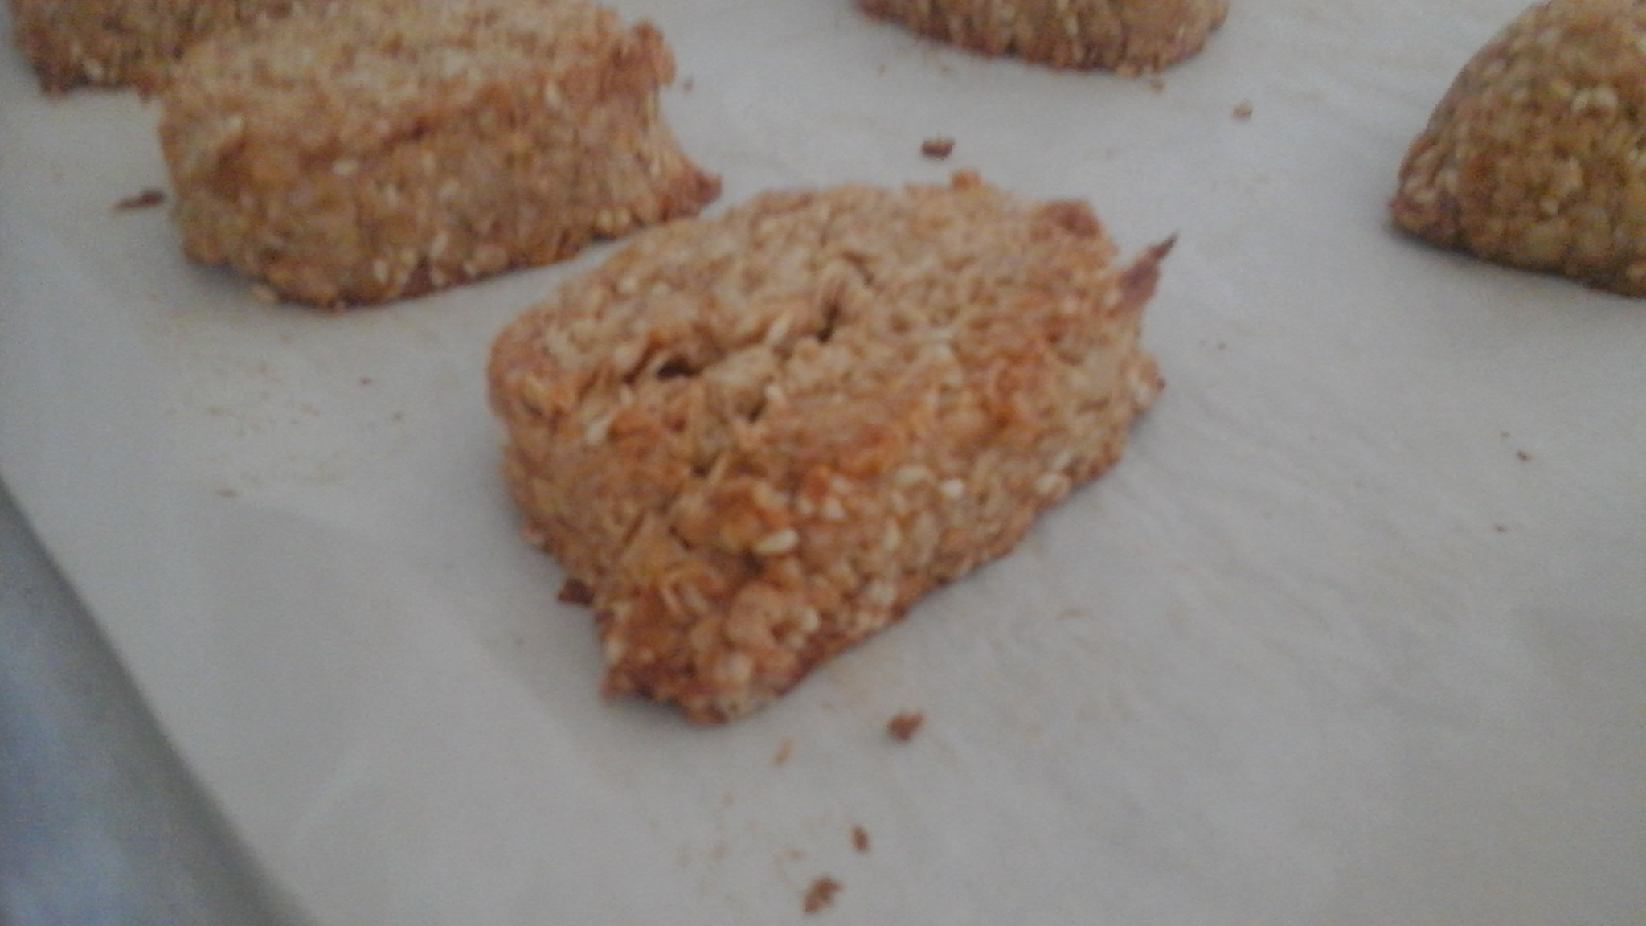
After 10-15 minutes take the cookies out of the oven.
The cookies are ready. Wait for 5-10 minutes to eat them.
Good appetite!

Slide 8
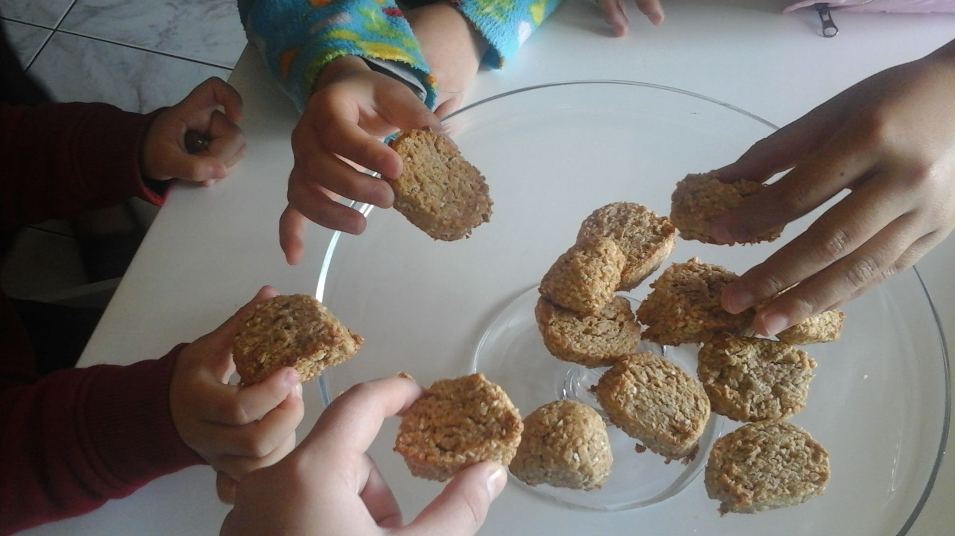
Try them…!!

