Slide 1
BACALHAU Á GOMES DE SA’

Slide 2
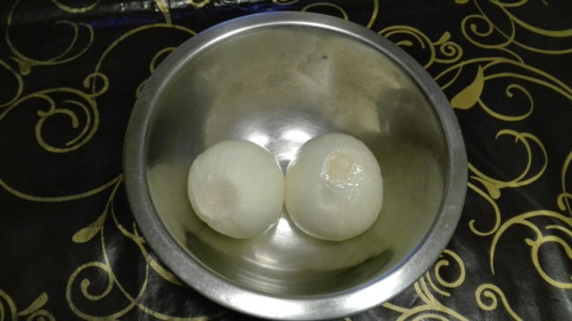
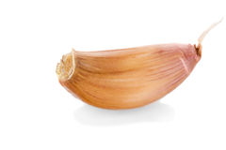
INGREDIENTS
A GLASS OF VEGETABLE OIL
TWO ONIONS
A CLOVE OF GARLIC
Notes:
A GLASS OF VEGETABLE OIL

Slide 3
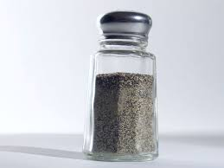
SALT
BLACK PEPPER
A SPRIG OF PARSLEY

Slide 4
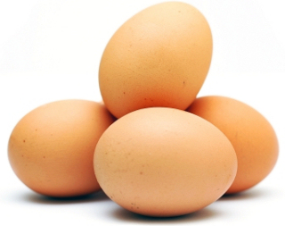
500 GRAMS OF POTATOES
4 EGGS
600 ml of milk

Slide 5
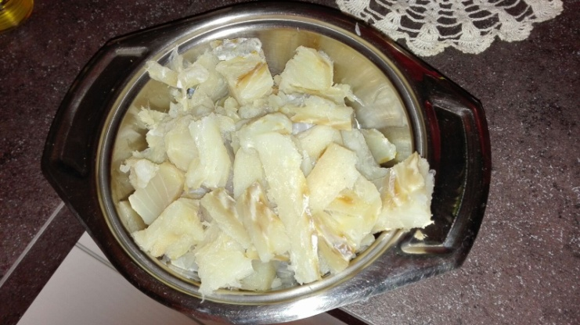
BLACK OLIVES
400 GRAMS OF BACALHAU

Slide 6
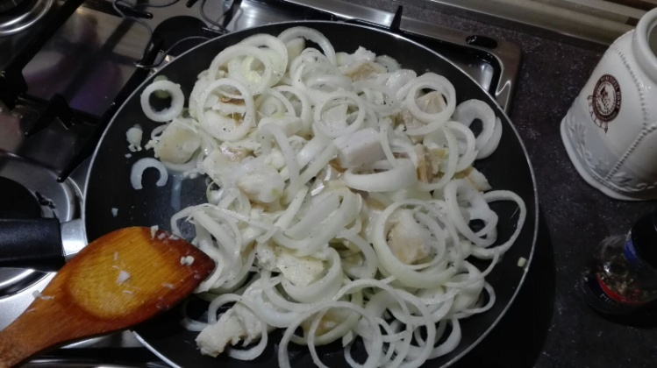
METHOD
CUT THE COD PIECES AND PUT THEM IN A PAN;
ADD TO BACALHAU ONION SLICED AND FRY INTO THE OIL;
Notes:
CUT THE COD PIECES AND PUT IT IN A PAN

Slide 7
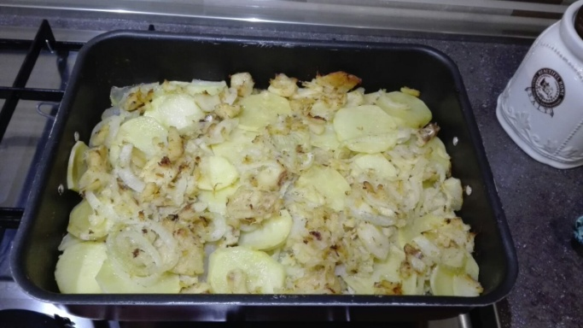
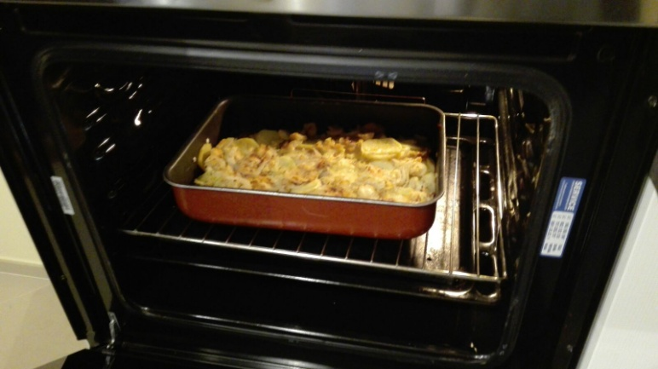
PUT THE POTATOES CUT IN A PAN;
SEASON WITH SALT AND PEPPER,
ADD THE BACALHAU
PUT IN THE OVEN

Slide 8
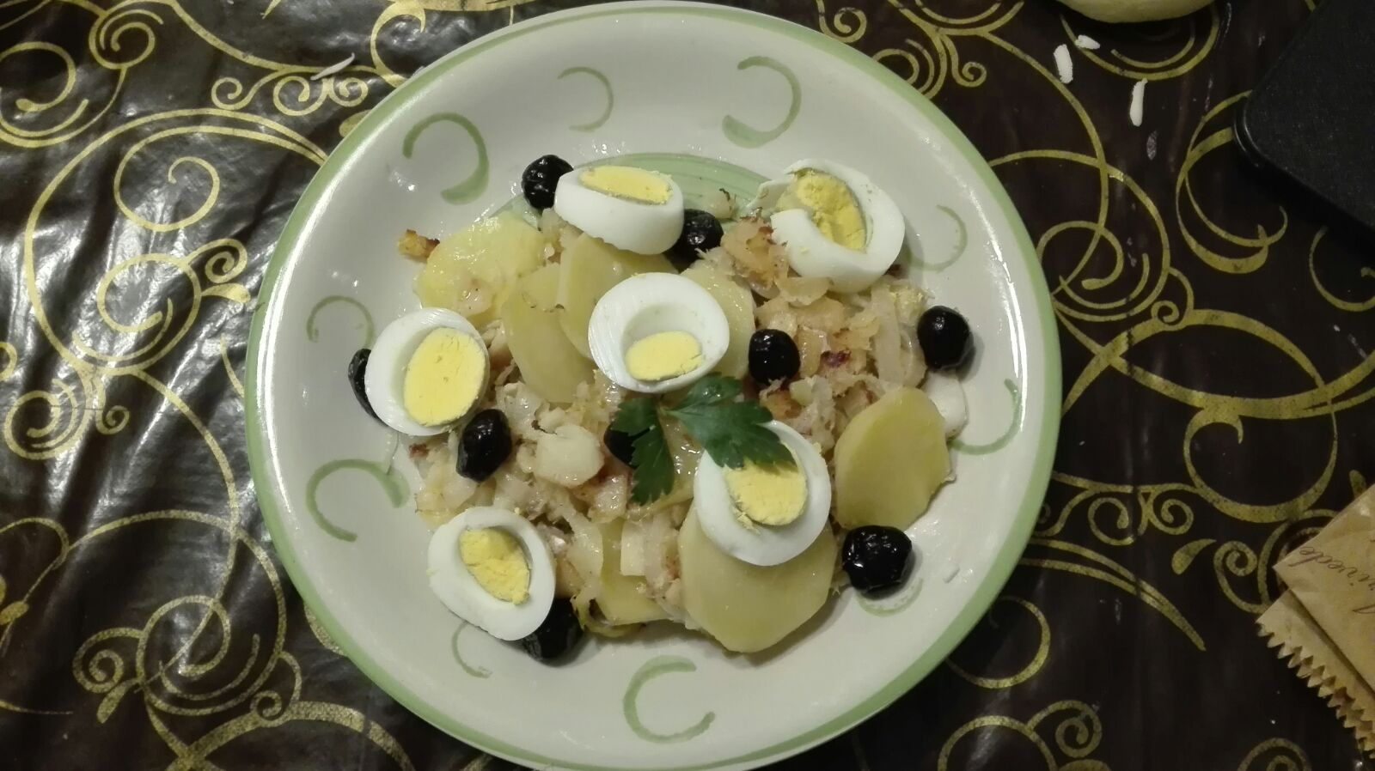
THE BACALHAU Á BRÁS IS READY.
Notes:
Finally the bacalhau á brás

