Slide 1
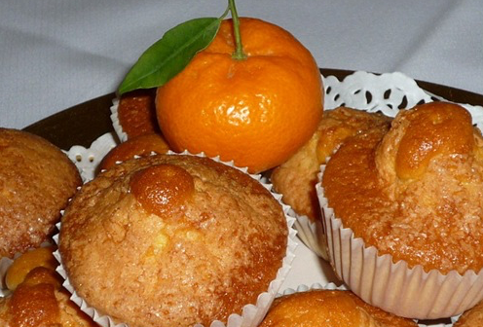
TANGERINE MUFFINS

Slide 2
Tangerine muffins
This recipe is very quick to make…
Ingredients:
2 tangerines (one with bare skin)
2 Eggs
Sugar 250 g
100 g Sunflower oil
220 g flour
2 teapoons vanilla liquid
Chocolate chips (This is optional ).

Slide 3
Steps:
Crush two tangerines in a blender. Add the rest of the ingredients.
Beat well and pour into small moulds. Add chocolate chips or apple.
Bake 15 -17 minutes.
Sprinkle sugar over the muffins.
Delicious!

