Slide 1
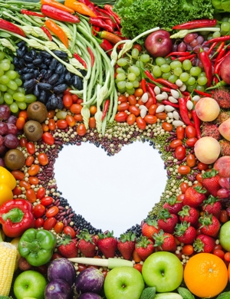
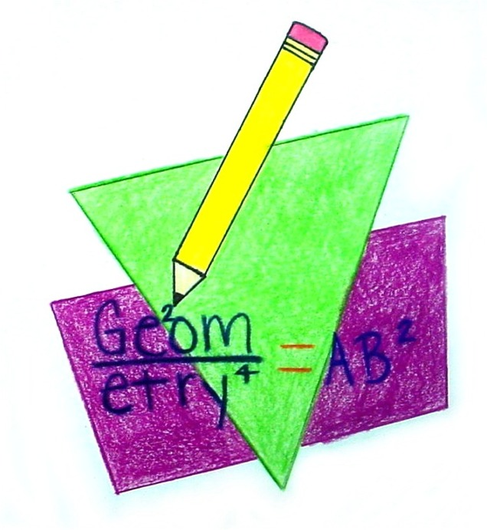
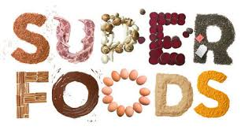
Geometry and Superfoods
Let’s make geometry with superfoods

Slide 2
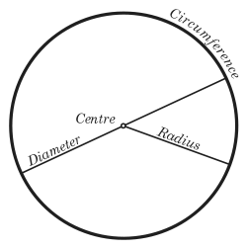
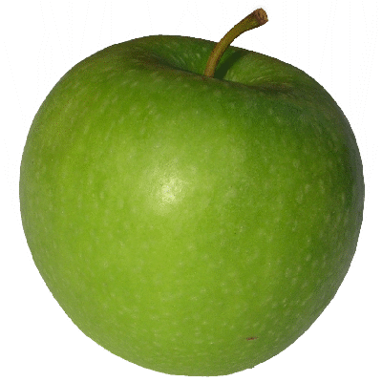
Apple
The circle ,is a locus of points equidistant from a given point called the center.

Slide 3
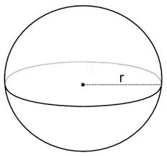
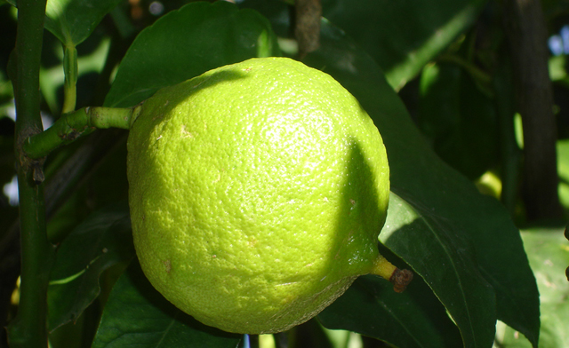
BERGAMOT
a sphere is the SET OF POINTS that are all at the same distance r from a given point, but in three-dimensional space.

Slide 4
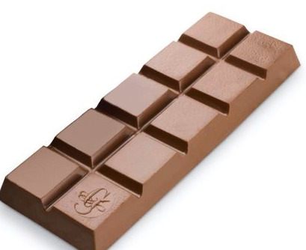
Chocolate
We found 2 geometric figures
The rectangle is a four- sided shape where every angle is right. opposite sides are parallel and of equal lenght.
The square has four equal sides and four right angles.

Slide 5
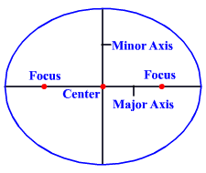
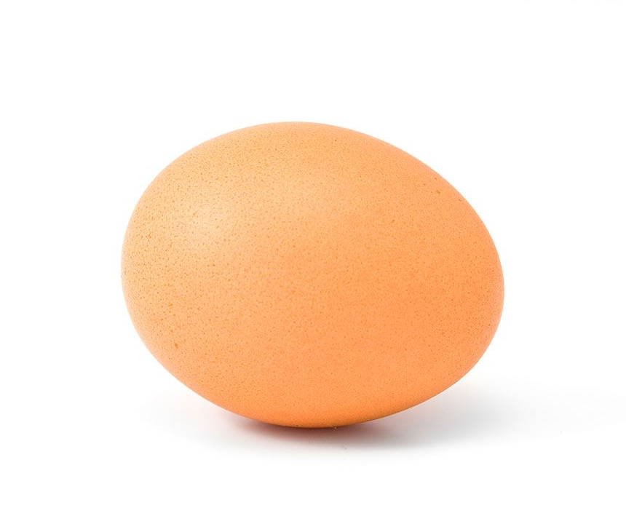
Egg
THE ELLIPSE are a set OF all POINTS oN A PLANE, WHOSE DISTANCES FROM TWO FIXED DATA POINTS (CALLED FOCI) add up to a CONSTANT.

Slide 6
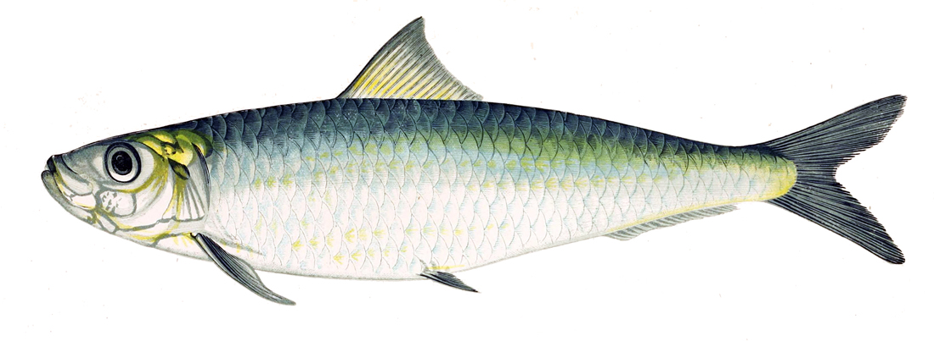
Fish
We can see a geometric figure composed of 3 triangles, a trapezium, an irregular hexagon !

Slide 7
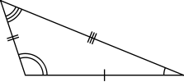
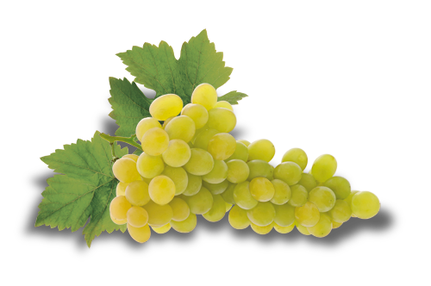
Grapes
A scalene triangle is a closed figure with three no equal sides and three no equal angles.

Slide 8
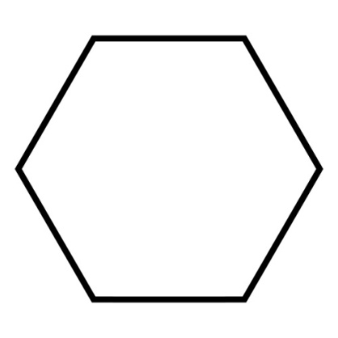
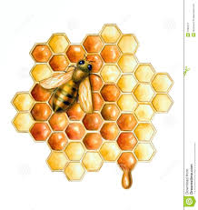
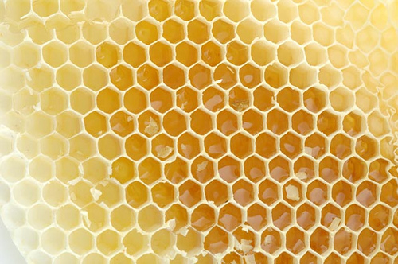
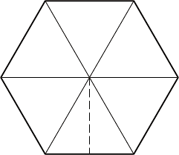
Honey
The geometric figure of a honeycomb Cell is a HEXAGON , that is formed of 6 equal sides.

Slide 9
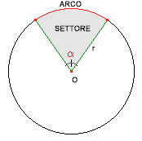
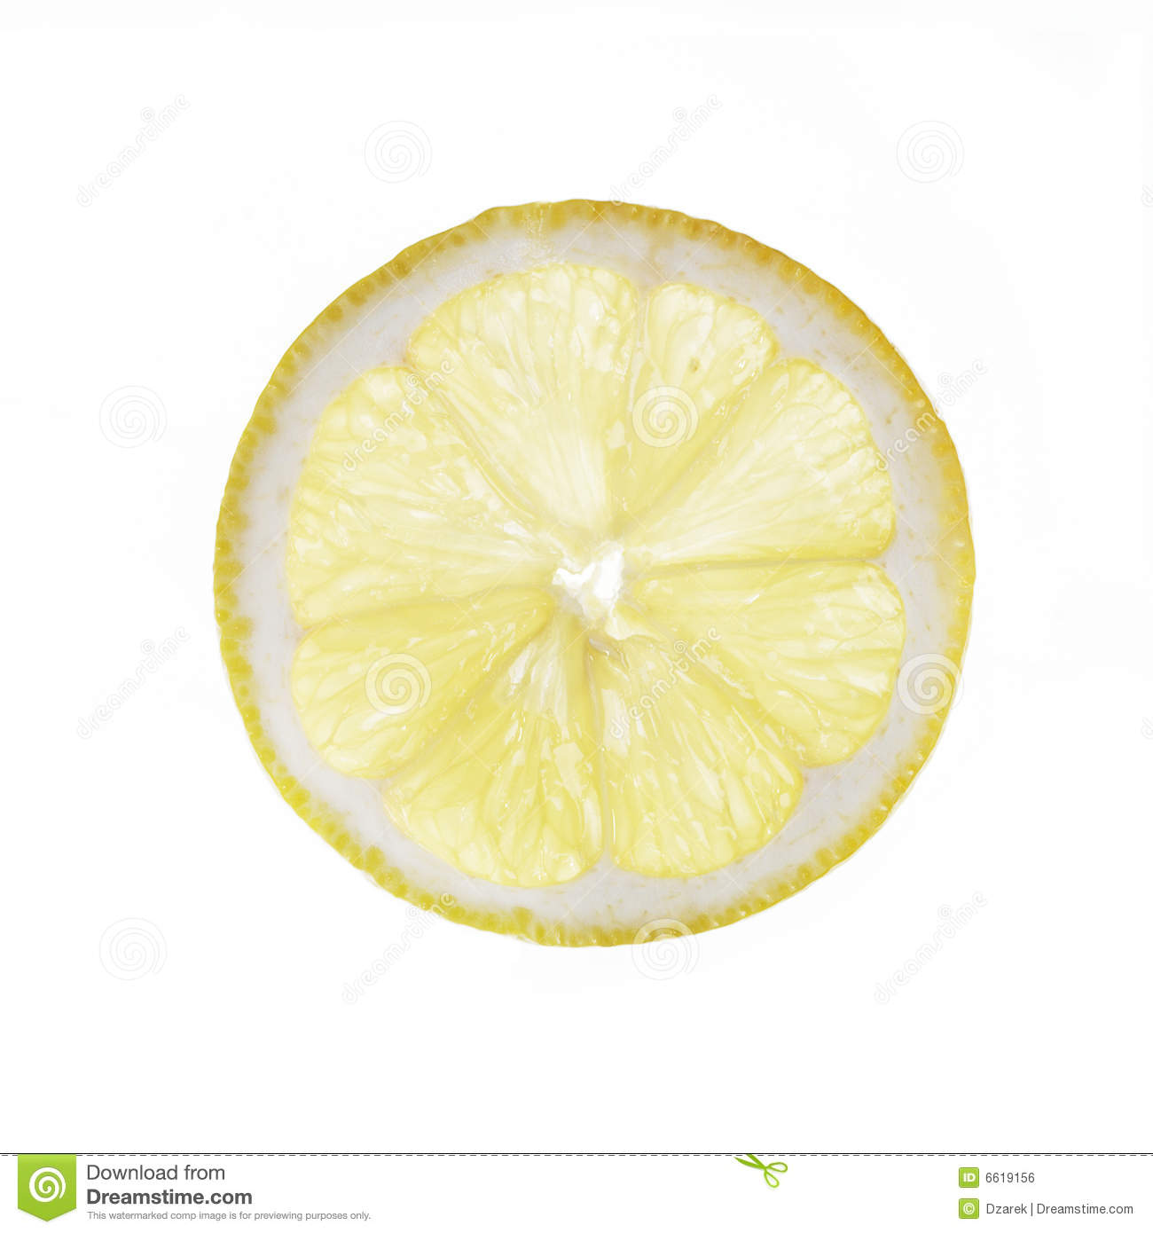
Lemon slice
The circular sector is the portion of a circle enclosed by two radii and AN ARC OF CIRCUMFERENCE.

Slide 10
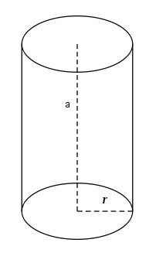
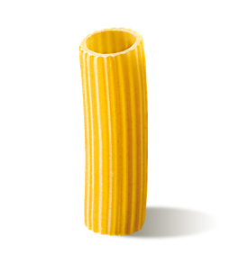
Pasta
The cylinder is a solid obtained by rotating a rectangle around one of its two sides.

Slide 11
Pasta spaghetti
a "Line Segment" is straight (no curves), • has no thickness, and • extends in both directions without end (infinitely )

Slide 12
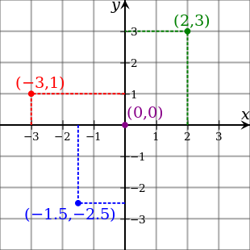
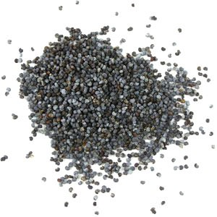
Poppy seeds
The point is an exact position or location on a plane surface.
It is represented by a dot and has no size

Slide 13
Did you like that ?
We enjoyed a lot in looking for the shapes of superfood !!
Luca,Alessandro, Demetrio Martina, Valeria, Gaetano,Aurora

