Slide 1
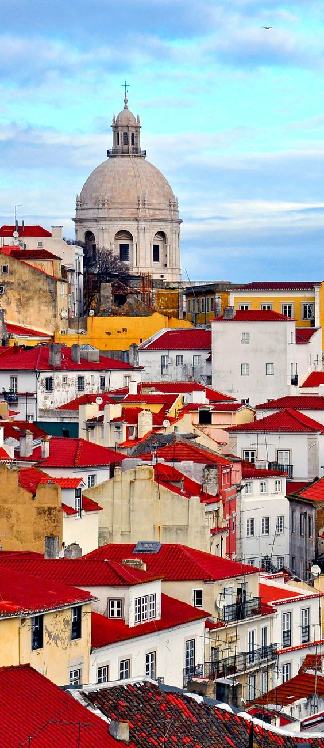
Portugal
And It’s Wonders

Slide 2
Where is it?

Slide 3
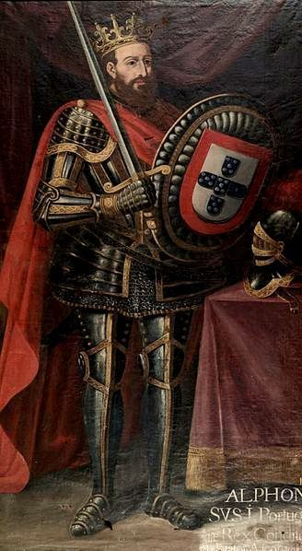
It’s history
Portugal was founded in the 12th century by a brave Prince who dreamed of a greater nation.
The first King of Portugal fought against his own mother for what we, portuguese people, know today as Independence.

Slide 4
Gastronomy
Francesinha
Bacalhau à Brás
Polvo à Lagareiro

Slide 5
Gastronomy
Pastéis de Belém
Pudim Abade De Priscos
Ovos Moles

Slide 6
Fado
A type of music tradicionaly sung in cafés and pubs.
Played in multiple guitars, this slow and very deep music gender usually trades the loss of something loved.

Slide 7
Literature and Art
Famous writers:
Gil Vicente: playwright
Luís Vaz de Camões: poet
Fernando Pessoa: poet
Sophia de Mello Breyner Anderson
Famous artists:
Cristiano Ronaldo: footballer
Amália: fado singer
Mariza: fado singer
Joana Vasconcelos: plastic artist

Slide 8
World recognition
Science
Sports
As an ancient nation, Portugal as contributed for the developing of science since the beggining of times.
Inventing many crutial tools for saling the seas back in the 15th century and now reciving many awards and recognition in the science/tecnology field.
Portugal is a very dynamic country when it comes to sports.
Recently, we won the 2016 european cup at football and futsal. In hockey we won the world championship.
And we have a lot of great achievements in running, triple and long jump, gymnastics,…

Slide 9
Our city: Braga
We live in a quite big city in the north.
Some might even call it the Rome of Portugal. The arquitecture is gorgeous so it’s basically a outdoor 24/7 museum.
It’s never really cold but it rains a lot so the locals joke about it beeing the potty of the heavens.

Slide 10
Spots
Arcada
Bom jesus

Slide 11
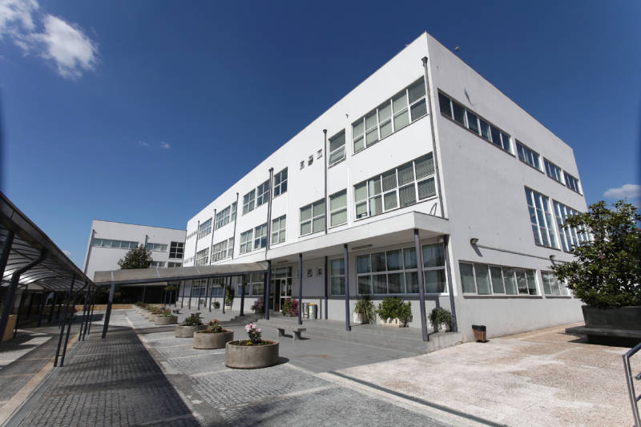
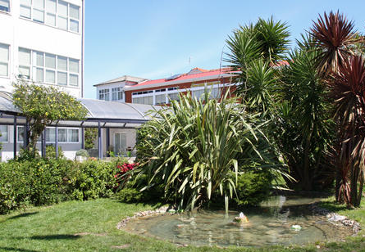
Alfacoop
Our school’s name is Alfacoop and it welcomes students from the 1st to the 12th grade
In 35 years of history we have been through a lot, but that never changed the unity of this cooperative.

Slide 12
By:
Ana Beatriz Costa
Ana Miguel Pereira
Daniel Faria
Diogo Vaz
Maria Cunha

