Slide 1
Welcome to Italy

Slide 2
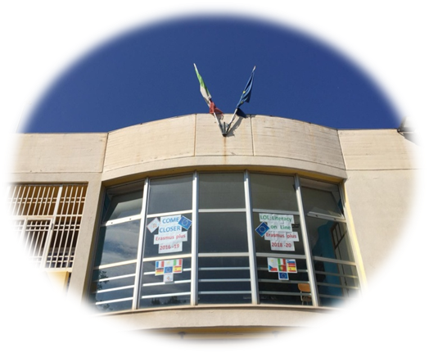
Our school …Carlo Levi
Carlo Levi was a famous writer of the twentieth century.
WE are very proud to study in the school with this name because Levi was an antifascist and he cared about the situation of the poor people of the South
This is the school we attend. Every day here we study and work.
Our school Carlo Levi is very colorful and beautiful, in fact we like it a lot. In the school we are 313 students.

Slide 3
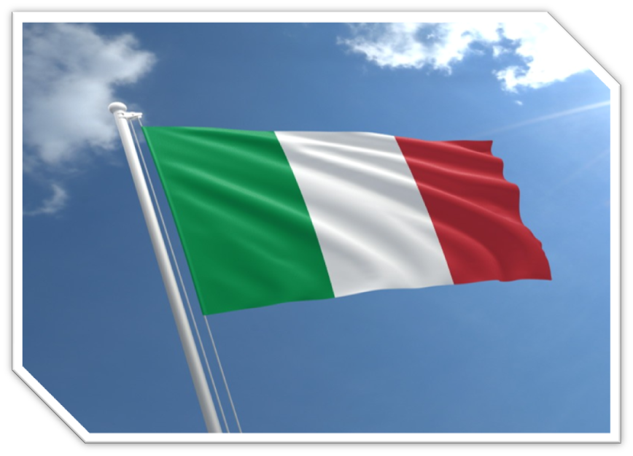
This is the Italian flag…!

Slide 4
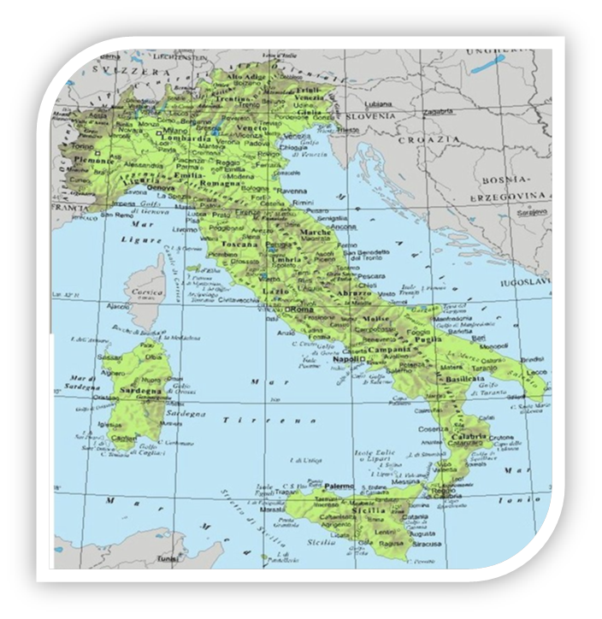
The Italian map

Slide 5
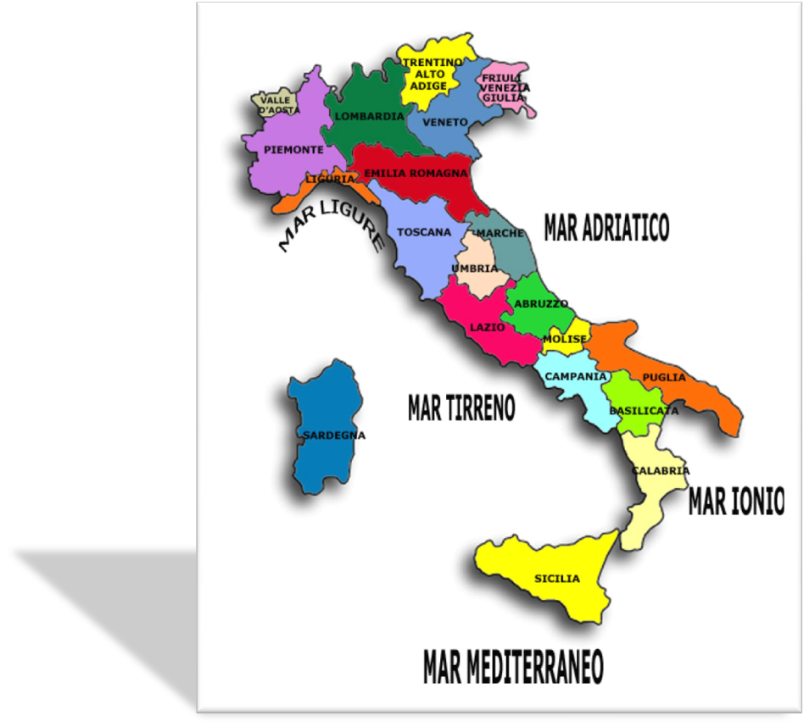
20 Italian regions
Italy is A European State Made Up Of 20 Regions: Aosta Valley, Lombardy, Trentino Alto Adige,veneto, Friuli Venezia Giulia, Piedmont, Liguria, Emilia-romagna, Tuscany, Marche, Umbria, Lazio, Abruzzo, Molise, Campania, Basilicata, Calabria, Sicily, Sardinia And Last, but not the least… Our Region: Apulia .

Slide 6
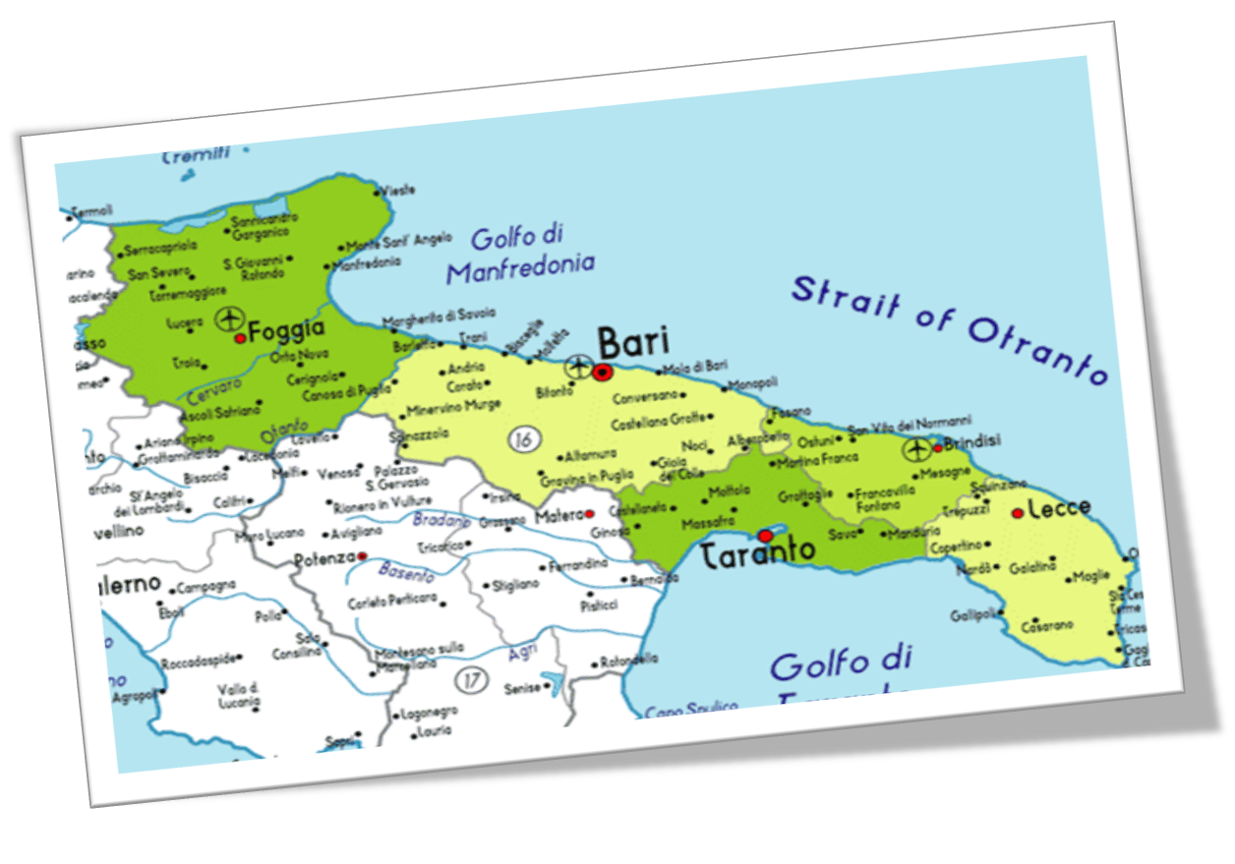
This is the map of Our region: Apulia!!!

Slide 7
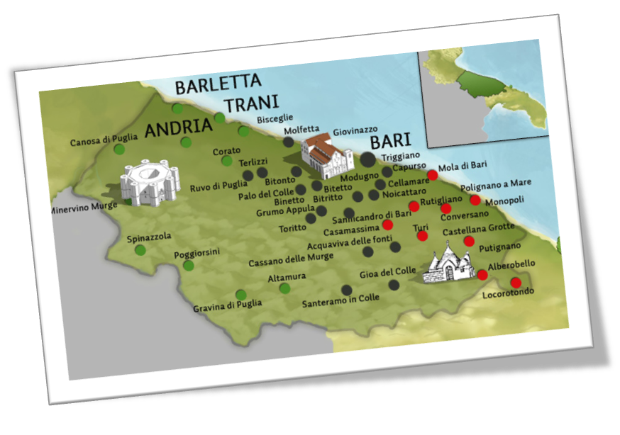
“ Land of Bari ”
The administrative and political division worked by Frederick II in 1222 brought the division of Puglia into three administrative bodies: capitanata, terra d’Otranto and Terra di Bari.

Slide 8
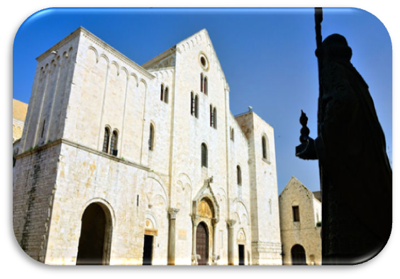
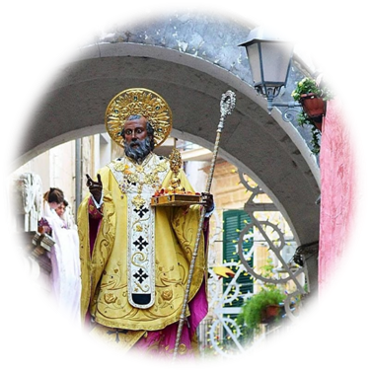
Bari, our culture…
San Nicola abbey in the heart of the old city of Bari is one of the most significant example of architecture of the Apulian romanesque style. The abbey is pontifical, but it was entrusted to a specific religious order: the Dominican order. So now it belongs directly to the Holy see.

Slide 9
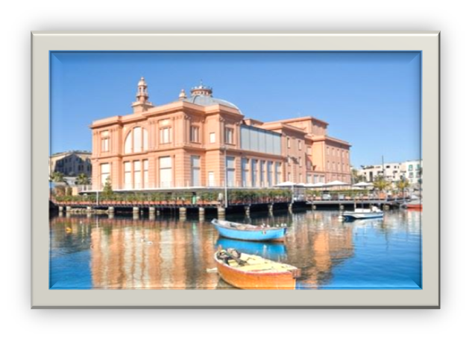
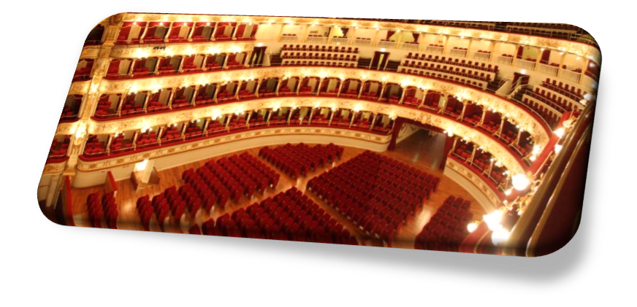
Margherita theater
The theater Margherita was built between 1912 and 1914. It was born on the sea; in fact it lies on many pillars in the sea.
It was impossibile to build another theatre on the land because the owner of the theatre Petruzzelli, the fantastic previous theater of Bari, didn’t want another theater in the same city.
Today after a long restoration, its spaces are converted into a contemporary art exhibition venue

Slide 10
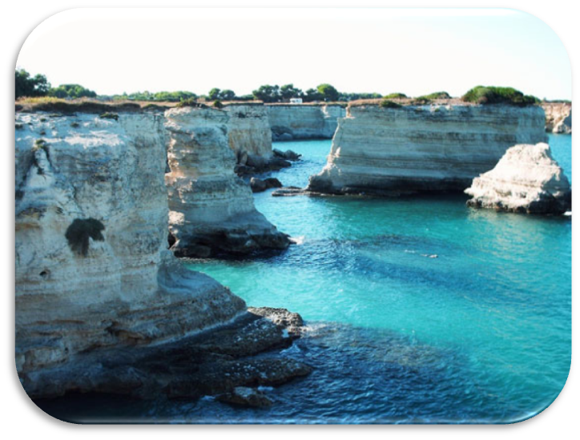
Our coast
The coast of Puglia, because of its beauty and charm, is visited and appreciated by a lot of tourists and visitors who every year come to Puglia to crowd the beautiful shores that from the Promontory of the Gargano down to the Cape Leuca and going up to the Gulf of Taranto reserve pleasant surprises and beautiful landscape to all the visitors.
Because of this fact Puglia is investing more and more in terms of quality and offers.

Slide 11
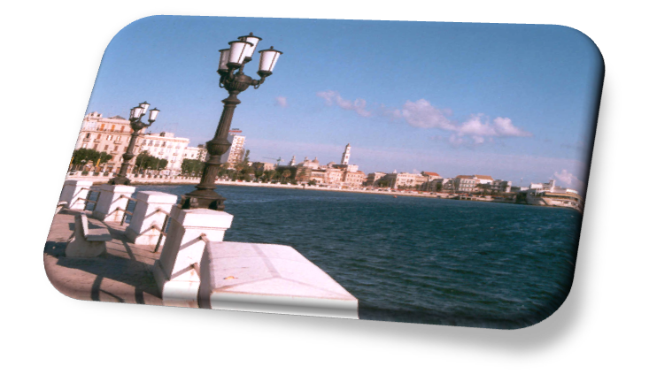
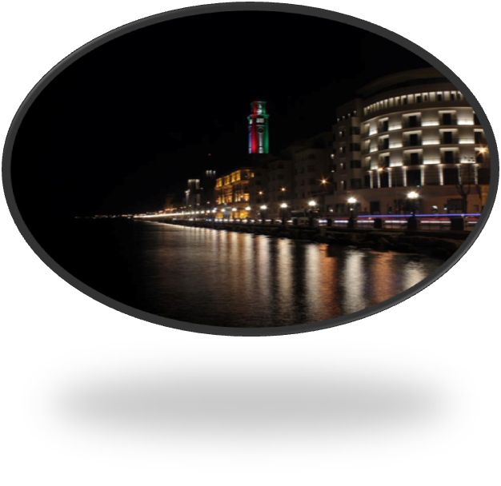
SEA FRONT OF BARI…
This is our sea front, both by night and by day; this is our best attraction .
A lot of people, not only tourists, spend time walking along the seafront. During the sunny days, they stay on the seafront to sunbathe, a lot of young and not so young people run and enjoy themselves.

Slide 12
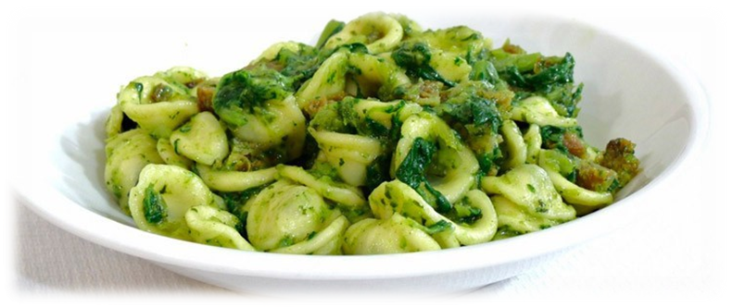
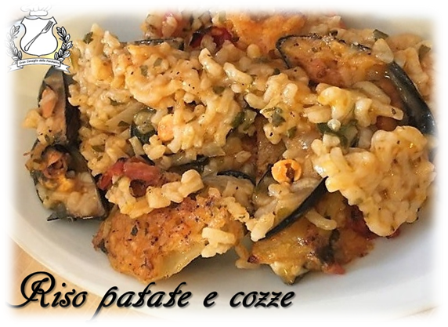
FOOD
Orecchiette to the rapa tops
Potatoes rice and mussels

Slide 13
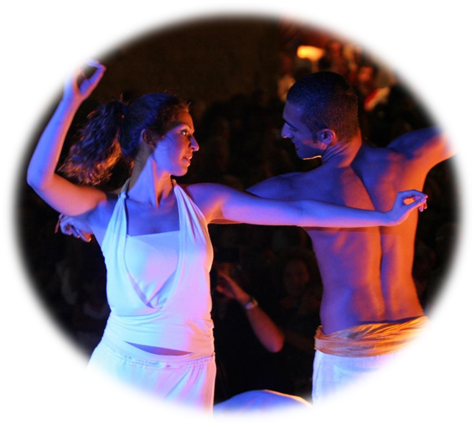
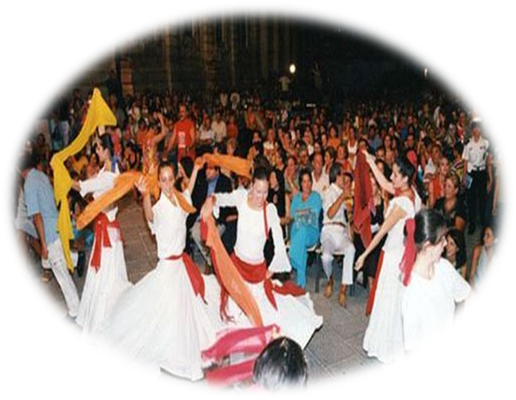
Dance: “pizzica”
It’s a traditional dance in Bari since 1900 up to today. During the summer a lot of people dance on the different cities squares; they dance all night long…

Slide 14
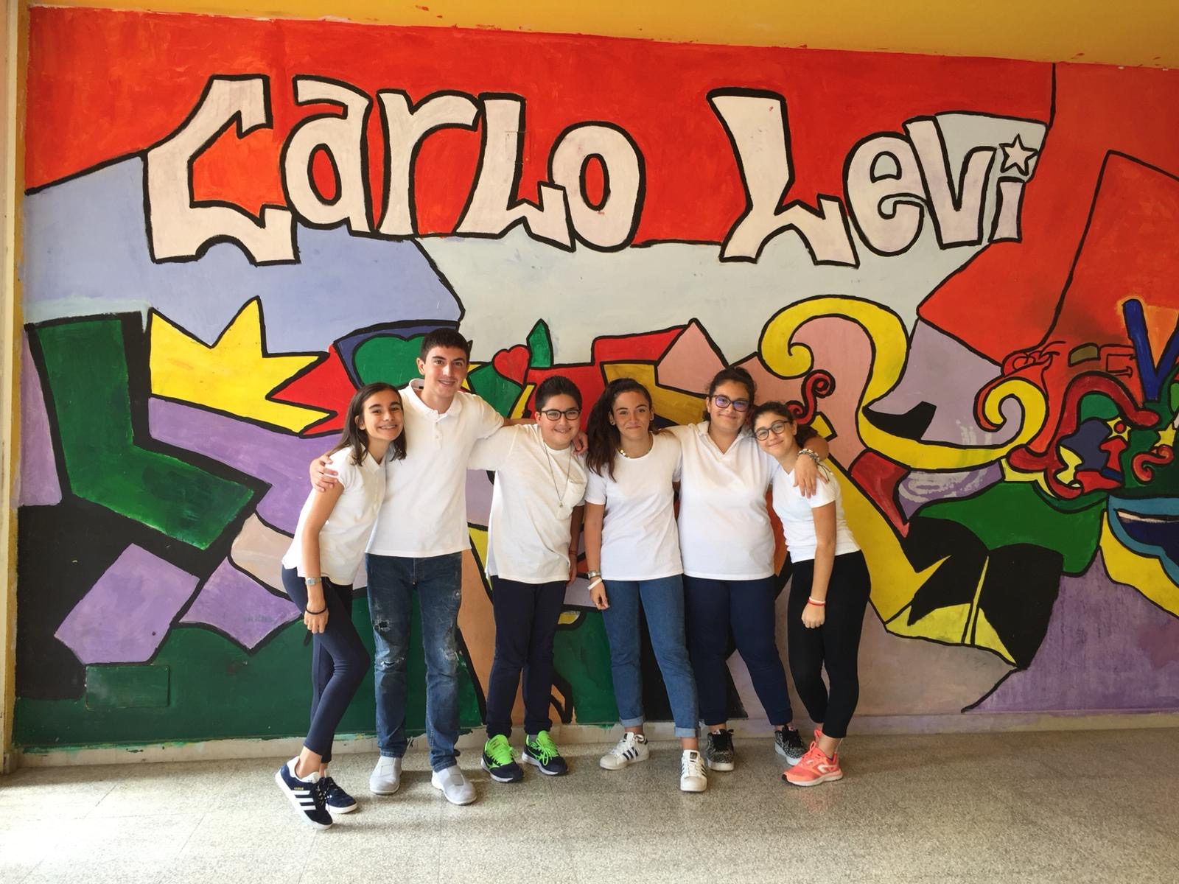
this is us…

Slide 15
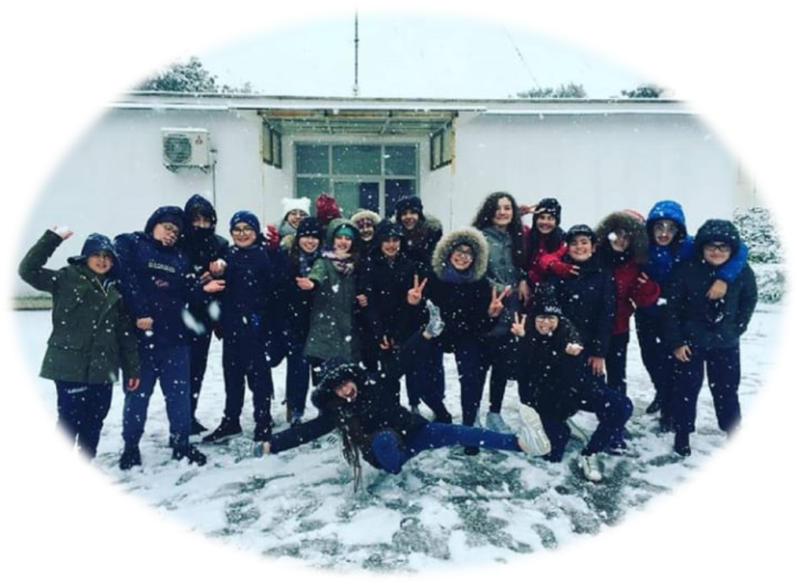
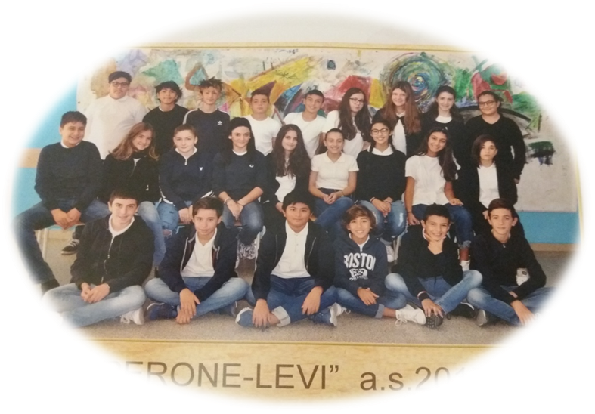
Our classes and classmates…
3^E
3^A

Slide 16
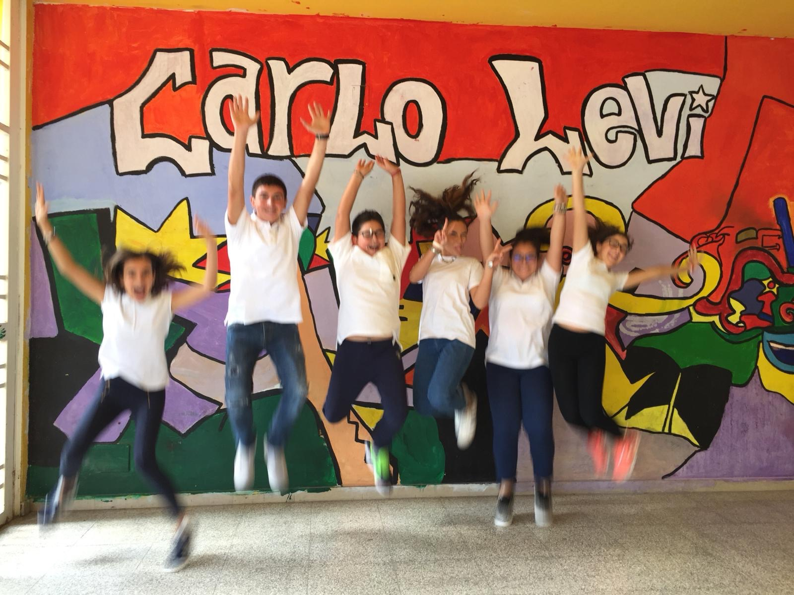
Thanks for your attention!!!
Enjoy this Erasmus plus project!!!
Antonacci Gaia
Bordignon Emanuela
Carofiglio Daniele
Ferrante Giorgia
Dammacco Alessio
Sciacovelli Flavia

