Slide 1
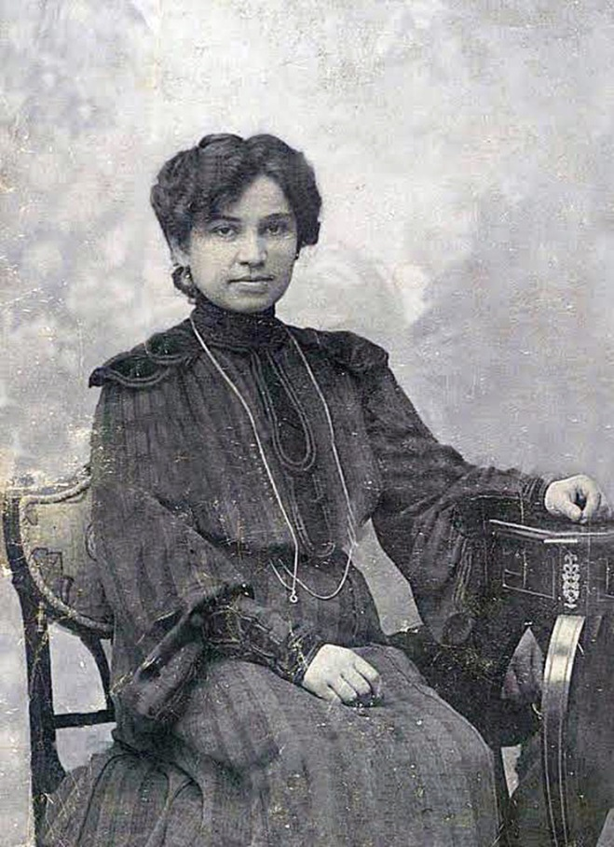
JELISAVETA NAČIĆ
Jelisaveta Načić (31th December 1878, Belgrade – 6th June 1955, Dubrovnik) was a notable Serbian architect. She is remembered as a pioneer who inspired women to enter professions which had earlier been reserved for men. Not only the first female graduate in architecture in Belgrade, she was also the first female architect in Serbia.

Slide 2
At the age of 22, she was the first woman to graduate from the Faculty of Engineering.
She sought employment at
the Ministry of Construction but was unable to become an official as there was a
requirement for
military service
to have been
completed.
She did however
succeed in gaining
a position as an
architect with
the Municipality of
Belgrade.
In 1903, she designed the
Little Staircase in Belgrade's Kalemegdan Park. Her
most notable work is the well proportioned school building she completed in 1906, now known as the Kralj Petar I (King Peter I) elementary school.

Slide 3
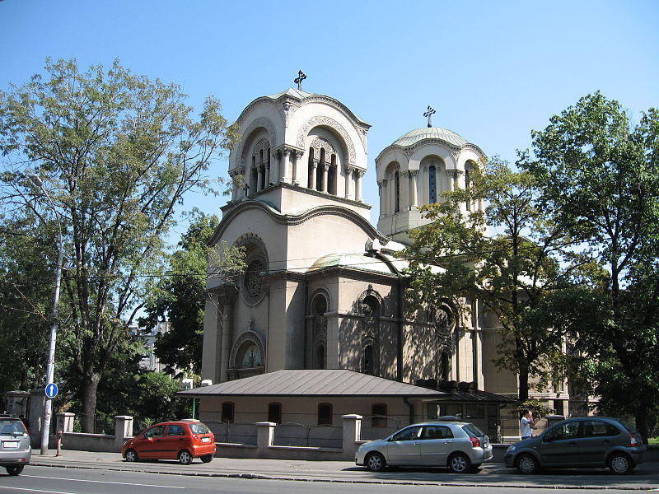
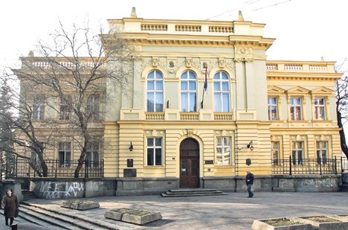
She also designed churches including the Moravian-styled Alexander Nevsky Church (1929) in Belgrade and a smaller church in Kosovo.
The hospital she designed was destroyed during the Second World War but many of her residential buildings from apartments to distinctive private homes, some with art nouveau or Neo-Renaissance elements, still stand today.
The first collective housing building for workers on Balkan was designed by Jelisaveta Načić.
Teodora Milutinović

