Slide 1
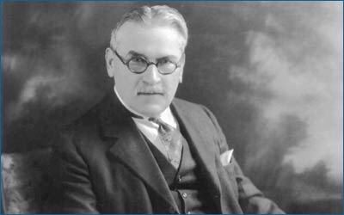
Mihajlo Pupin
Mihajlo Idvorski Pupin (4 October 1858 – 12 March 1935), also known as Michael I. Pupin was a Serbian American physicist and physical chemist.

Slide 2
About his life
Pupin is best known for his numerous patents, including a means of greatly extending the range of long-distance telephone communication by placing loading coils (of wire) at predetermined intervals along the transmitting wire (known as "pupinization"). Pupin was a founding member of National Advisory Committee for Aeronautics (NACA) on 3 March 1915, which later became NASA. In 1924, he won a Pulitzer Prize for his autobiography.

Slide 3
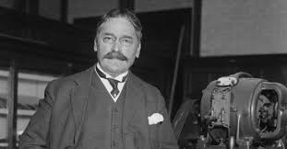
Pupin was elected president or vice-president of the highest scientific and technical institutions, such as the American Institute of Electrical Engineers, the New York Academy of Sciences, the Radio Institute of America, and the American Association for the Advancement of Science. He was also a honorary consul of Serbia in the USA from 1912 to 1920.

Slide 4
Image Source: https://www.biografija.org/wp-content/uploads/2016/09/mihajlo-idvorski-pupin-642x336.jpg
Image Source: http://s3-eu-west-1.amazonaws.com/lowres-picturecabinet.com/43/main/11/89944.jpg
Text Source: https://en.wikipedia.org/wiki/Mihajlo_Pupin
Velimirovic Andrija
Cvetanovski Filip

