Slide 1
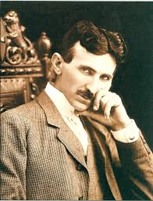
Nikola Tesla
Nikola Tesla(1856. – 1943.)
Nikola Tesla is one of the biggest scientist of humanity. He was born at 10th of July, 1856. in Smiljan, Austrian empire. His parents were, Serbian, Milutin Tesla, orthodox priest and his mother Djuka.

Slide 2
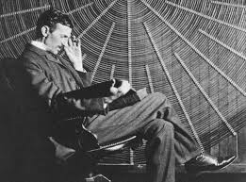
Education
. At his young ages, he was smarter then his peers. Through education, he showed up interest about physic, electricity and radio tehnique. Tesla was at many school s in Europe and later he went to America to improve his knowledge.

Slide 3
Abouut his lif
Inovations that he invented, like induction motor, three-phase electric power, remote control, Tesla coil etc have many use in modern life and changed the way of living. He died in America in 1943. at his 86th year in room 3327 of the New Yorker Hotel. Many of his patents are still secret and scientist are unable to understand and recreate his inventions. Some of his inventions are abused and used in military purpose.

Slide 4
Picture source:https://www.blic.rs/slobodno-vreme/vesti/nikola-tesla-je-ovim-recima-odbio-najlepsu-zenu-svog-vremena/qer1gym
Picture source:https://sh.wikipedia.org/wiki/Nikola_Tesla
Text source:https://sh.wikipedia.org/wiki/Nikola_Tesla
Uros Noveski
Milos Stefanovic

