Slide 1
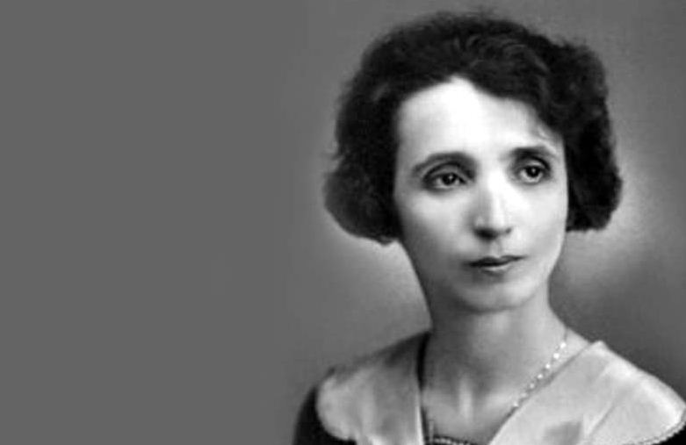
Ksenija Atanasijević
Ksenija Atanasijević (1894–1981) was the first recognised major female Serbian philosopher, and one of the first female professors of Belgrade University, where she graduated.
She wrote about Giordano Bruno, ancient Greek philosophy and the history of Serbian philosophy and translated some of the most important philosophical works into the Serbian language, including materials by Aristotle and Plato.
She was also an early Serbian feminist writer and philosopher.

Slide 2
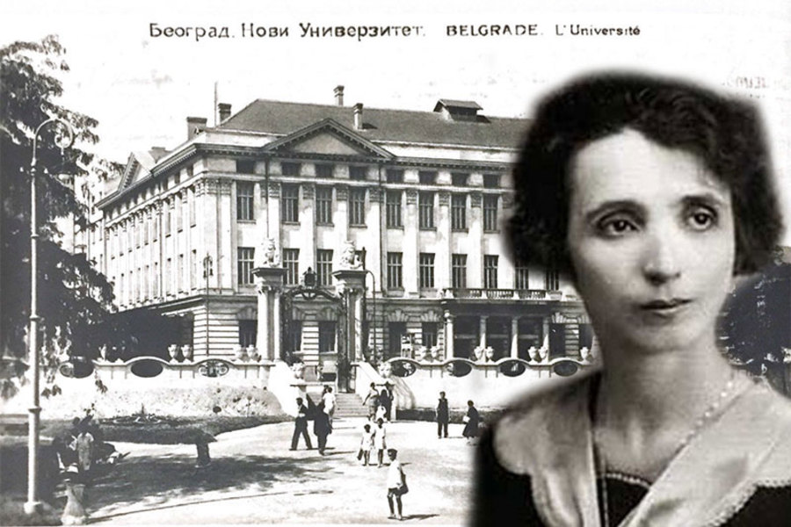
In the autumn of 1918, Ksenija Atanasijevic became pupil at the University of Belgrade.
She graduated in July 1920 with the highest marks in her graduating class, obtaining a university diploma in "pure and applied philosophy and classics."
An excellent student, she decided to pursue an academic career in philosophy and soon after graduation, began working on a doctoral thesis on Giordano Bruno's De triplici minimo.
She went to Geneva and Paris to seek out rare philosophical works and to discuss her thesis with specialists in the field, and on January 20th 1922, defended her Ph.D with honors in Belgrade before a panel of academics.
After her thesis was successfully defended, she became the first woman to hold a Ph.D. in Philosophy in Serbia. She was then 28 years old.

Slide 3
In 1924, she became the first female university professor to be appointed to the Arts Faculty, Department of Philosophy at the University of Belgrade, where she taught classics, medieval and modern philosophy and aesthetics for twelve years.
During her teaching career, she was a committed feminist both in theory and practice. She was a member of the Serbian Women's League for Peace and Freedom, the Women's Movement Alliance, and editor of the first feminist journal in the country, "The Women's Movement" , published from 1920 to 1938.
Ksenija Atansijević left more than 400 texts, among them books and essays in philosophy, psychology, history, and literature.
She is best known for her original interpretations of Giordano Bruno's work and for her 'philosophy of meaning' developed in Philosophical fragments, 1928–1929), considered to be her most important work.
World War II brought troubles and unrest, even for the apolitical Ksenija Atanasijević. After writing articles against anti-Semitism and National Socialism, she was arrested by the Gestapo in 1942.
Sofija Stojilović

