Slide 1
Recycling and sustainability at st Julian’s church school
By Wilf, Jonah, Ashley, Josh, Amelia and Natasha

Slide 2
ABOUT US
We go to St Julian’s Church School in Wellow.
Wellow is a small village near the city of Bath
in the South –West of England.
Take a look at our website: www.stjuliansprimary.co.uk

Slide 3
At St Julian’s, we feel strongly about looking after our planet and each other.
Our Christian theme this term is kindness - to ourselves, each other and our planet.

Slide 4
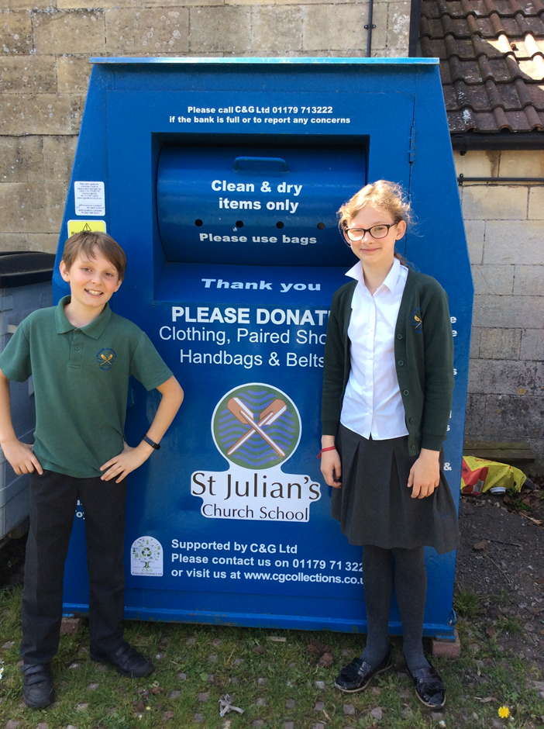
WE HAVE BEEN helping everybody to recycle
We have a clothes recycling bin.
The clothes bin is a place to put unwanted clothes, toys and shoes. They are then passed onto people who can use them. This means clothes are recycled and not just thrown away - and precious resources aren’t used making new ones.
The recycled clothes also earn money for the school.

Slide 5
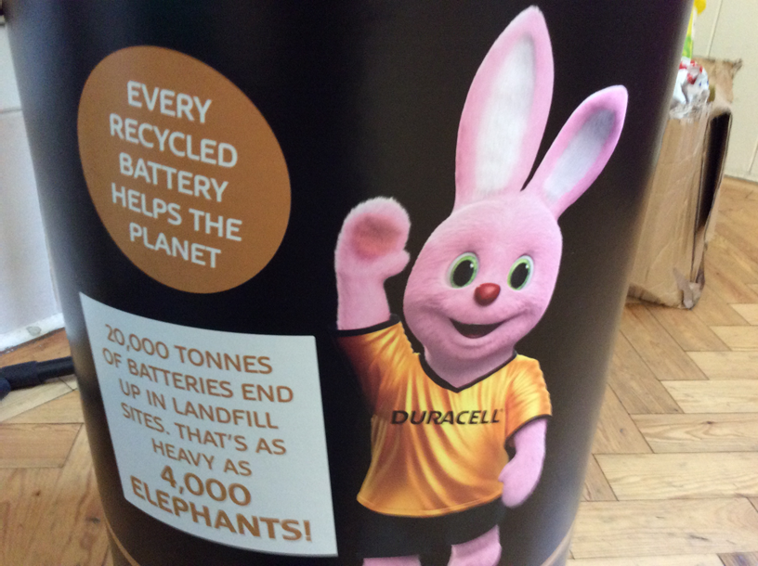
We have a battery recycling bin.
All pupils in the school are encouraged to bring old batteries in from home and recycle them at school. This stops them ending up in landfill where dangerous chemicals could seep into the environment.
20,000 tonnes of batteries in landfill

Slide 6
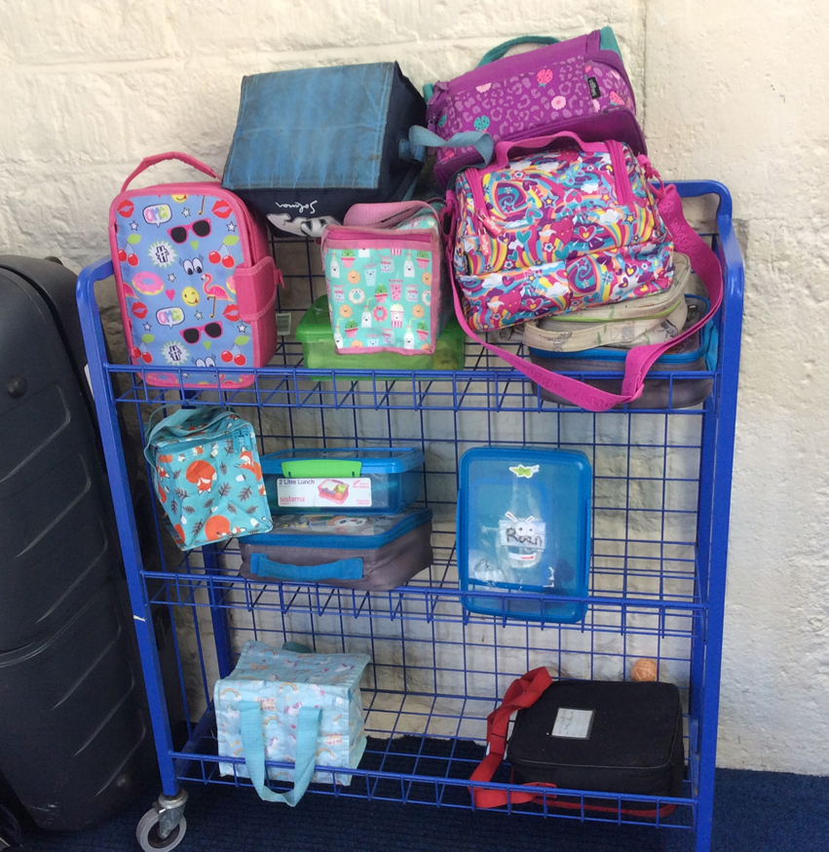
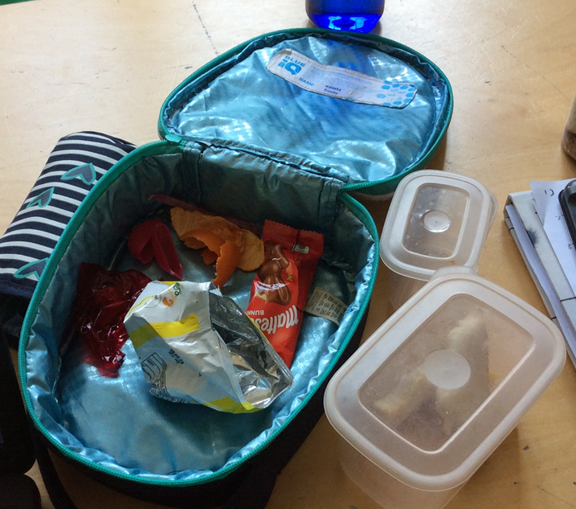
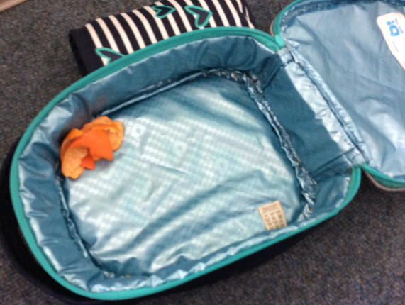
We are introducing a zero waste lunch policy.
At St Julian’s Church School 65% of people bring in packed lunches every single day.
We want to encourage children to reduce the amount of plastic they use in their lunchbox and thereby reduce waste. Plastic containers should be reused and not thrown away.
Before After

Slide 7
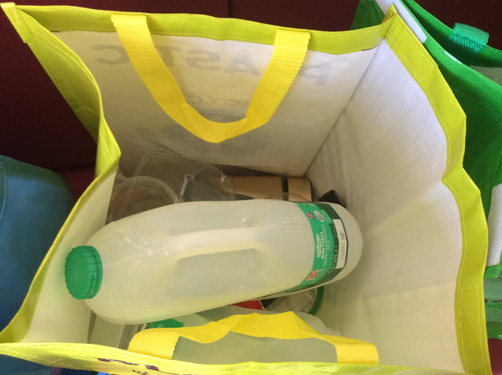
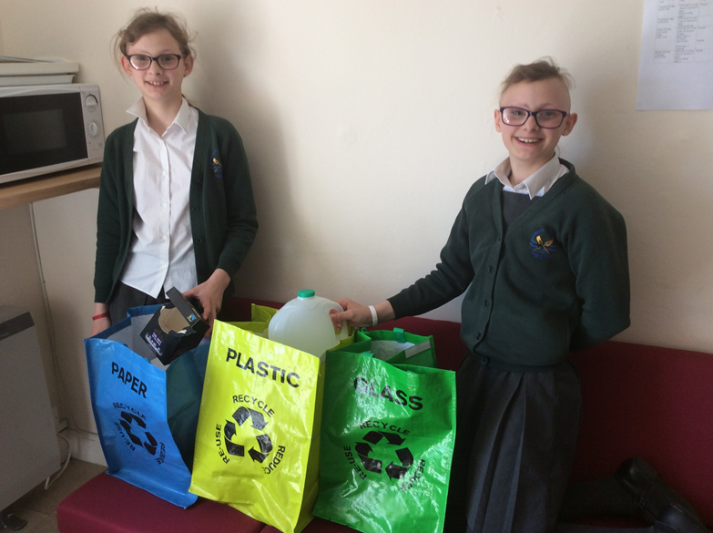
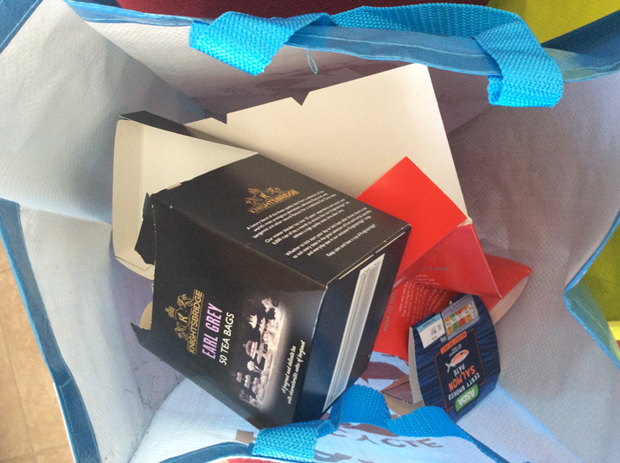
The teachers recycle their waste in the staffroom into sorting bins.

Slide 8
There are visual displays around our school.
We have created eye- opening displays around school.
They remind us to take care of our planet and to recycle more.
They teach us to respect our planet and our friends.
They tell us about the dangers of marine pollution.

Slide 9
We promote awareness through public speaking and debate.
We took part in an inter-school competition called SPEAK OUT. We had to talk about a subject we were passionate about.
We put forward arguments for and against banning plastic.
Our team won the trophy!

Slide 10
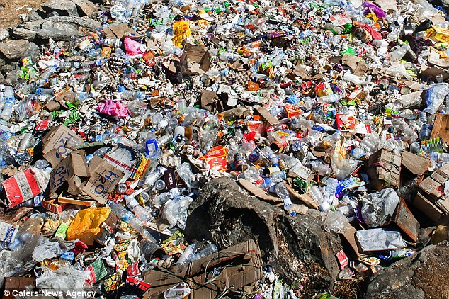
We are going to organise school and community litter picking.

Slide 11
We hope you enjoyed our presentation. Thank you for listening.

