Slide 1
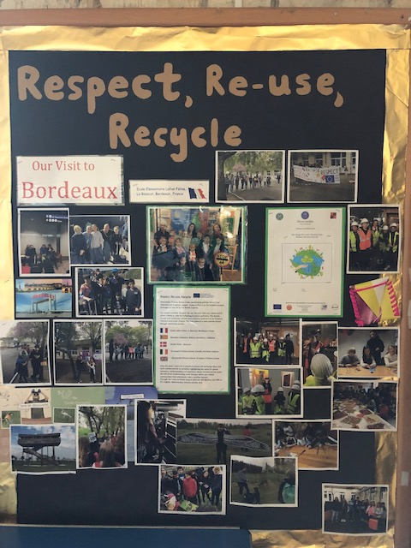
Recycling at Shoscombe School and in our local area

Slide 2
When we have grown out of our school uniform clothes we donate them to school. They are recycled, parents can buy these uniforms at a reduced price and the money goes to the school .

Slide 3
We collect eggs from our school chickens. We sell our eggs in recycled empty egg boxes that people donate.

Slide 4
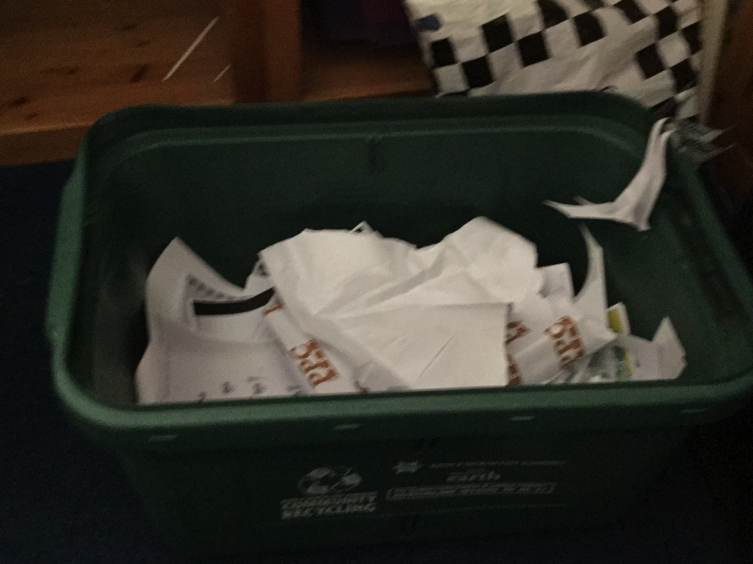
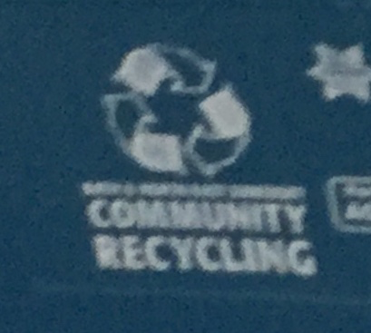
We have recycling boxes in our classrooms and food waste bins in our playground and staffroom. They are collected regularly.

Slide 5
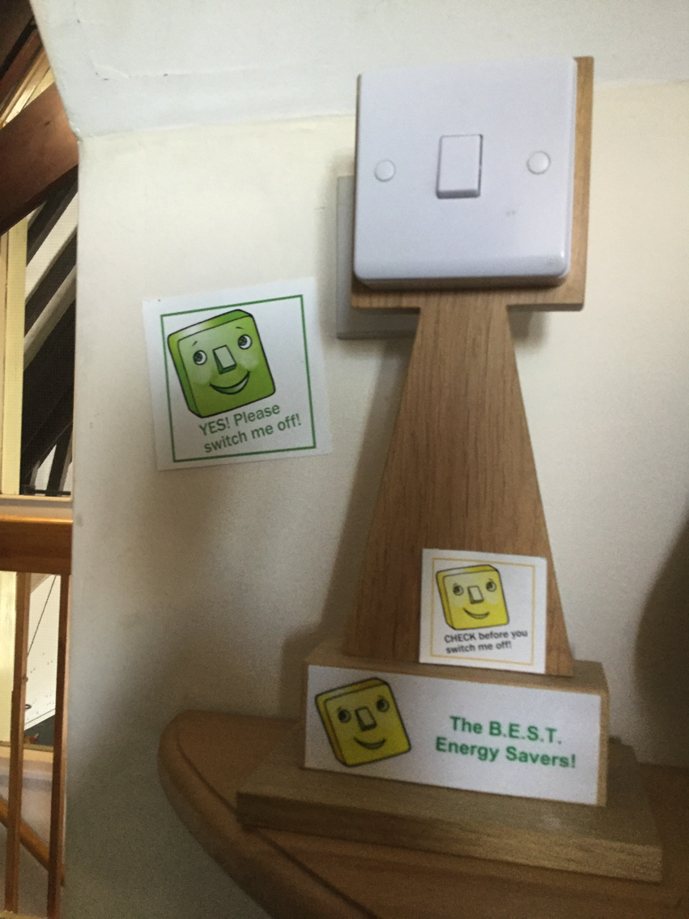
We remember to switch off lights and computers when we are not using them.

Slide 6
The recycling lorries come to our homes every 2 weeks to collect cardboard, plastic, food waste and gardening waste. We have to sort our waste into the right box.

Slide 7
Every year we have a school art week. Edwina Bridgeman a local artist comes to work with us, we make art using recycled materials.

Slide 8
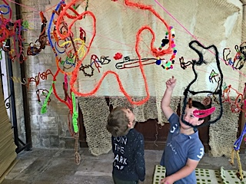
This was last year’s project with Edwina. We are looking forward to working with her again in June.

Slide 9
In our Early Years outdoor garden area we have a water butt to collect rainwater and a compost bin.

Slide 10
A teacher brought in some spare strawberry plants she had grown at home. We used recycled plastic milk bottles to make planters for them to hang on the railings.

Slide 11
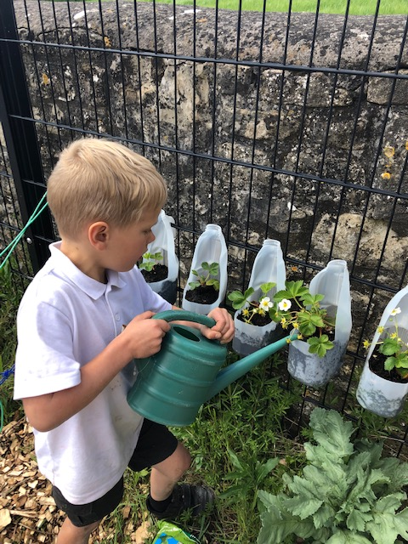
We water them with our recycled water

Slide 12
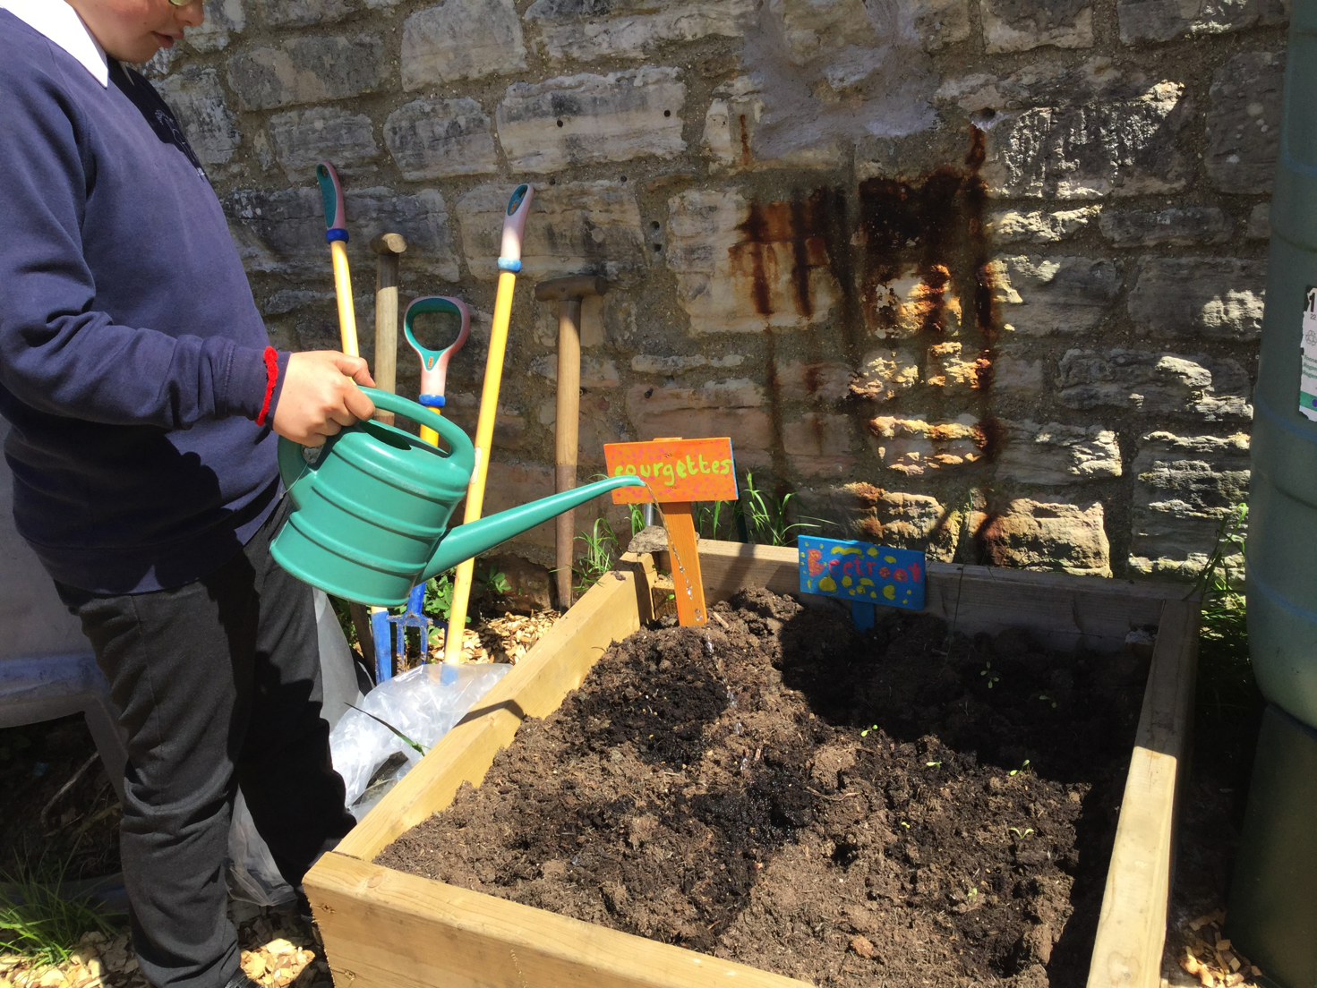
We have planted lots of seeds and we are waiting for them to grow!

Slide 13
We use recycled wood and bark chips from a garden business to make a safe surface to play on. We have just had a delivery !

Slide 14
Thank you for listening!

