Slide 1
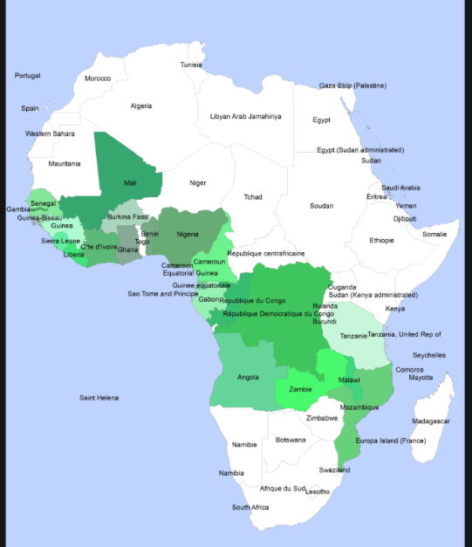
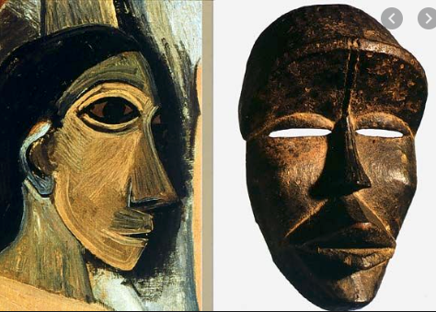
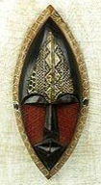
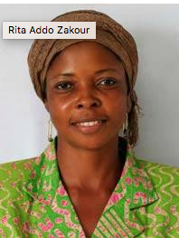
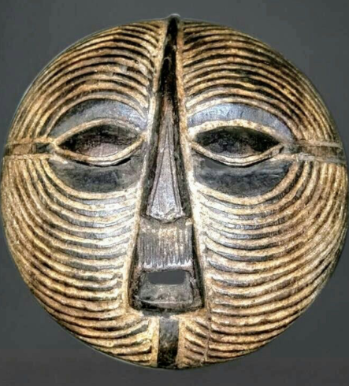
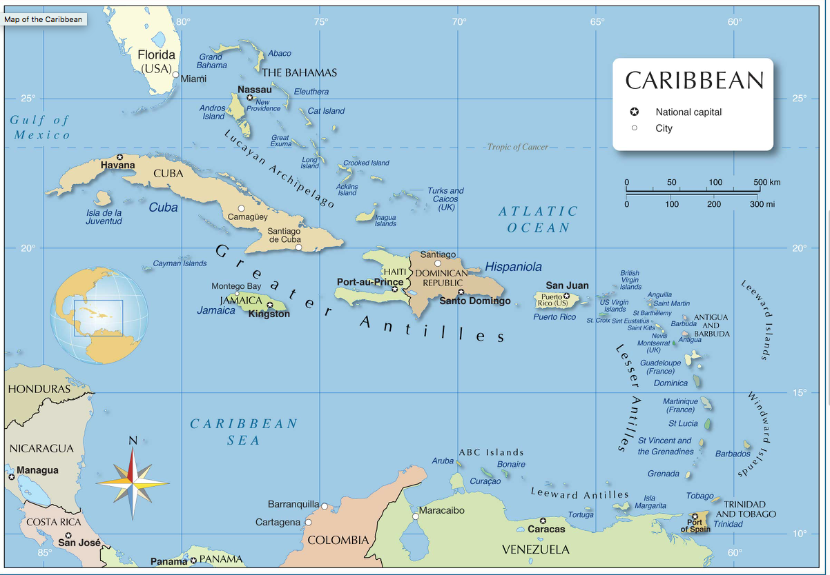
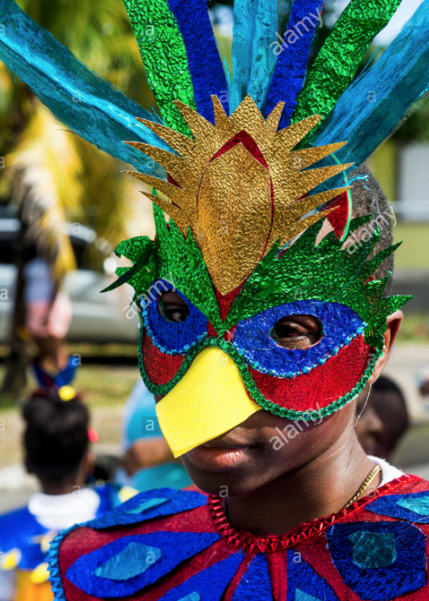
Week 2 Art & Design - Masks from Africa and the Caribbean
We will be learning about the history of masks in Africa, their different appearances, uses and significance and how the masks vary according to the African country they come from.
We will look at examples of African mask designs from the past and learn how the masks influenced artists in Europe in the early 1900’s, in particular Pablo Picasso.
We will learn about the life and work of a contemporary African artist Rita Addo Zakour, from Ghana. We will learn about the masks she makes and sells globally.
We will then learn about how the descendants of African slaves forcibly taken from Africa to the Caribbean developed a tradition of creating masks to use in Carnival celebrations.
We will design and create our own masks developing the following skills:
Drawing – using a variety of different pencils and mark making techniques
Designing – creating original pieces that are influenced by studying the work of others
Exploring and Developing our ideas and Annotating our work
Painting - mixing colours and choosing colours to create mood.
Collage – naming, selecting and arranging materials, experimenting with media and processes

Slide 2
Lesson 2 : LO Create original work influenced by artists and designers from different cultures
LO Develop paper collage techniques
What did we learn about African masks last week? What were they used for? How did they differ? Can you describe some the examples we saw? Which European artist was influenced by African masks? Where did he see them? What drawing technique did he use when creating his faces?
Discuss ideas in pairs and then feedback.
In different African cultures, masks traditionally had spiritual, cultural and religious meaning and were used in dances, social and religious events. People who created and wore the masks had a special status. Over the past 100 years there have been some changes Why do you think this is?
In the past particularly, mask-making was an art that was passed on from father to son, along with the knowledge of the symbolic meanings conveyed by these masks.
How is it made? The Making of African Masks
Which skills did you see being demonstrated?
This video was made by a company called Novica who sell art all over the world.
https://www.novica.com/masks/west-africa/ Novica are a fair trade company and are partnered with UNICEF

Slide 3
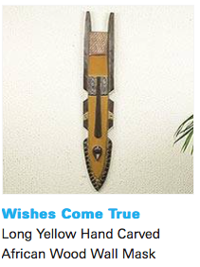
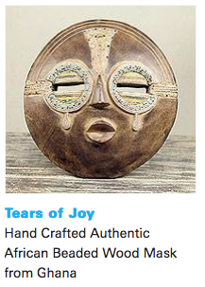
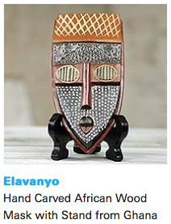
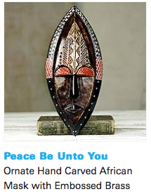
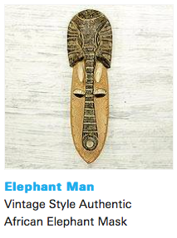
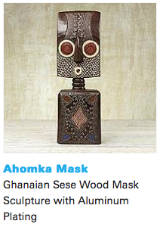
In particular we are looking at the masks made by Rita Addo Zakour
Handcrafted Artwork from Rita Addo Zakour | Unicef UK Market
As times have changed the traditional art of mask-making is no longer such a privileged, status related practice for men only. African masks are now mass produced, taking ideas from traditional masks from different geographical and cultural African areas. They are produced for the tourist market and sold globally to decorate homes, schools and other buildings. Rita employs local craftsmen and women and her masks combine ideas from different African styles. You can read more about the work of UNICEF by clicking the ‘about’ tab at the top of the web page
Rita’s masks are not generally used in dances or ceremonies but her titles often reflect her positive values.
Can you also spot some hatching and cross hatching in her work?

Slide 4
Today we are going to create a mask design using paper collage techniques.
Firstly select your basic shape of paper and draw an outline shape filling the page. For example to draw a round face shape will need a square sheet of paper to work on. If you are designing a tall mask shape make sure you use the height of the paper but you will not necessarily need the full width if it is a tall and thin design such as the plank masks we looked at last week or some of Rita Addo Zakour’s masks.
Is your design based on a human face or animal muzzle? Does it combine different animals? What values does your mask portray? What does it signify?
Cut out your basic shape carefully and then start to select and arrange paper materials, cutting pieces and overlapping if necessary to create your face.
Stick to a limited colour palette of 2 or 3 colours at least initially.
Do not stick anything down until you have decided on a basic layout - experiment with different options. You can refer to your design from last week and also to the examples of Rita Addo Zakour.
Once you are happy with your design you can start to stick the pieces down carefully and add details.

