Slide 1
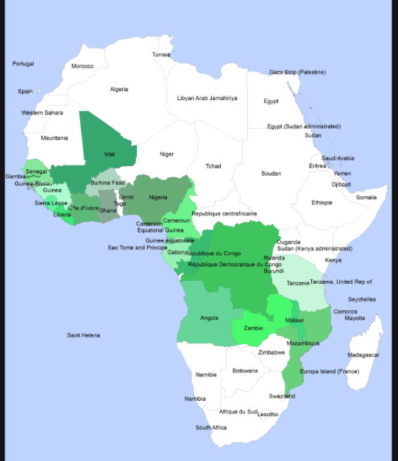
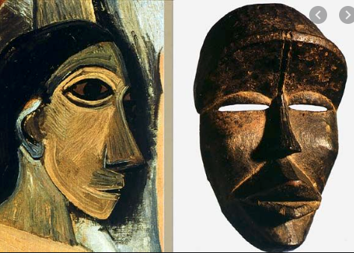
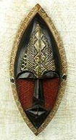
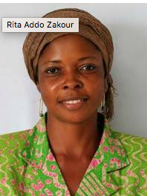
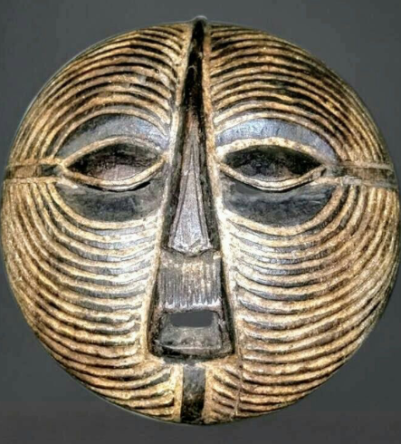
Week 3 Art & Design - Masks from Africa and the Caribbean
We have have been learning about the history of masks in Africa, their different appearances, uses and significance and how the masks vary according to the African country they come from.
We have looked at examples of African mask designs from the past and learn how the masks influenced artists in Europe in the early 1900’s, in particular Pablo Picasso and the Cubists.
We have learnt about the life and work of a contemporary African artist Rita Addo Zakour, from Ghana. We will learn about the masks she makes and sells globally in partnership with Fair Trade, UNICEF and Novica.
We have designed and created our own masks developing the following skills:
Drawing – using a variety of different pencils and mark making techniques
Designing – creating original pieces that are influenced by studying the work of others
Exploring and Developing our ideas and Annotating our work
Collage – naming, selecting and arranging materials, experimenting with media and processes

Slide 2
Lesson 3 : LO Create original work influenced by artists and designers from different cultures
LO Further develop collage techniques using a variety of textures and materials
What does the word contemporary mean? What did we learn about contemporary African masks last week? Discuss ideas in pairs and then feedback.
Recap: As times have changed the traditional art of mask-making is no longer such a privileged, status related practice for men only. African masks are now mass produced, taking ideas from traditional masks from different geographical and cultural African areas. Many of the traditional dances and ceremonies involving masks no longer happen. Many masks today are produced for the tourist market and sold globally (through Fair Trade companies such as UNICEF and NOVICA) to decorate homes, schools and other buildings. Artists such as Rita Addo Zakour employ local craftsmen and women and her masks combine ideas from different African styles. Rita’s masks are not generally used in dances or ceremonies but her titles often reflect her positive values.
Do you remember what Rita Addo Zakour has been able to afford to do because she can now sell her masks at a fair price?
If you buy Rita’s work through UNICEF who else can benefit?
Discuss and Feedback

Slide 3
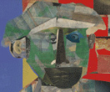
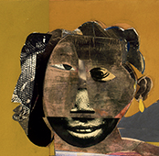
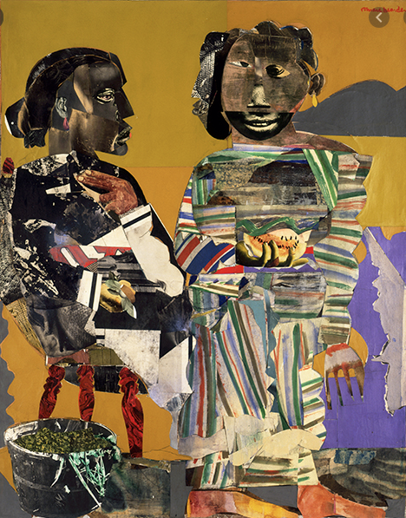
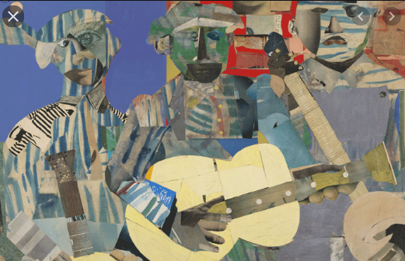
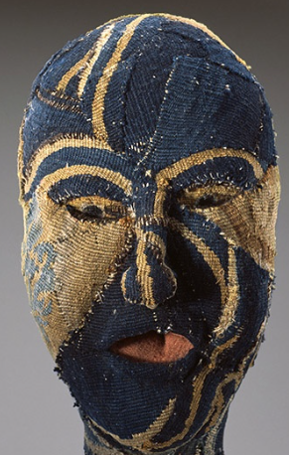
Collage using recycled paper and cardboard and other materials is a technique that has been used by many artists
Many artists in the 20th Century were influenced by African art and masks in particular. We have learnt how African Masks influenced the Cubists and Pablo Picasso.
African-American Artist Romare Bearden was particularly famous for his collage work and was influenced by art from Africa and also by Picasso. He was also active in the Civil Rights Movement in Harlem in the 1960s The New York Times described Bearden as “the nation’s foremost collagist” in his 1988 obituary. romare bearden collage follow link to see more of his collage work
Louise Bourgeois a French artist was influenced by all these.
Louise Bourgeois Mask
Romane Beardon Collages

Slide 4
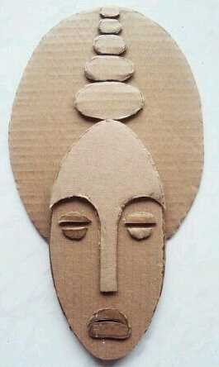
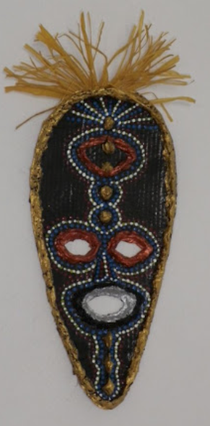
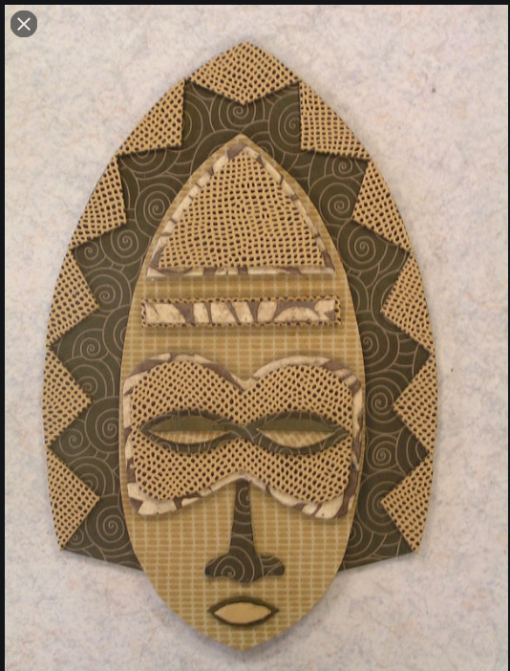
Some mask collage examples

Slide 5
Today we are going to create a mask design using card collage techniques. We will also add a variety of recycled materials.
Our design will build on your work from the previous two weeks and can also draw from the work of the artists and artisans we have looked at.
Firstly select your basic shape of card and draw an outline shape that touches the top, bottom and and sides of the card at at least one point. To create a round face shape will need a square sheet of card to work on. If you are designing a tall mask shape make sure you use the full height of the card for a tall and thin design such as the plank masks we looked at last week or some of Rita Addo Zakour’s masks.
Is your design based on a human face or animal muzzle? Does it combine different animals? What values does your mask portray? What do the different features signify?
Cut out your basic shape carefully and then start to select and arrange materials starting with eye, nose and mouth features, cutting pieces and overlapping if necessary to create your face. Make sure you choose a contrasting and varied selection of textures and materials DO NOT START GLUING OR STICKING until you are sure you are happy with your design. You can experiment with different ways of arranging materials until you are happy.
Once you are happy with your design you can start to stick the pieces down carefully and add decorative details.

