Slide 1
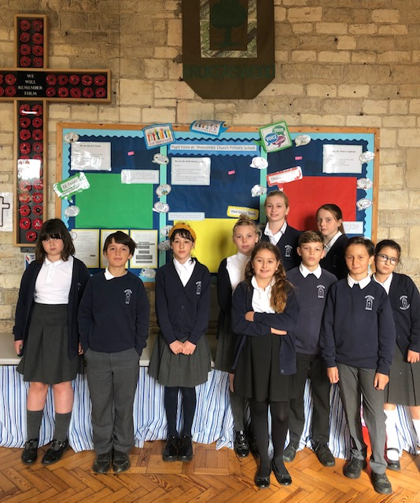
Pupil Voice at Shoscombe - Respect, Re-Use, Recycle
We have new Pupil Voice teams at school. We promote our school values and lead other pupils in having a say and making decisions on issues such as Recycling and Respect for others.
Because of Covid we cannot photograph all the team members from different classes together. We are the team leaders from Year 5 and 6 (Sycamore Class).
You might recognise 2 pupils who travelled to Belfast in March. Two of us should also have travelled to Barcelona in June but we sadly had to miss our trip because of Covid 19.
You will be able to talk to us live next Friday and ask us lots of questions about what we do as team leaders.

Slide 2
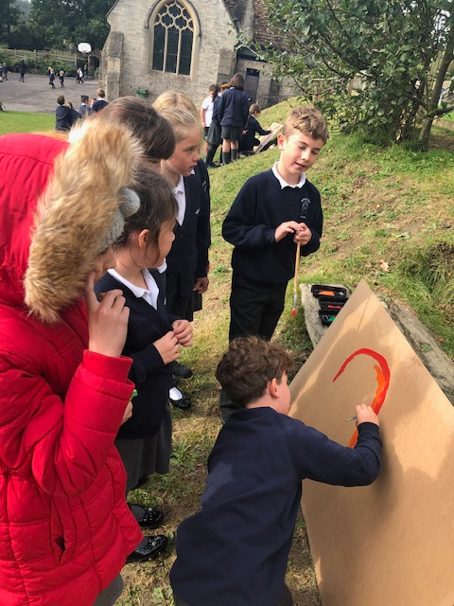
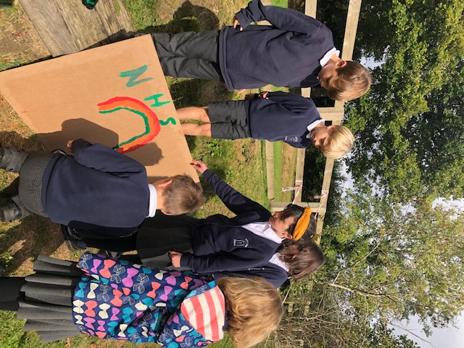
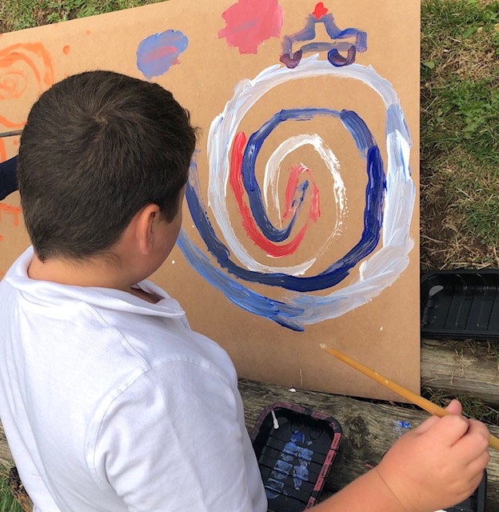
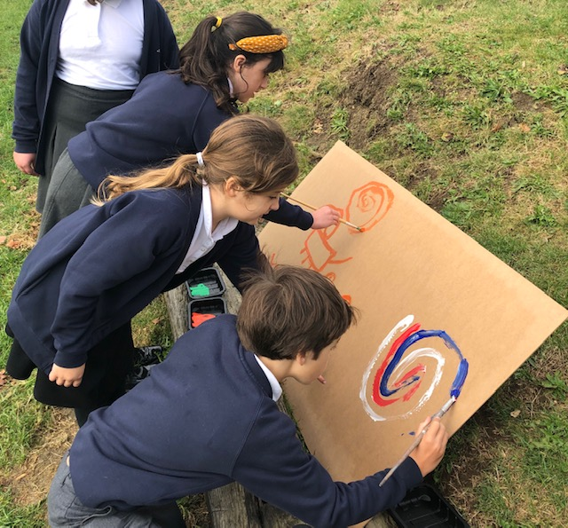
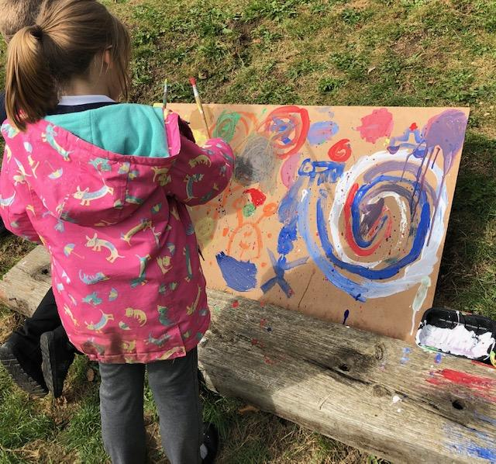
The Well Being Leaders
We love art and we help to decide what art we do in school. We wanted to be able to paint outside at playtime and we want to choose what to paint. Some of us like Graffiti art. We have just started leading this new activity.
We lead others to think about Erasmus aims.
We are painting on Recycled boards that came from Scrapstore. We will keep the boards and re paint over the designs to make new designs. That is Re-using.
The only rule is not to paint anything rude or unkind. We show Respect.
We lead the activity. We set it all up and tidy it away and make sure anyone who wants a turn can.

Slide 3
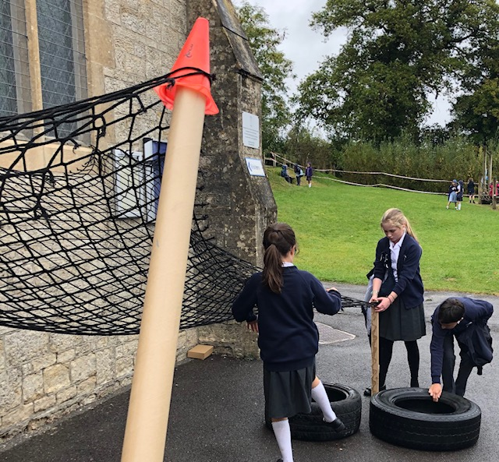
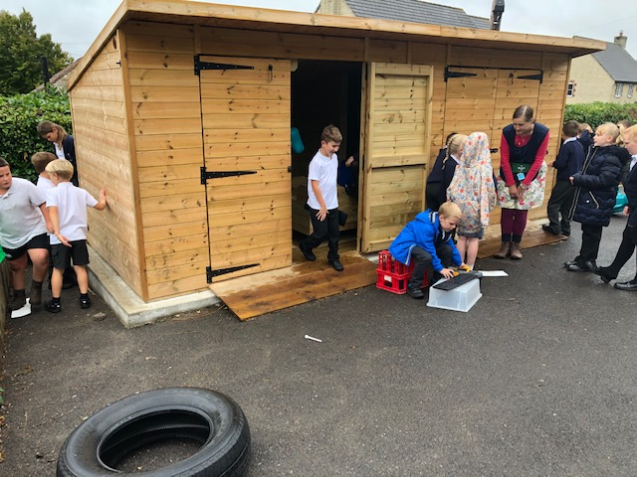
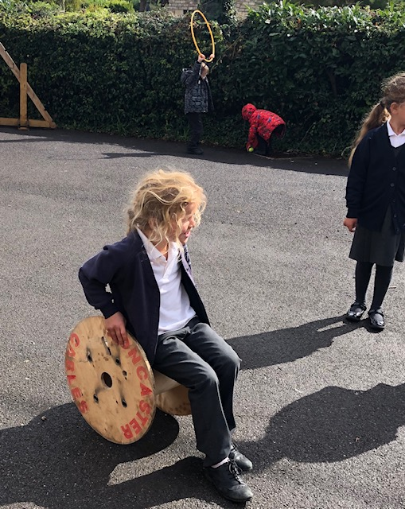
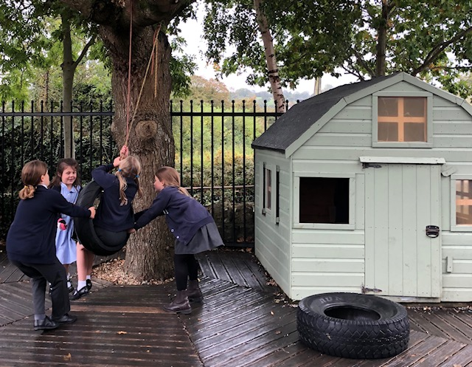
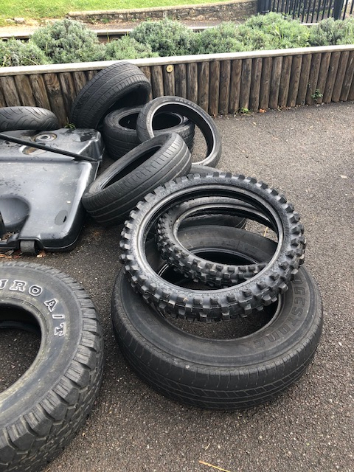
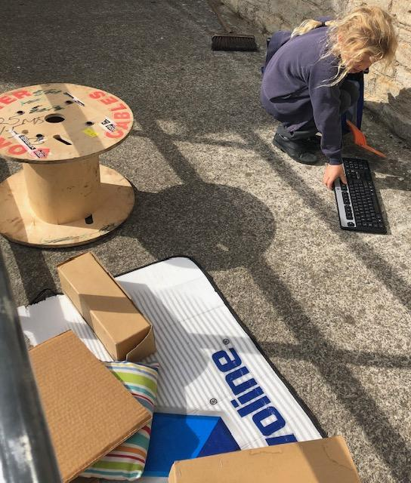
The Team Leaders
We promote and lead OPAL play at Shoscombe. Our school is an OPAL school you can find out more about this here. Outdoor Play and Learning At playtimes all children can select materials from our OPAL shed. All the materials are Recycled or Re-used. They come from local Scrapstores Home - Scrap Store Children's Scrapstore or are donated by local businesses or parents. We can do what we want to with the materials as long as we are kind to others. We are creative and we assess our own risks. We are all responsible for making sure everything that needs to be put away goes back in the shed. We do surveys to find out what else children might want to do at playtime, what is going well and what could be improved.

Slide 4
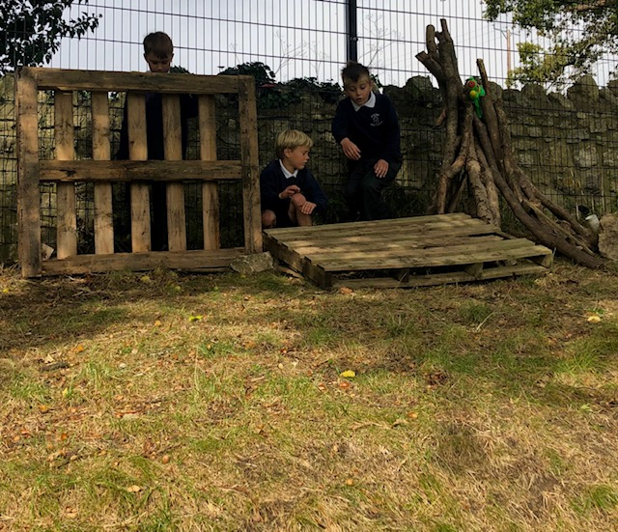
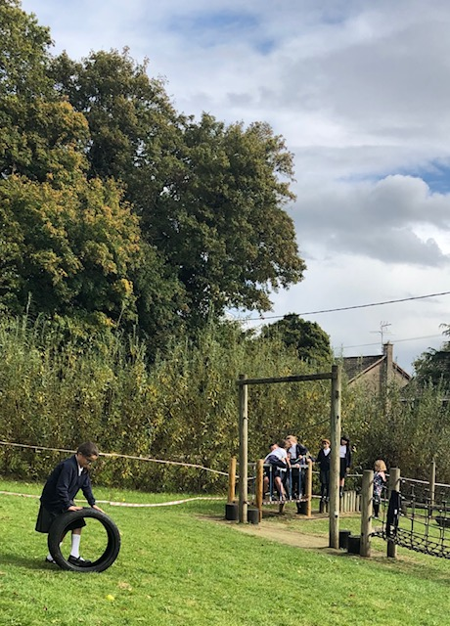
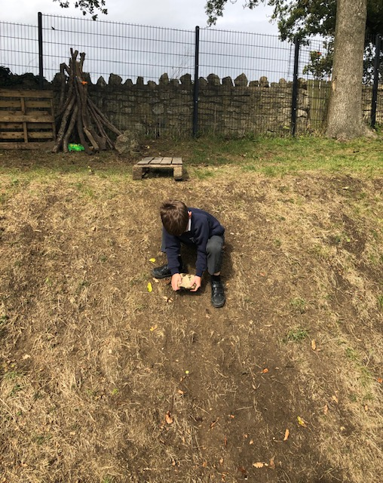
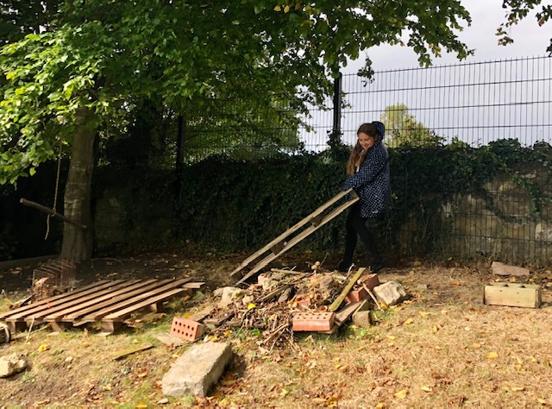
OPAL Play and Forest School
We are very creative! This term our school value is Creativity.
We manage our own risks. We work things out. We have fun!
During OPAL playtimes we can also use some of our Forest School materials (all recycled , re-used or natural materials ) and some areas of our Forest School.

