Slide 1
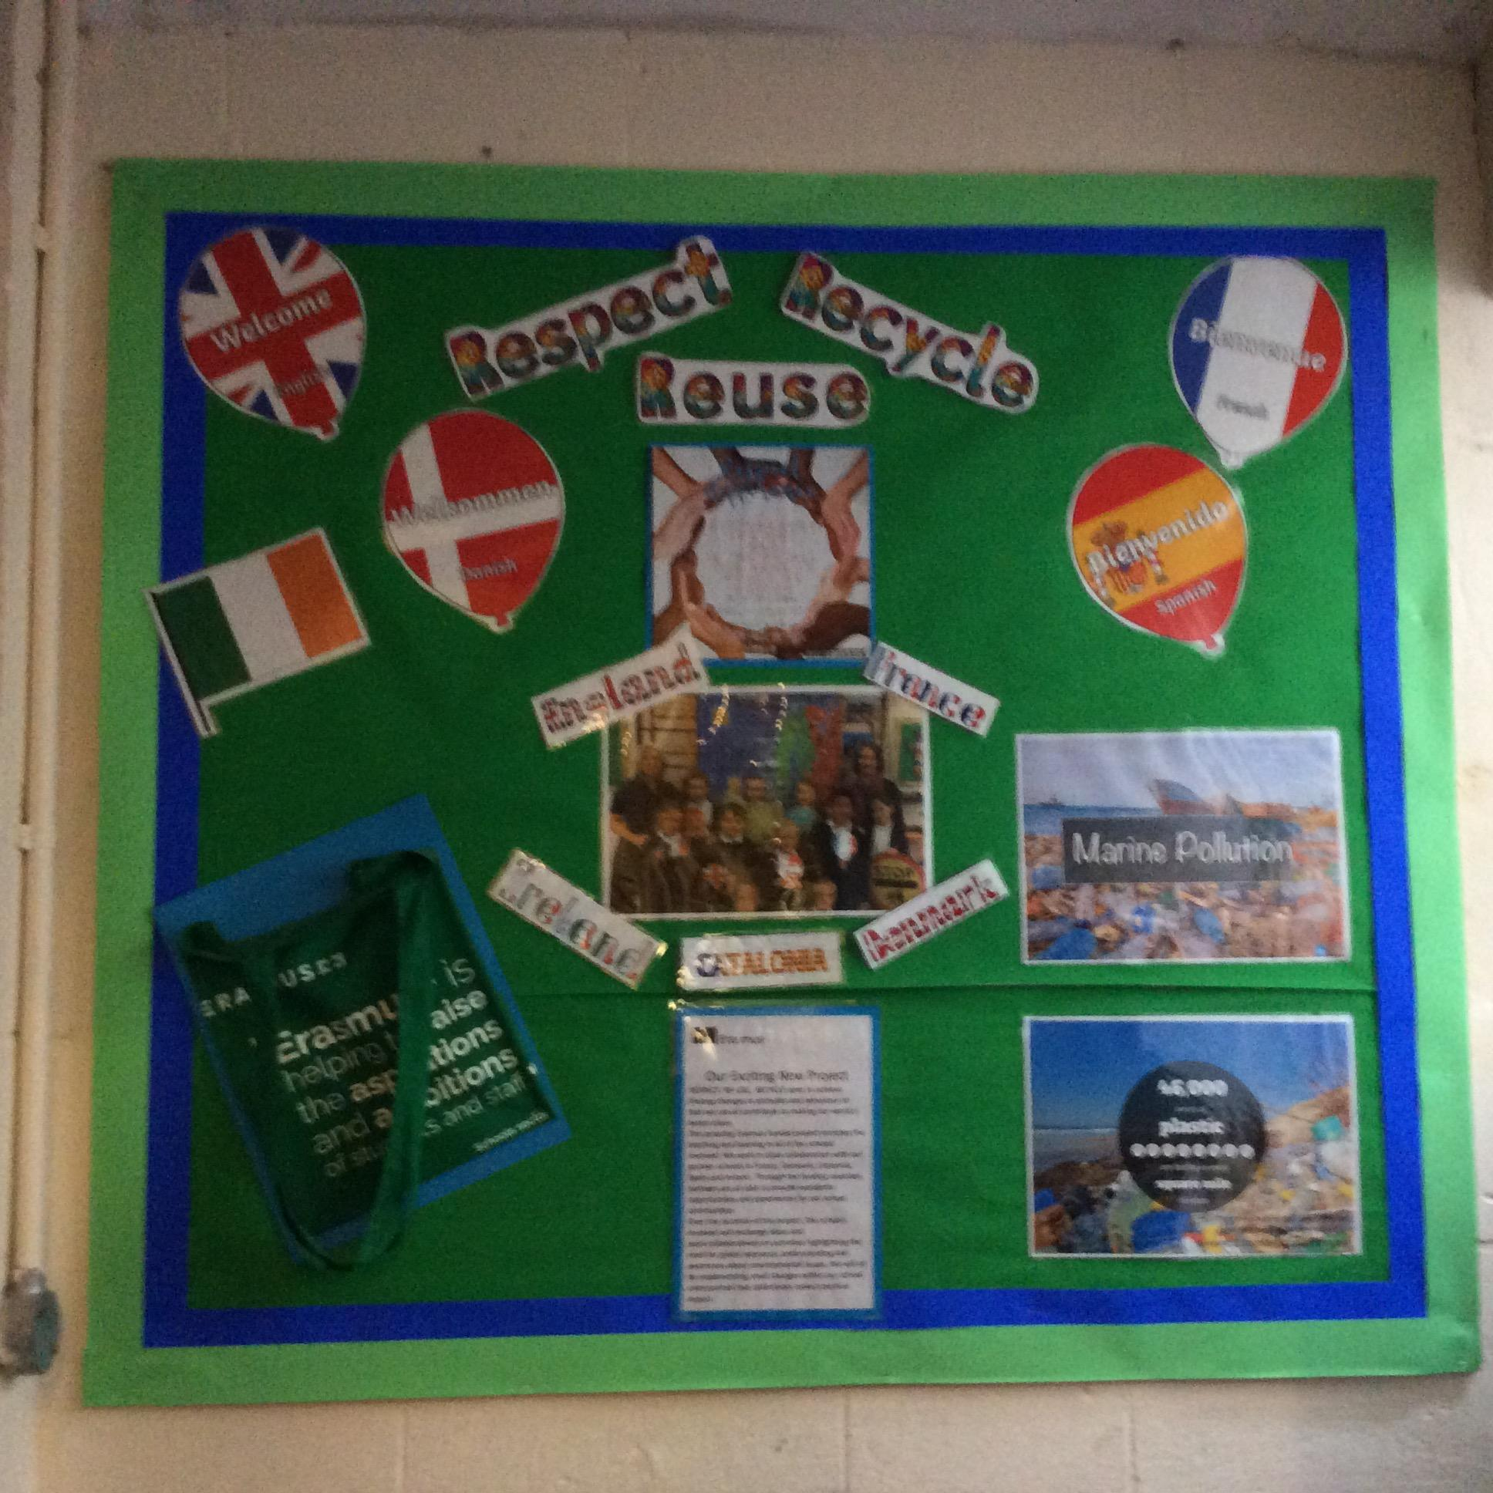
Respect,Reuse,Recycle
Created by:St Julians Erasmus project

Slide 2
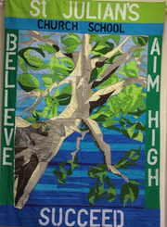
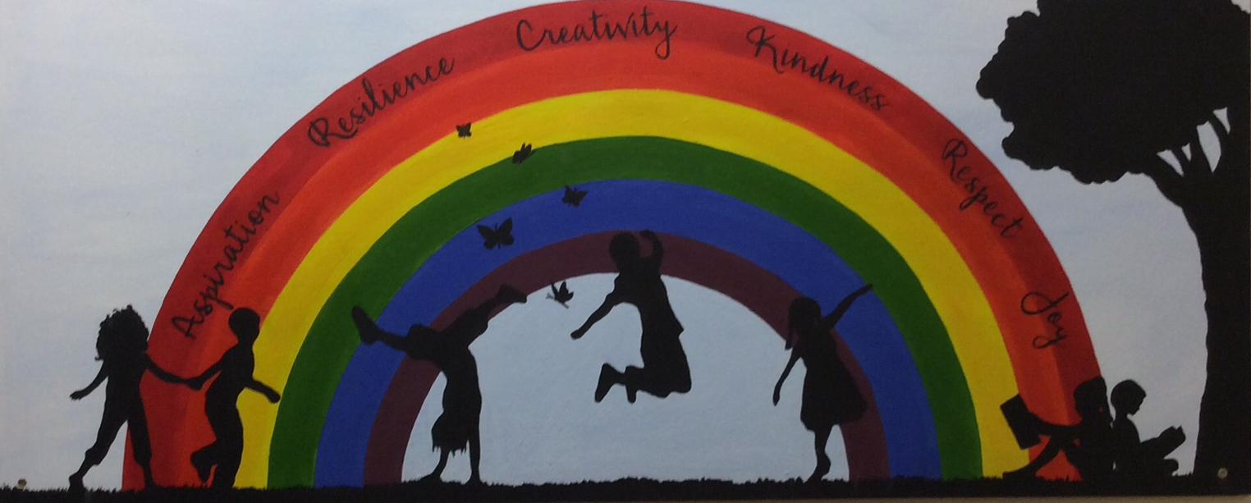
Our school:St Julian’s
We try to make our school a happy and enjoyable environment for everyone in it. We do this by respecting the teachers and our fellow pupils and we do this with everyone of different religions and faiths;--- we don’t treat anyone differently because of this.There are 111 children and 71 families.

Slide 3
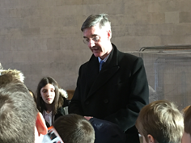
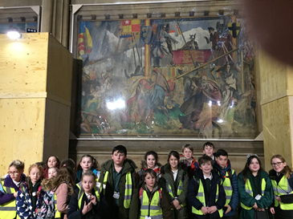
British Values
Democracy.
The rule of law.
Individual liberty.
Mutual respect.
Tolerance of those of different faiths and beliefs.
At St. Julian’s we consider these Values very important and we learn about them in lessons and put them into practise. We have learnt about Democracy and Rule of Law first-hand by visiting the Houses of Parliament and have spoken to our local MP there and raised our concerns verbally, and through letters, about environmental issues.

Slide 4
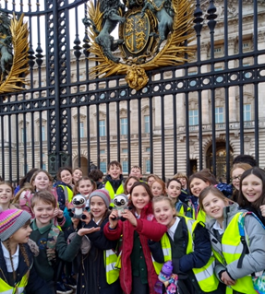
The Monarchy
The United Kingdom has a Monarchy which means the King or Queen is the Head of the country. Queen Elizabeth 2 is our current Queen and is the longest ever serving monarch. She is a ‘Constitutional Monarch’ which means she has no political power- Parliament does.
We went to see Buckingham Palace where the Queen lives when in London and Zig and Zag were excited to see the flag flying, as it meant the Queen was home!

Slide 5
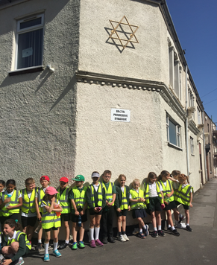
Respecting Others faiths and beliefs.
No matter what your religion or beliefs are, we’ll respect you.We should always respect everyone no matter what they look like or what belief they have. In R.E (Religious Education) we have been learning about Judaism and we will be learning about Hinduism soon.
We have visited a Jewish synagogue and are planning a visit to a Hindu temple. We held a Sikh ‘langar meal’ and shared all the workload, as we learnt that Sikhs respect everyone equally, and this is what we aspire to do.
Learning about other cultures and belief systems is important as it helps us understand life practises that are different to ours and with understanding, comes respect. Mutual respect and tolerance are two of the British Values as well.

Slide 6
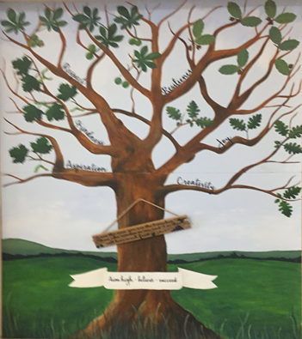
Christian Values-
Respect
Although ‘Respect’ is a value for everyone, it is also one of our focus Christian Values. As a Christian school, we look at these Values from a Christian point of view. Our other focus Values are; Creativity, Aspiration, Kindness, Joy and Resilience and these help us to try and live good lives.
The Erasmus Project helps us to learn about other people and definitely helps us to show these Values!
The Student voice is respected in our school. We have an Equalities and Ethos team who make sure everyone has a happy time in school. We also have a School Council who listen to what children want in school, and then put these ideas forward to staff.

Slide 7
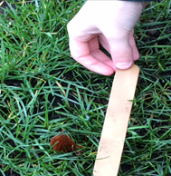
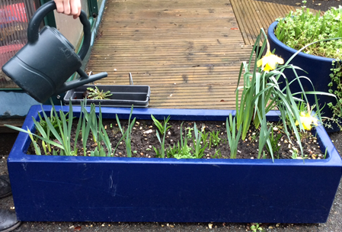
Respecting our environment
We like to grow vegetables and fruit and we have a big garden. We all take turns to help with gardening and watering. It helps us to learn about being healthy and to respect our health.
We grow flowers to make our school a pleasant place to be and we regularly litter pick to ensure any mess is cleared up.

Slide 8
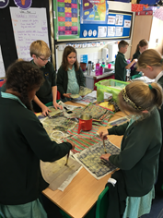
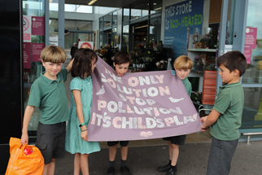
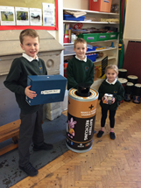
Respecting our environment by reusing and recycling
In our school we take recycling quite seriously.We have a recycled pen box and we reuse almost everything we can. Even though we are a small school, we know if we all try our hardest to stop the problem of plastic, we will make a huge difference to our world.
We made sea creatures out of chicken wire and old recycled materials including plastic to show our respect. We made it because unfortunately, some sea creatures are eating plastic and dying.
Beech Class made wax wrappers for sandwiches to promote an alternative to plastic sandwich bags.
We have campaigned against plastic pollution by letter and some of us protested outside a supermarket!

Slide 9
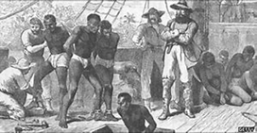
Mutual Respect and Human Rights
In our ‘Jigsaw’ programme we learn about respect for differences- whether these are physical, racial, religious or ability.
We also try and learn about times when these have been ignored so we can realise right and wrong.
We went to Bristol to learn about the Slave Trade as Bristol was one of the main cities for slave trade. We learnt about how badly slaves were treated.
We learn about our rights as a child- and how we can ensure we are treated with respect. For example we have anti-bullying days and Internet safety days where we learn how to deal with potential problems.

Slide 10
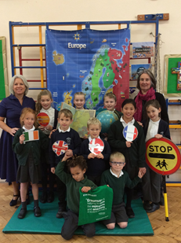
Thank You Erasmus!
We are very grateful to Erasmus and our partner schools, for this opportunity to be together to respect our different countries and cultures.
We hope that we can continue to work together as schools as we believe respect comes from knowledge.
Children have a big part to play in saving our planet so we hope we all continue to work towards this goal.

