Slide 1
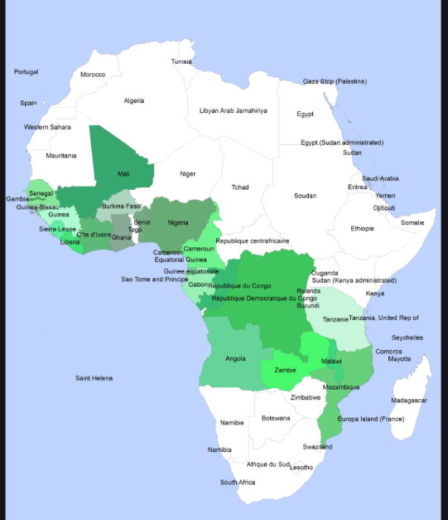
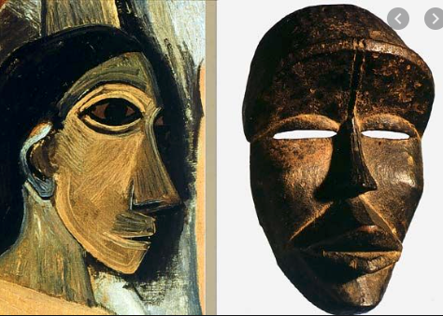
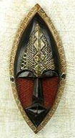
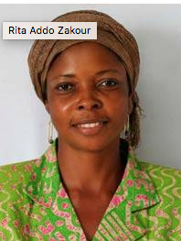
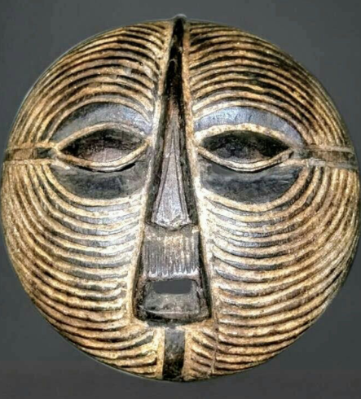
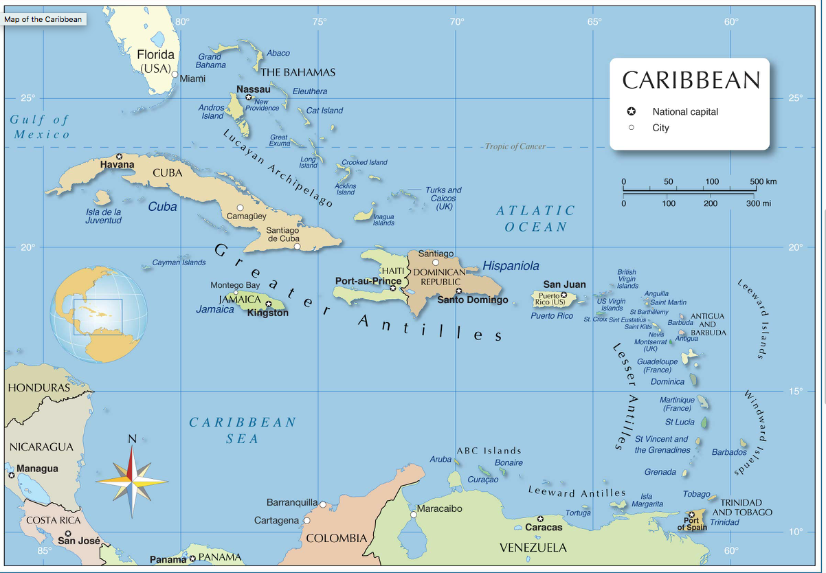
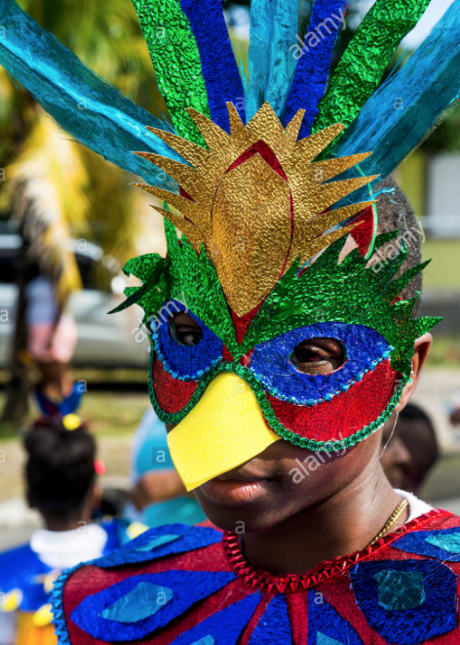
Art & Design - Masks from Africa and the Caribbean
We will be learning about the history of masks in Africa, their different appearances, uses and significance and how the masks vary according to the African country they come from.
We will look at examples of African mask designs from the past and learn how the masks influenced artists in Europe in the early 1900’s, in particular Pablo Picasso.
We will learn about the life and work of a contemporary African artist Rita Addo Zakour, from Ghana. We will learn about the masks she makes and sells globally.
We will then learn about how the descendants of African slaves forcibly taken from Africa to the Caribbean developed a tradition of creating masks to use in Carnival celebrations.
We will design and create our own masks developing the following skills:
Drawing – using a variety of different pencils and making marks techniques
Designing – creating original pieces that are influenced by studying the work of others
Exploring and Developing our ideas and Annotating our work
Painting - mixing colours and choosing colours to create mood.
Collage – naming, selecting and arranging materials, experimenting with media and processes

Slide 2
Lesson 1 : LO Create original work applying techniques used by notable artists.
LO Show tone and texture using hatching and cross hatching with different grades of pencil.
What are masks for? Discuss ideas in pairs and then feedback.
Watch video of huge variety of African masks https://www.youtube.com/watch?v=Xld_kRCuGhY Stop at 4m 38s or earlier.
In African cultures, masks traditionally have spiritual, cultural and religious meaning. Masks are used in dances, social and religious events. People who create and wear the masks have a special status. Why do you think this is? In the past particularly, mask-making was an art that was passed on from father to son, along with the knowledge of the symbolic meanings conveyed by these masks.
In most traditional African cultures, the person who wears a mask temporarily ‘loses’ his or her human life and turns into the spirit represented by the mask itself. This transformation also includes certain types of music, dance and costumes that contribute to the shedding of the mask-wearer's human identity. People believe that the mask wearer becomes able to speak to the spirits of ancestors or animals.
Masked dances are a part of many traditional African events. In African cultures, masks are not playthings or decorations. They serve an important role in rituals or ceremonies such as funerals, weddings or initiation (such as becoming an adult). They are also used in ceremonies to ensure a good harvest, or address tribal needs in time of peace or war. Some animal masks are used to ask wild beasts to stay away from a village or to symbolize the animals that are important to a certain family or group.

Slide 3
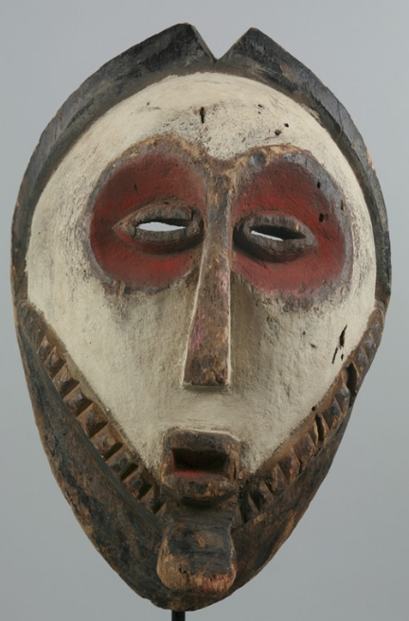
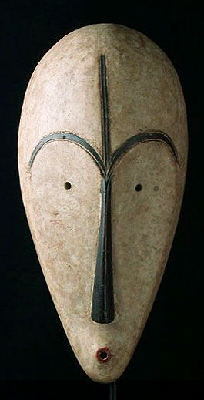
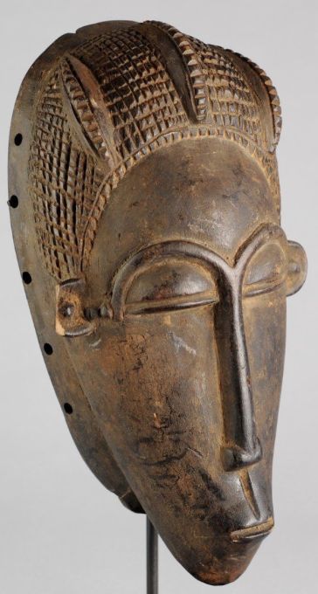
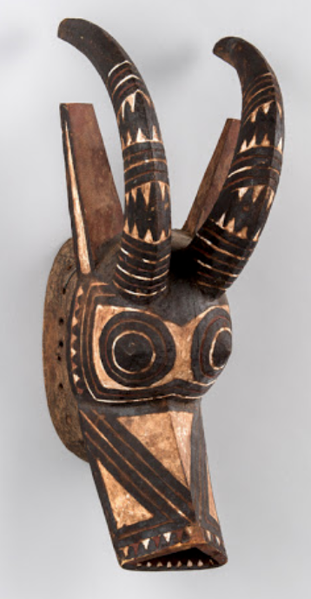
https://www.youtube.com/watch?v=jZz5aRf_g8A Senufo - Ivory Coast Initiation – masked ‘ sacred panther’ dance
https://www.youtube.com/watch?v=DaQuGEndA8k Yoroba - Harvest dance Nigeria
https://www.youtube.com/watch?v=whAY9R-_7ac Dogon mask dance – Mali West Africa
African masks depict a human face or animal muzzle, but are often abstract, rather than realistic, representing it’s spirit. The different patterns on masks have meanings such as the path of the ancestors.
Features of the mask may have different meanings. For example:
Half closed eyes means a peaceful attitude, self control and patience
A large chin and mouth symbolize authority and strength
A small mouth and eyes mean humility
A wide protruding forehead mean wisdom
Round eyes mean alertness
A straight nose means not giving up
Different animal masks depict different virtues
Buffalo masks depict strength
Antelope horns mean a good harvest
Panthers mean agility and speed

Slide 4
Merging different animals in a mask will increase its power – for example it could have antelope horns with crocodile teeth and warthog fangs
Kifwebe masks from the Congo mix zebra stripes, crocodile teeth, chameleon eyes, aardvark mouths, a rooster crest and feathers of owl.
https://www.google.com/search?q=kifwebe+mask&client=safari&rls=en&source=lnms&tbm=isch&sa=X&ved=2ahUKEwirs5fo8szrAhUQXsAKHT0jA1oQ_AUoAXoECA0QAw&biw=1812&bih=919
Many masks depict the ideal of female beauty or ‘mwana pwo’ although they are worn in ceremonies by male dancers.
Many of these masks show scarification and filed teeth which were traditionally considered beautiful.
https://www.google.com/search?q=mwana+pwo&client=safari&rls=en&source=lnms&tbm=isch&sa=X&ved=2ahUKEwi-9eWj88zrAhVNXsAKHcexAwgQ_AUoAXoECA4QAw&biw=1812&bih=919
African masks are usually made from wood, although other metals such as copper or bronze, and different types of fabric can be used. Some masks are painted using ochre or other natural pigments. Decorations such as animal hair, horns, teeth, shells, seeds straw, egg shell, and feathers are sometimes added. Most masks cover the wearer's face. Others are worn on the top of the head such as the plank masks of the Bwa people of Burkina Faso,
bwa plank mask burkina faso

Slide 5
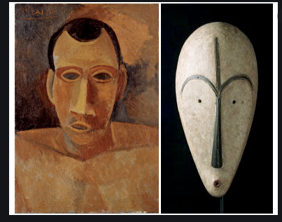
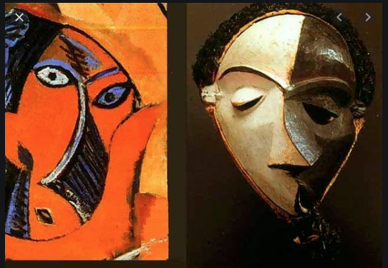
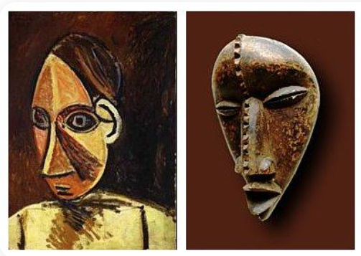
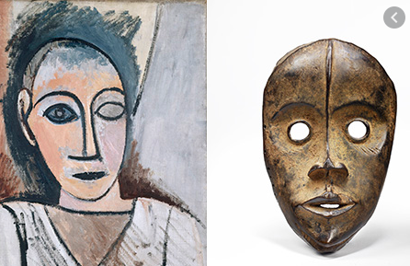
During the forced colonisation of Africa by white Europeans many objects were taken from Africa and placed in museums in Europe. Pablo Picasso saw African masks in the Louvre Museum in Paris in 1907 and his cubist style of drawing and painting became strongly influenced by the abstract geometric features of the masks.

Slide 6
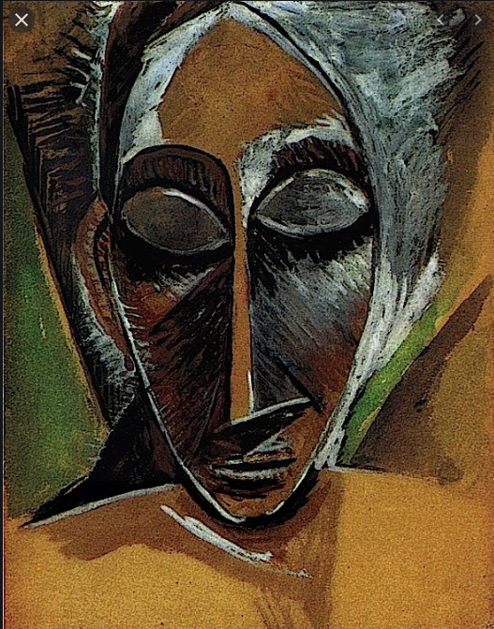
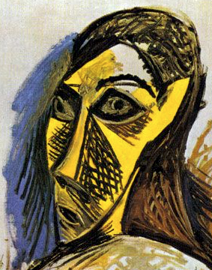
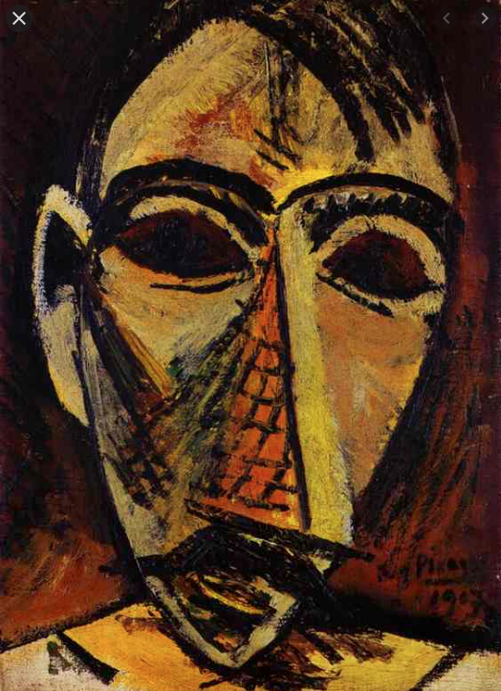
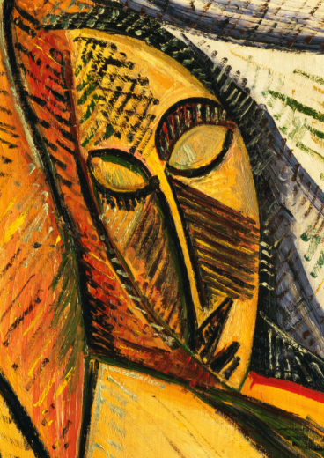
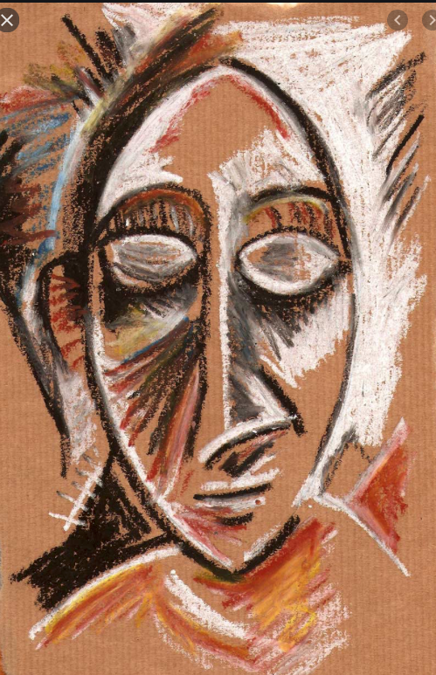
In these drawings and paintings by Pablo Picasso how can you tell that he has been influenced by African masks?
Can you also see how he has used the technique of hatching and cross hatching lines to create tone and texture?

Slide 7
Today we will be sketching some ideas for masks influenced by what we learnt today. We will try out pencils of different hardness and experiment with different examples of mark making.
Spend some time practising some hatching, and cross hatching. Then include these techniques in your mask drawing to create tone and texture.
What shape will your mask be? Draw the outline lightly and carefully on the paper making sure your make your basic shape fit the page well.
Will your mask have a human or animal face? You can decide what the facial features of your mask represent (the shape of the eyes, mouth, nose, forehead, chin). Either using the positive examples we have learnt today - peace, patience, strength, wisdom, alertness, determination. Maybe you could use our school values? How could your mask’s features show aspiration, resilience, joy, or empathy? If you add patterns to your mask what might they represent? Annotate your drawings with some notes.

