Slide 1
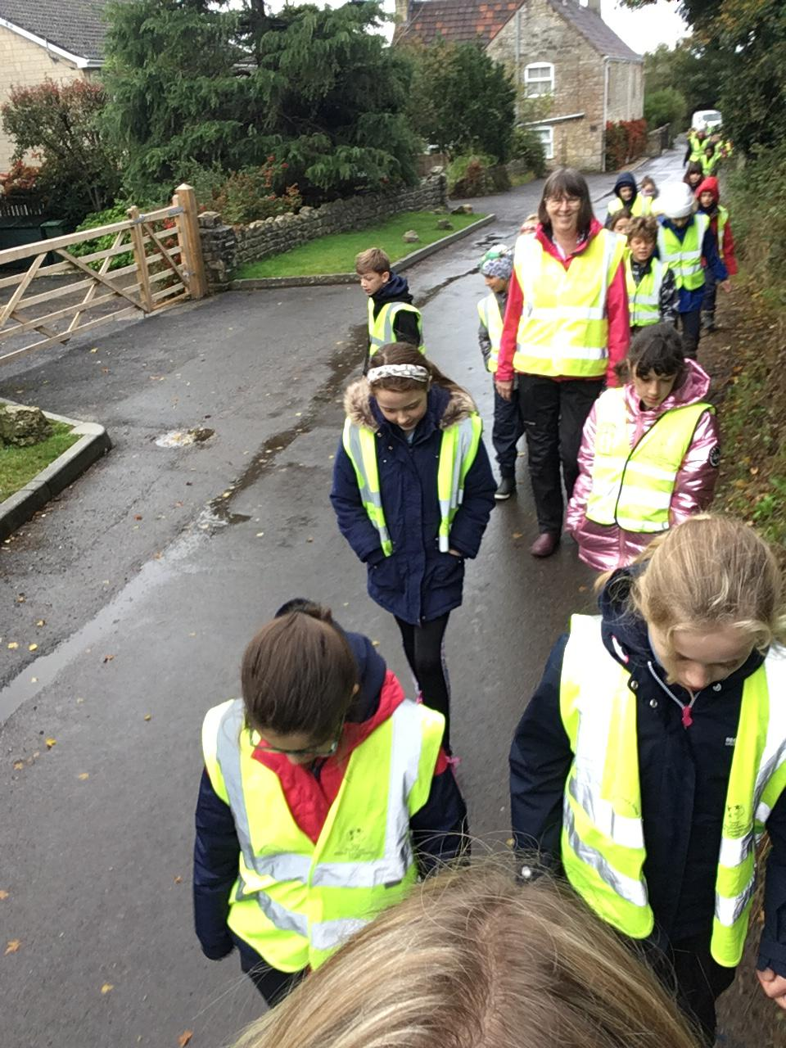
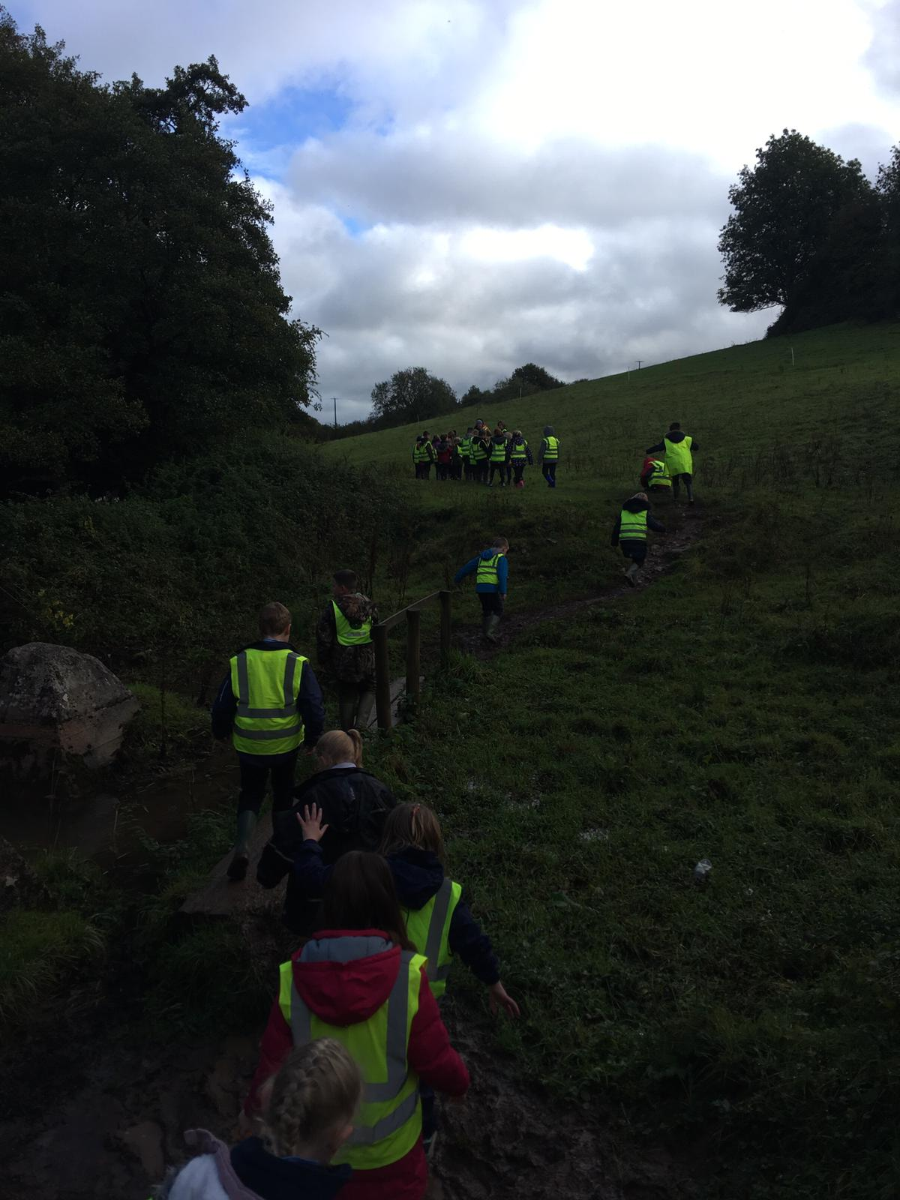
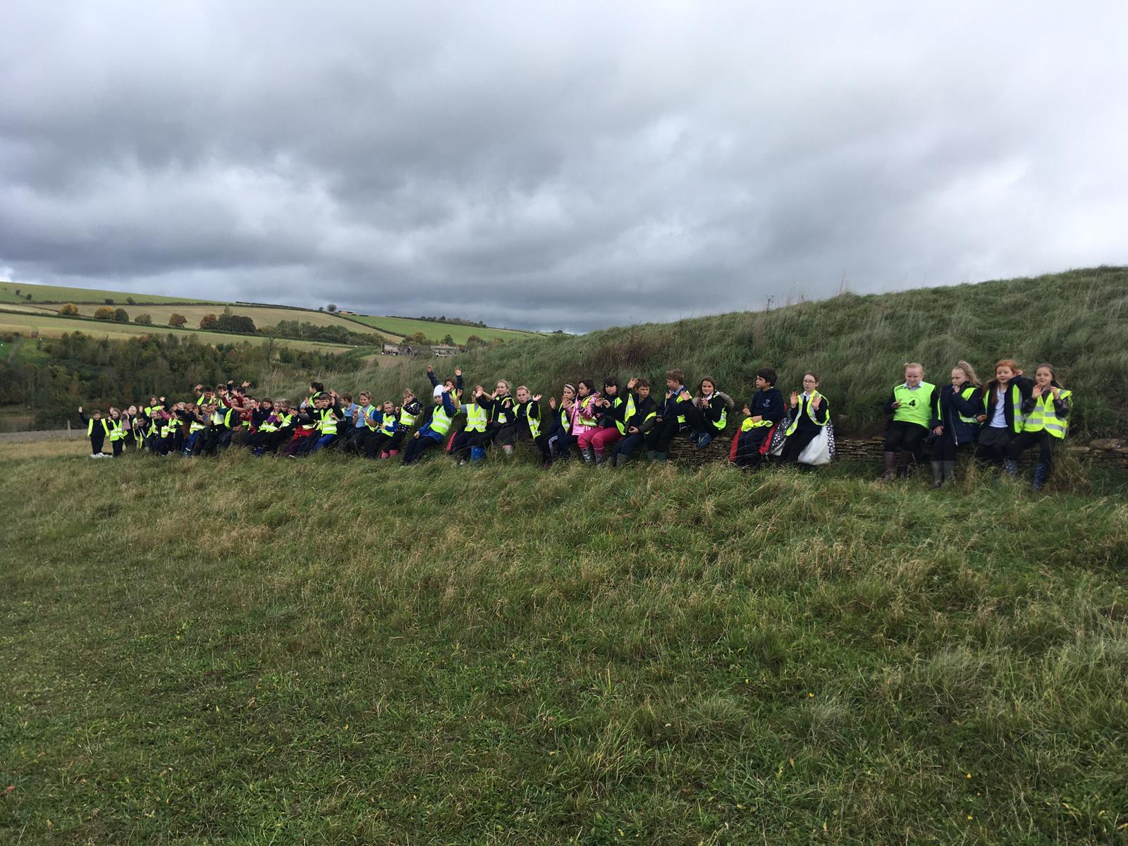
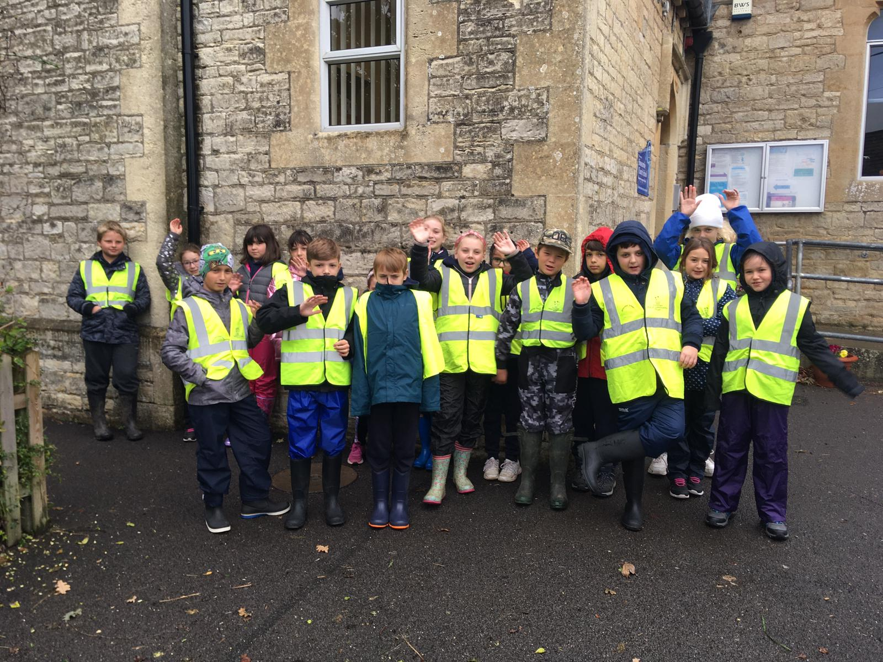
Stoney Littleton Walk Longbarrow Yesterday we all went on a long walk from our school to Stoney Littleton Longbarrow. You can find out all about it here. Stoney Littleton Long Barrow We had a great time despite the rain. We try to do as much learning outdoors as possible especially because of Covid19

