Slide 1
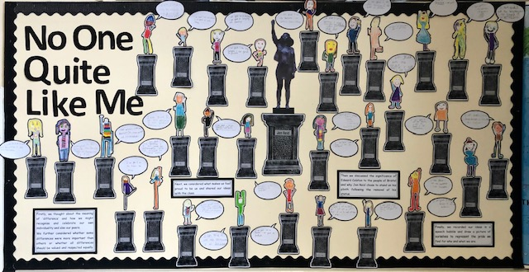
KS2 have been learning about Black History this term

Slide 2
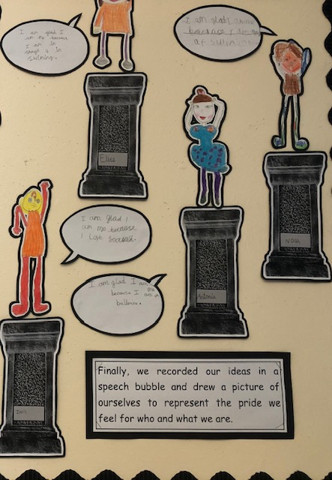
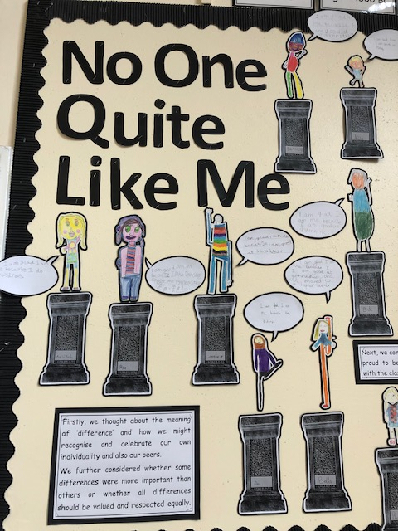
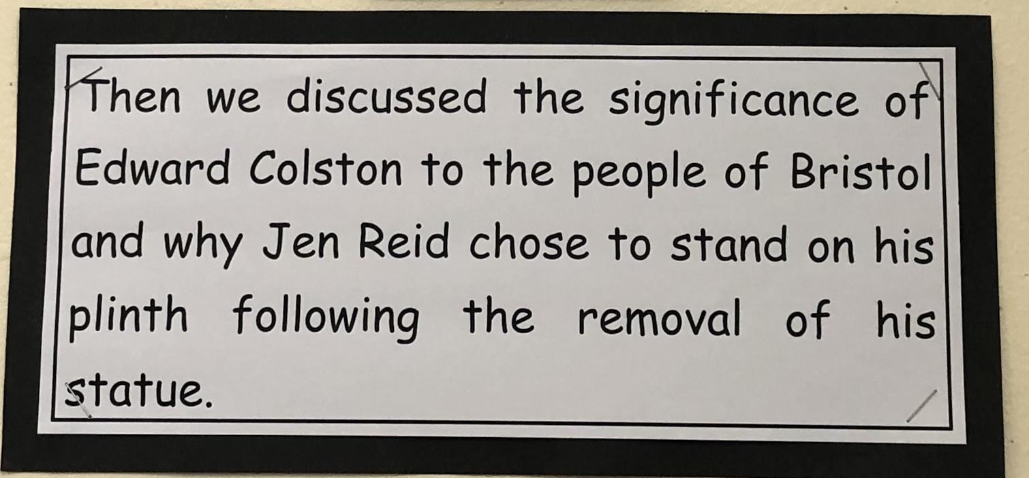
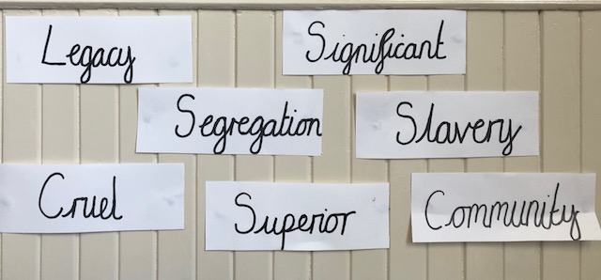
We discussed the meanings of these words

Slide 3
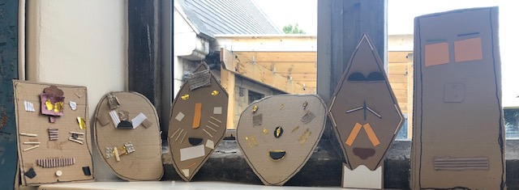
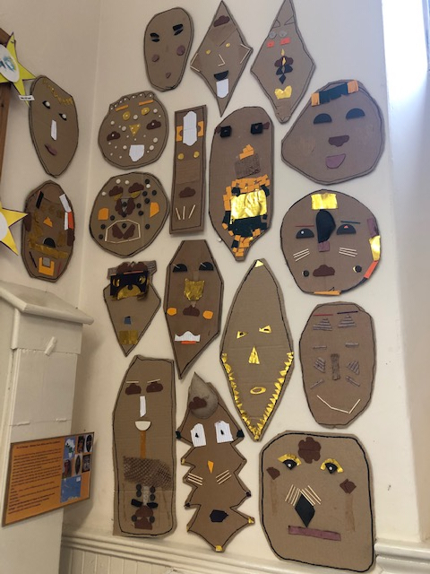
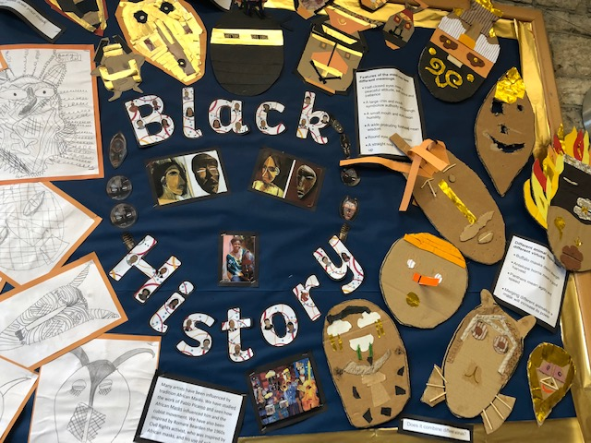
In Art we have been learning about African masks, their meanings and their influence on the art of Picasso and the Cubists, and on the art of African American Civil Rights collage artist Romare Bearden. We have learnt about Rita Addo Zakour a contemporary artist from Ghana, who makes masks and sells them through UNICEF and Novica, Fair Trade partners. We made our own masks using all recycled materials and different drawing and collage techniques.
Our Well Being Leaders will be fundraising to buy one of Rita Addo Zakour’s masks for our school. This supports the work of UNICEF and she will get a Fair Trade price.
Handcrafted Artwork from Rita Addo Zakour | Unicef UK Market
This is a link to Romare Bearden’s amazing work.
romare bearden collage

