Slide 1
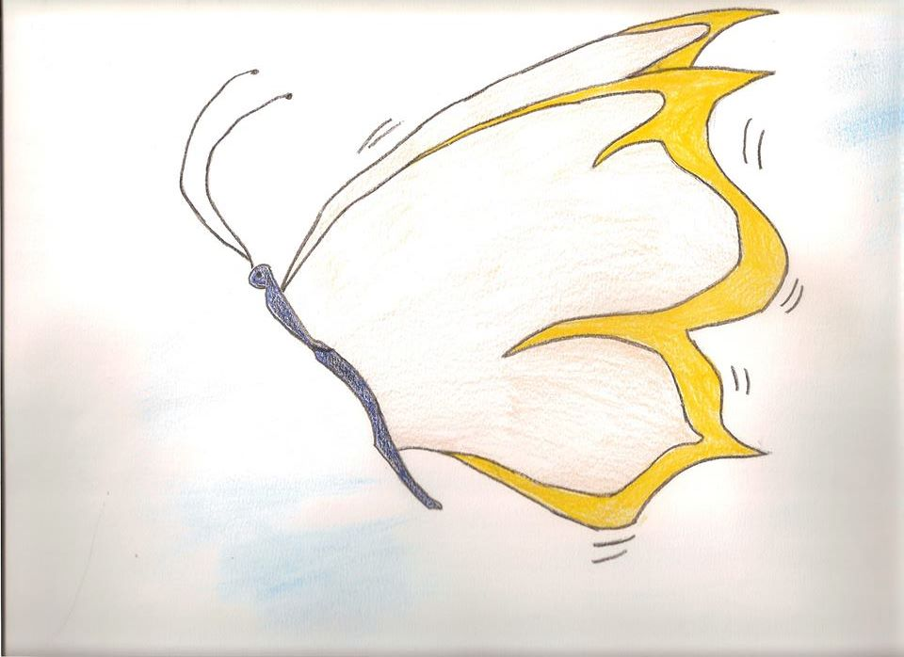
The butterfly with the golden wings La farfalla dalle ali d’oro

Slide 2
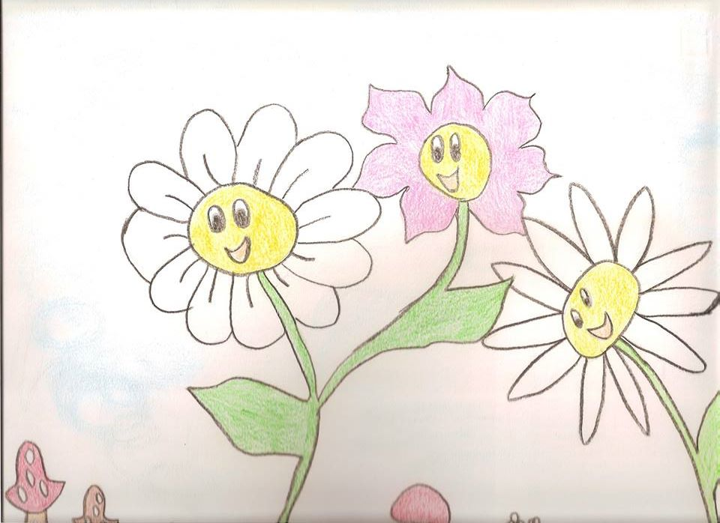
Animals and flowers live happily in the kind garden

Slide 3
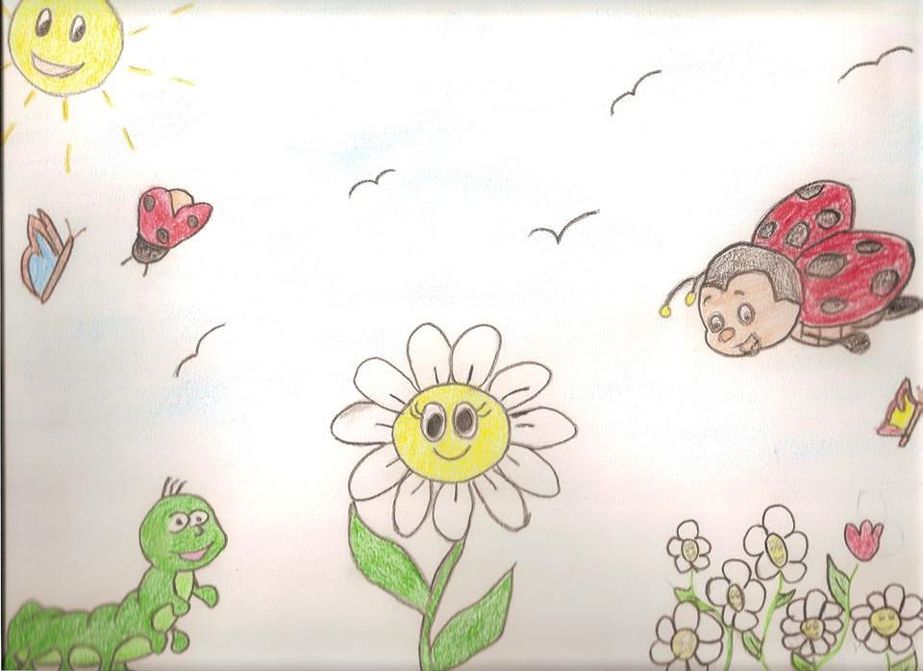
In the garden there are three kind animals because they use “magic words” and are an example for the others.
Please
Hello
Hi

Slide 4
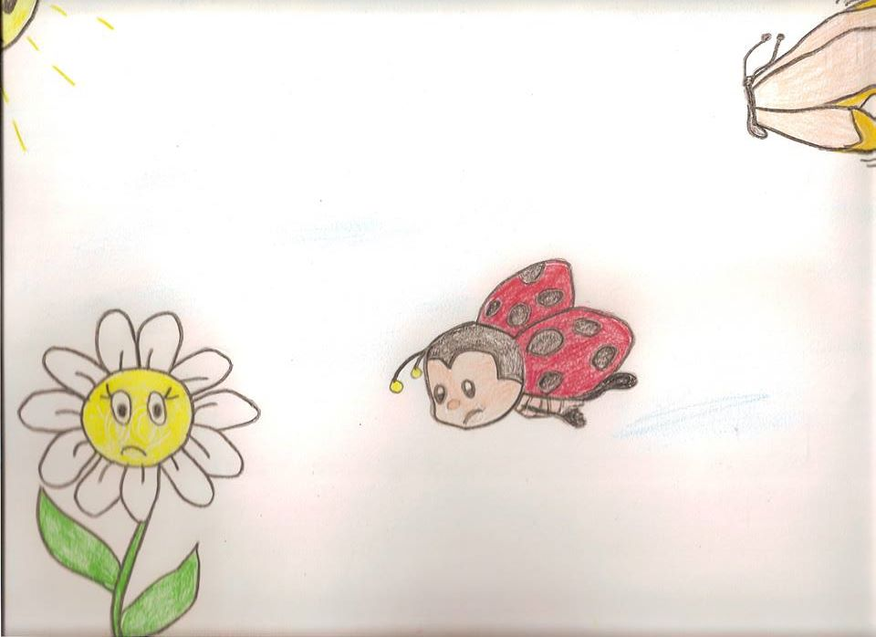
One day the ladybird and the butterfly meet in the garden but the caterpillar is not there. They are worried. Later they see a butterfly with the golden wings
Hi! I am here
Where is the caterpillar?
I don’t know

Slide 5
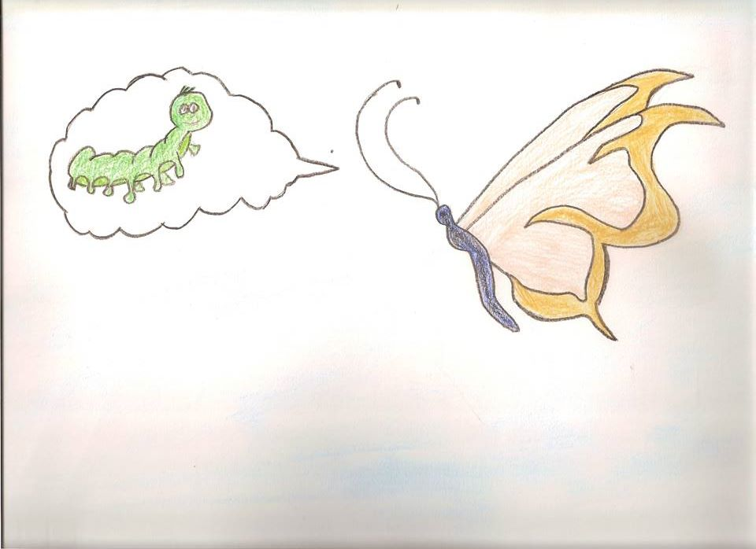
The butterfly explains them its transformation and has golden wings because it uses “magic words” anytime.

Slide 6
This story was realized by Tomas, Tonia , Maria attending
the first class of secondary school.
The work was coordinated by the Italian and English
teachers.

