Slide 1
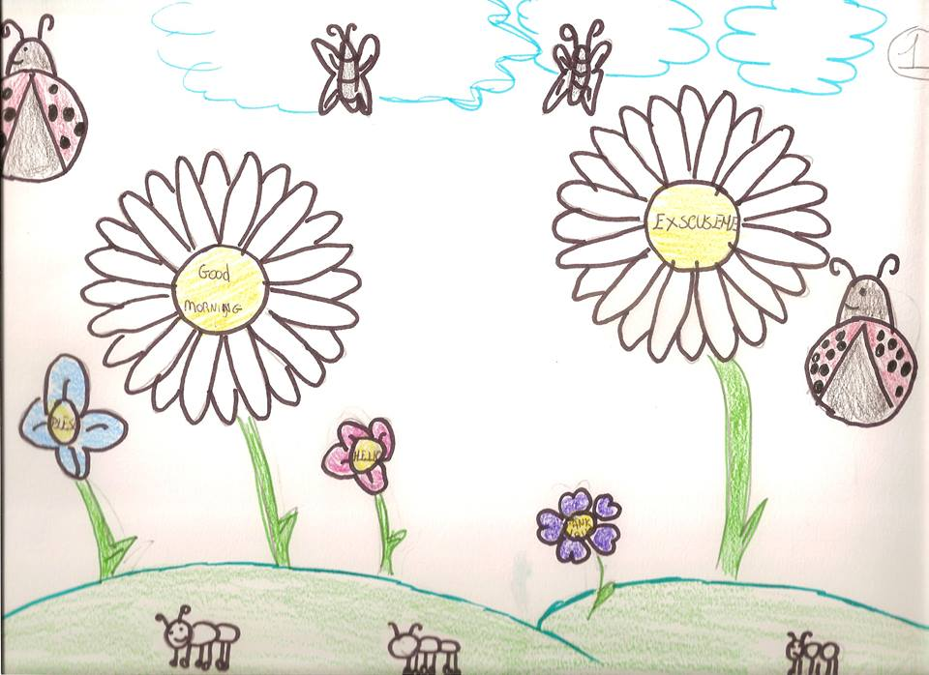
The garden of “Good Manners” Il giardino delle “Buone Maniere”

Slide 2
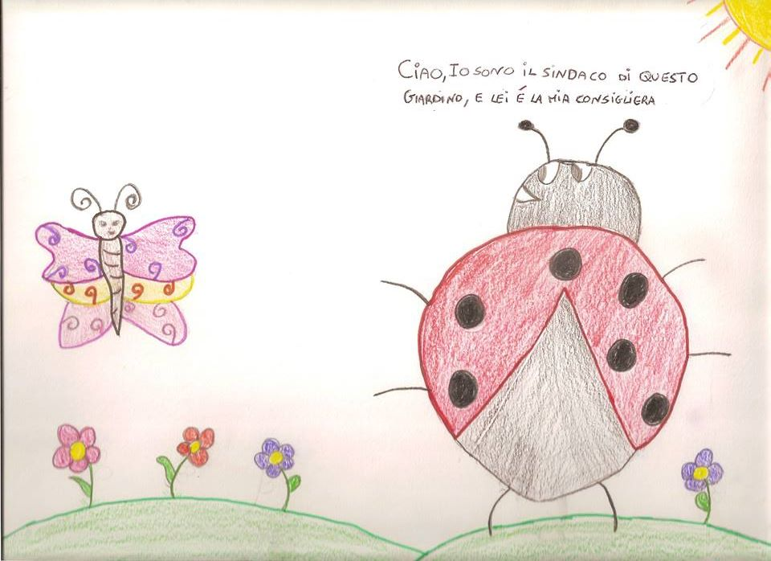
Ladybird : Hello! I am the mayor of this garden and the butterfly is my trusted advisor.

Slide 3
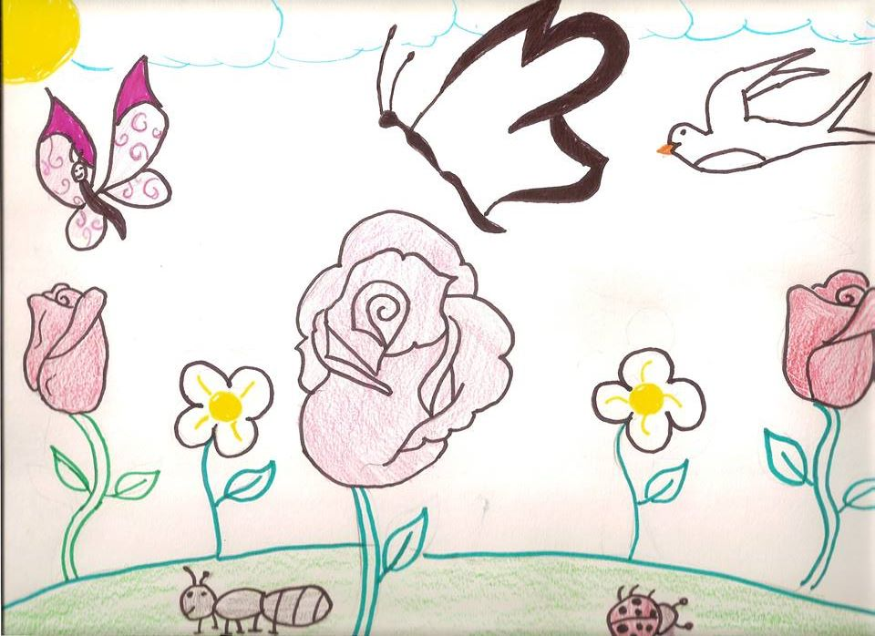
We are very happy to live all together. We respect each other.
Our rules are based on “good manners”. We use “please, excuse
me, thank you “ and other magic words .

Slide 4
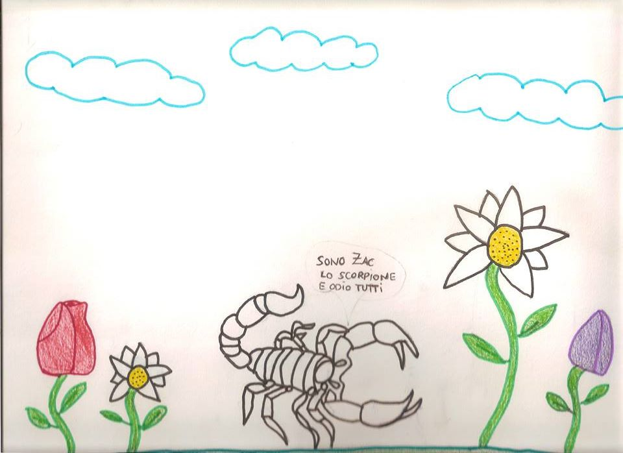
But one day …..
a scorpion named Zac arrives and everything changes.
I am Zac. I am very rude. I don’t like “love” and “friendship”. I don’t like “rules”

Slide 5
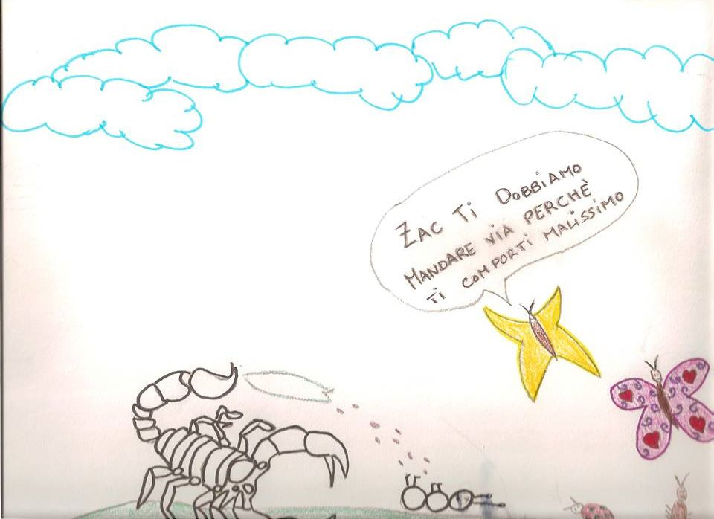
That’s not good. You have to respect us. If you don’t like this idea, you can go away. Zac doesn’t like that so decides to rebel and spits the poison from its mouth. Zac realizes the poison is so dangerous that one insect dies so decides to justify its behaviour.
poison

Slide 6
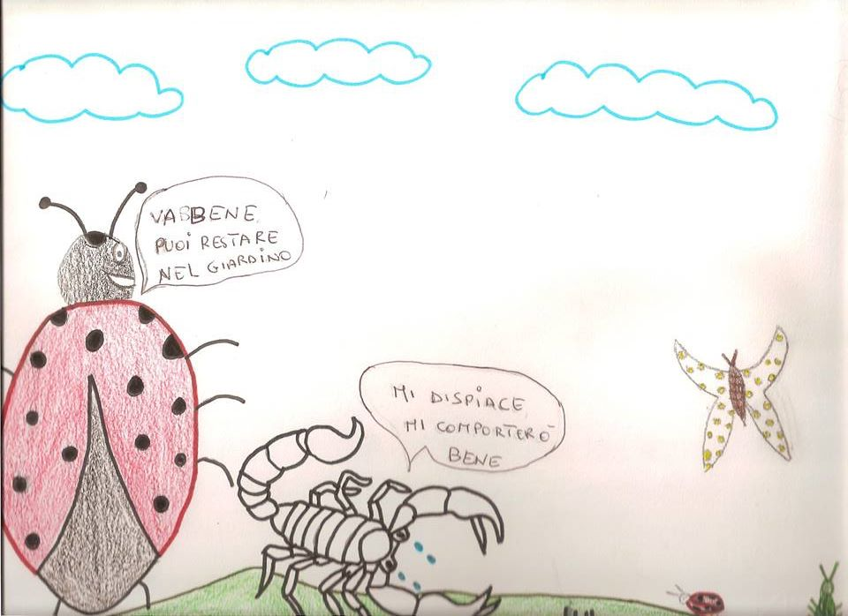
All the inhabitants of this garden decide to forgive Zac and are so happy to live all together.
Ok, you can stay with us.
I am sorry. I will behave well.

Slide 7
This short story was realized by
Sara Arman, Giuseppe Di Lisi, Serena Miele, Clara Musano
The Italian teacher and the English one coordinated the work in Italian and English

