Slide 1
Our favourite singers and songs
by students
from the third class

Slide 2
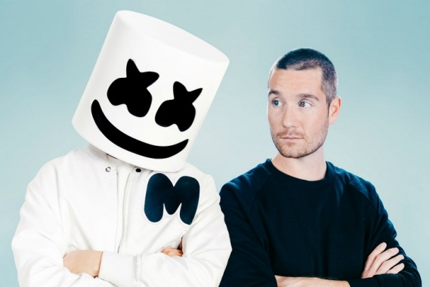
My favourite singer is Marshmello
my favourite song is
Happier
I am really happy and relaxed when I listen to it
https://youtu.be/RE87rQkXdNw

Slide 3
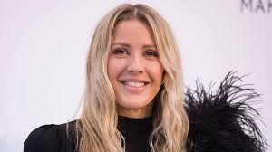
My favourite singer is Ellie Goulding
and my favourite song is
Beating heart
https://youtu.be/miss21Qm4bI

Slide 4
My favourite singer is Divergent
and my favourite song is
I won’t let you go
https://youtu.be/plUTOMoUsxA

Slide 5
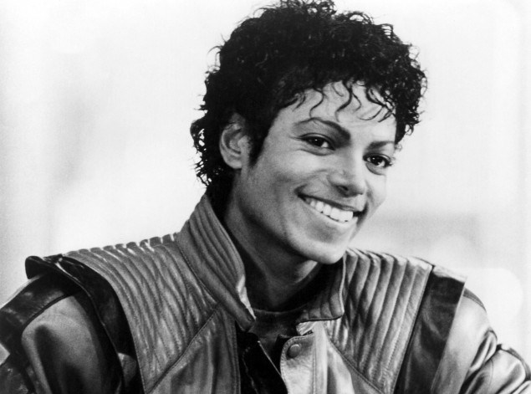
My favourite singer is
Michael Jackson
My favourite song is
Billie Jean
https://youtu.be/Zi_XLOBDo_Y

