Slide 1

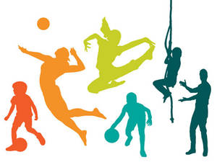
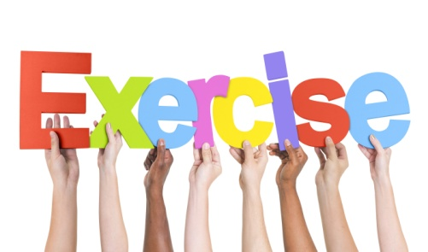
What is Physical Activity?
Anything that gets you moving!

Slide 2
Physical Activity and Exercise
Physical activity is a general term that includes sports, dance, and activities done at work or at home, such as walking, climbing stairs, or mowing the lawn.
When people do physical activity especially for the purpose of getting fit, we say they are doing exercise.

Slide 3
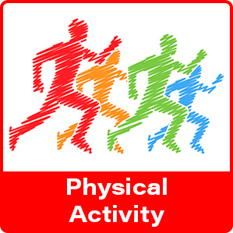
BENEFITS of
Helps people achieve and maintain a healthy weight
Reduces feelings of stress, anxiety & depression
Builds and maintains healthy bones, muscles & joints
Boosts energy level
Improves quality of sleep

Slide 4
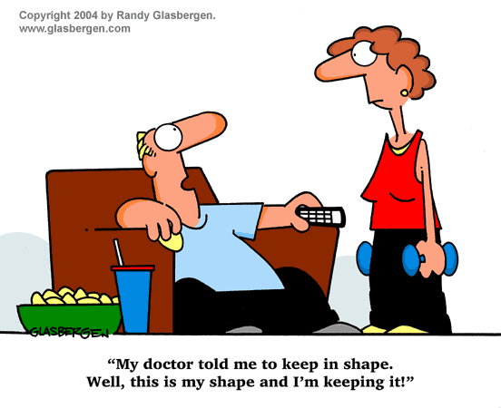

Slide 5
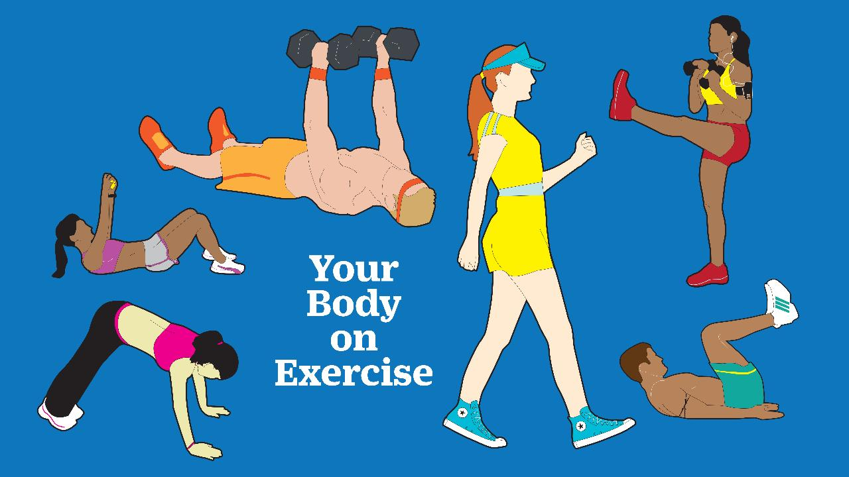
THE BENEFITS OF EXERCISE

Slide 6
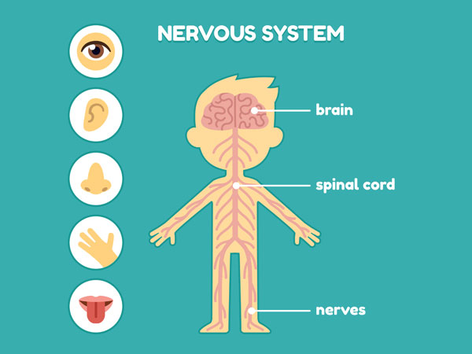
  Tunes it for more skillfull movement
  Improves your reaction time
  Improves mental performance

Slide 7
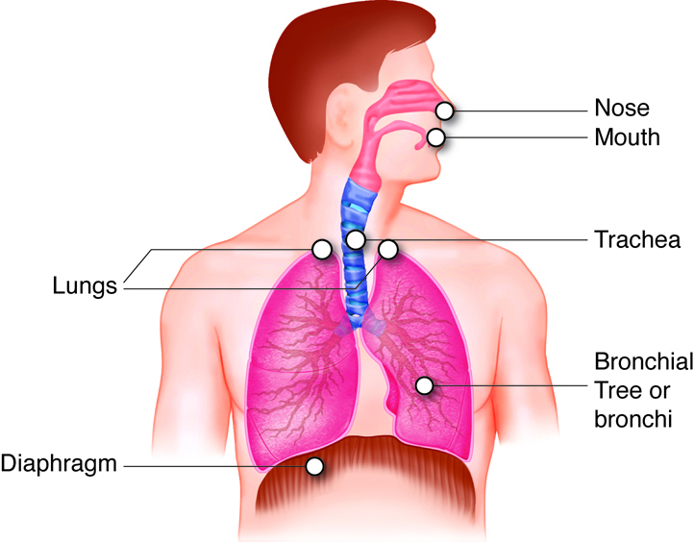
RESPIRATORY SYSTEM
  Lung capacity increases
  Works more efficiently

Slide 8
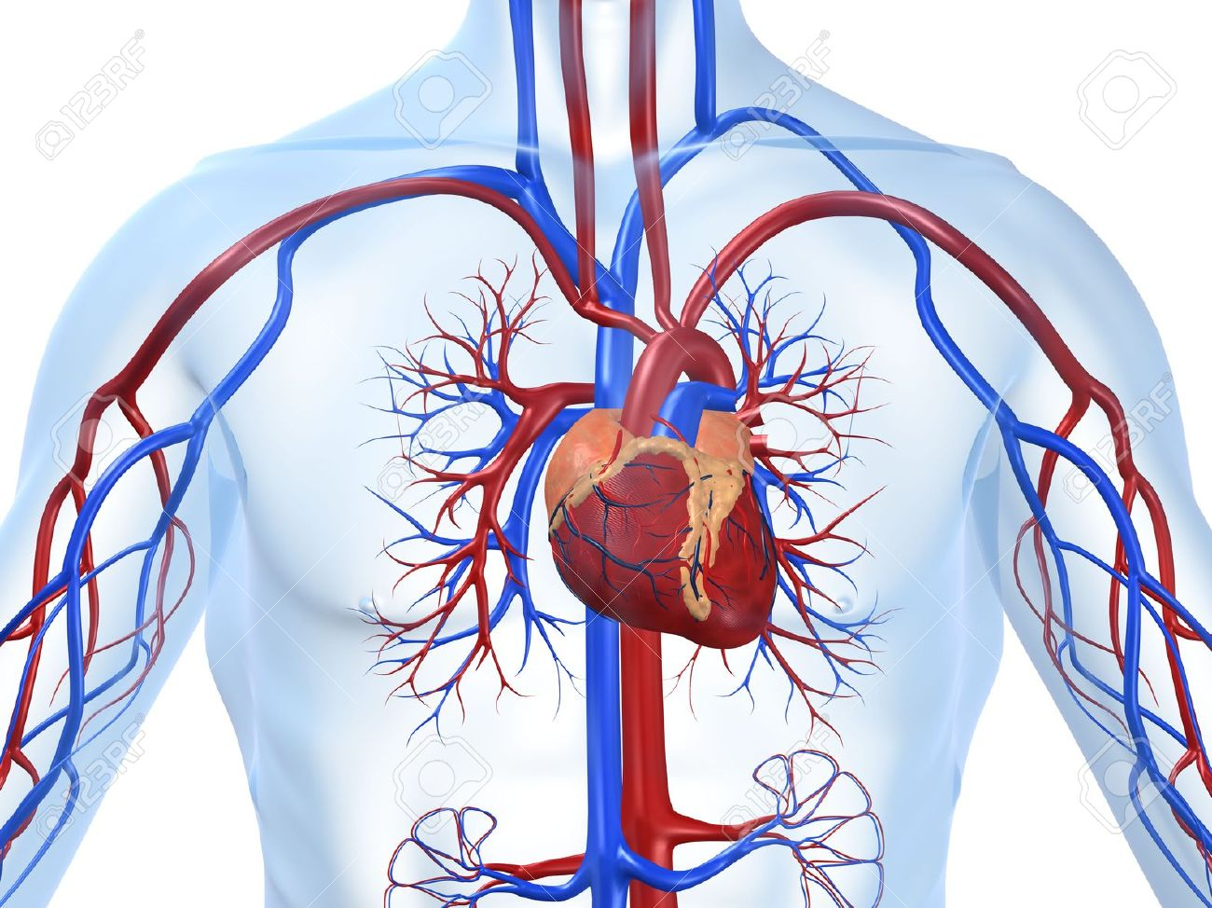
CARDIOVASCULAR SYSTEM
Heart increases in strength
Heart able to pump more blood more efficiently

Slide 9

Contributes to positive self esteem
Helps deal with stress
Able to relax
Leads to more productive work
Decreases fatigue

Slide 10

Helps one meet new people
Helps one find new area of enjoyment with friends

Slide 11
Types of exercises
Jogging
Walking
Cycling
AEROBIC
Muscular strength
Muscular endurance
Flexibility
ANAEROBIC

Slide 12
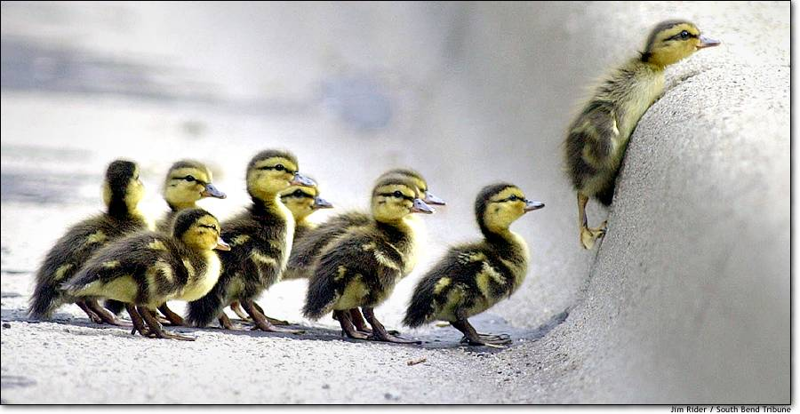
Believe …..
…anything is possible!
“The only reason the bumble bee can fly is because no one told him that he can’t!”

Slide 13
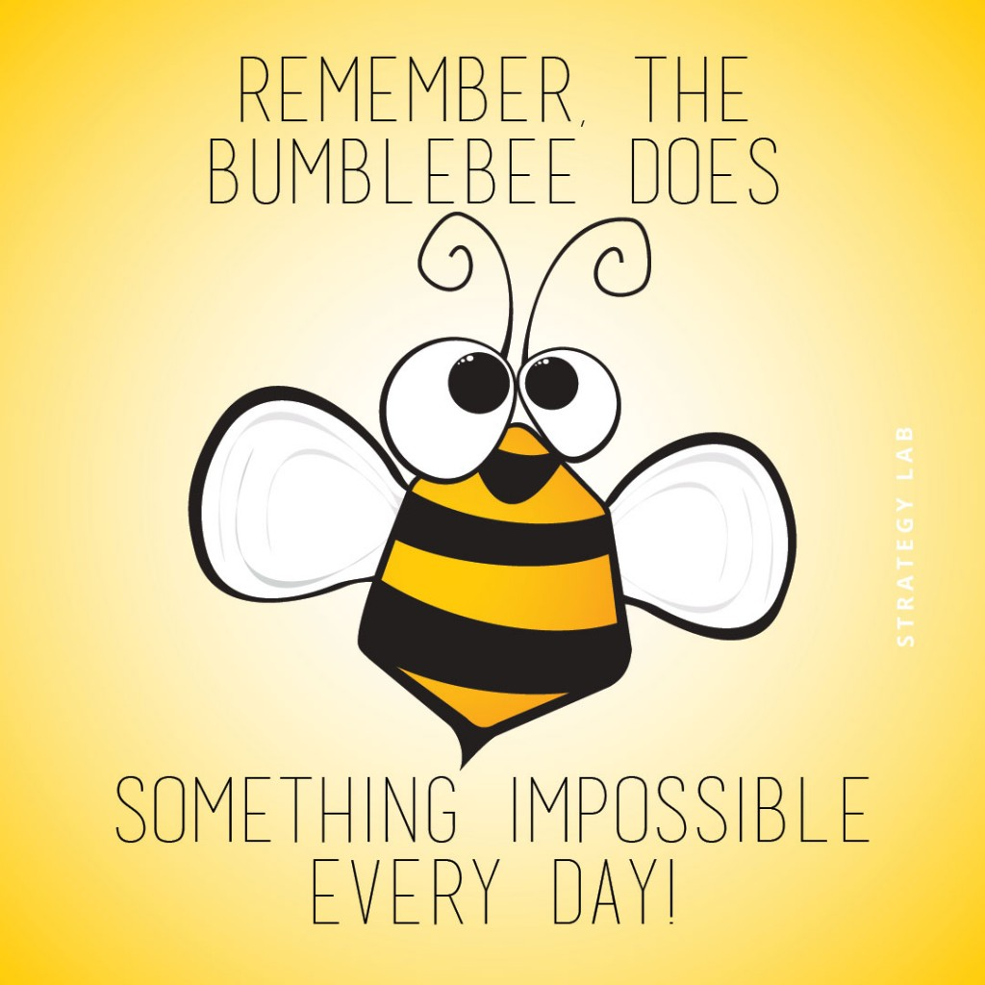
Exercise is Important…
Why Don’t We Do It

