Slide 1
EUROPEAN CIVIC ATTITUDE THROUGH SOCIAL ENTREPRENEURSHIP
2019-1-RO01-KA229-063748_4
24th – 30th November 2019

Slide 2
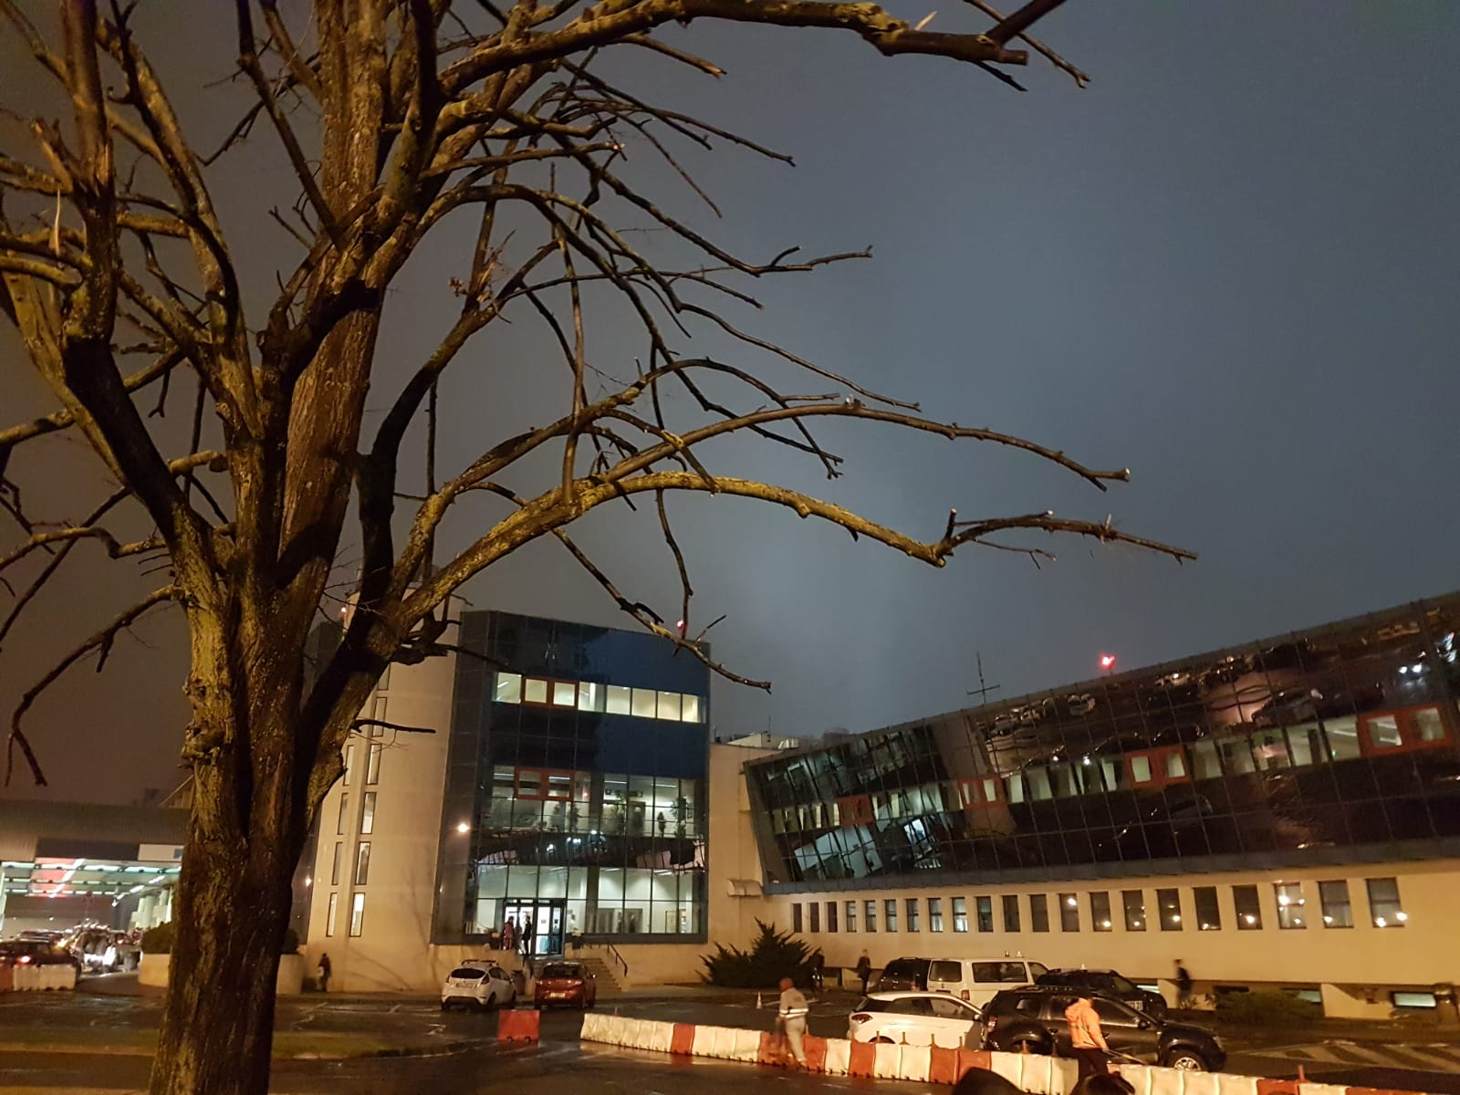
Sunday 24
We spent the whole Sunday traveling and once we arrived at the hotel we met our new friends.

Slide 3
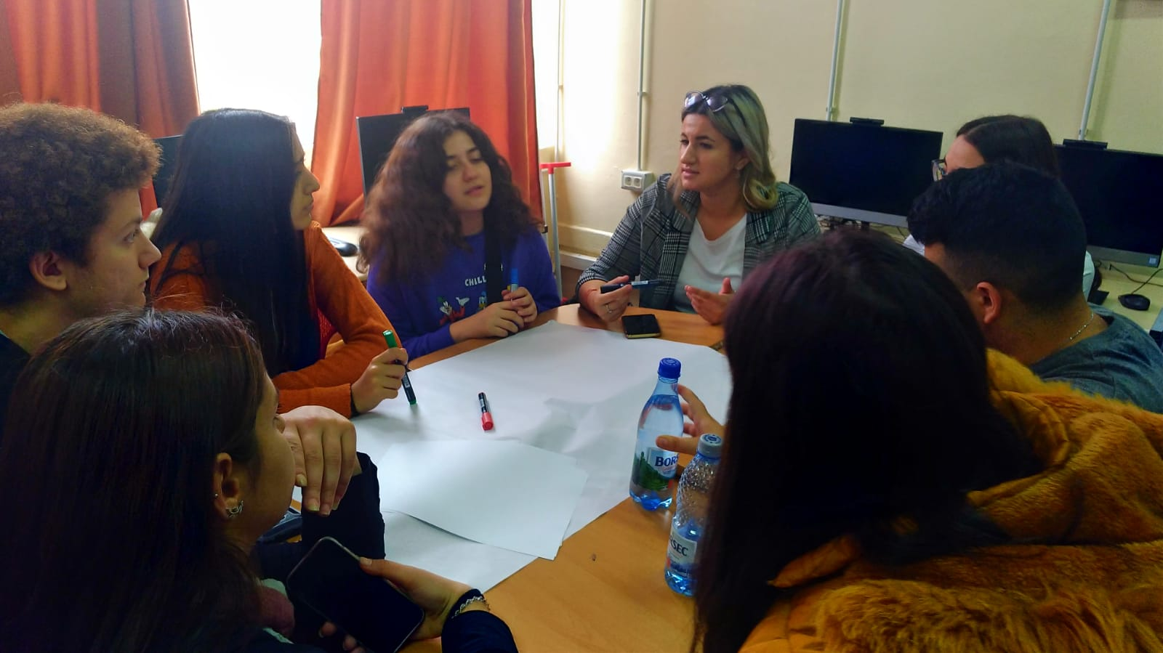
Monday 25
On Monday after visiting the school and introducing the project, we started creating a poster with our logo.

Slide 4
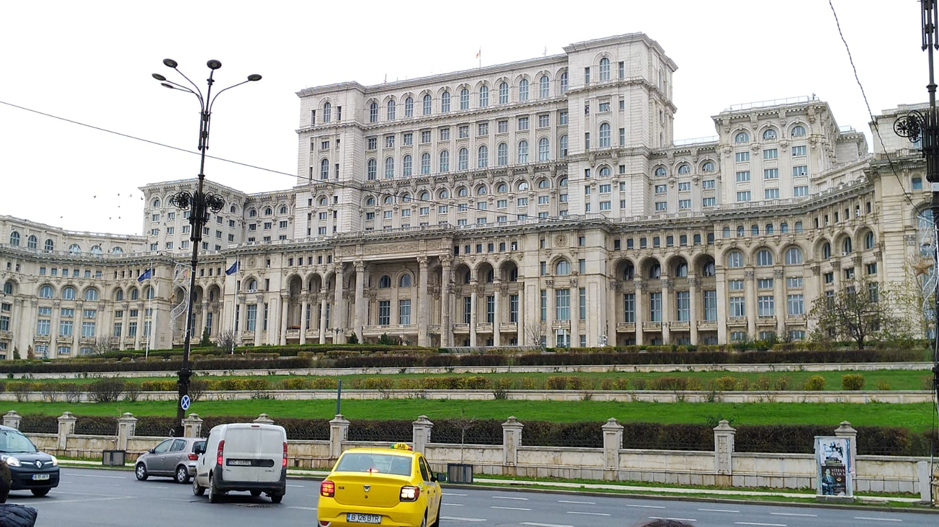
Tuesday 26
On Tuesday we went to visit Bucharest and in particular the Parliament.

Slide 5
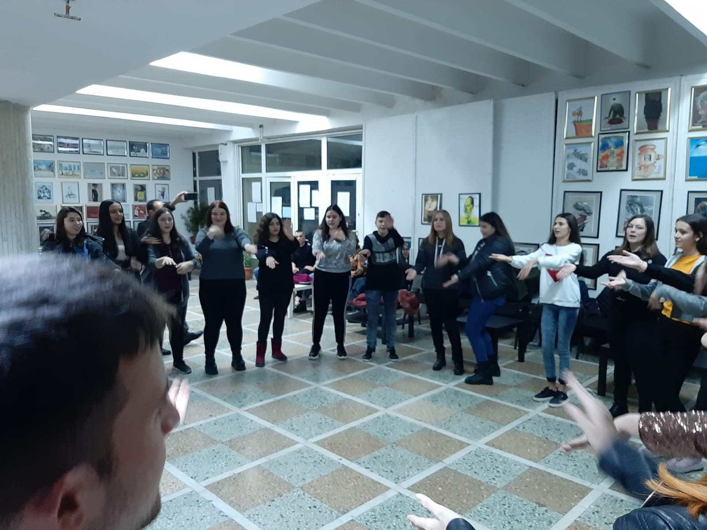
Wednesday 27
On Wednesday we dealt with enterpreneurship in each country and in the evening we had a party.

Slide 6
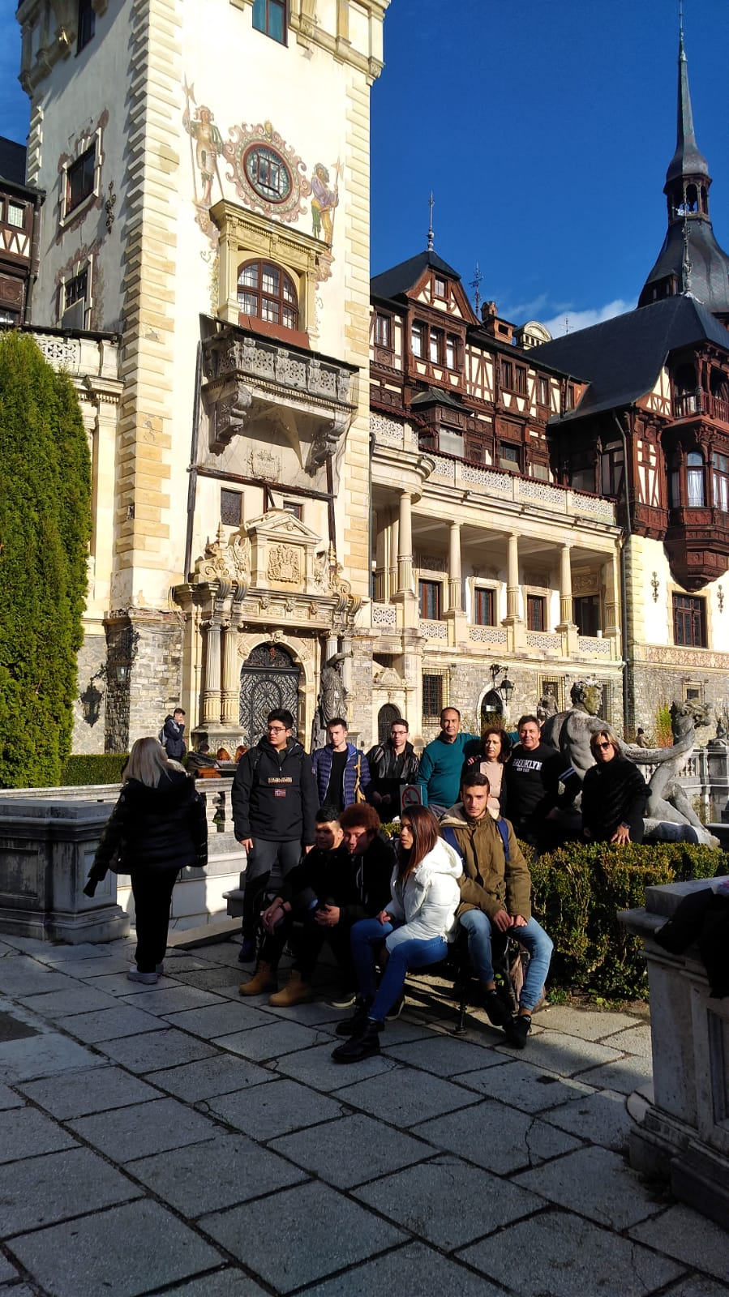
Thursday
28
On Thursday we went to Sinaia where we visited the Peles Castle and some local churches

Slide 7
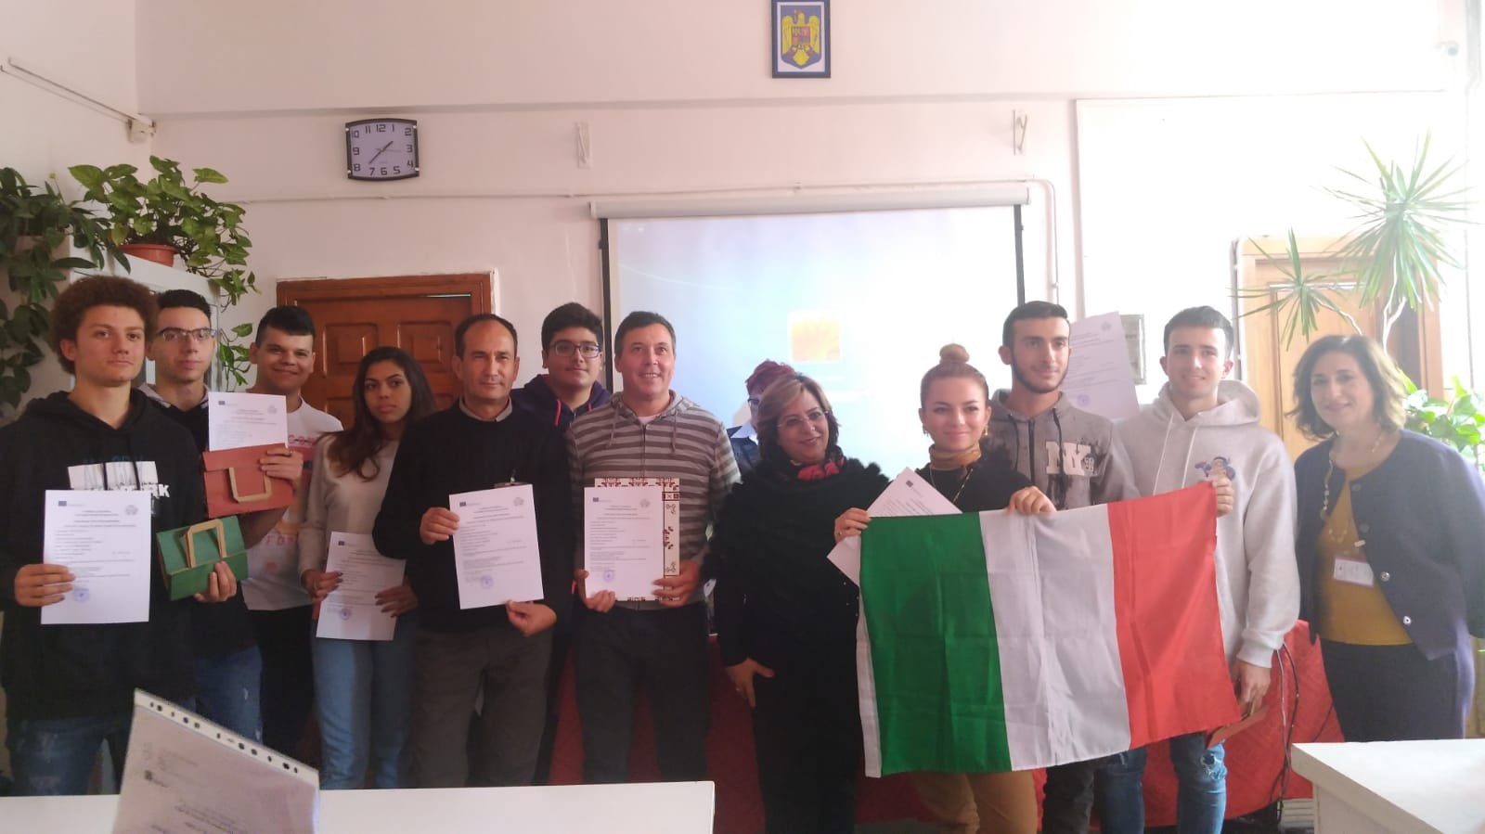
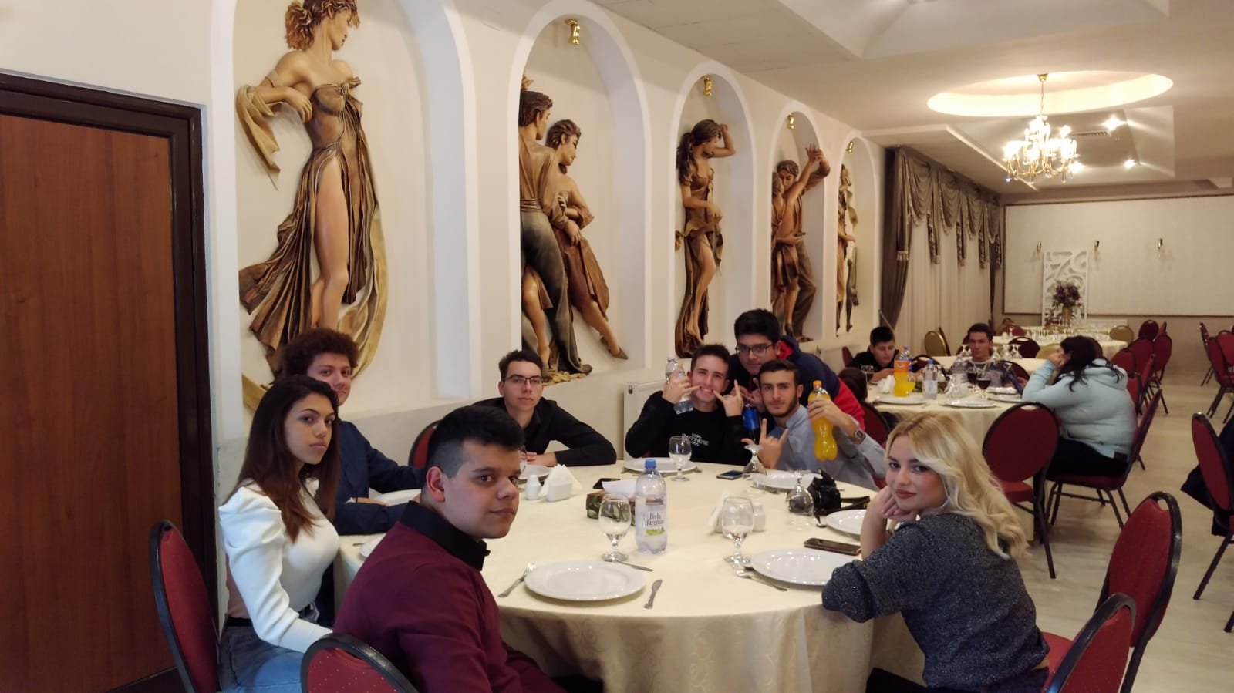
Friday
29
On Friday morning we finished our workshops and presented the posters. Certificates have been delivered to us. Finally, in the evening there was the final party with lots of music and fun for everyone.

Slide 8
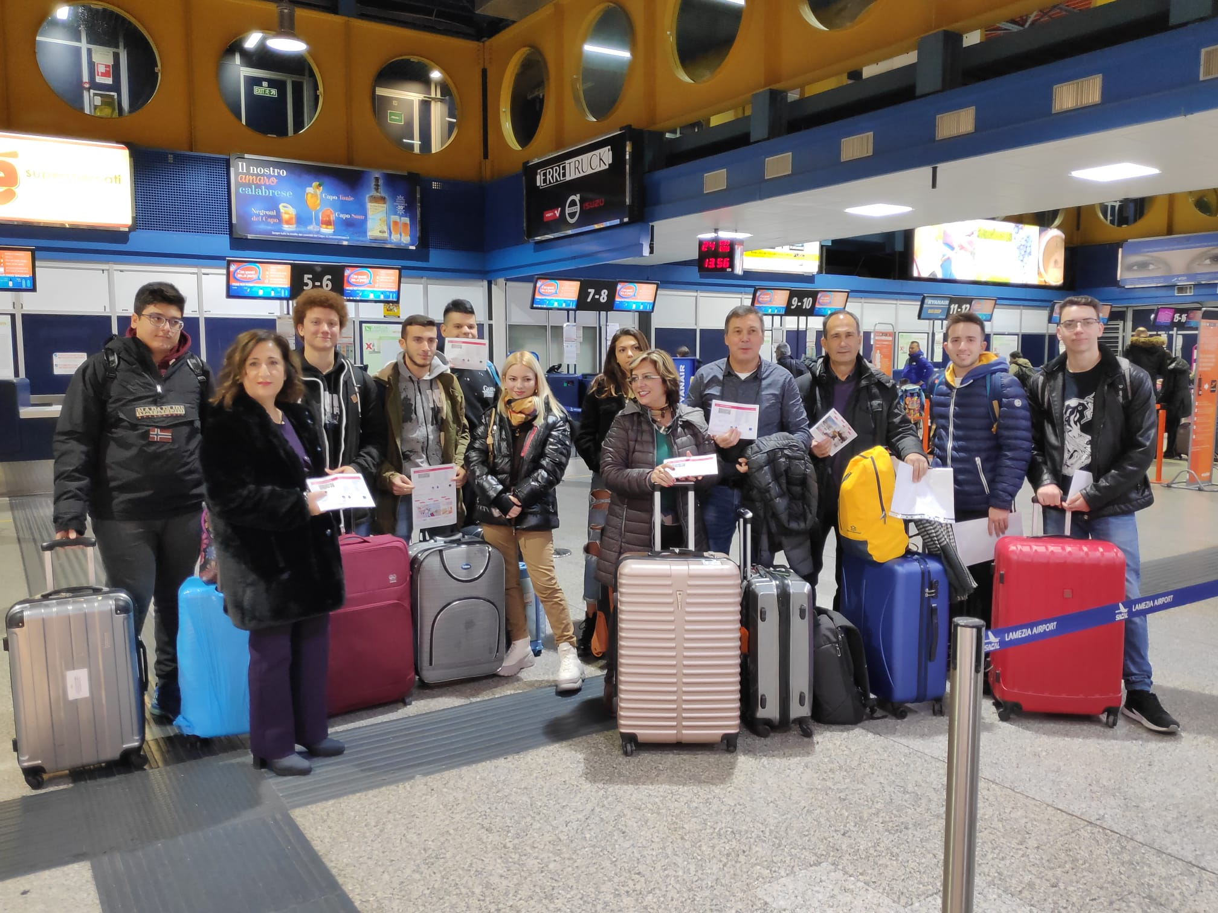
Saturday
30
On Saturday we went back to Italy

Slide 9
It was a really nice experience that allowed us to increase our knowledge on social entrepreneurship, to improve our language skills, to meet new people and to compare ourselves with other cultures

