Slide 1
European civic attitude through social entrepreneurship
2019-1-RO01-KA229-063748_4

Slide 2
What is entrepreneurship?
Entrepreneurship is commonly related to the creation of an autonomous enterprise, or to a group of people who establish a new one.

Slide 3
Can entrepreneurship solve social problems?
People endowed with good ideas can solve any kind of problem with the support of institutions

Slide 4
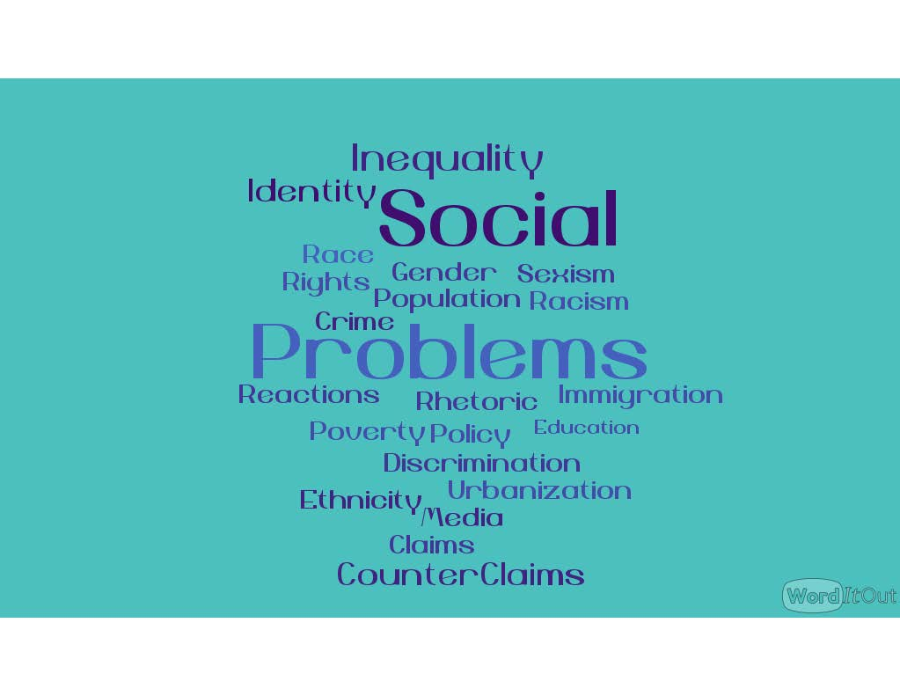
Identifying social problems of the community
A social issue is a problem that affects all individuals within a society. It is often the consequence of factors extending beyond the individual's control.
Poverty
Racial discrimination
Unemployment
Lack of infrastructures
Crime
Obsolete mentality
Pollution
Brain Drain
Seasonality of work opportunities

Slide 5
Establishing business ideas that can solve social problems that community has
We can solve social problems starting from adopting new law rules on: taxation, social assistance, health care etc.
Teaching civic education in schools from an early age would be useful too. Investing in young people, giving them the opportunity to create new and flourishing companies..
Social companies composed of unemployed and immigrants that deal with
Environmental issues such as garbage collecting and recycling
Welcoming tourists and organizing events and cultural activities
Cultural activities
Hosting elderly people

Slide 6
Types of companies, according to the legal form which can be established in the country of each partner
Company of persons
S.S. | Simple Company
S.N.C. | General partnership
S.A.S. | Limited partnership
Capital
company
S.R.L. | Limited Liability Company
S.P.A. | Joint Stock Company
S.A.P.A. | Limited Partnership
Cooperative companies: companies characterized by mutualistic purposes. All cooperative societies have legal personality and must follow the accounting and budgetary rules of legal persons, with the addition of supervision by the Ministry of Labor.
A consortium company, on the other hand, is defined as the organization established between entrepreneurs of the same branch or related activities for the discipline or for carrying out specific phases of the respective companies

Slide 7
Legal social enterprises which can be established
in Italy
Legislative Decree no. 112/2017 provides that all private entities, including companies, can acquire the status of social enterprise
Social cooperatives and their consortia are social enterprises pursuant to law.
Religious bodies can acquire the qualification limited to the activities referred to in Article 2, if managed on the basis of a formalized regulation that incorporates the provisions of Legislative Decree 112/2017
Social enterprises are entities of the Third sector (and their name must contain the indication "social enterprise")
The provisions of Legislative Decree 112/2017 are supplemented by the Third Sector Code and the Civil Code

Slide 8
What are the documents needed to set up a company?
The data relating to the members;
The receipt of the payment of cash contributions rate;
The sworn report of estimate of any contributions in kind;
The data relating to the company to be set up;
The legal form (s.r.l. or s.p.a.); the registered office;
Duration;
The corporate purpose; the expiration of the exercises;
The share capital and shares / shares of the shareholders;
The corporate bodies with the relative powers of administration and representation.

Slide 9
How to complete these documents?
Before making a risky move, you need an idea for setting up the company. It should be an activity that you are passionate about, since a new business really consumes so much time and money. Try to come up with business ideas by identifying people's needs, the things they are willing to pay for that are not available in your area or that you can provide better than anyone else.
You need a solid business plan to present to potential investors, and the best starting point is to determine the basic costs of the initiative. This will outline a precise scheme and help you understand how much money is needed to manufacture the product or offer the service you have in mind. This includes production costs, shipping costs, taxes, employee salaries, job rental, etc.
Once you have broadly calculated the amount of money required, write a budget dedicated to the promotion that indicates the amount you can spend on advertising.
Contact a bank with which you already have a positive relationship. Find out about the types of loans offered to start-ups and how they can benefit your business. By relying on a bank you know well, the company will have easy access to your financial records and will feel safer making an investment with you.
Buy all the tools you need to get to work. The equipment may include mechanical tools, computers, telephones or supplies for craft work. It all depends on the nature of your company. Try to buy in stores that sell wholesale materials for businesses, so you can get significant discounts. If you are short of money, the rental solution or a similar contract is also valid, in order to get the company going and avoid blocking you .
You must have a way to reach potential customers to convince them to rely on your business. This is especially important when you're just starting out, before you have a stable and regular customer base .
If you plan to sell products online, you need to make sure you set up an appropriate payment system on the net. Services like PayPal make it incredibly easy. Do a search to find the method that's right for you. However, you need to make sure the system is secure, whatever it is. You should also prevent your information or that of customers from being hacked or stolen by malicious people .
The most important thing to start a business is to open a VAT number and then to enlist the company in the Business Register held by the Chamber of Commerce.

Slide 10
ESTABLISH THE NAMES OF THE COMPANIES AND THEIR OBJECT OF ACTIVITY
Change Minds
monthly reading of a book with weekly meetings;
weekly viewing of a film chosen based on a theme;
meetings with authors, singers, actors, etc
environment in safety
We could help all people by making the planet more comfortable and enjoyable
Assisting the older people 24 hours a day
SUN HOUSE
Leisure centre for the older people who live at their own home.
Creating new jobs
Providing services to the older people such as bringing their shopping at home or providing medical tests at home.
TOGETHER IS BETTER
Building new streets
STREET FOR FUTURE
Letting immigrants work
Introducing new jobs
ASSISTANCE TO TOURISM
TOURISM ORGANIZATION
Encouraging the integration of immigrants
HIRING EMPLOYEE
REDUCiING POVERTY
PROMOTING TOURISM
REDUCING THE SEASONALITY OF WORK

Slide 11
THANKS FOR YOUR ATTENTION

