Slide 1
Vocational school of trade and catering European civic attitude through social entrepreneurship
2019-1-RO01-KA229-063748
Business idea and a business plan

Slide 2
Business idea
Some sources of business ideas:
Your own professional and social experience – as a learner, worker or consumer or just an observer.
All kind of information derived from the Internet, radio, television and all media and commercial resources.
Target research, free talks, questionnaires, focus groups with customers, traders or experts in the relevant fields

Slide 3
Business idea
Criteria of evaluation:
Market opportunity
Competition
Marketing system
Financial features
Production factors
Risk.

Slide 4
Business idea
Financial resources:
Personal savings;
Bank credit;
Donations;
Leasing

Slide 5
Business plan
The business plan summarizes the intentions of a company for a particular endeavor;
encourages entrepreneurs to make an objective assessment of the strengths and weaknesses of the business;
The business plan is the essential part for banks and shareholders to invest in a future endeavor.

Slide 6
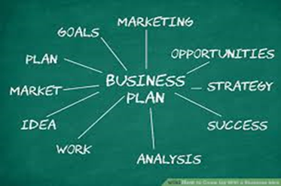
Structure of a business plan
Review:
What is the product?;
What is the market?;
Competition on the market?;
What is your marketing strategy?;
What is your management strategy?;
What is your operational plan?;
What is your financial plan?

Slide 7
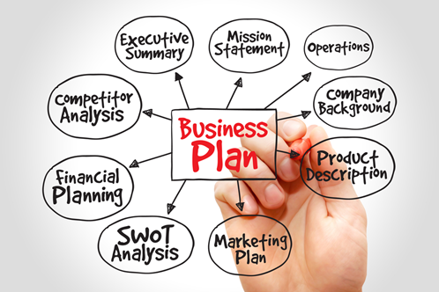
Structure of a business plan
Market analysis:
defining the market in terms of size, demographics, structure, growth prospects, trends, and sales potential
Prospects in both short and long term

Slide 8
Structure of a business plan
Competitive Analysis:
the strengths and weaknesses of the competitors within your market.
strategies that will provide you with a distinct advantage.
barriers that can be developed to prevent competition from entering your market.
any weaknesses that can be exploited in the product development cycle.

Slide 9
Structure of a business plan
Marketing strategy:
positioning strategy;
establishing prices;
determine distribution;
promotion strategy.

Slide 10
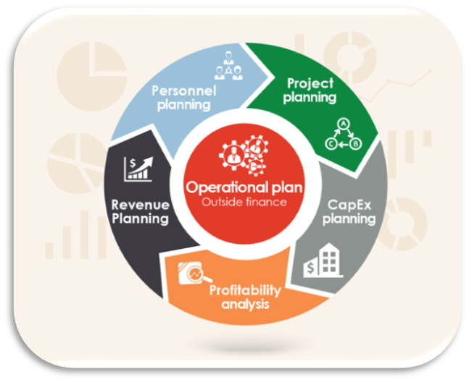
Structure of a business plan
Operations and Management:
how the business functions on a continuing basis
logistics of the organization,
management team
personnel

Slide 11
Structure of a business plan
Financial Components of Your Business Plan
the income statement,
cash flow statement,
balance sheet.

Slide 12
Structure of a business plan
Supporting Documents:
Any other documents that are of interest to your reader, such as your resume; contracts with suppliers, customers, or clients, letters of reference, letters of intent, copy of your lease and any other legal documents, tax returns for the previous three years, and anything else relevant to your business plan

Slide 13
Thank you for your attention!

