Slide 1
European Civic Attitude Through Social Entrepreneurship

Slide 2
What Is Entrepreneurship?

Slide 3
The capacity and willingness to develop, organize and manage a business venture along with any of its risks in order to make a profit. The most obvious example of entrepreneurship is the starting of new businesses.
In economics, entrepreneurship combined with land, labor, natural resources and capital can produce profit. Entrepreneurial spirit is characterized by innovation and risk-taking, and is an essential part of a nation's ability to succeed in an ever changing and increasingly competitive global marketplace.

Slide 4
Examples:
Examples Of Well-known Entrepreneurs Include

Slide 5
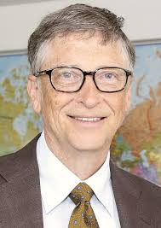
Bill Gates
Steve Jobs

Slide 6
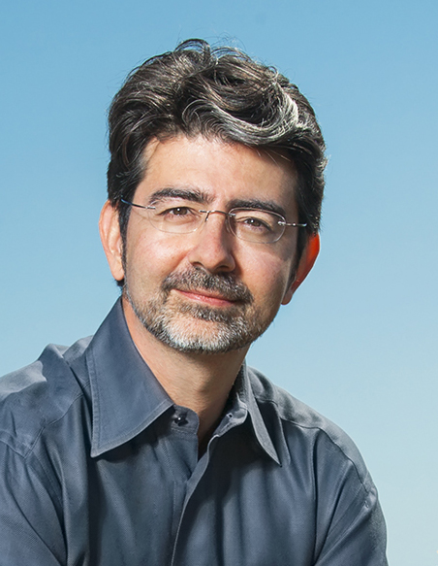
Mark Zuckerberg
Pierre Omidyar

Slide 7
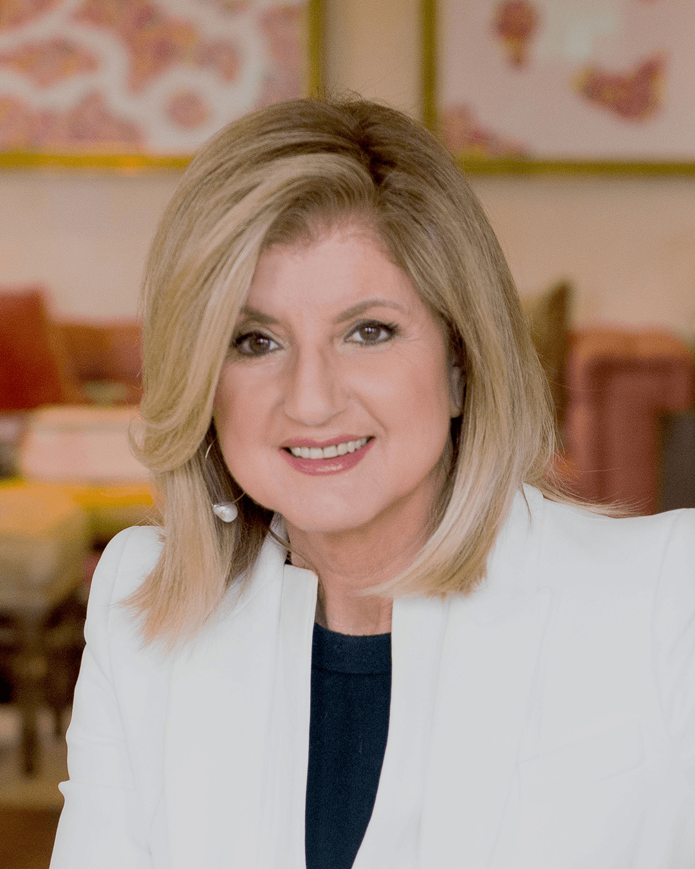
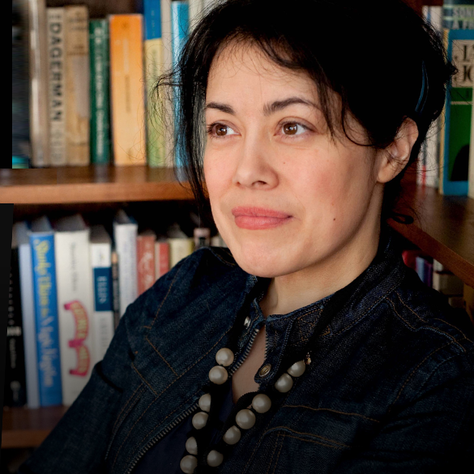
Arianna Huffington
Caterina Fake

Slide 8
Can Entrepreneurship Solve Social Problems?

Slide 9
You may have heard the saying, “Give a man a fish, and he can eat for a day; teach a man to fish and he will eat for a lifetime.” I would argue, “Give a man the tools and resources to create a fishing business, and his whole village can thrive for generations.” That is the main idea behind social entrepreneurship and that is the answer of our question.

Slide 10
Importance Of Social Entrepreneurship
Social entrepreneurship is important because it provides a framework for businesses to find their own success in the pursuit of helping others.
It will be an inspirational source of impact.
It will respond to customer’s needs.
To manage Relationships beyond economic purpose.
A more responsive business to create economic and social value.
A social mission to make the world a better place.

Slide 11
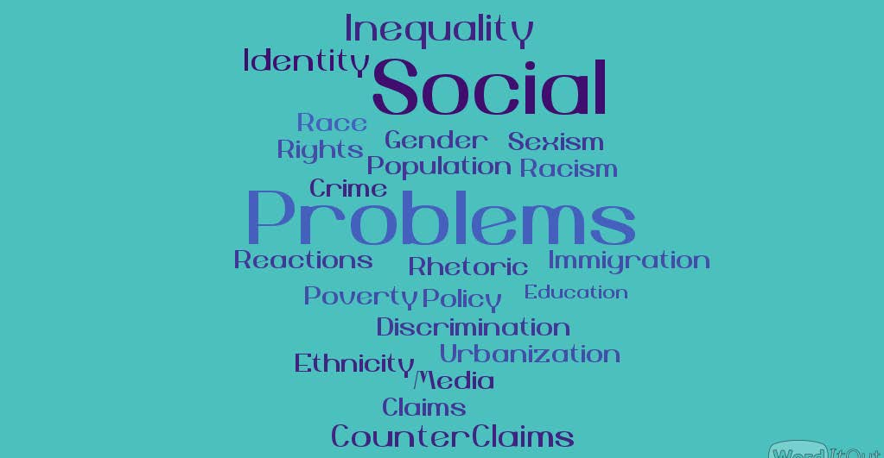
Social Problems Of The Community In Our Country

Slide 12
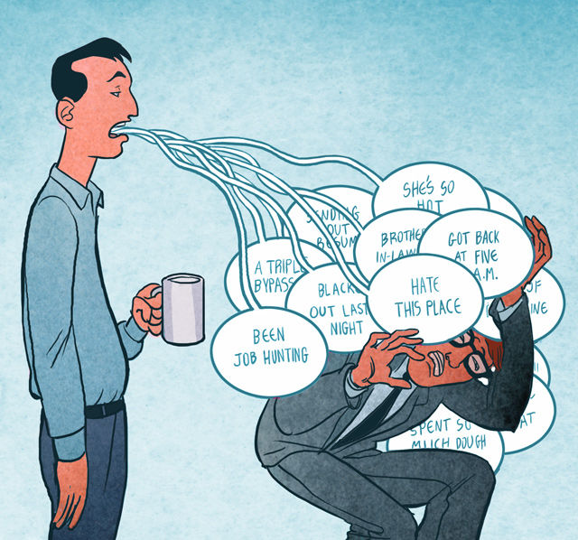
Social Problems
Anti social behavior
Poverty
Drug abuse
Alcohol abuse
Economic Deprivation
Unemployment
The shortage of schools
The lack of infrastructure

Slide 13
The Business Ideas That Can Solve Social Problems

Slide 14
Social Supermarket
Used Textbooks for Social Change
Online Socially Conscious
Marketplace
Sustainable Water
Micro Lending
Social Crowdfunding Baking/Cooking
Efficient Wood Stoves for Developing World

Slide 15
Thank You For Giving Us Time And Watching!
Created by,
Gaziantep Anadolu Highschool’s Students…

