Slide 1
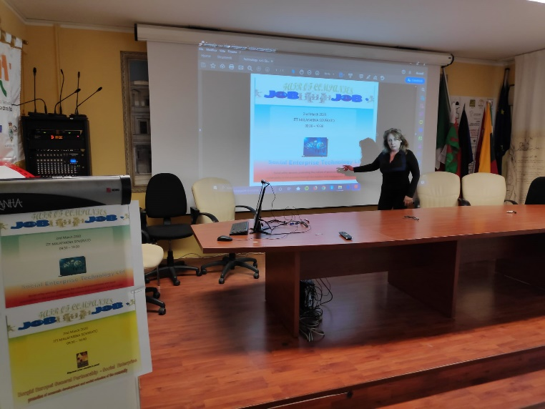
European Civic Attitude Through Social Entrepreneurship
2019-1-RO01-KA229-063748

Slide 2
Social Enterprise Technology l.t.d.
Who We Are- Our Objectives
The main Features: Aims and Duties
Other Info: Headquarters, Share Capital and Corporate Purpose
Goals and Target
Mode of Operation of the Internet Portal
Users’ opportunities
Signalling service
Staffing Plan
Acknowledgments

Slide 3
Who We Are- Our Objectives
Social Enterprise Technology l.t.d.
has been specifically created by a group of young experts in the field of technology in order to promote new forms of dialogue and interaction between citizens/consumers and businesses that work for the progress and social change of their communities.
Through the design, implementation and management of an ethical Internet portal capable of aggregating information on the sustainability of companies, Social Enterprise Technology intends to pursue the following
objectives:
building a more sustainable and participatory economy
contributing to the creation of a culture oriented towards social innovation, thus generating a precious social value.

Slide 4
The main Features: Aims and Duties
Social Enterprise Technology l.t.d.carries out a no-profit business activity of general interest on a stable basis, adopting responsible and transparent management methods
According to its no-profit nature:
It pursues civic, solidarity and social utility purposes
a) it is forbidden to distribute dividends;
b) it is forbidden to distribute the reserves among the members;
c) in case of dissolution, the entire corporate assets, but for the share capital, must be donated for purposes of social utility.
It is required to publish the social report annually, in order to communicate its value and the measure of the social impact of its business with transparency, promoting a wide involvement of all stakeholders (investors, users, other subjects).

Slide 5
Other Info:Headquarters, Share Capital and Corporate Purpose
Social Enterprise Technology l.t.d.
Headquarters: Soverato- Giuseppe Verdi St
Website: www.socialenterprisetechnology.it
Share Capital: EURO 25.000,00
Duration: 31.12.2060
It operates in favor of the European, national, regional and local community to inform, promote, assist, protect the individual and collective rights and interests of consumers of goods and users of services.

Slide 6
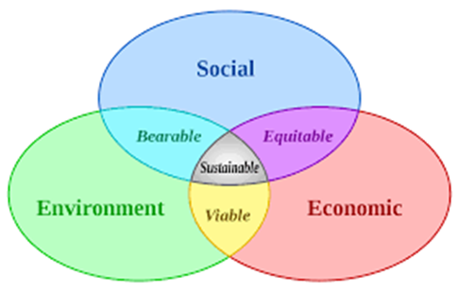
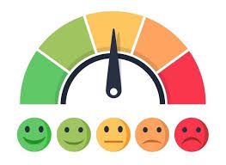
Goals and Target Social Enterprise Technology l.t.d. has created a new economy model based on information and dialogue. The ethical internet portal is the meeting place between consumers / citizens and organizations (businesses, third sector entities, unions and universities)
FOR CITIZENS
It allows the consumer to orient himself in the choice of his purchases
It verifies and evaluates companies according to their performance
It offers a useful tool for managing citizens’ reports
FOR COMPANIES
It rewards and encourages social and environmental sustainability behaviors and the commitment to respect customers
It increases the reputation of responsible companies
It provides information useful for improving strategies

Slide 7
Mode of Operation of the Internet Portal
The portal by means of an independent algorithm calculates
in a simple, transparent and interactive way
THE COMPANY REPUTATION INDEX,
evaluating the following factors:
the degree of social responsibility to sustainability
the quality of the relationship with the consumer.
The portal helps the citizen in his purchase choices.
Social Enterprise Technology l.t.d

Slide 8
Users’ opportunities
Through the portal, before purchasing a good and / or a service, each consumer can:
Choose
Checking useful info
Look for
Identifying suppliers and reading other consumers’ feedback
Estimate
Comparing the reputation index of companies

Slide 9
Signalling service
The ethical reputation portal aggregates information on the sustainability of companies, allowing consumers to compare companies' statements with their real behaviors.
An email address has been set up (segnalazionireputazioneaziende@SET.it ), where consumers can send reports of non-compliant behavior or highlight points of disagreement, with the possibility of suggesting areas for improvement.
Companies must implement actions and correct their behavior to improve the reputation index.
THE REPUTATION INDEX OF COMPANIES
it is the result of democratic verification
and is periodically updated

Slide 10
Staffing Plan
Social Enterprise Technology l.t.d.
Press Agent
SHAREHOLDER'S MEETING
the functions Statutory Auditors
with the functions o of Supervisory Board f Supervisory Board,
Management Board
President
CEO
Information Systems
Coordinator
Administrative and Accounting
Team Responsible
back office staff:
Project Team, for the creation and management of the web portal
Team Responsible
Other Staff
Response team to react efficiently to consumers’ issues and feedback
Team Responsible
Other staff

Slide 11
Thanks
ITT Malafarina Team

