Slide 1
Splenor
Textile companIES
BUSINESS PLAN

Slide 2
Busıness Concept
Provide safe service to our customers.
Help them to fallow fashion
Provide customers with convenient shopping opportunities

Slide 3
Our Strategy
Splenor’s strategy is to aggressively develop and market a full range collection to consumers. The company intends to market its line as an alternative to existing clothing lines and dierentiate itself through its marketing strategies, exclusiveness, and brand awareness.Splenor intends to build on its core portfolio of products and overcome any obstacles by using the company's expertise in the clothing industry.

Slide 4
The mission of the company is to provide a new look for consumers, based on style and quality.

Slide 5
Market Segmentation
The company plans to target males between the ages of 20 and 40 with a combined household income of more than $40,000. Within this group, there are no color barriers, and customers have diverse backgrounds. Splenor customer is a versatile man who can fit into any environment and is willing to pay a high price for quality clothing.

Slide 6
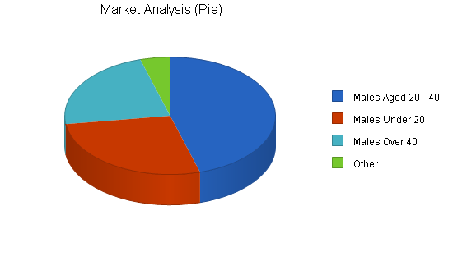

Slide 7
Opportunities
Splenor products will be priced at the high end to reflect the quality and exclusiveness associated with the brand. The company will use highend materials such as cashmere, a wool blend, and high gauge denim. When a mark up is placed on Splenor products, customers are willing to pay the premium because of the perceived value and quality guarantee that comes with all products. Splenor line is targeted at males between the ages of 20 and 40.
Competitive Edge In a market where consumers are barraged by advertising and marketing campaigns delivering an onslaught of lifestyle and fashion messages, a brand name is a powerful weapon. Brands have become an increasingly significant factor in apparel and footwear. Many consumers have less time to shop an are spending their disposable income more carefully. Established brand names, with their quality image, make the shopping experience easier and faster for many consumers. For manufacturers, brands build consumer loyalty, which translates into repeat business.

Slide 8
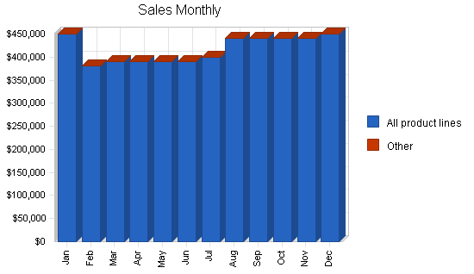

Slide 9
Competition and Buying Patterns
Although the apparel industry is mature and slow growing, it exists in a dynamic and competitive environment. In order to improve profitability, many companies are restructuring to create leaner organizations and adopt new technologies. Consolidation has been prevalent in this industry in the past few years, as larger companies gain leverage in market position and cost cutting. In the apparel industry, companies can operate as retailers or manufacturers (wholesalers) or both.

Slide 10
Targets
Public relations. Press releases are issued to both technical trade journals and major business publications such as DNR Magazine. Trade shows. Company representatives will attend and participate in several trade shows such as Magic in Las Vegas. Print advertising. The company's print advertising program includes advertisements in magazines such as Code, and Rap Pages. Internet. Splenor plans to establish a presence on the Internet by developing a website. Plans are underway to develop a professional and effective site that will be interactive and from which sales will be generated worldwide. In the future, this is expected to be one of the company's primary marketing channels. Other. The company also plans to use various other channels including billboards, radio and television commercials, and a street team

Slide 11
Our Team
Kübra Nur VURUCU (CEO):
I created and implemented a strategy to achieve my goal.
It ensures that all lines are made at the same time.
Süeda ARIK (MANAGER):
It aims to leave a medium and long-term heritage by considering the institution it works with.
At the end of the day, the responsibility of the manager is to make the right suggestions to the Leader. The responsibility of the leader is to accept or reject the suggestions presented to him.
Ahsen ATALAY(FINANCIAL AND LOGISTIC DIRECTOR):
Its duty is to follow the changes in the financial markets and advise the company executives accordingly.

Slide 12
Kübra Nur VURUCU(CEO)
Percy JACKSON (marketing director)
Ahsen ATALAY (financial and logistics director)
Alina STARKOV (Purchasing manager)
Ted MOSBY (director of human resources)
Süeda ARIK(manager)
Vladia SİSHİNA (data manager)

Slide 13
Financial Plan
The company is seeking a substantial long-term business loan for the purpose of developing the clothing line. This funding will cover operating expenses.

Slide 14
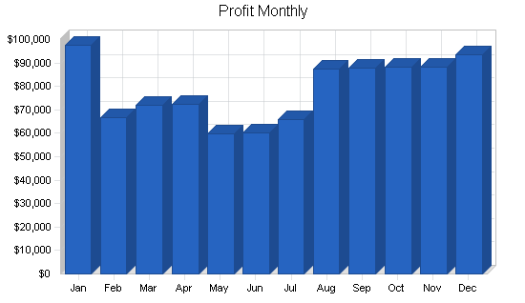
Projected profit and loss
The only risky part is not reaching the intended profit
But we do not encounter this problem as we move to wards goals.

Slide 15
Shareholders
KÜBRA NUR VURUCU %80
SÜEDA ARIK %8
ASENA ATALAY %2
PERCY JACKSON %8
ALINA STARKOV %2

