Slide 1
Impact of COVID-19 on Enterprises and Needs - Turkey
European cıvıc attıtude through socıal entrepreneurshıp
GAZIANTEP ANADOLU LISESI

Slide 2
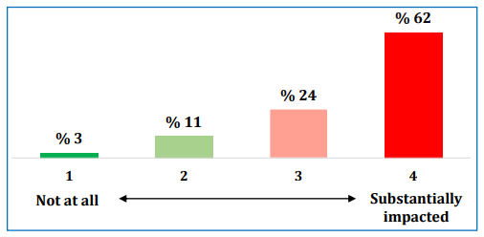
It can be observed that Covid-19 crisis has substantially impacted enterprises; however there are striking differences by regions, sectors and scales of enterprises.
To what extent did Covid-19 impact enterprises in Turkey

Slide 3
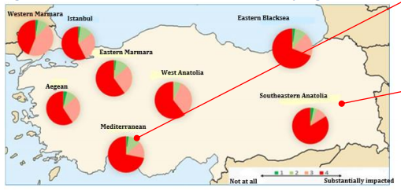
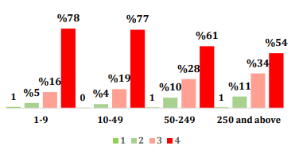
To what extent did Covid-19 impact enterprises in Turkey
distribution by region
For Mediterranean and Southeastern Anatolia regions, distribution by main activities, %
distribution by company scale, %

Slide 4
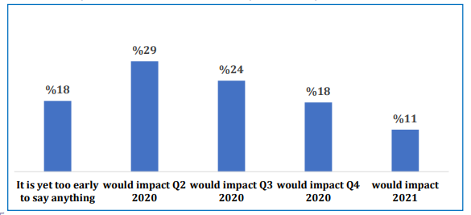
How long do entrepreneurs estimate effects of Covid19 crisis on their business will last?
There is no overall consensus as to how long the impact of Covid-19 crisis on enterprises will last.

Slide 5
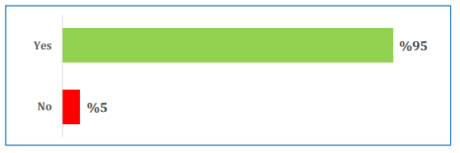
95% of companies took various measures against the crisis.
Answers to the question «Did you take measures in your enterprise about Covid-19 crisis?

Slide 6
Measures taken by enterprises in Turkey

Slide 7
A sizeable proportion of enterprises need that their payment of bills/taxes/social security contributions are postponed and discounted in addition to financial support.
The most important support mechanisms for enterprises are:
• Support for or full coverage of obligatory expenses (salaries, rent, energy costs, taxes and fees)
• Support for cheque payments to maintain commercial relations
• Expansion of scope of access to short-time working allowance
• Psycho-social support

Slide 8
Level of advantage includes the extent to which elements beyond a company’s control, for example sector and supply chain are impacted by adverse consequences of Covid-19. In other words, advantaged companies are those that are less impacted by the crisis.
Level of resilience is an index value made up of elements under a company’s control such as strategic planning, crisis management capabilities, existence of contingency/business continuity plans.
59% of 780 respondent companies are, by nature, in a disadvantaged position against Covid-19 crisis. 1 in 3 companies that are in a disadvantaged position demonstrates a level of resilience above the average in terms of measures taken against the crisis. It may be relevant to differentiate strategies of support against the crisis according to resilience and advantage levels of companies.

Slide 9
THANK YOU

