Slide 1
Modern Methods for Teaching the Business Plan four approaches to induce a social entrepreneural attitude
European civic attitude through social entrepreneurship
2019-1-RO01-KA229-063748

Slide 2
Developing and enhancing the Entrepreneurship Attitude
by Italian Team

Slide 3
The Entrepreneur
“If you want to launch a successful start-up, the
only way is to offer to the customers a value
proposition immensely better than
what they currently have”
Jeff Bezos, founder of Amazon.com

Slide 4
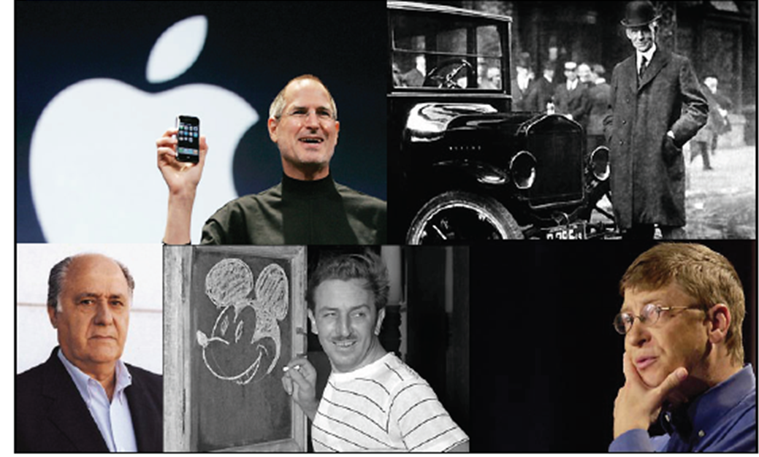
Issue
Are Entrepreneurs born or made?
Educational access to Entrepreneurship

Slide 5
Who the Entrepreneur is
Where others see a problem, a social entrepreneur sees a chance
Innovate!!!

Slide 6
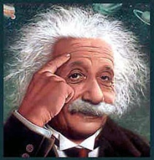
What an entrepreneur does
1. He perceives an issue
2. He conceives an Idea
Innovative answer
3. He verifies the opportunities
6 . He creates an organizational routine
5 . He finds the funds
4 . He lays the business pattern out

Slide 7
The three elements
Context
Opportunity
Investors
Founders
Value
Clients
HR
Team
Business
Model
Notes:
Hr= human resources

Slide 8
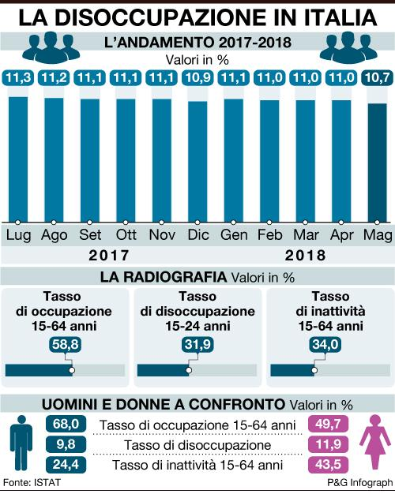
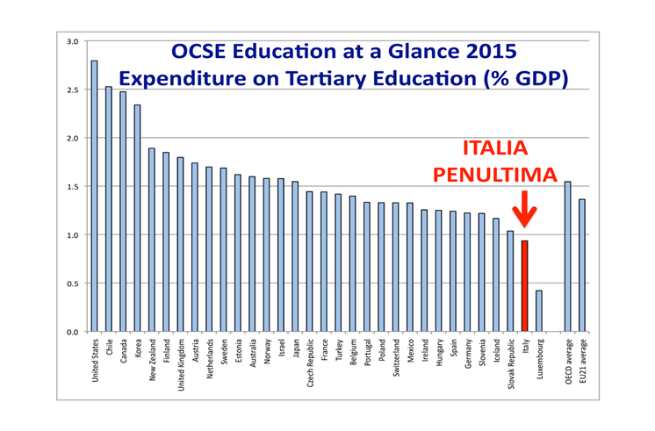
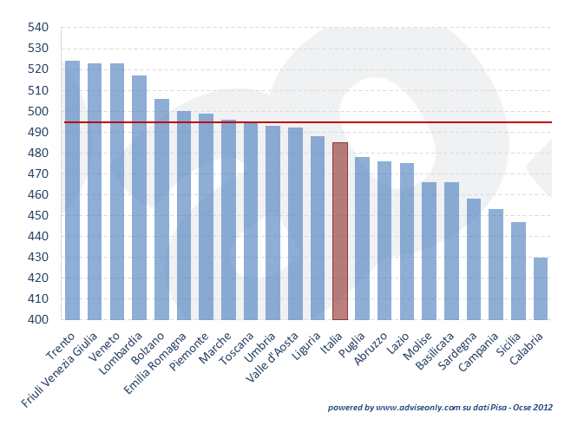
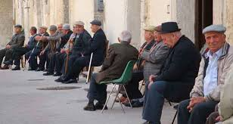
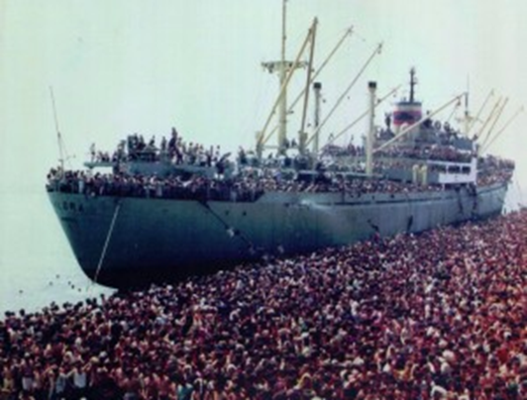
Scenario
Employment
Learning
Pisa Ocse Results
Tech Explosion
Geopolitics Revolution
Hyperconnectivity
Mass Migrations
Population Ageing

Slide 9
Growth Sectors
Health & Wellness
Energy
Tech
Shopping online
Info
Genetics
Care
Notes:
Craig Venter

Slide 10
Developing countries
Geopolitics- countries' GDP
2010
1 Usa
2 China
3 Japan
4 India
5 Germany
6 Russia
7 Uk
8 France
9 Brasil
10 Italy
11 Mexico
12 South Corea
13 Spain
14 Canada
15 Indonesia
2020
1 China
2 Usa
3 India
4 Japan
5 Russia
6 Brasil
7 Germany
8 Uk
9 France
10 Mexico
11South Corea
12 Indonesia
13 Italy
14 Canada
15 Spagna
International and World Economic Euromonitor Outlook /United Nations

Slide 11
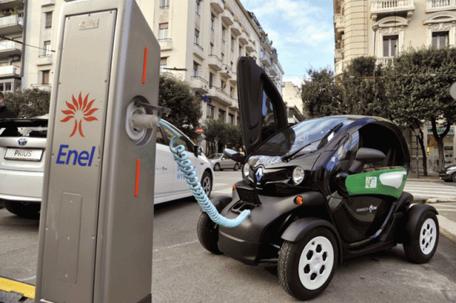
Internal Adaption Strategies
Context
Macro-economic setting
Asset
Field of Appliance
Technology
Regulatory System
Competitive Arena
Notes:
Asse= risorse Mercat di riferimento: analisi pest
Players: quanti sono, come si muovono produttori di colonnine-
Nrmative
Arena: 5 forze competitive di Porter
Tecno: livello 1: presa- livello 2: 4 ore di ricarica- livello 3: efficientamento energetico
Risorse: sia economiche – partnership industrilai- brevettuali-

Slide 12
Recognizing a talented entrepreneur
high
Empowerment
Learning
Parasite
low
low
Motivation
high

Slide 13
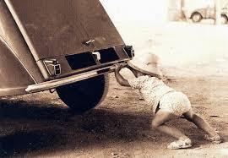
Honing a talented entrepreneur
The 7 Habits of Highly Effective People
(S. Covey)
•Be proactive
•Begin with the end in mind
•Put first things first
•Think win win
•Seek first to understand, then to be understood
•Synergize
•Sharpen the saw

Slide 14
The Entrepreneur’s Educational Path
Innate Gained Mature
behaviour behaviour Personality
FOURTH STEP THIRD STEP SECOND STEP FIRST STEP
LEADERSHIP
KNOW HOW TO MAKE SOMEONE DO
ABILITY
(KNOW-HOW)
stages skills behavious
kNOWLEDGE
(KNOWING)
pre-entrepreneurIal entrepreneurial MANAGERIAL
Notes:
Matura le competenze e scìviluppa il know how, solo se sa, può …..
Necessita di formazione, trasferirli e svilupparli negli altri

Slide 15
The skills to be developed
Group working to cooperate
Communicating to listen and to persuade
Motivating to self motivate and to enthuse
Exercising Power to be resolute
Deciding to opt for new approaches in real time
Negotiating to reach balance
Managing time to plan events and others’ time
Analyzing to face uneven events and likely options quickly
Stress Relieving to limit critical situations
Change Handling to foresee and rate factors systematically

Slide 16
The attitudes to foster
Common Sense
Courtesy
Trust
Optimism
Culture
Responsibility
Humility
Tenacity
Good taste
Confidentiality
Authoritativeness
Honesty
Belief
Negotiation
Resilience
Curiosity
Caution
Generosity
Perfectionism
Enthusiasm
Patience
Confidence
Notes:
O le hai o non le hai

Slide 17
A proper leader’s mindset is characterized by:
Energy adopting a responsible attitude and having charismas at the same time
Pursuing objectives producing outcomes coherent with own’s aims
Respect protecting one's own and others' dignity
Consent consulting employees
Influence arousing Authoritativeness
Acknowledgment sharing results with own’s team
Leadership respecting team’s requirements
Continuous Learning expansion of skills and skill-sets

Slide 18
The common features of an Entrepreneur
He needs to face new challenges
He is independent
He is responsible of his outcomes
He is keen of taking risks
He is self-confident
…. the Successful Entrepreneur…
He is technically expert
He has a full knowledge of the industry
He is deeply involved into his project
Notes:
Ci lavora 24 ore a giorno e vince le sfide

Slide 19
The Red Queen Effect
"A slow sort of country!" said the Queen. "Now, here, you see, it takes all the running you can do, to keep in the same place. If you want to get somewhere else, you must run at least twice as fast as that!"
Notes:
Red Queen Effect. The red queen effect is a metaphor used in the business world to describe the unsuccessful efforts of a company to get ahead of its competition. Companies typically research or study the competition and then implement strategies to help boost their company sales and profits.

Slide 20
Vocational school of trade and catering
From Business idea to the Business Plan
by Bulgarian team

Slide 21
Business idea
Some sources of business ideas:
Your own professional and social experience
as a learner, worker or consumer or just as an observer
All kind of information derived from the Internet, radio, television and all media and commercial resources
Target research, free talks, questionnaires, focus groups with customers, traders or experts in the relevant fields

Slide 22
Criteria of evaluation
Market opportunity
Competition
Marketing system
Financial features
Personal savings/Bank credit
Donations/Leasing
Production factors
Risk

Slide 23
From the Business Idea to the Business Plan
The business plan summarizes the intentions of a company for a particular endeavor
It encourages entrepreneurs to make an objective assessment of the strengths and weaknesses of the business
The business plan is the essential part for banks and shareholders to invest in a future endeavor

Slide 24
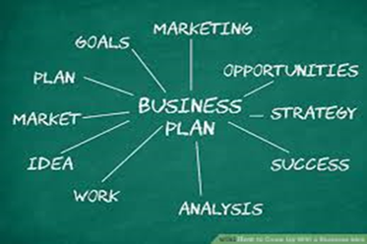
Structure of a Business Plan
What is the product?
What is the market?
Competition on the market?
What is your marketing strategy?
What is your management strategy?
What is your operational plan?
What is your financial plan?

Slide 25
Market analysis:
It defines the market in terms of size, demographics, structure, growth prospects, trends, and sales potential
It gives a prospect in both short and long term

Slide 26
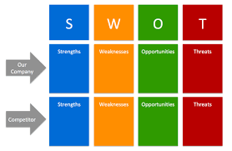
Competitive Analysis:
The strengths and weaknesses of the competitors within your market
Strategies that will provide you with a distinct advantage
Barriers that can be developed to prevent competition from entering your market
Any weaknesses that can be exploited in the product development cycle

Slide 27
Marketing strategy:
Positioning strategy
Establishing prices
Determining distribution
Promoting strategy

Slide 28
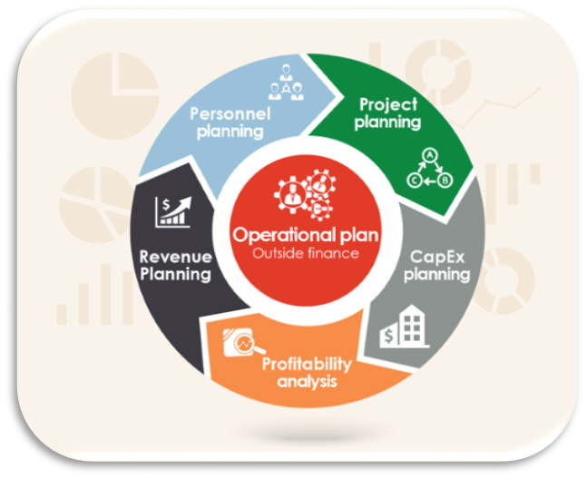
Operations and Management:
How the business functions on a continuing basis
Logistics of the organization
Management team
Personnel

Slide 29
Financial Components of Your Business Plan
The income statement
Cash flow statement
Balance sheet
Supporting Documents:
your resume
contracts with suppliers, customers, or clients
letters of reference
letters of intent
copy of your lease
tax returns for the previous three years and anything else relevant to your business plan.
Thank you for your attention!
The Vocational school of trade and catering
Vratsa- Bulgaria

Slide 30
Teaching Entrepreneurship
Anadolu Lisesi
Gaziantep, Turkey
by the Turkish team

Slide 31
What is entrepreneurship ?
Can entrepreneurship solve social problems ?
Identifying Social problems of the community in one’s country
The business ideas that can solve social problems

Slide 32
What is the entrepreneurship?
Entrepreneurship is the process of designing, launching and running a new business, which is often initially a small business
Entrepreneurship has been described as the “Requirement to develop, organize and manage a business while taking risk to get profit”
Who is an Entrepreneur?
The people who sets up a business or businesses are called entrepreneurs
Entrepreneur is an entity which has the ability to find new opportunities or technologies into products and services

Slide 33
Can entrepreneurship solve social problems ?
Yes, it can solve some social problems.
Entrepreneurship is a way of helping people and solving social problems as well as a way of earning money.
If you as an entrepreneur are able to solve a problem for society, you have the potential to using it to your advantage
So entrepreneurship is profitable for both sides.

Slide 34
Which social problems can be solved with entrepreneurship ?
Some examples:
Unemployment
Economic Deprivation
Healthcare problems
Drug Abuse
Hunger etc.

Slide 35
Social problems of the community in Turkey
1.
Economic Crisis
2.
Gender Violence
3.
Drug Abuse
4.
Immigration and Refugees
5.
Income Unequalty

Slide 36
50.000>
Since 2017
women killed by their ex-husbands in the world.

Slide 37
Social Supermarket
Business Ideas that can solve social problems
Create a food market that sells food to low-income communities at a low-price.
Low-priced food is donated (or purchased very cheaply) from food suppliers and other supermarkets, who cannot sell the food themselves because of some reasons like approaching expiry dates and damaged cans.
Baking/Cooking for a Social Cause
Open a bakery/restaurant that focuses on building employment skills for underemployed groups, such as at-risk youth or former drug addicts.
The profit from sales of food and beverage go to wages, training, and social betterment programs.

Slide 38
Water for everyone
Create a home water filtration machine that you sell to the third world countries , and use the income to improve the third world countries.
As a bonus, use environmentally friendly materials and processes in the creation of the product.
Social Crowdfunding
Build a platform for social entrepreneurs to find groups of funders.
Lenders take a promise of something in the future in return for ‘donating’ a bit of money to the Social Entrepreneur’s project now.
Take a small fee to cover the operational costs of the platform.
Thank you for your attention!
Anadolu Lisesi
Gaziantep, Turkey

Slide 39
The role of entrepreneurial education
Tehnological School Sfanta Ecaterina
Urziceni, Romania
by Romanian team

Slide 40
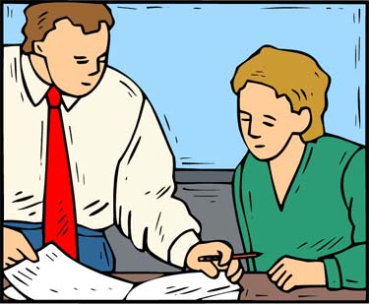
Entrepreneurial Education
The concept of Social Entrepreneurship as part of the business environment
Aspects of Social Entrepreneurship in Romania
The mission and impact of social entrepreneurship
Facing social problems at school

Slide 41
Social Entrepreneurship is different from the traditional one because of its purpose. Social entrepreneurship aims to generate profit in order to transform it into social capital that will ensure sustainable development of society.
Social entrepreneurship does not aim to make substantial profit for investors or for itself. Instead, it seeks to produce social changes for the benefit of a single group of people or even of the whole society.

Slide 42
Social entrepreneurship in Romania is in its infancy, although there is a great potential for its value. First of all, the inefficient and restrictive legislative framework represents the real challenges for this field. Following a study at European level it was found that the social entrepreneurship environment in Romania is composed of 53% women and 47% men being the only one in Europe with this structure. 17% of innovators work in the field of social inclusion, 17% in education, 15% in civil involvement, 7% in health, 14% in other fields
Although it is in an early social stage in Romania, social entrepreneurship supports a variety of ideas and challenges. The large urban centers – Bucharest, Iasi, Cluj and Timisoara offer the most possibilities for social business development.

Slide 43
Those social enterprises benefit the community, they are predisposed to innovate, they are addressed to the socially excluded people, offering them opportunities for volunteering, training and even employment. Young people are the first to respond to these types of concepts because they will create the economy of the future. The mission and impact of social entrepreneurship in the communities in which it is active is also noticed by the fact that more and more business people are interested in the social impact of the investments made, especially since in the last years there are some favorable legislative elements (for example: Employment of unemployed means the reduction a certain tax rate for the employer), unemployment being a social problem with real impact.

Slide 44
High school students have the maturity necessary to identify social problems in the family and society and even get involved. This involvement can be presented in the form of identifying the definite problems, engaging in a volunteerism that shapes their personality. The student is from the point of view of the educator, the adult in training and can be later an entrepreneur with the chance to develop a business. It depends on the support offered equally by the school and the family, but also by the society. The theoretical basis is laid, practically his involvement and responsibility comes later. It is very important to teach the students to think in pragmatic, applied terms, to pose problems and to seek ways to solve and raise awareness of social problems such as poverty, unemployment, school dropout, etc...; if he later chooses Social Entrepreneurship, he will have to consider both its purpose as a profit, but also its inner aim of helping certain disadvantaged categories, so as to be inclined to solving social problems.
At a first stage he can volunteer to know the real problems of the space where he lives, and the school offers the necessary support in this regard. Volunteering leads the investor to a better investment, to identifying some real real problems. It also means seeking solutions that can later have a social impact to the same extent provided by the educational system.
Thank you for your attention!

