Slide 1
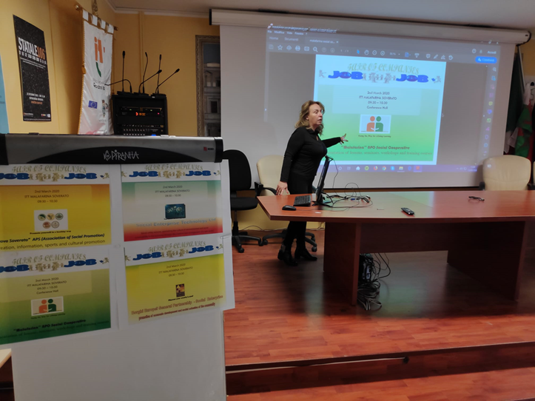
European Civic Attitude Through Social Entrepreneurship
2019-1-RO01-KA229-063748

Slide 2
Presentation Index
Logo / Cover
Presentation Index
Who We Are (Name, Headquarters, Duration, Share Capital)
Our Mission and Values
Corporate Purpose
Our Philosophy
Our Strategy
Code of Ethics
The Social Report
The guidelines for drawing up the social report
Governance
Main Performance
Acknowledgments

Slide 3
Who We Are
«MALAFARINA» SOCIAL COOPERATIVE ENTERPRISE (NPO), “MALAFARINA COOP”
is a social cooperative made up of a group of young people in 2019
Headquarters in Soverato, Trento e Trieste street
Website: www.msce.it
The Company duration is established until 31 December 2050
The share capital amounts to Euro 5,000.00
Each shareholder made the relative payment to the social coffers
The cooperative operates without any speculative purposes
in order to manage services in the form of an enterprise
in the educational, cultural and social training sector

Slide 4
OUR MISSION AND VALUES
MALAFARINA COOP
inspired by the principles of solidarity and mutuality of the cooperative setting
intends to:
pursue the general interest of the community in human promotion and social integration with particular reference to socially disadvantaged subjects, through the rational use of the human and material resources available.
It provides a qualified response to social, educational and training issues and needs.
It guarantees the answers that best meet users' needs, through the personalization of interventions, qualifying training courses, promoting the well-being of the person and the groups
through prevention actions, active involvement and sharing of objectives.

Slide 5
Cooperative purpose MALAFARINA COOP is a professional training course provider recognized by Calabria Region with the code 2678-1
Compulsory training courses, recognized and professional qualification courses
Children's workshops (in schools and out of school)
School support
Meeting supply-demand in the professions of personal care
Art and well-being for children and adults -Summer centers
Orientation service
Training, updating, research in the social, pedagogical, educational, welfare, promotion of inclusion and integration rights for minors and adults in situations of social exclusion.
Promotion and collaboration in international initiatives aimed at promoting rights in children and adolescents, intervention projects coordinated by "non-governmental organizations", European projects in the field of education, professional training, promotion of rights and social inclusion for adults.
Study, research and training for the affirmation of ethical orientation, professionalization and quality development in the "non profit" sector
.

Slide 6
Our Philosophy
MALAFARINA COOP is proactively aimed at relationships enhancement,
providing active listening both to individuals and to groups’ needs.

Slide 7
Our Strategy
MALAFARINA Coop
is a cooperative organization
of utmost importance
It provides a team of highly skilled experts, ensuring maximum efficiency, transparency, reliability and expertise in active participation techniques that putting people at the centre of their care will improve the quality of the services available by taking into account their
peculiarities, resources and needs.
Our approach involves:
need detection;
the identification of the most suitable service and its provision.

Slide 8
Code of Ethics
The cooperative acts in compliance with
principles and values set out in the Code of Ethics (approved by the BoD):
Integrity, honesty and loyalty
Respect for human rights
Value and protection of the person
Transparency, fairness and confidentiality
Legality
Responsibility
Health and safety protection
Environmental Protection

Slide 9
The Social Report
Third sector entities with revenues, annuities or income exceeding €1 million must file the social report drawn up according to guidelines adopted by the decree of the Italian National Register of the Third sector, and publish it on their website.
Minister of Labor and Social Policies Art. 14 paragraph 1 of the Third Sector Code
From 2021, the social report must be published, by June 30 of each year, in the Register of Companies
The social report is a public document addressed to all the stakeholders (all workers, volunteers, donors, institutions), concerning useful information to evaluate to what extent the organization considers and pursues its aims and principles.
It also represents a way to publicize the value of the company's work.
OBLIGATION OF LAW 124/2017
Social Cooperatives must publish information relating to grants, subsidies, benefits, contributions or aids, in money or in kind, in fringe benefit in the notes to the financial statements and, being a non-profit organization, by June 30 the same information on its website.

Slide 10
The guidelines for drawing up the social report
The principles of drafting
Transparency:
Neutrality:
Comparability:
Clarity: truthfulness and verifiability:
Reliability:
Autonomy:
Contents
Methodology adopted: drafting criteria for the financial statements and general information on the entity
Governance: data on a social basis and on direct and control bodies, stakeholders
People: information and data relating to workers and volunteers, employment contracts adopted, activities carried out, compensation structure
Activities: achievement or non-achievement of the planned objectives and the factors that have facilitated or made it difficult to achieve them as well as the factors that risk compromising the purposes of the Body and the actions taken to counter this eventuality
Economic and Financial situation
Other Information: environmental impact (if applicable), gender equality, human rights and prevention of corruption

Slide 11
GOVERNANCE
Board of Directors
X
X
Shareholders’ meeting
NGO
elects
board of statutory auditors
Ceo
X
Chairman of the board
x
HSE
Board of arbitrators
appoints
Admnistrative services
Staff
Managers
Directors
workers (members and no members)
volunteers, co-workers, trainees and interns
Notes:
HSE: rspp responsabile-del-servizio-di-prevenzione-e-protezione
NGO- ovd

Slide 12
The main performance
Malafarina Coop:
was established in the form of a notarial deed, drafting the articles of association and the articles of association;
requested the Tax Code / VAT number for the registration of the articles of association at the competent local Office of the Revenue Agency;
filed the articles of incorporation through a notary at the Register of Companies of the Chamber of Commerce of Catanzaro;
was registered in the National Register of Cooperatives with prevailing mutuality;
paid the annual fee - fixed amount - to the Chamber of Commerce;
communicated the concrete start of the activity to the Chamber of Commerce (Business Register) with a special form;
enrolled in the Regional Register of Social Cooperatives.

Slide 13
Thanks for watching
The Ceo
………….

