Slide 1
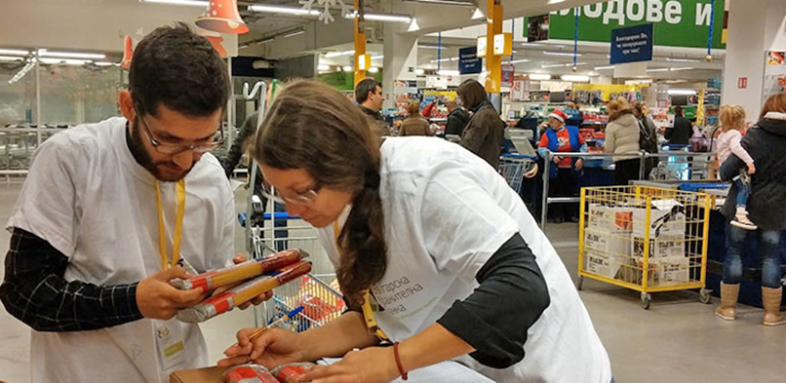
VOCATIONAL SCHOOL OF TRADE AND CATERING
European Civic Attitude Through Social Entrepreneurship
2019-1-RO01-KA229-063748
FOOD DONATION Ltd,

Slide 2
CONTENT
THE PROBLEM
MISSION STATEMENT
OUR VALUES AND PRINCIPLES
OUR GOALS
BENEFICIARIES
LEGAL FRAME
FUNDING
STAFFING PLAN
YOU COULD DONATE
CONTACTS

Slide 3
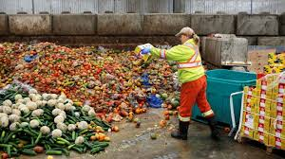
THE PROBLEM
It is estimated that 30% of the food produced, or a total of 1.3 billion tonnes, is lost. At the same time 1 billion people worldwide are malnourished, another one billion are starving.
It is officially estimated that in Bulgaria alone about 670 thousand tons of food are thrown away every year.
In Bulgaria, more than 1.6 million people live below the poverty line.
This amount of thrown away food could provide enough food for all people in need in Bulgaria for a period of 15 months. Our organization offers a solution for both food waste and direct impact on local communities.

Slide 4
Mission statement
We are a non-profit organization that collects, stores and distributes donated food with a limited shelf life, complying with all food safety standards, as well as ready-to-eat foods that cannot be sold. This is food that is about to expire and to be destructed. With the help of people from vulnerable groups and volunteers, food is distributed to thousands in need. Food donation is a member of the Global Food Banking Network and the European Federation of Food Banks.

Slide 5
Our values and principles
Impartiality - providing food support to those in need regardless of their ethnic, religious, age, professional, gender and other affiliation.
Integrity, transparency, accountability;
Reliability - the organization works in accordance with the laws of Bulgaria;
Partnership;

Slide 6
Our goals
To develop food banking as a tool for providing food support and a link between the food industry and organizations providing food support;
To work to limit the disposal of edible food and thus to contribute to the effective reduction of food waste;
To organize the collection of donations of food products, services and funding from producers, processors, food traders and others;
To provide regular, wide-ranging, permanent and effective food support to groups in need of food;
To support and encourage the development of volunteering
To create opportunities for social inclusion of vulnerable groups of long-term unemployed, low-income retirees, single mothers.

Slide 7
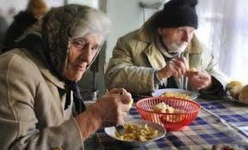
Beneficiaries
Our non-profit organization was established by the association of 5 companies from the city of Vratsa that work in the field of food. They join forces to work for the benefit of society by connecting other food companies and potential consumers:
Long-term unemployed;
Single mothers;
Pensioners;
Orphanages and nursing homes;

Slide 8
LEGAL FRAME
Non-profit association with the name Food Donation, a legal entity registered in accordance with the provisions of the Non-profit Legal Entities Act . The members of the Association are obliged to pay the provided monetary contributions on time. The Association does not distribute profits and dividends, and the revenues received from the activities of the Association are used to achieve the goals set out in these statutes.

Slide 9
Funding
The property of the association consists of the founding contributions of the founders.
Sources of funds to achieve the goals:
donations in food, money or other assets from Bulgarian and foreign individuals and legal entities;
sponsorship agreements with state bodies and international organizations;
membership fee from the members of the association;

Slide 10
YOU COULD DONATE :
Food donation meets all food safety standards and ensures that the food it provides to those in need is fit and of good quality. Works only with legal entities - registered producers, processors and food traders and retailors.
Food with a short shelf life
Food with wrong labels and packaging that are not expired
Seasonal foods produced in excess
Promotional products withdrawn from the market
Rejected orders
Raw materials for food production suitable for direct consumption
Food with labels in a foreign language
Foods with damaged commercial appearance, but with preserved integrity of the packaging

Slide 11
YOU COULD DONATE :
Meat and meat products
Eggs and egg products
Milk and dairy products
Fruits and vegetables
Chilled and frozen foods
Beverages with or without storage temperature
Dry, packaged and canned foods
Cereals, legumes, pasta
Durable and perishable confectionery
Chocolate
Flour, bread and bakery
Vegetable oil and butter
Spices
Tea, coffee, cocoa
Formula for babies

Slide 12
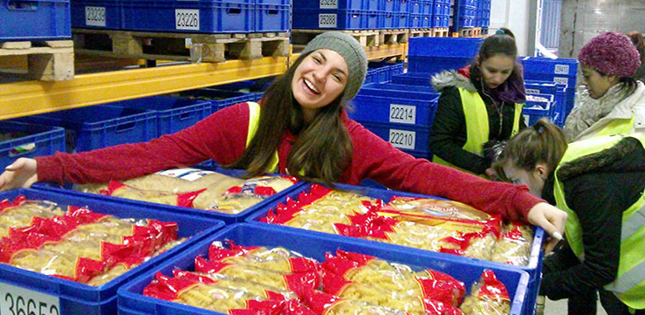

Slide 13
WHAT YOU CAN NOT DONATE
Expired food
Food of unclear origin and without quality documents
Frozen and refrigerated foods with broken temperature circuit
Catering food
Homemade food or food canned at home.
All donated food must be accompanied by the relevant certificates, commercial and other documents certifying that the food meets the hygienic and regulatory requirements for safety and is fit for consumption.

Slide 14
STAFFING PLAN
1. Food donation saves perfectly edible food which otherwise would be destructed.
3. To the warehouse of Food donation
4.
With the help of volunteers and people from vulnerable groups, the food is distributed in food packages
2. Food industry donates and delivers the food.
5. And it is distributed to people in need and from vulnerable groups.

Slide 15
STAFFING PLAN
Manager
Department
Spedition
Department Marketing
Department Warehouse
Department Finance
Department
Human resources
Speditors
Marketing expert
Warehouse workers
Head accountant
Manager Human resources
Delivery specialist
Public relations expert
Cashier
Specialist manpower and wages

Slide 16
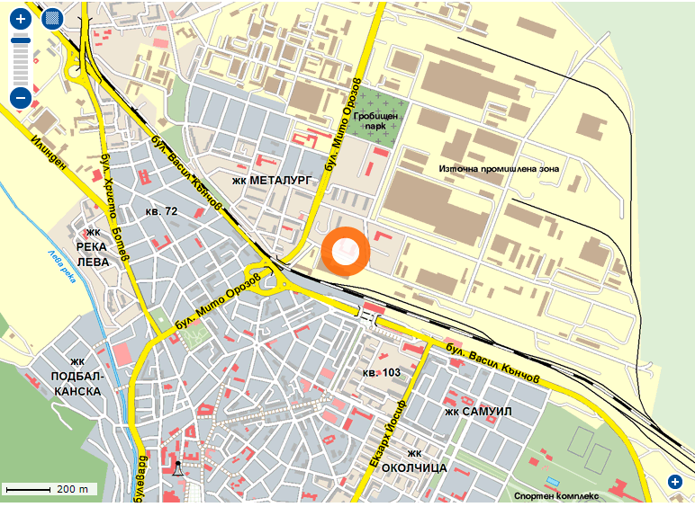
CONTACT US
Our adress:
BULGARIA
3000 Vratsa,
3 Hristo Smirnenski Str. +35992847689 email: contact@abv.bg,
www.fooddonation.bg

Slide 17
OUR LOGO AND MOTTO
“If you can’t feed a hundred people, then just feed one.” –Mother Theresa

