Slide 1
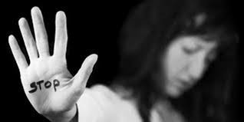
GAZİANTEP ANATOLIAN HIGH SCHOOL European Civic Attitude Through Social Entrepreneurship 2019-1-RO01-KA229-063748
LIFE WITHOUT VIOLENCE FOUNDATION (LIVIO)

Slide 2
CONTENT
THE PROBLEM
GOALS
BENEFICIARIES
FUNDING
ORGANIZATIONAL CHART
LOGO AND MOTTO

Slide 3
THE PROBLEM
Increasing number of women exposed to violence therefore living far from society and in fear.
Approximately 320 women were subjected to violence in 2017.
Approximately 474 women were subjected to violence in 2019 .

Slide 4
GOALS
To bringing women exposed to violence and their children to society,
To inform women and their children about what to do when they are subjected to violence,
Getting support from institutions that deal with this issue,
Making to them feel they are not alone.

Slide 5
A Woman Who Is Exposed To Violence Calls For Help

Slide 6
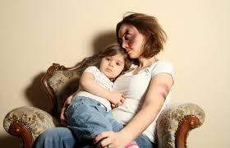
Beneficiaries
Women exposed to violence and their children.

Slide 7
FUNDING
Civil Society Organizations,
Ministry Of Family And Social Policies,
Hospitals.

Slide 8
Organizational chart
MINISTRIES
MANAGER
TEACHERS
PSYCHOLOGİST

Slide 9
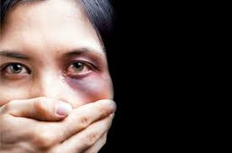
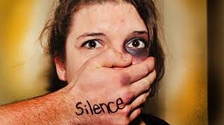

Slide 10
OUR LOGO AND MOTTO
OUR MOTTO OUR LOGO
DO NOT BE QUIET !

