Slide 1
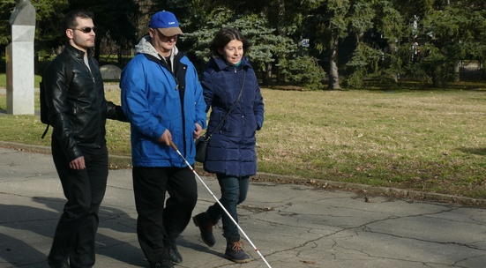
VOCATIONAL SCHOOL OF TRADE AND CATERING
European Civic Attitude Through Social Entrepreneurship
2019-1-RO01-KA229-063748
Hope for Life Ltd,

Slide 2
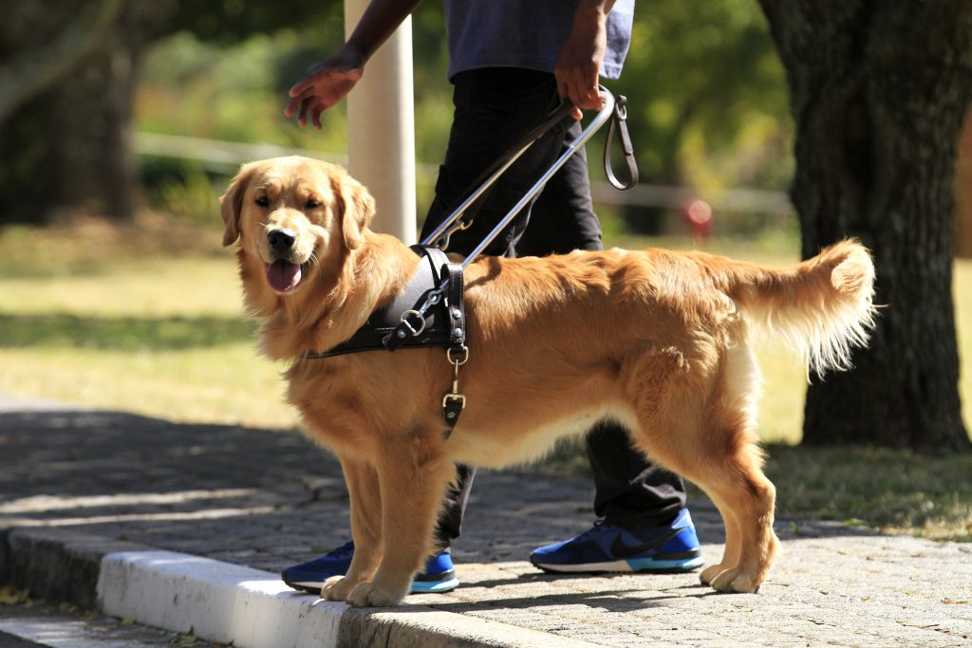
GENERAL INFORMATION
-name; Hope for Life Ltd
-slogan; Little helpers- big steps
-legal form; Ltd - Limited Liability Company
-headquarters; Vratsa
-phone; +5555555555
-website; https://sites.google.com/view/hope-for-life-ltd/home
-Social capital; The property consists of the founding contributions of the founders.
-number of shares or shares;
- CAEN code: 88.99 Other social work activities without accommodation not elsewhere classified.

Slide 3
Legal frame and key activities
Hope for Life Ltd A non-profit organization is a legal entity registered in accordance with the provisions of the Non-profit Legal Entities Act. The income from this activity can be used only to achieve the goals set out in its bylaws without the possibility of profit distribution.

Slide 4
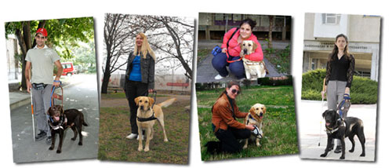
DESCRIPTION OF THE COMPANY Main activity
According to the World Health Organization, there are nearly 40 million blind people in the world. Like every other person on the planet, they need independence. And it can be safely provided by the presence of a specially trained dog.
Guide dogs for people with blindness are specially trained and educated. They support people's lives, allow them to walk and travel, to be independent in a way that was not possible before. It is much easier to socialize and communicate with other people.

Slide 5
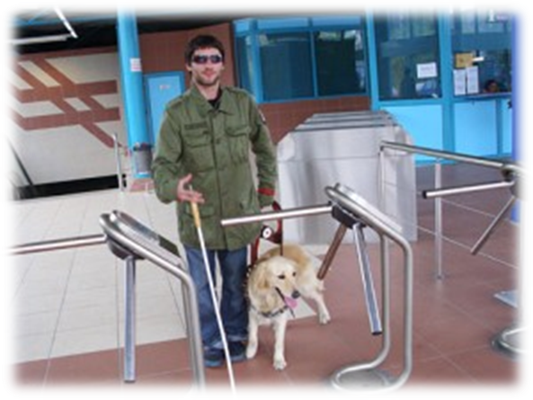
Main activity
Our organization will be located in Bulgaria, in the city of Vratsa and we will help many people to start a new life and return to society through their dogs - guides and assistants. The company will be created for people in social exclusion:
Blind people, people with severe visual impairment
Hope for Life Ltd will be a full member of the European Guide Dog Federation (EGDF) and the The International Guide Dog Federation (IGDF). Membership in these 2 prestigious organizations is a guarantee for the quality of our service dogs. The foundations will be laid by volunteers.

Slide 6
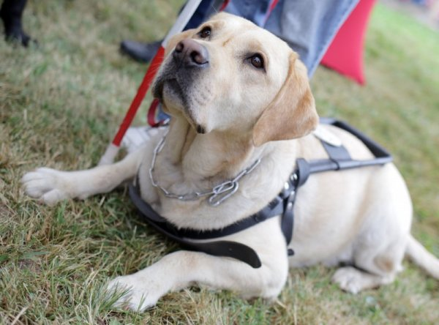
Secondary object of activity
Social media pages will be created in order to increase donors and retention rates, to spread the idea of Hope for life Ltd, our goals, our values and the results achieved.

Slide 7
Mission of the company
Hope for Life Ltd strives to provide disadvantaged people with the best and most appropriate service that gives them a sense of comfort and a fulfilling life.

Slide 8
Strategy: short-term and long-term company's objectives;
Improving the quality of life of people with disabilities in Bulgaria by strengthening their social inclusion through the provision of innovative social services;
Creating a partnership for the exchange of knowledge, know-how and good practices;
Improving the effectiveness in developing and offering solutions to address the problem of rehabilitation and reintegration of people with disabilities with the help of guide dogs;
Creating conditions for full social inclusion of people suffering visual impairments;
New job opportunities for blind people;
Sustainability of Hope for Life Ltd.

Slide 9
Structure of the company
Manager
Executive bureau
Animal instructors
Dog center
Foster families
PR&Social networks

Slide 10
MANAGEMENT
FORM MANAGEMENT (about those who ensure the management of the company) - - is provided by a manager who is at the top of the management hierarchy of Hope for Life Ltd.
USE OF NEW TECHNOLOGIES AND PROMOTION OF THE INFORMATION SOCIETY
-impact on the environment; inapplicable
-Energetic efficiency- inapplicable

Slide 11
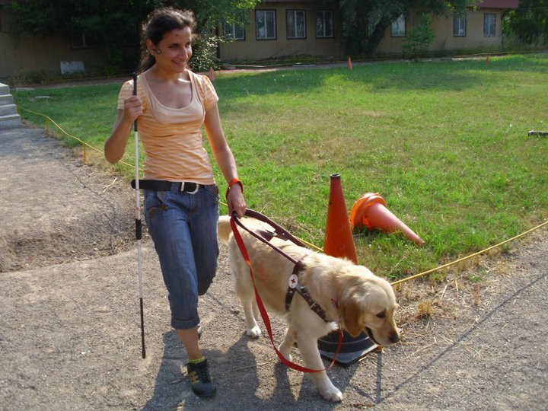
Business idea
- Finding a job and hard-to-reach urban environment are the most serious issues for blind people in Bulgaria ;
Challenges related to the use of various services;
Most pedestrian areas and bus stops still lack guide lines that show the safest area to drive;
The lack of an accessible environment, the complicated procedure for providing free assistance and accessibility equipment for the disabled, low employment rates;
There are 16,000 blind people in Bulgaria and over 200,000 in the Balkans.

Slide 12
Quantifiable objectives: economic, psychological
The organization's mission is to build a Balkan service dog training center for people with disabilities. We believe that with our coordinated and focused efforts and with the help of volunteers and donations, we will create a one-of-a-kind school for guide dogs and assistants for people with disabilities. With their special skills and еndless love that are available 24/7, our certified guide dogs and assistants could improve the mobility and independence of people with severe vision impairment.

Slide 13
Expected activities
The program for socialization of future guide dogs is carried out entirely on a voluntary basis. Foster families have the difficult task of raising a healthy, well-behaved and happy dog that is not afraid of the intense urban environment, travels smoothly in all kinds of transport. During the whole period while the dog is in the foster family, weekly trainings and socialization events are held in different places in Sofia.
Foster families do not have any costs and financial obligations for raising the dogs. The organization will provide everything needed - food, veterinary services, accessories and free travel for the dog and its foster owner in public transport.
Resourses needed : The two-year training process, as well as the support of the service dogs are funded and provided by the organization through donation contracts.

Slide 14
the SWOT analysis
Strengths
Helping disadvantaged people;
We are creative with new ideas;
Аvailability of experience and contacts in the industry
We are committed to our work with the goal of satisfying the customers who work.
Weaknesses
Financing;
Lack of qualified and trained staff
Opportunities
Retaining positions;
Improving the qualification and motivation of the staff.
Threats
Changing the economic situation as a result of the global economic crisis;
Competition;
Lack of financial resources.

Slide 15
FINANCIAL ESTIMATES AND NECESSARY FUNDING
The property consists of the founding contributions of the founders.
Sources of funds to achieve the goals:
Donations
Sponsorships
Targeted projects with external financing

Slide 16
BUSINESS MARKETING
Clients
- There are similar organizations in Europe which provide these services for free.
Guide dogs are very expensive, the only choice people with visual impairment have is to use our services for free.
We are highly motivated and with the help of sponsors, volunteers our organization will manage to achieve the goals we set. Our school for outrunners will have instructors, foster families, volunteers

Slide 17
Action plan to attract customers
We perform social activities and our company does not aim to attract customers and profit. Hope for Life Ltd is a non- profit organization. A brochure, catalog, website, poster will be created to promote our activities.

