Slide 1
European Civic Attitude Through Social Entrepreneurship 2019-1-RO01-KA229-063748
Gaziantep Anatolian High School

Slide 2
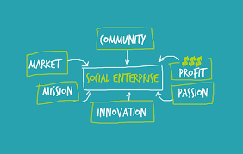
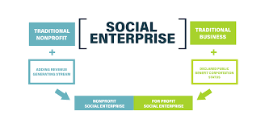
Content:
-Who We Are- Our Objectives
-The main Features: Aims and Duties
-Other Info: Headquarters, Share Capital and Corporate Purpose
-Goals and Target
-Mode of Operation of the Internet Portal
-Users’ opportunities
-Signalling service
-Staffing Plan
-Acknowledgments

Slide 3
Who We Are
GAL Cooperative Enterprise was established in 2020 by
Young students and their English Teacher.
GAL Cooperative Enterprise has been created in order to grow more young entrepreneurs and create better conditions for entrepreneurs.

Slide 4
Aims and Duties
Our aims are helping new entrepreneurs in financial and teach them how to start an enterprise.
Our duties are make them trust themselves and make them prouder about what they do.
Basically, our aims and duties is grew succesful entrepreneurs.

Slide 5
For the realization of the Project;
The Company going to invest the young entrepreneurs.
The Company going to create new surfaces for new enterprises.
The Company going to have meetings with young entrepreneurs.
The Company going to invite big entrepreneurs and CEOs to inspire young and new entrepreneurs.
The Company going to meet with business persons to convince to give scholarships to bright entrepreneurs.

Slide 6
Other Info: Headquarters, Share Capital and Corporate Purpose
Our ‘Headquarter’ will be in Gaziantep because we are in Gaziantep Anatolian High School.
Our ‘Share Capital’ will be gained by the business persons donates and our entrepreneurs a small percentage of their earnings.
Our ‘Corporate Purpose’ is let young entrepreneurs enterprise.

Slide 7
Goals and Target
Our goal is economic and social development.
Due to economic development the Turkey and the World won’t have economic crises like 2008.
Due to economic and social development young entrepreneurs will create bright futures.
Due to social development the people will be nicer to each other.

Slide 8
Mode of Operation of the Internet Portal
Our internet portal is quite simple.
All you should do is fill in the blanks and wait till we turn back to you.
Our system examines your application by considering this factors:
The possibility of the succes,
The benefits of the Project at the end.

Slide 9
Users’ opportunities
Users can start their enterprises easily which they dream.
Users will be a part of our estabilishment.
Great Entrepreneurs will give a speech and they will have chance to meet them.
Users will be able to discuss their opinions with experts.
Simply, it is a win win for all of us.

Slide 10
Signalling Service
Our email service(galcooperative@gmail.com) is always open for new mails.
Our company phone( 0598 989 8989) is always open for your calls.
You can send us fax.
You can send us letters.
You can come and meet face to face.

Slide 11
Staffing Plan
Our Staffs
Office Staffs:
Manager:We have a manager to manage the business.
Co-Managers:We have 2 co-managers to help our main manager.
Consultant:In critic moments, we consult with our consultant.
Cleaning Staff:We have 5 staffs working active in our Office.
Social media:
We have a social media crew for advertisment and help.
Internet:
Web site developer:We have a web site developer for our website.
Social Security:We have 2 staffs to secure our website and social media from hacking.

Slide 12
Thanks!

