Slide 1
European Civic Attitude Through Social Entrepreneurship
2019-1-RO01-KA229-063748

Slide 2
01
02
Table of
Contents
03
04
Who Are We
Aims and Duties
About our team and the project
Our team’s aims and duties
Goals
Other Info
Our team’s goals
Other info about us

Slide 3
Table of
Contents
05
06
Website
Organization Chart
About our website
Employee organization chart

Slide 4
01
Who Are We
About our team and project

Slide 5
Who Are We
People Food is a team that helps every kind of people from the society with low priced sales.
Our team detects neighborhoods with low welfare.
Opens shops in selected neighborhoods.
Our team collects products close to the expiry date frome the
supermarkets for a low price or free.
Sells the purchased products cheaply in our shops.

Slide 6
Most importantly, our team works non-profit and sustainably for people.

Slide 7
02
Aims and Duties
Our team’s aims and duties

Slide 8
Cheap and heathy food.
Aims and Duties
Easy access.
Our main aim is ensuring that everyone has access to healthy and cheap food and other products. Our shops contains products fits every person's budget.
We are going to open shops in every eighty one province in Turkey. In every province, we will have average twenty shops. in this way, we ensure that everyone has access to our shops. And we are planning to open shops abroad; in this way, more people will have access to our shops. That’s our main duty.

Slide 9
03
Goals
Our team’s goals

Slide 10
GOALS
Our goals are:
Having everyone access to our products
Opening a website that contains information about us and our shops
Opening shops in most of countries (at least 10 or 20)
Offering people cheap and healthy products

Slide 11
04
Other Info
Other info about us

Slide 12
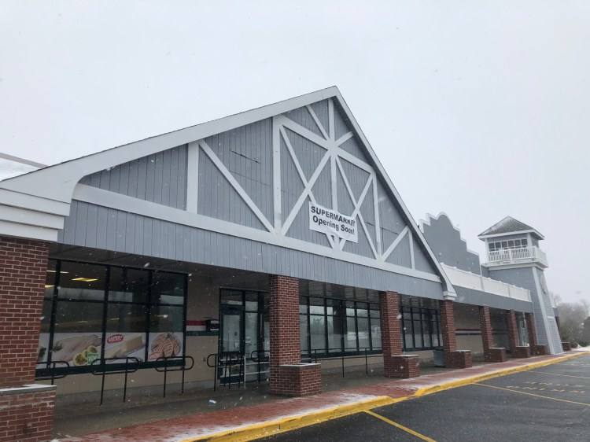
Contact Information and Other Info
E-mail: info@peoplefood.com
Website: www.peoplefood.com
Phone Number: +902123742300
Share Capital: 30000€

Slide 13
05
Website
About our website

Slide 14
Our Website
People Food
Products
About Us
In our website, you can find informations about us, our products and our shops.

Slide 15
About Our Website
Map
Product Information
About Us Page
You can see our shops’ location on this map. And you can get directions to our shops.
You can see which products are available in our shops on this page.
You can find this slide and other informations about our team in our website.

Slide 16
06
Organization Chart
Employee organization chart

Slide 17
Management Board
Products
Marketing
Management Board President
CEO
Transportation Manager
Journalist
Quality Control
Website Developer
Staff
Marketing Manager

Slide 18
THANKS
Mehmet Efe Calap
Gaziantep Anatolian High School

