Slide 1





GAZİANTEP ANATOLIAN HIGH SCHOOL
European Civic Attitude Through Social Entrepreneurship
2019-1-RO01-KA229-063748
PANDEMIC- BUSINESS ASSOCIATION

Slide 2
CONTENT
CHALLENGES
GOALS
BENEFICIARIES
FUNDING
ORGANIZATIONAL CHART
LOGO AND MOTTO

Slide 3
CHALLENGES
Dismissal of some people due to pandemic ,
There are some people who are not paid due to a pandemic,
An increase in the speed of the virus due to the community of these people in some regions.

Slide 4
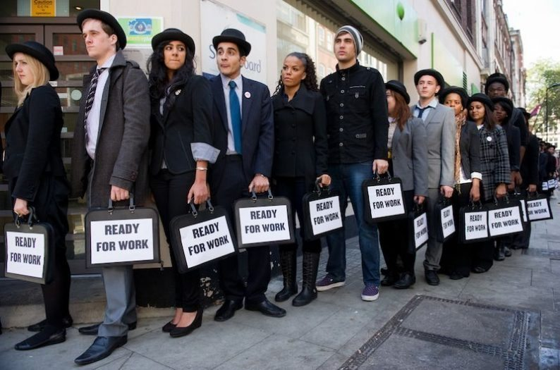

Slide 5

GOALS
Helping unemployed people to find jobs,
To inform people who cannot get their salary about what to do,
To compromise with employers ,

Slide 6

BENEFICIARIES
People who are unemployed and have problems with work due to the pandemic.

Slide 7
fundIng
IŞKUR
THE MINISTRY OF LABOR AND SOCIAL SECURITY
CIVIL SOCIETY ORGANIZATIONS

Slide 8
Organizational chart
MANAGER
COURTHOUSE
EMPLOYER
IŞKUR
LAWYER

Slide 9


LOGO AND MOTTO
WORKING IS LIFE, THINKING IS LIGHT.
VICTOR HUGO

Slide 10

