Slide 1
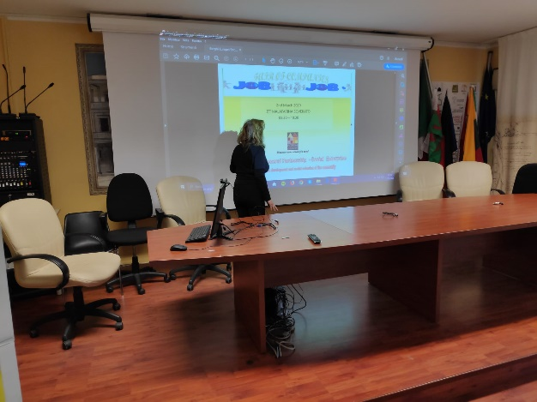
European Civic Attitude Through Social Entrepreneurship
2019-1-RO01-KA229-063748

Slide 2
Who We Are
Borghi Europei COMPANY was established in 2019, pursuant to Legislative Decree 117/2017 "Third Sector Code", as a NON-PROFIT, SUSTAINABLE, SOLIDARITY SOCIAL TOURISM BODY operating in the cultural, tourism and recreational fields.
For the realization of the project, the COMPANY:
met with tour operators with decades of experience to receive important suggestions
observed the trend, not only quantitative, but above all qualitative of the Eco-System, paying particular attention to the evolution of the following aspects:
the management of cultural heritage and tourist destinations;
the marketing of restaurant facilities;
the professionalism of the employees and the training for new operative tasks;
the behaviors of the traveler and tourist of the Third Millennium.

Slide 3
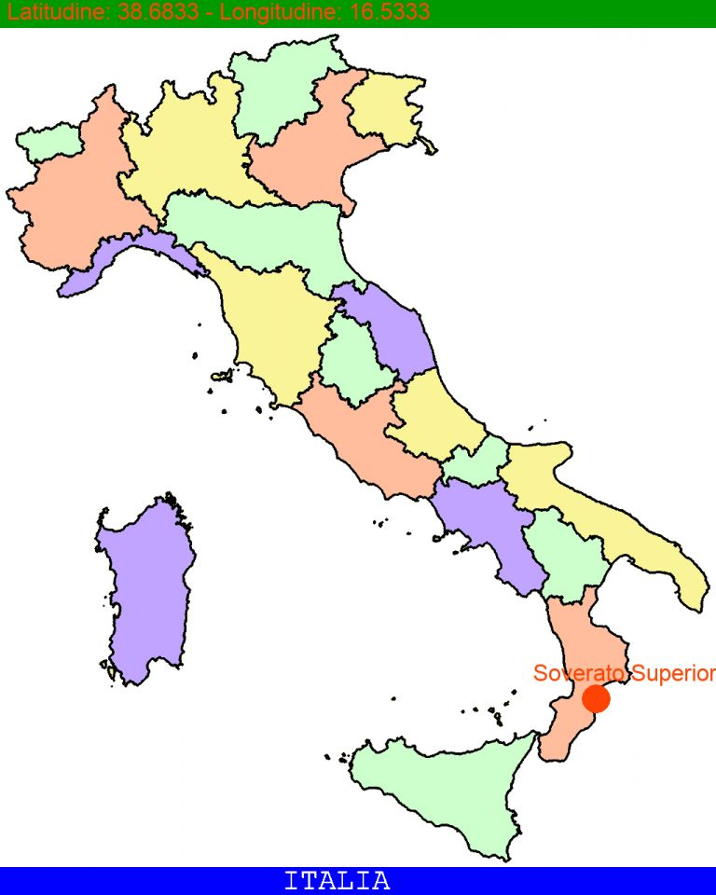
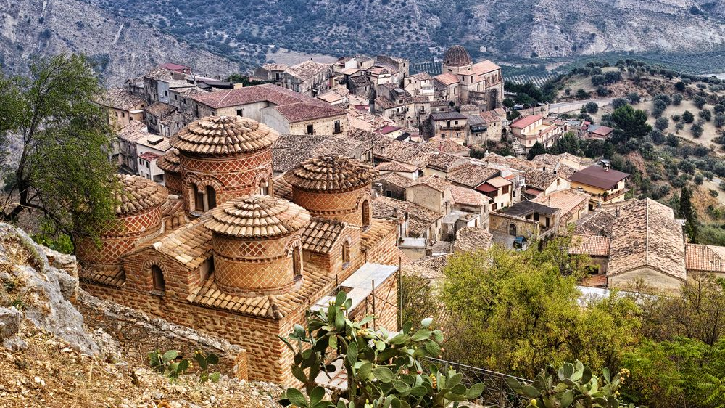
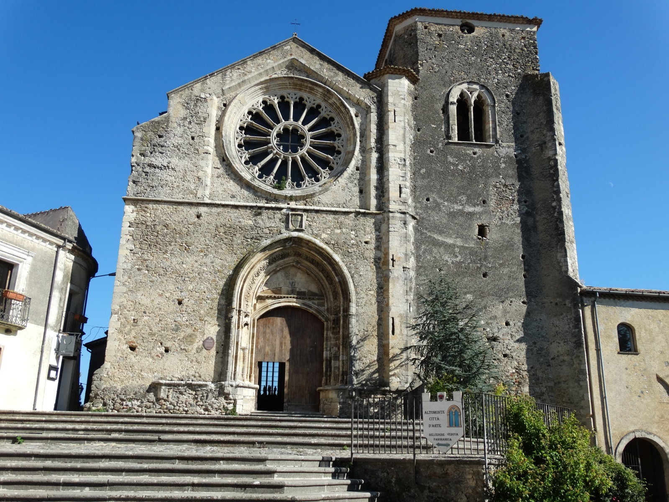
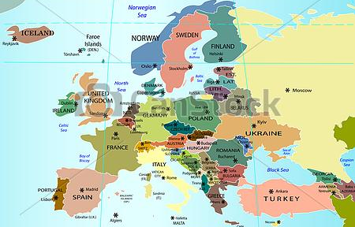
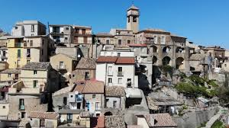
Stilo
www.borghieuropei.it
Altomonte
Badolato

Slide 4
Corporate Purpose
To promote Italian and international tourism Borghi Europei Company carries out the following general non-profit, activities for all members and third parties:
enhancement of cultural heritage, through the management of restaurant facilities and the organization of tourist trips
promotion and implementation of agriculture activities
training, through the organization of courses, seminars, stages
tourist events
For the pursuit of these institutional purposes, the Company:
mainly makes use of the activity of volunteers
collaborates with associations with similar purposes, with scholars, experts and with public administrations, cultural heritage associations, parks and natural reserves managers.

Slide 5
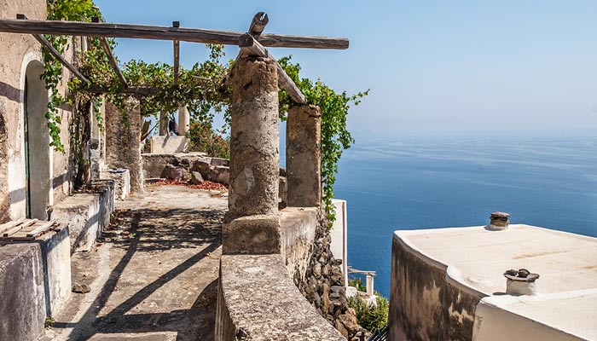
OUR MISSION
beneficial actions for the territory
With municipalities, national and international agencies, NGOs, stakeholders
funds for the development of unused assets
local issues, favoring redemption of marginal areas
project actions to access regional, national and European funds
to implement
to comply with
to guide
to interact
to accumulate

Slide 6
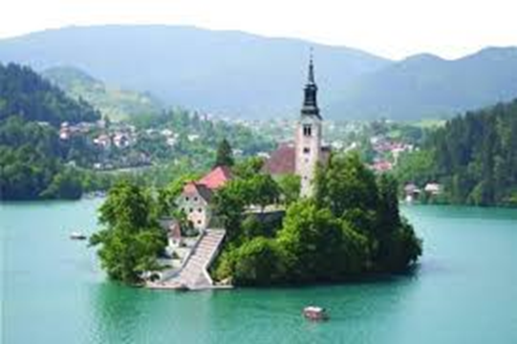
Aims
Borghi Europei intends to pursue, with transparency and effectiveness, the following objectives:
to revamp the small territories, through tourism in respect of economic and environmental sustainability
to participate in the growth process of the 'THIRD SECTOR', considered not as a residual and/or marginal element of the national economy, but as one of the main protagonists of the country's development.
to favour social cohesion through processes that connect people with communities.
to valorize human and environmental resources located in marginal territories, to spread awareness of the importance of "common goods".
To make people who have been so far excluded from the innovation and growth, protagonists

Slide 7
Subsidy
Borghi Europei is supported by the following fiduciary relationships:
Listening attitude capable of grasping people's expectations, the needs of the communities, the problems of the territories.
Alliances to converge and define collaborative agreements.
Cooperations to identify objectives and find solutions.
To build and strengthen these "relationships", the company receives:
Payment of Funds
in maximum transparency and in compliance with current regulations, protecting their destination and respecting any purpose indicated as a restriction.
Donation of real estate in the villages which have been abandoned and / or not used for some time
Charitable Donations
taking advantage of the tax relief provided by law

Slide 8
OBLIGATIONS RELATING TO ACCOUNTING PURSUANT TO ART. 9 OF D.LGS. 112/2017
Filing and publication on own’s website of the SOCIAL REPORT, to be drawn up in accordance with the criteria established by specific guidelines defined by a specific decree of the Minister of Labor and Social Policies (according to the provisions of Law 106/2016)
Drafting and filing at the Companies Register of the Financial Statement in accordance with the corresponding provisions of the Civil Code.
Storing of accounting records, identified in the journal and in the inventory book
The main purpose function of the Social Report is to provide a precise State of Art of the activities carried out towards the beneficiaries of all the social involved interlocutors, in order to express a reliable qualitative and quantitative assessment of the effects produced on the reference community, in relation to well-defined objectives and with short, medium and long term projections

Slide 9
Organization chart
Accounting
Administrative and Accounting
Audit Board
Funds Management
Enhancement of Cultural Heritage Team
Promotion and Implementation of Agriculture Activities Team
Assembly of the Associates
Management Board
Operational
function
Training Team
Tourist Events Team
Human Resources Management
Staff management
Relationship Management

Slide 10
Thanks for the attention!
Annamaria Salerno
ITT G. Malafarina Erasmus+ team

