Slide 1
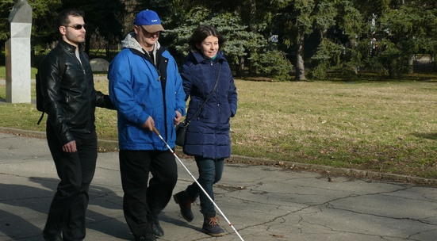
VOCATIONAL SCHOOL OF TRADE AND CATERING
European Civic Attitude Through Social Entrepreneurship
2019-1-RO01-KA229-063748
Hope for Life Ltd,

Slide 2
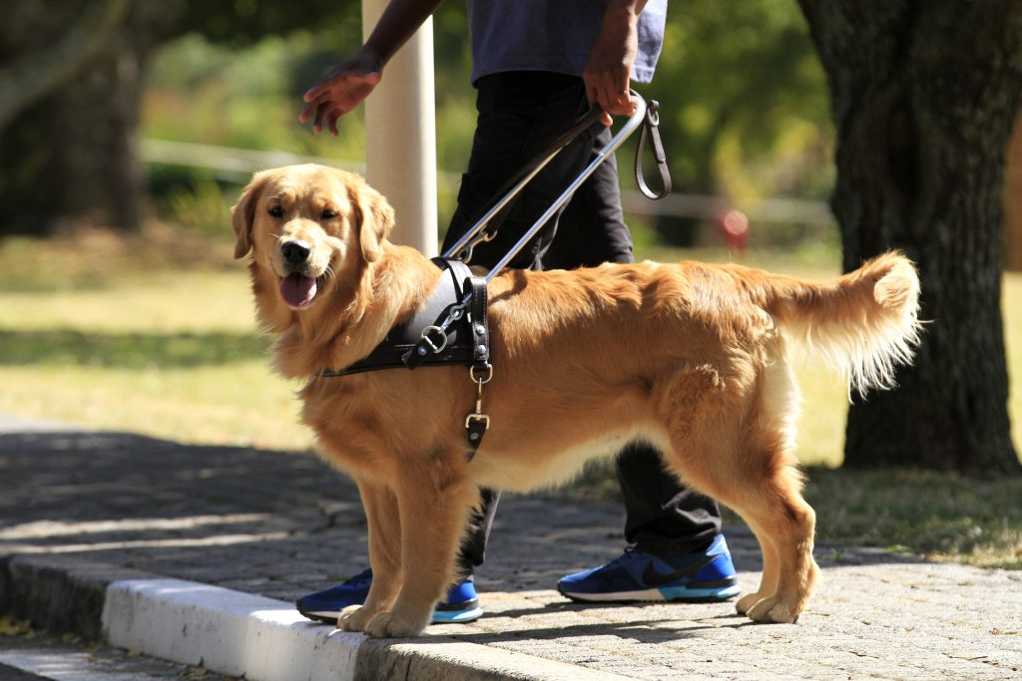
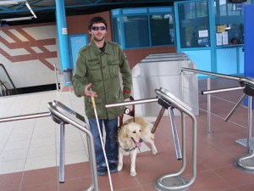
The challenge
Finding a job and hard-to-reach urban environment are the most serious issues for blind people in Bulgaria ;
Challenges related to the use of various services;
Most pedestrian areas and bus stops still lack guide lines that show the safest area to drive;
The lack of an accessible environment, the complicated procedure for providing free assistance and accessibility equipment for the disabled, low employment rates;
There are 16,000 blind people in Bulgaria and over 200,000 in the Balkans.

Slide 3
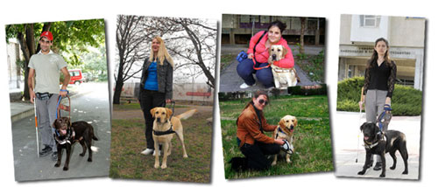
Goals
The organization's mission is to build a Balkan service dog training center for people with disabilities. We believe that with our coordinated and focused efforts and with the help of volunteers and donations, we will create a one-of-a-kind school for guide dogs and assistants for people with disabilities. With their special skills and еndless love that are available 24/7, our certified guide dogs and assistants could improve the mobility and independence of people with severe vision impairment.

Slide 4
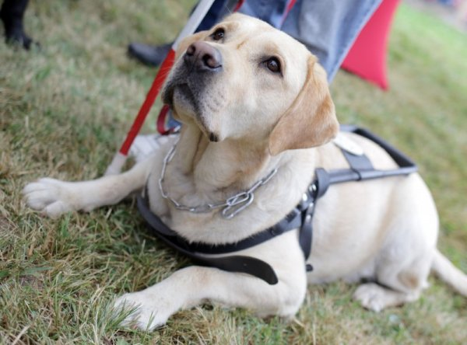
Target group
Our organization will be located in Bulgaria, in the city of Vratsa and we will help many people to start a new life and return to society through their dogs - guides and assistants. The company will be created for people in social exclusion:
Blind people, people with severe visual impairment
Hope for Life Ltd will be a full member of the European Guide Dog Federation (EGDF) and the The International Guide Dog Federation (IGDF). Membership in these 2 prestigious organizations is a guarantee for the quality of our service dogs. The foundations will be laid by volunteers.

Slide 5
The program “Foster family“
The program for socialization of future guide dogs is carried out entirely on a voluntary basis. Foster families have the difficult task of raising a healthy, well-behaved and happy dog ​​that is not afraid of the intense urban environment, travels smoothly in all kinds of transport. During the whole period while the dog is in the foster family, weekly trainings and socialization events are held in different places in Sofia.
Foster families do not have any costs and financial obligations for raising the dogs. The organization will provide everything needed - food, veterinary services, accessories and free travel for the dog and its foster owner in public transport.

Slide 6
Our goals
Improving the quality of life of people with disabilities in Bulgaria by strengthening their social inclusion through the provision of innovative social services;
Creating a partnership for the exchange of knowledge, know-how and good practices;
Improving the effectiveness in developing and offering solutions to address the problem of rehabilitation and reintegration of people with disabilities with the help of guide dogs;
Creating conditions for full social inclusion of people suffering visual impairments;
New job opportunities for blind people;
Sustainability of Hope for Life Ltd.

Slide 7
Legal frame and key activities
Hope for Life Ltd A non-profit organization is a legal entity registered in accordance with the provisions of the Non-profit Legal Entities Act. The income from this activity can be used only to achieve the goals set out in its bylaws without the possibility of profit distribution.

Slide 8
Funding
The property consists of the founding contributions of the founders.
Sources of funds to achieve the goals:
Donations
Sponsorships
Targeted projects with external financing

Slide 9
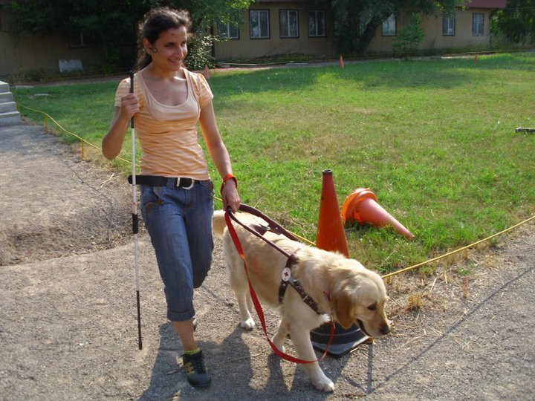
Beneficiaries
There are similar organizations in Europe which provide these services for free.
Guide dogs are very expensive, the only choice people with visual impairment have is to use our services for free.
We are highly motivated and with the help of sponsors, volunteers our organization will manage to achieve the goals we set. Our school for outrunners will have instructors, foster families, volunteers

Slide 10
We accept donations
At our office;
Using EasyPay or other money transfer company.
Bank account
Through PayPal
Through ePAY
The two-year training process, as well as the support of the service dogs are funded and provided by the organization through donation contracts.

Slide 11
Organizational chart
Manager
Executive bureau
Animal instructors
Dog center
Foster families
PR&Social networks

Slide 12
Website, logo and motto
A website and socal media pages will be created in order to increase donors and retention rates, to spread the idea of Hope for life Ltd, our goals, our values and the results achieved.
Our motto- Little helpers- big steps

Slide 13
Our logo

Slide 14
