Slide 1
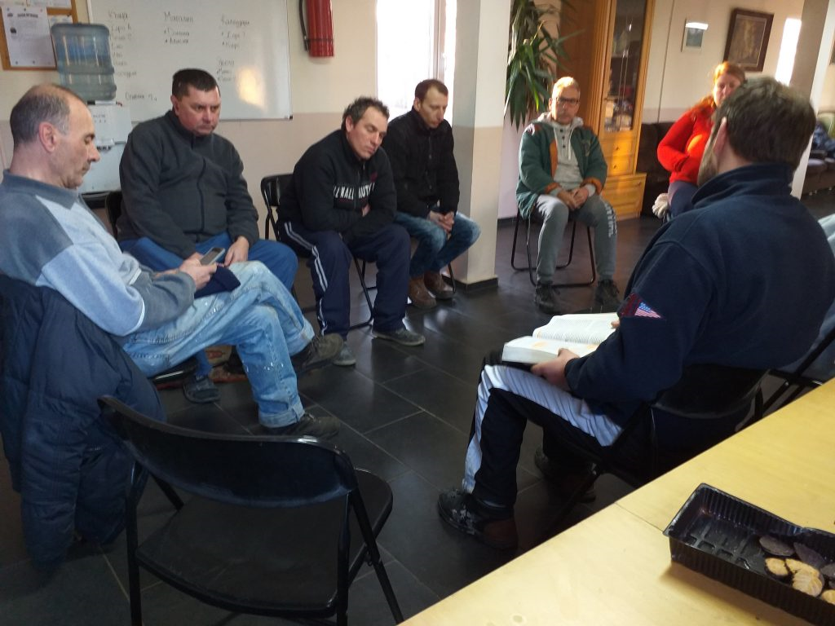
VOCATIONAL SCHOOL OF TRADE AND CATERING
European Civic Attitude Through Social Entrepreneurship
2019-1-RO01-KA229-063748
reintegRATED Ltd,

Slide 2
Content
Critical problems of the target group and prevention policy in Bulgaria
Mission statement
Legal frame and key activities
Funding
Beneficiaries
Financial sustainability - donations
Organizational chart
Our website, logo and motto

Slide 3
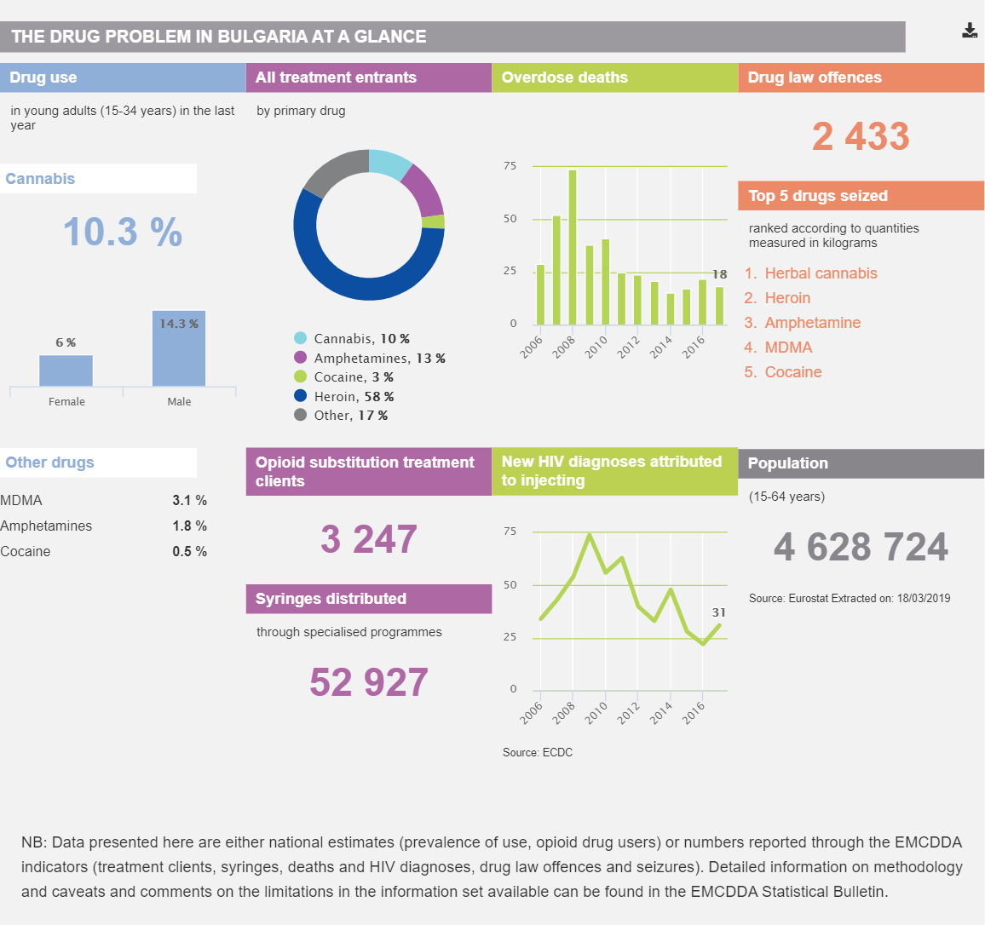
The drug problem in Bulgaria

Slide 4
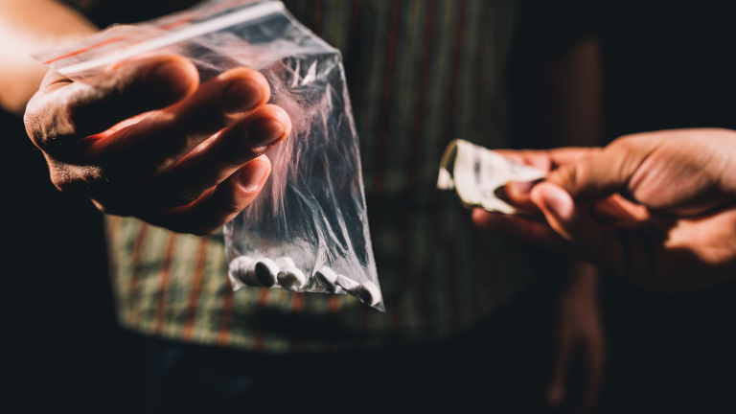
Prevention
The main objectives and features of Bulgaria’s drug use prevention policy are (i) the expansion of systematic health education in the field of secondary education; (ii) the development and implementation of programmes targeting children and young people; (iii) the establishment and training of multidisciplinary teams; (iv) the implementation of media campaigns; (v) the expansion of sport and tourism programmes for children and young people; and (vi) the development and implementation of programmes for high-risk groups and activities to integrate them into the community.

Slide 5
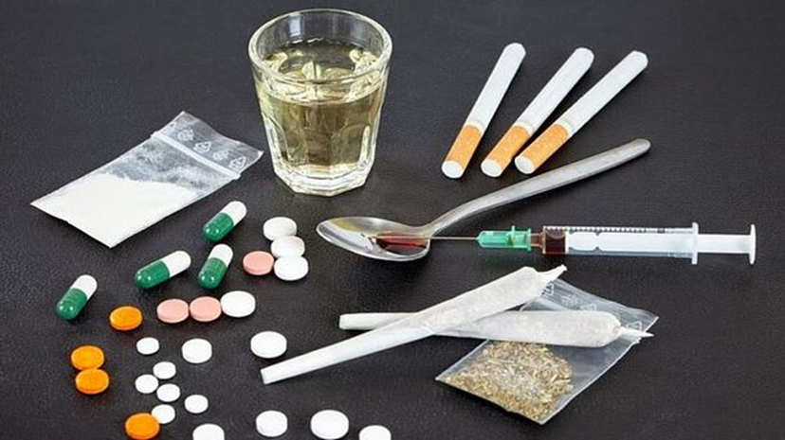
Prevention
National and municipal authorities share responsibility for the planning and implementation of prevention activities. A total of 27 municipal drug councils implement the national drug policy at the local level and are supported by prevention and information centres that collect and analyse data and inform the design and implementation of municipal programmes and strategies. Local committees on juvenile delinquency also play a role in the implementation of some of the objectives of the national prevention policy. To secure funding, programmes must comply with the European Drug Prevention Quality Standards.

Slide 6
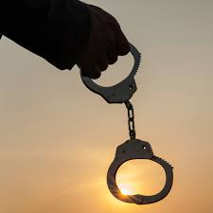
(Re) Socialiazed
Another major problem in Bulgarian society is the socialization of former offenders. Outside prisons, it is important to create a safe environment for ex-prisoners to support them in order to avoid or at least reduce the possibility of them returning to prison.
Every year, about 4,000 people who have served their sentences leave prisons. 5% of them are people with higher education who hope to lead a normal life again.
According to statistics from the Ministry of Justice, about 50% of those released sooner or later commit a new crime and end up in prison again. According to civil society representatives, the percentage is much higher - 70 %.

Slide 7
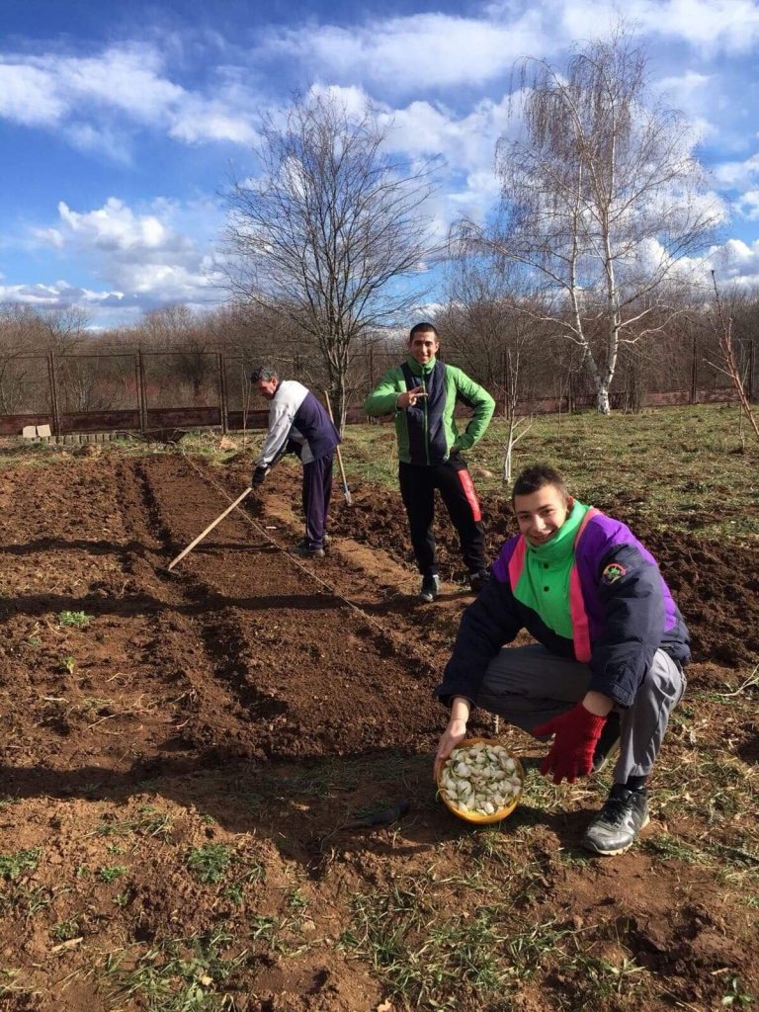
Who We Are Legal frame
In Bulgaria :
'Social enterprise' - combines economic results and social objectives, achieves measurable, positive financial added value, is managed transparently with participation to members, employees or employees in decision-making and / or with a profit expended mainly on the pursuit of a social activity and / or in pursuit of a social purpose.
Eco-farm “ReintegRATED Ltd" will be a Non-profit Legal Entity with public benefit . It will be created in order to help people suffering from all kinds of addictions and those who have been imprisoned to resocialize.

Slide 8
Key activities
For at least 24 months, our beneficiaries will live in a sheltered housing, and will attend drug addicts treatment program and trainings and groups for re-socialization of drug addicts and persons who have been imprisoned.
They will also have ARTtherapy, which is key element in the program, through which participants feel productive, work gives them meaning and purpose, they will acquire professional and social skills.
Along with the therapies, the participants in the program will maintain the house and will grow fruits and vegetables in the eco farm. They will prepare winter food depending on the season in which it will be grown. Everything will be available for sale. This will help them feel productive, develop work habits, professional skills, teamwork, mutual trust and respect, skills for reintegration into society.

Slide 9
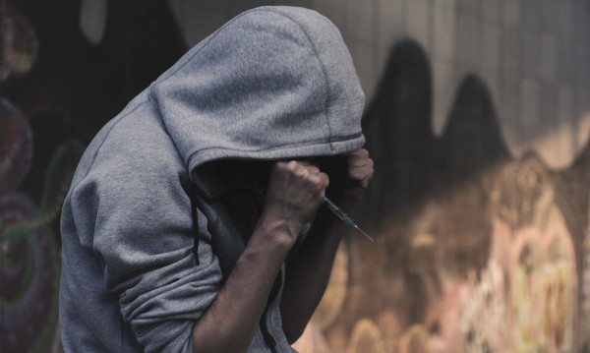
Beneficiaries
Our organization will be located in Bulgaria, in the city of Vratsa and we will help many people to start a new life and return to society. The company will be created for people who suffered social exclusion:
Individuals suffering from different addictions
People who have been imprisoned for a long time;
Caring for them and meeting their daily needs will take place in a different family like and warm environment, without drugs, alcohol and violence, in an environment of comfort, acceptance and support. Thе start of these activities will be done by volunteers.

Slide 10
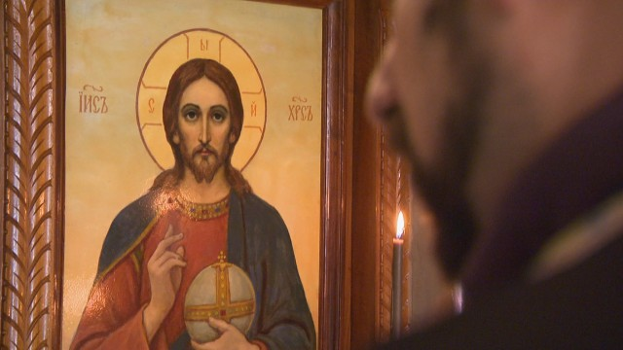
Value proposition
Christian values and moral
Resocialization;
Vindication
Partnership with various organizations such as: social workers, probation services, local communities, police, hospitals, churches, associations and other voluntary organizations dealing with people suffering from addictions, private charities etc.

Slide 11
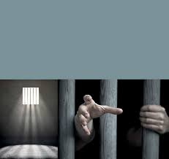
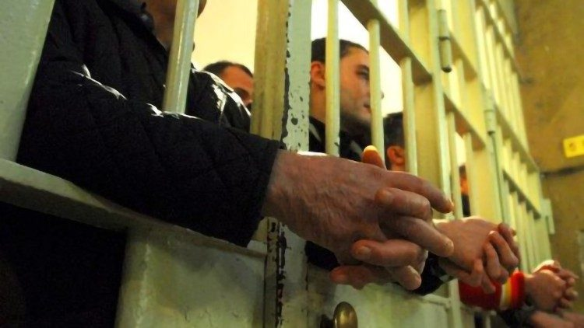
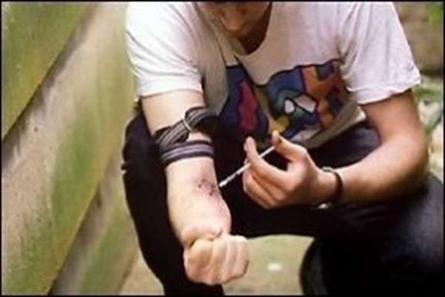
Our goals
Teamwork - building qualities such as: loyalty, honesty, responsibility, professional skills, hard working and self-esteem;
Improving individuals living standards;
Employment of people otherwise rejected from society;
Providing support for active social inclusion in the economic life of the country;
Sustainability of the social enterprise reintegRATED Ltd

Slide 12
Legal form
Non-profit association named reintegRATED Ltd, is a legal entity registered in accordance with the provisions of the Non-profit Legal Entities Act, which also performs a commercial purpose - sale of products produced by the eco-farm. The members of the Association are obliged to pay in time the provided monetary contributions. The income from this activity can be used only to achieve the goals set out in its bylaws, without possibility of profit distribution. Our goal is not to gain profits for the partners, but investing to achieve our social goal.

Slide 13
Funding
The property consists of the founding contributions of the founders.
Sources of funds to achieve the goals:
Donations from Bulgarian and foreign individuals and legal entities;
Sponsorship agreements with government agencies and international organizations;
Revenues from economic activity
The company will support itself by providing its services in various areas such as construction, cleaning/housekeeping, and sale of some of the products from the eco farm.

Slide 14
Donations
Food
Clothes
Furniture
Housekeeping products
Medical supplies
Electric appliances
Entering ReintegRATED is free for its beneficiaries. At the same time, the expences must be covered, so we count on you!
All donated food must be accompanied by the relevant certificates, commercial and other documents certifying that the food meets all hygienic and regulatory requirements for safety.

Slide 15
Organizational chart
Manager
Social media and communications
IT Service
Accountant
Supervisor
Deliveries

Slide 16
Our website, logo and motto
A website and socal media pages will be created in order to increase donors and retention rates, to spread the idea of ReintegRATED, our goals, our values and the results achieved.

Slide 17
A new race – a new life !

Slide 18
