Slide 1
European civic attitude through social entrepreneurship
2019-1-RO01-KA229-063748_2

Slide 2
Our visit in local financing institution “MICROFOND”
Can I benefit from a microloan?
Yes if you:
want to become self-employed or set up/develop a microenterprise (fewer than ten employees), particularly a social enterprise
are unemployed
have taken time out of the labour market
have difficulty getting conventional credit (because you're: female, considered too young or too old, a member of a minority group, or you have a disability, etc.).
How can I apply?
Find out if there are already microcredit providers in your country. They can inform you about specific application requirements and procedures. You can send them your application for a microloan directly.

Slide 3
Progress Microfinance
The European Progress Microfinance Facility (Progress Microfinance) was launched in 2010 to increase the availability of microcredit – loans below € 25 000 – for setting up or developing a small business.

Slide 4
Financial instruments
Financial instrument for shared risk microfinance
The financial instrument "Microcredit with shared risk" under the Operational Program "Human Resources Development" 2014 - 2020, funded by the EaSI programme. (Financial Instrument), aims to improve access to finance for the creation and development of start-ups, including those from certain vulnerable groups and social enterprises, as well as to attract additional private capital aimed at achieving public employment policies.
Microfond AD as a selected financial intermediary will grant loans to start-up social enterprises, micro-enterprises, craftsmen and freelancers registered within the previous two years, as well as existing social enterprises.

Slide 5
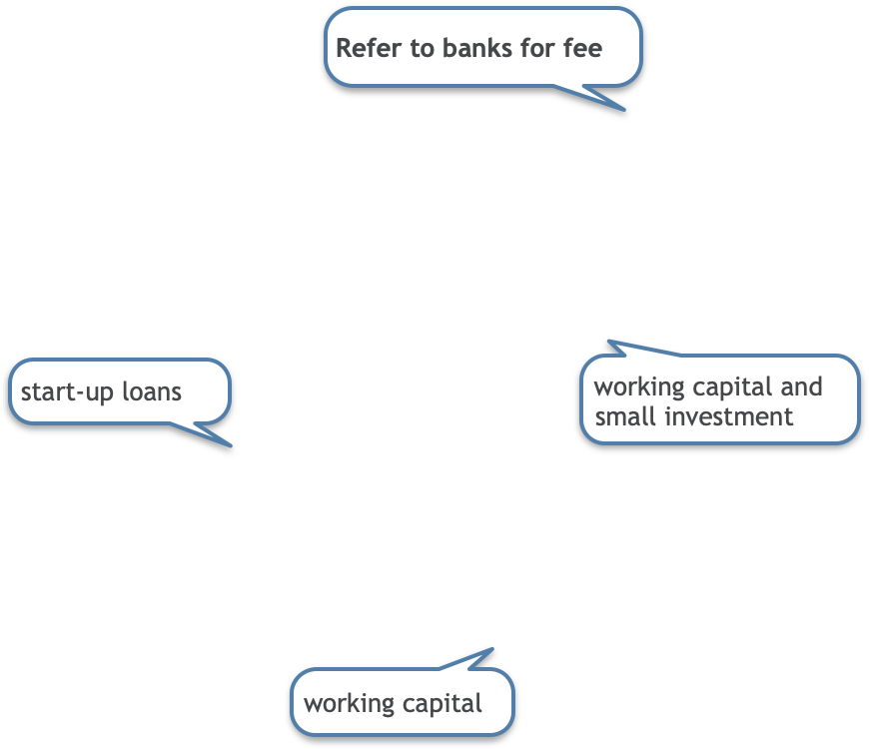
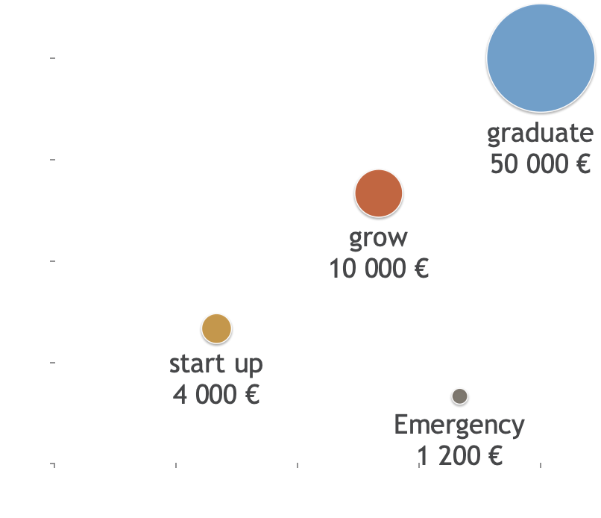
Success storywriter
Support for every need
Support in every stage
From start-up till maturity

Slide 6
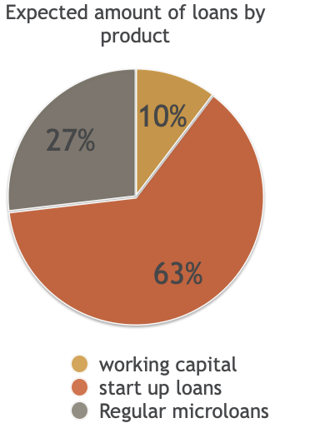
Beneficiaries
Target end client - start-up enterpreneurs and social enterprises
Young people up to 29 years old
Social enterprises
Small and microbusinesses
Unemployed who start a business
Disadvantaged people

Slide 7
Social goals
Social performance goals, verifiable by official data
number of jobs created
income growth
reduced overindebtness
debt management training beneficiaries

Slide 8
Thank you

