Slide 1
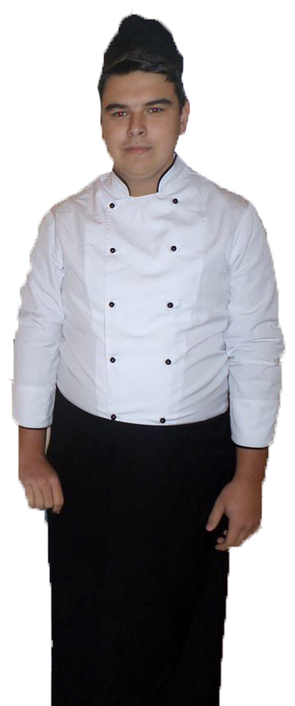
Target groups
Problems
Our solution
Proposal for added value
Activities
Funding
Results
Distribution
Financial and economic sustainability
MENU
Vocational school of trade and catering
Bulgaria
European Civic Attitude Through Social Entrepreneurship
2019-1-RO01-KA229-063748

Slide 2
Target groups
Problems
Our solution
Proposal for added value
Activities
Funding
Results
Distribution
Financial and economic sustainability
MENU
Target groups
Direct group: working women and their families, students, Indirect group: children from foster care homes in Vratsa after graduating and students from vocational schools according to their training and practice internship

Slide 3
Target groups
Problems
Our solution
Proposal for added value
Activities
Funding
Results
Distribution
Financial and economic sustainability
MENU
What are the problems
Long working hours for women, lack of time to prepare home made food
Usually workers, students tend to eat fast food which is unhealthy.
Children from homes after completing their secondary education find it very difficult to find a job and do not have their own home.

Slide 4
Target groups
Problems
Our solution
Proposal for added value
Activities
Funding
Results
Distribution
Financial and economic sustainability
MENU
Problems
Vocational high school students who study full-time must conduct their training and production FREE internships in real job positions. In a very small number of the companies this practice is carried out efficiently and qualitatively and the students find it difficult to acquire professional knowledge and skills.

Slide 5
Target groups
Problems
Our solution
Proposal for added value
Activities
Funding
Results
Distribution
Financial and economic sustainability
MENU
Problems

Slide 6
Target groups
Problems
Our solution
Proposal for added value
Activities
Funding
Results
Distribution
Financial and economic sustainability
MENU
The solution
Creating food places offering healthy food near your home, office, school, neighborhoods will enable many people - workers, students, families and others to have healthy food, and this in turn will lead to fewer diseases. Job opportunities and higher income will be provided for children leaving home after high school. Students will be able to have their internship efficiently in a real work environment.

Slide 7
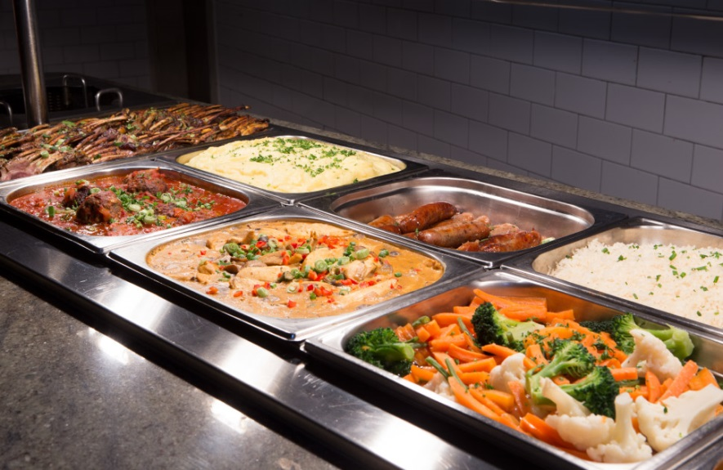
Target groups
Problems
Our solution
Proposal for added value
Activities
Funding
Results
Distribution
Financial and economic sustainability
MENU
The solution

Slide 8
Target groups
Problems
Our solution
Proposal for added value
Activities
Funding
Results
Distribution
Financial and economic sustainability
MENU
Proposal for added value
The principle of operation of healthy food establishments will be planning, ie. the previous day a person will make a request with payment according to a pre-provided menu of what he would like to eat the next day for breakfast, lunch and / or dinner.
As owners of these establishments we will have a guarantee that everything that is produced will be sold on the basis of preliminary orders. The dishes offered will have a minimum percentage of commercial markup. We will benefit from higher sales turnover and lower staff salaries and insurance costs. This will be our main advantage over competitors who have high costs and high prices.

Slide 9
Target groups
Problems
Our solution
Proposal for added value
Activities
Funding
Results
Distribution
Financial and economic sustainability
MENU
Proposal for social added value
We will conduct a survey of a number of families on whether they would eat out, how much they would pay for, what they would like to eat.
Part of the profit will be used to create a house for children who leave social care institutions, orphanages, in which they will be able to live after graduating high school, and in the meantime they can support themselves. Another part will be provided as a scholarship to those children who want to acquire higher education.

Slide 10
Target groups
Problems
Our solution
Proposal for added value
Activities
Funding
Results
Distribution
Financial and economic sustainability
MENU
Main activities
Creating a chain of restaurants for healthy food- canteen. For this purpose, existing but unused canteens in schools, institutions, neighborhoods of Vratsa will be rented. Initially, the idea will start from our school in two buildings in the two large districts of the city, and later it will be developed in other schools, institutions and neighborhoods of Vratsa and other cities in the country.
Priority will be given to students from orphanages after high school and students from vocational high schools.
Students will make home deliveries made online or by phone.

Slide 11
Target groups
Problems
Our solution
Proposal for added value
Activities
Funding
Results
Distribution
Financial and economic sustainability
MENU
FUNDING
Financing: from Microfund - "Loan for start-up" business with interest up to 4.35% and an amount up to 10,000 euros. Funding is intended for start-ups and social enterprises. Collateral - a guarantee from relatives and friends. The funds are granted with the help of the financial instrument "Microcredit with shared risk" under the Operational Program HRD 2014-2020. This loan will finance the purchase of technological equipment and furniture, software for automation of processes in the kitchen and the initial costs for the purchase of materials / products, water, electricity /, salaries, insurance, services / telephone, advertising, rent /.

Slide 12
Target groups
Problems
Our solution
Proposal for added value
Activities
Funding
Results
Distribution
Financial and economic sustainability
MENU
THE RESULTS
Healthy food will be provided for families, workers and students at a low price, compared to other restaurants. Families will have lower bills for water, electricity, detergents and more, which will offset the slightly higher cost of eating out. The children from orphanages will have a secure job and salary and independence. In general, the idea will lead to environmental protection from saving electricity and water. New jobs will be created.
Our motto : “Time, health and social inclusion”

Slide 13
Target groups
Problems
Our solution
Proposal for added value
Activities
Funding
Results
Distribution
Financial and economic sustainability
MENU
Distribution
Students from the “Chef” profession will prepare the food;
Students from “Catering” profession will organize the service;
Students studying in “Sales Representative” “profession will organize trade and accounting activities.
Distribution
The direct target group will be acquainted with the offered dishes through: social networks, brochures, flyers, short messages on local television or radio. The children will tell their parents. The indirect target group will be informed about the opportunity to work or practice in the restaurants by the employees in orphanages, foster care homes or schools.

Slide 14
Target groups
Problems
Our solution
Proposal for added value
Activities
Funding
Results
Distribution
Financial and economic sustainability
MENU
Financial and economic sustainability
All costs are for repairs, equipment and furnishing of healthy food restaurants, as well as the initial purchase of materials. The cost of the dishes will be determined by the value of the food products and a minimum markup rate - 30-40%, which will cover other costs and profits. The formed prices will be much lower than those of our rivalry and will therefore be affordable to customers. After the start of work of the first establishments, self-financing will be provided, on the basis of which it will be possible to open more such establishments in the neighborhoods, schools and institutions throughout the country.

